Slide 1
Final Report of OPS5:
At Crossroads for Higher Impact
Anna Viggh
Senior Evaluation Officer
December 16, 2013

Slide 2
OPS5 Reports
OPS5 phased reporting:
First report: cumulative evidence of the three years since OPS4 at the start of the replenishment
Final report: comprehensive overview at the third meeting
Published version for Assembly will integrate several issues from first report: relevance (guidance from conventions) and country ownership
Statement of Senior Independent Evaluation Advisors
OPS5 reports, presentations, and technical documents are available on the website

Slide 3
Evidence Basis
33 evaluations and studies undertaken by IEO since OPS4
20 technical documents and several additional studies
Full GEF portfolio of 3,566 projects from pilot phase through Sept. 30
Outcome evidence on 491 completed projects
Design and implementation evidence on 969 projects approved since the close of OPS4
Field-level evidence from 54 countries
From more than 115 FSPs and MSPs
From more than 90 SGP projects

Slide 4
Conclusion 1
Global environmental trends continue to decline
The replenishment may show no increase in purchasing power, while the GEF has accepted more obligations
Higher level of funding leads to faster progress toward impact
Mercury Convention

Slide 5
Recommendation 1
Resource mobilization and strategic choices in the GEF need to reflect the urgency of global environmental problems
Burden-sharing arrangements and pro-rata contribution arrangements should be abandoned in the GEF replenishment, as they hurt rather than help
Broadening the financing basis should be further explored and should include an invitation to the European Commission to become a donor to the GEF
A no-risk soft pipeline, accepted practice in many bilateral aid organizations and many international organizations, should be initiated
This could lead to speeding up the delivery of about $400 million of transfers to recipient countries at a time that the urgency of global environmental problems is increasing

Slide 6
Conclusion 2
The “Business Model” of the GEF is no longer appropriate and leads to growing inefficiencies
Delivery is slow…
Costs too high?
RBM burden too heavy…
Partnership difficult…

Slide 7
Delivery Is Slow…
Project Cycle Problems
PIF/project concept was supposed to focus on eligibility but became information heavy
Delays caused by RBM burden and co-financing requirements
Tendency to go back-and-forth on proposals
PIFs with more than 2 (re-) submissions: 23%
CEO endorsement proposals with more than 2 (re-) submissions: 15%
Programmatic approaches and harmonization show promise

Slide 8
Costs Too High?
GEF was based on assumption of mainstreaming of environmental concerns in Agencies through GEF involvement
Expectation was that Agencies would invest in GEF through co-financing also at corporate level
Innovation and risk taking require higher costs
Agencies are pushed towards full cost recovery
GEF is pushed towards reduction of fees
Yet requirements and interactions continue to increase costs

Slide 9
RBM Burden Too Heavy
Best International Practice aim for 5-10 indicators or targets, easily measured from available data
Differentiate between indicators and targets for learning versus accountability
Indicators/targets to show whether GEF is on track versus targets as milestones…
Differentiate between indicators for management and for global public knowledge
GEF-4: more than 140 indicators
GEF-5: more than 180 indicators
GEF-6 proposals: reduction to about 120
Tracking tools complicated and not user friendly
Multi-focal area projects continue to be overburdened

Slide 10
Partnership Difficult…
OPS3 warned that the network was becoming too dense
Problems have been averted by reducing communications and involvement of GEF Agencies
But limits of network communications are now reached
Communications may increase, but partners have less “voice”
But voice is essential to achieve:
Agreement on roles and responsibilities
Adequate input of resources
Transparency
Accountability and trust between partners
Vision of “partner of choice” is endangered

Slide 11
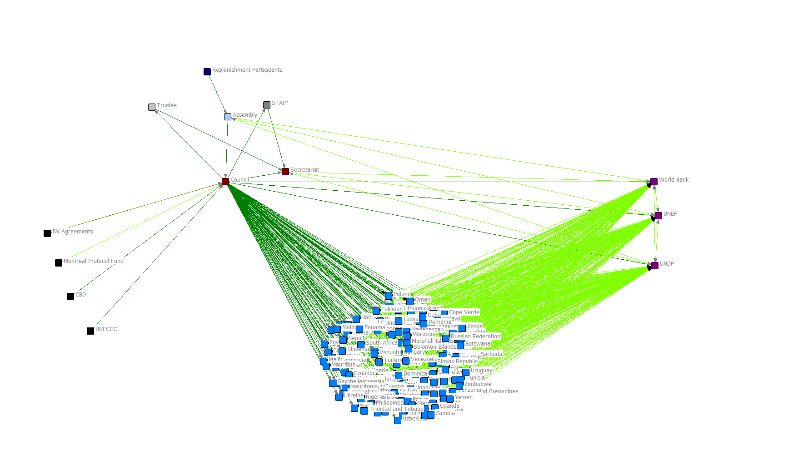
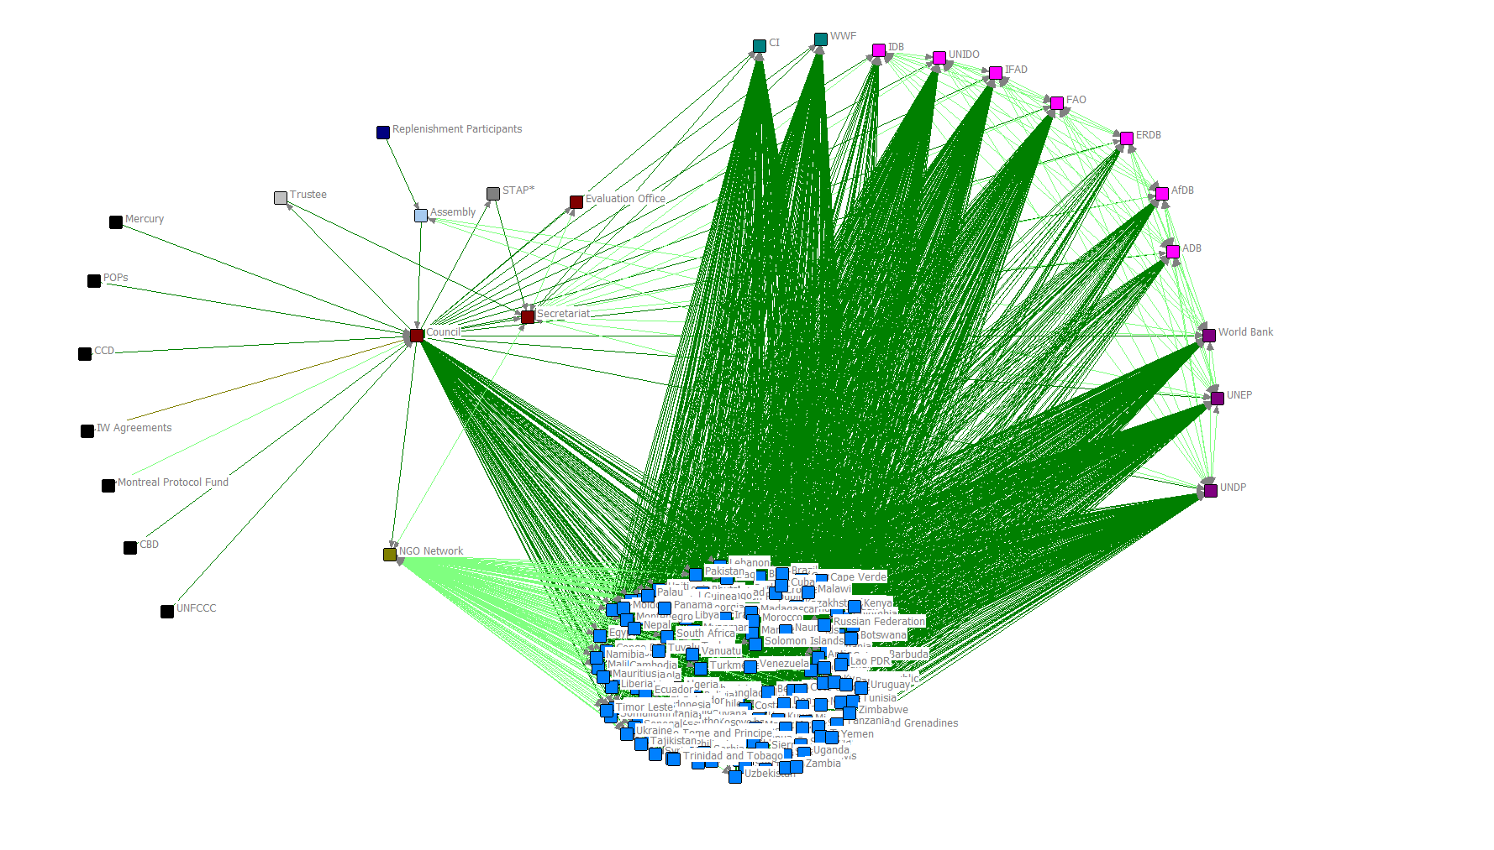
Network Proliferation…

Slide 12
Co-Financing
Co-financing is especially important at country level
Countries on average commit more in co-financing than they receive from the GEF
Co-financing brings benefits
Increased country ownership; efficiency gains; risk reduction, synergies, greater flexibility and better follow-up
Co-financing ensures that GEF funds only incremental costs
OPS3, OPS4 and now OPS5 warn against one-size fits-all approach for co-financing and indiscriminate drive towards higher co-financing ratios
Realized co-financing is consistently higher than promised co-financing
Cost of mobilizing co-financing insufficiently taken into account

Slide 13
Recommendation 2
The business model of the GEF needs major overhaul in the GEF-6 period
Decision points in the project cycle should be reorient
The RBM framework for GEF-6 should include a limited number of outcome indicators that can be measured through existing or easily generated data; tracking tools should be simplified
Replenishment should invite the Council, the CEO and the GEF partners to develop a new partnership vision during GEF-6

Slide 14
Conclusion 3
The intervention logic of the GEF is catalytic and successful in achieving impact over time
Inefficient delivery does not mean that it is also ineffective…
Results of GEF supported projects are quite impressive: more than 80% have satisfactory outcome ratings
Only 7% of projects show no progress toward impact, as measured through broader adoption and/or environmental impact

Slide 15
From Outcomes to Impact
Potential system impact: 92.8%
Completed projects (281)
Satisfactory outcomes range> 80%
Broader adoption initiated 90.5%
Impact
> 65%
20% unsatisfactory is due to risk taking: please continue to take risks!
This is the challenge: how to speed up and increase broader adoption, leading to transformational change of systems

Slide 16
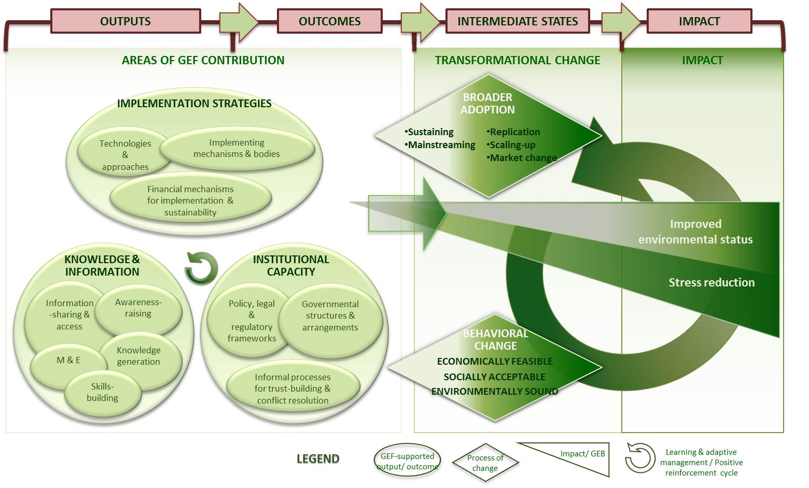
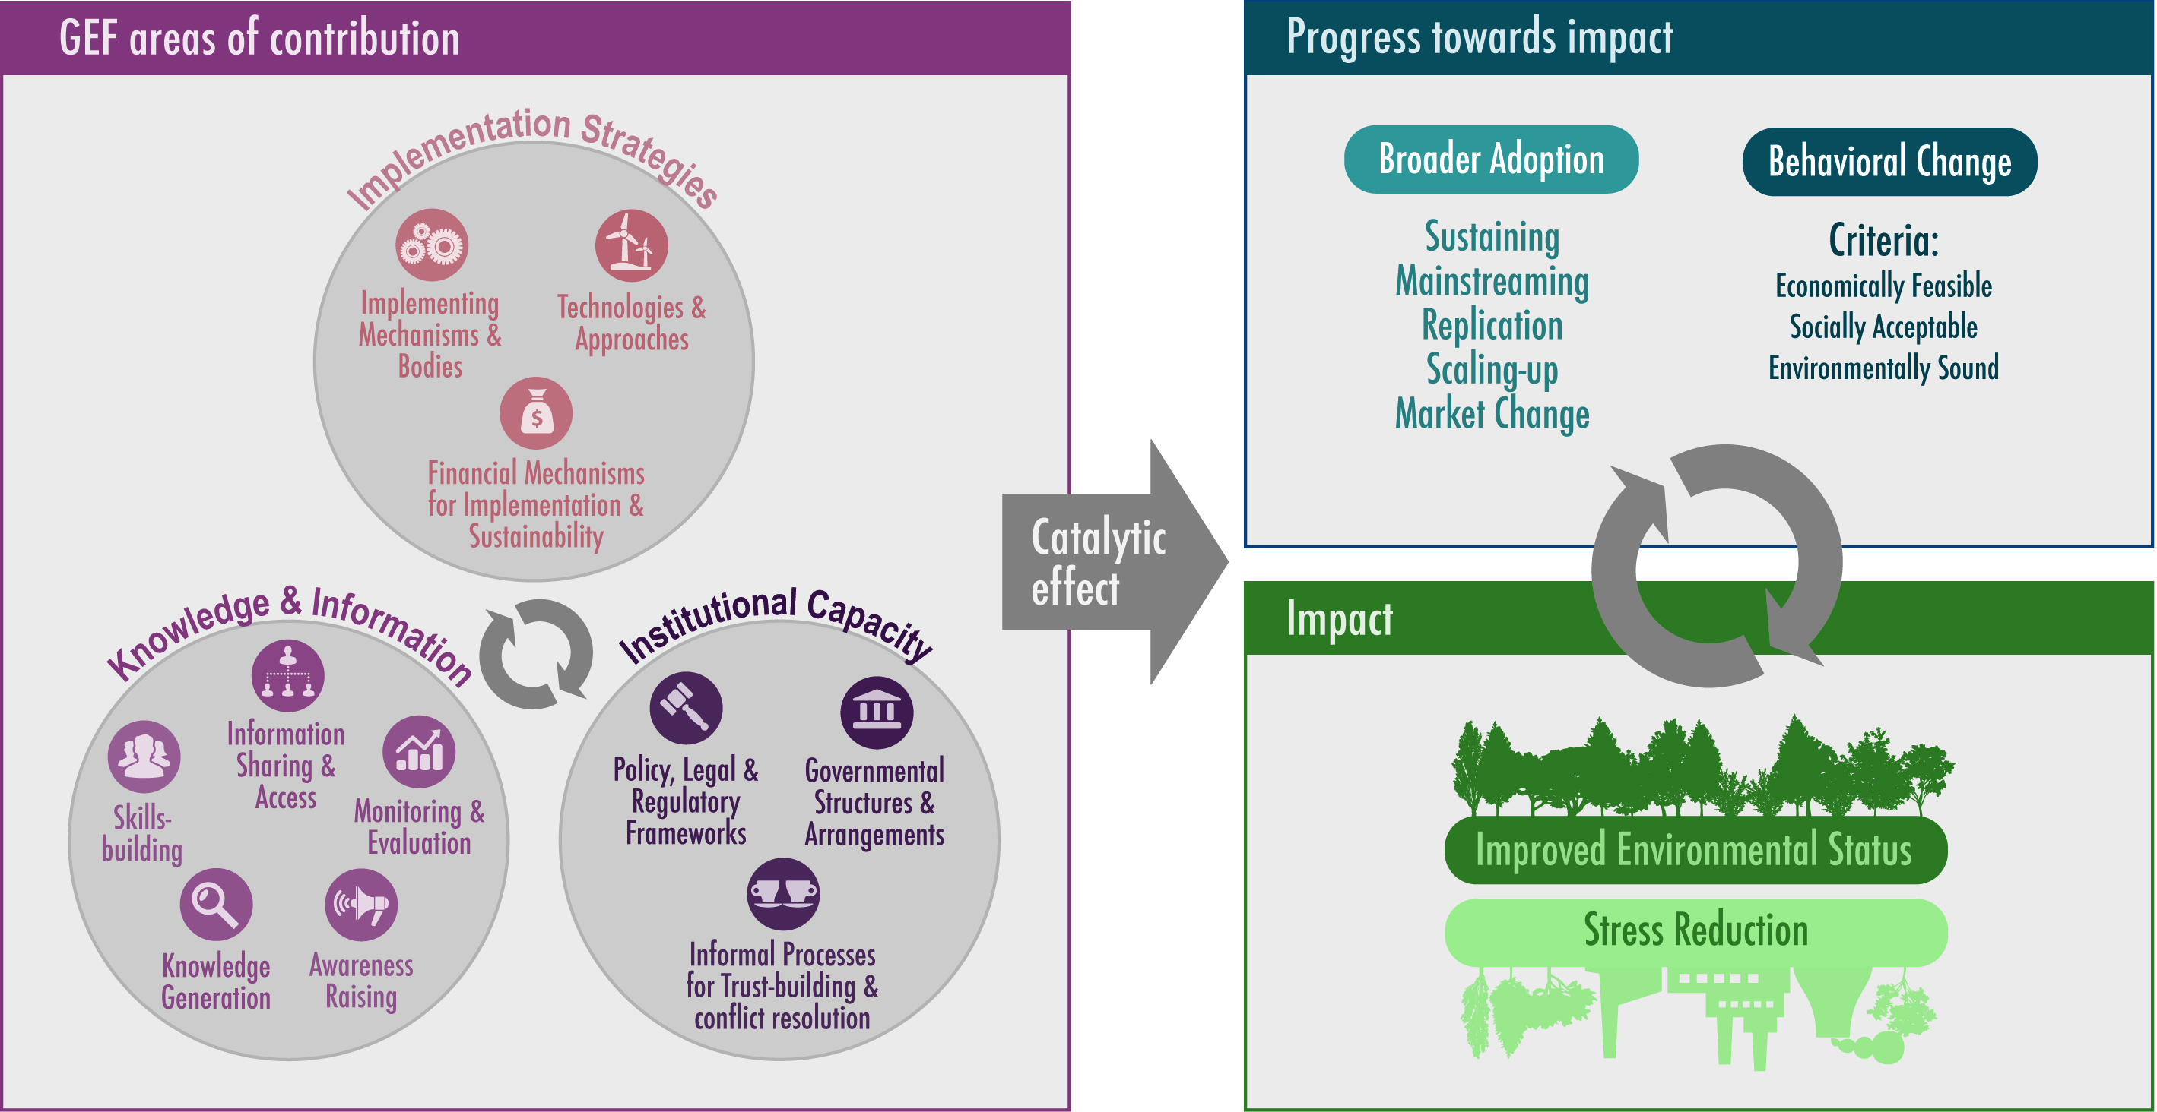
Intervention Model

Slide 17
Intervention Logic
Interventions supported by the GEF are catalytic and successful in achieving impact over time
To maximize results, the intervention model of the GEF needs to be applied where it is most needed and supported by a better business model

Slide 18
Recommendation 3
To maximize results, the GEF intervention model needs to be applied where it is most needed and supported by a better business model
Make broader adoption an important focus of national and regional programming
Civil society organizations and private sector engagement should be taken up in portfolio identification, as well as in focal area strategies
Strategic roles for STAP and for SGP
Action plan on mainstreaming gender
Knowledge brokerage and capacity development

Slide 19
Factors Affecting Progress Toward Impact at Project Completion
 | CONTRIBUTING FACTORS | HINDERING FACTORS
PROJECT-RELATED | Good engagement of stakeholders Highly relevant technology/approach Broader adoption processes initiated using project resources | Poor project design No activities to sustain project outcomes
CONTEXTUAL | Country support Previous/current related initiatives (by government, global events, etc.) Other stakeholder support | Other unfavorable political/ policy conditions/events Unfavorable economic conditions/events/ drivers Lack of country support
REALM OF GEF CONTROL
Notes:
N=473. Factors affecting most projects, regardless of extent of broader adoption. Poor project design: wrong assumptions about risks, government cooperation & stakeholder needs, overly ambitious objectives, no M&E to provide sufficient information. No activities to sustain momentum: lack of resources or activities related to broader adoption. Other unfavorable political/ policy conditions/events: political power changes, civil unrest, no tenure rights, country priorities and programs not aligned or in conflict with project objectives. Unfavorable economic conditions/events/ drivers: no market demand for environmental solutions, higher demand for goods and industries not aligned or in conflict with project objectives. Lack of country support: no political will, law enforcement or funds allocated to support initiatives at either national or local level. Other stakeholder support: e.g. donors, private sector, local communities.
FINDING: 1) Hindering factors affecting most projects are due to drivers beyond the project’s control.

Slide 20
Civil Society Engagement
Essential to achieve broader adoption
Although systematically included in GEF affairs, engagement often stops short of being meaningful
The public involvement policy of 1996 needs to be updated and included in programming guidance
PMIS needs to systematically gather data on CSO engagement
Terminal evaluations need to include questions on CSO engagement

Slide 21
Small Grants Programme
First phase evaluation report concludes that SGP continues to be effective
New modalities for interaction between SGP and other country level support emerge
M&E for SGP is too complex and not suitable for local communities
Strategic guidance on these issues would be welcome
Steering Committee for SGP should be revitalized and asked to provide a management response to the evaluation

Slide 22
Private Sector Engagement
Essential to achieve broader adoption
GEF has strong track record in engaging with the private sector in focal areas, especially climate change and chemicals
Set asides for private sector (e.g. Earth Fund) have been less successful
Best possibilities for engagement need to be identified at the national and regional levels
Focal areas should consider how private sector engagements can address sectors that have severe impacts on the environment
Knowledge brokerage and M&E on private sector engagement

Slide 23
Gender Mainstreaming
Mainstreaming policy was adopted in 2011
OPS5 provides a bleak picture of the baseline that this policy aims to improve
Many projects that were considered “gender not relevant” were in fact relevant
SIEA: gender evaluation of “not relevant” projects would show more relevant projects
The GEF should adopt an action plan to implement the policy
STAP, knowledge brokerage & M&E can support

Slide 24
Focal Area Challenges
Biodiversity: strong performance in environmental impact, low private sector engagement
Climate Change: strong performance in stress reduction and private sector engagement / challenge to achieve market transformation
International Waters: time dimension and achieving regional sustainability & impact
Other focal areas: time horizon
Multi-focal area projects: M&E burden
Resilience: framework document on resilience throughout GEF focal areas should be finalized

Slide 25
STAP
More strategic role of STAP needed and functional independence strengthened
Integrative work across focal areas needs to be strengthened
Coverage of sciences needs to be broadened
Targeted research to be revitalized
Technical advice on projects needs to shift from project to program and/or strategy level
UNEP should enhance its support to STAP

Slide 26
Knowledge Brokerage and M&E
Learning is now mainly in silos
GEF communities of practice could break through these silos
GEF IEO has proposed a community of practice on impact and broader adoption
Knowledge brokerage and capacity development strategy to be developed
The burden of M&E in the GEF needs to be reduced
Professional peer review of the GEF evaluation function
Work program for GEF-6
Terminal evaluation guidelines
Evaluability assessment of RBM for GEF-6
Stronger engagement of GEF IEO in knowledge brokerage

Slide 27
Questions
ops5@thegef.org
www.gefeo.org

