Slide 1
Programming directions for GEF-6
Climate Change Mitigation
&
Chemicals and Waste

Slide 2
Climate Change Mitigation
The Global Environment Facility and the Conventions:
Is the financial mechanism for the Stockholm Convention on Persistent Organic Pollutants
Is the financial mechanism of the Intergovernmental Negotiating Committee for the Convention of Mercury
Supports the implementation of the Montreal Protocol in countries with economies in transition
It is an operating entity of the financial mechanism of the UNFCCC

Slide 3
GEF’s Unique Value for Climate Financing
1. Facilitating innovation & technology transfer
2. Catalyzing systemic impacts through synergistic multi-focal initiatives
3. Building on Convention obligations for reporting & assessments towards mainstreaming
Assisting recipient countries prepare for new climate regime under UNFCCC that seeks commitments to emission reduction at universal level

Slide 4
Proposed GEF-6 CCM Strategy
1. Promote innovation & technology transfer, and supportive policies and strategies
Program 1: Promote timely development, demonstration & financing of low carbon technologies and mitigation options
Program 2: Develop & demonstrate innovative policy packages & market initiatives
2. Demonstrate systemic impacts of mitigation options
Program 1: Integrate findings of Convention obligations & enabling activities into national planning processes & mitigation targets
3. Foster enabling conditions to mainstream mitigation concerns
Program 1: Promote integrated low-carbon systems
Program 2: Promote conservation and enhancement of carbon stocks in forest & other land use, & support climate smart agriculture
Goal:
To support developing countries and economies in transition
in
achieving transformational change
towards development with low carbon emissions

Slide 5
Objective 1 - Promote Innovation and Technology Transfer and supportive policies and strategies
Program 1: Promote the timely development, demonstration, and financing of low-carbon technologies and mitigation options
Focus on technologies which are not yet commercially available / greater emphasis on the early stages of the innovation chain:
Smart grid technologies; SLCF reduction measures; information and communication technology (ICT), industrial energy control systems
Support policies and mechanisms to accelerate low carbon technology intake, which include energy efficiency, renewable energy and sustainable transport
Notes:
In particular, reducing the concentration of SLCFs (short-lived climate forcers - are substances in the atmosphere that contribute to global warming and have relatively short lifetimes in the atmosphere), such as black carbon, tropospheric ozone, methane (CH4), and HFCs, has the potential to slow the rate of global warming over the next two to four decades
EE: certification and standards programs for efficient appliances and equipment → candidates are lighting, air conditioning, refrigeration, motors, and building codes
RE: medium and small-scale hydropower; on-shore wind power; geothermal power and heat; and bio-energy systems using biomass from wastes and residues; solar photovoltaic systems
Sustainable transport: fuel and road pricing; policies and strategies to improve fleet fuel efficiency and promote low impact refrigerants for mobile air conditioning; support for alternative fuels and advanced engine technology pilots; demonstrations of smart transport grids, and; ICT applications for travel demand management; public transport infrastructure such as bus rapid transit; along with integration of non-motorized transport options

Slide 6
Objective 1 - Promote Innovation and Technology Transfer, and supportive policies and strategies
Program 2: Develop and demonstrate innovative policy packages and market initiatives to foster a new range of mitigation actions
Particularly supports countries that seek to mitigate the generation of carbon emissions in their policy frameworks that are consistent with the results of their national communications, BUR and other reports.
Test innovative incentives for of ex-post emission reductions based on an agreed baseline emission scenario (sector level, city level, or economy-wide level)
Financial instruments that do not seek to directly address policy and regulatory barriers, but instead share the risks that investors face with public actors
Notes:
While maximizing economic benefits and/or minimizing the socio-economic consequences
Associate loan financing to a GEF grant where the grant would incentivize additional emission reductions and lower the loan cost for the country if additional emission reductions are achieved
Guarantees, hedging instruments, regulatory risk insurance, and public co-investments.

Slide 7
Objective 2 – Demonstrate systemic impacts of mitigation options
Program 3: Promote integrated low-carbon urban systems
Support the GEF-6 Sustainable Cities signature initiative.
Focus on urban projects with significant climate change mitigation potential, to help cities shift towards low-carbon urban development
Promote sustainable production and consumption practices to de-couple urban growth and resource use (reduce use of POPs, methane emissions, mercury, lead, and e-waste)
Notes:
Design and implementation of sustainable urban strategies, policies, and regulations, combining energy efficiency (buildings, lighting, air conditioning, transport, district heating systems), renewable energy development (solar, wind, co-generation, waste-to-energy), other sources of GHG emissions (waste and wastewater management) and other concerns (adaptation, chemicals management, air quality management, resilient buildings, green zones development).
Land use management, planning, and zoning, including the integration of land use planning with transport planning and transit-oriented development, for sustainable cities to reduce energy demand, enhance climate resilience, and improve living standards.
Phase-out of ozone depleting substances, with energy efficient and low greenhouse potential options.
Support urban sustainable transport infrastructure and systems to reduce demand for car
Support sustainable freight and logistics services to address the supply chain

Slide 8
Objective 2 – Demonstrate systemic impacts of mitigation options
Program 4: Promote Conservation and Enhancement of Carbon Stocks in Forest, and other Land-Use, and Support Climate Smart Agriculture
Support land use, forestry and agriculture projects that significantly mitigate climate change (including management practices by local communities)
Continue to reduce CO2 emissions and CO2 sequestration from the agriculture and forestry sectors. Include activities targeting the CH4 and N2O emissions.
Focus on forest-agriculture because agriculture is the greatest driver of deforestation globally
Notes:
The LULUCF and the agriculture sectors represent major GHG emission sources, accounting for approximately 31% of global emissions.43 CH4 and nitrous oxide (N2O) emissions from the agriculture and to a lesser extent forestry sectors represent 14% of global emissions. Globally, agricultural CH4 and N2O emissions have increased by nearly 17% from 1990 to 2005. These emissions were not explicitly included in previous GEF strategies. GEF-6 support is extended to mitigate them.

Slide 9
Objective 3 – Foster enabling conditions to mainstream mitigation concerns
Program 5: Integrate findings of Convention obligations and enabling activities into national planning processes and mitigation targets
Help countries prepare National Communications, TNAs and BURs, as well as the implementation of NAMAs
NAMAs: They are a set of policies and actions that countries undertake to reduce greenhouse gas emissions. Different countries may take different nationally appropriate action on the basis of equity and in accordance with common but differentiated responsibilities and respective capabilities.
Notes:
The evolving NAMA modalities, may include domestic credit systems, cap and trade systems, and other voluntary new market mechanisms, and could constitute single-sector, multi-sector, or economy-wide approaches

Slide 10
How will GEF-5 and GEF-6 Strategies Differ?
GEF-5
Proposed GEF-6
Differences
O1, P1: Promote the timely development, demonstration, and financing of low-carbon technologies and mitigation options
Early stage innovation, tech transfer and risk taking, compliment other climate funds
SO 1: Technology transfer
O1, P2: Develop and demonstrate innovative policy packages and market initiatives to foster a new range of mitigation actions
Support voluntary innovative measures, such as performance-based incentives, etc.
SO 2: Energy efficiency
SO 3: Renewables energy
O2, P3: Promote integrated low-carbon urban systems
Links to the special initiative for cities, urban management focus on systematic impacts
SO 4: Transport and urban
O2, P4: Promote conservation & enhancement of carbon stocks in forest, & other land-use, & support climate smart agriculture
Inclusion of agriculture, N₂O and methane, link to signature initiative on food security
SO 5: LULUCF
SO 6: Enabling activities
O3, P5: Integrate findings of Convention obligations enabling activities into national planning processes & mitigation targets
Connecting Convention obligations, enabling activities with national planning & articulating ways to achieve mitigation targets

Slide 11
Chemicals and Waste

Slide 12
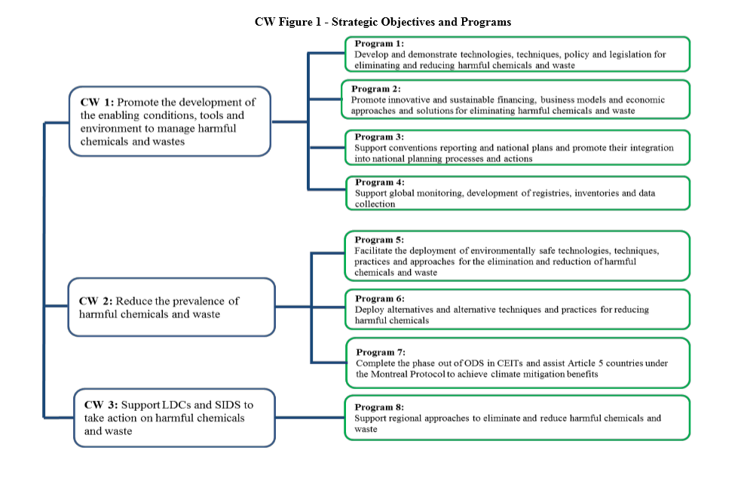

Slide 13
LONG TERM GOAL
A significant reduction in the production and consumption and prevents the exposure of humans and the environment to harmful chemicals and waste of global importance including mercury, persistent organic pollutants and ozone depleting substances.
TWO MAIN AREAS
Reduce existing stockpiles of persistent organic pollutants, mercury and chemicals
Reduce the use of persistent organic pollutants and mercury in production and supply chains

Slide 14
Objective 1: Promote the development of the enabling conditions, tools and environment to manage harmful chemicals and wastes
Program 1: Develop and demonstrate technologies, techniques, policy and legislation for eliminating and reducing harmful chemicals and waste
Support new techniques, alternatives, and technologies in order to take quick action on the 11 new chemicals
Program 2: Promote innovative and sustainable financing, business models and economic approaches and solutions for eliminating harmful chemicals and waste
Develop the mechanisms and financial/economic models that can achieve large scale and long-term investment
Notes:
(P1) Examples of cutting-edge technologies include contaminated soil and sediment cleanup technologies, bioremediation, Green Chemistry, and non-combustion technologies
(P2 - before) To deal with the extent of global pollution caused by harmful chemicals and waste, financing on a much larger scale needs to be mobilized for long-term sustainable actions

Slide 15
Objective 1: Promote the development of the enabling conditions, tools and environment to manage harmful chemicals and wastes
Program 3: Support conventions reporting and national plans and promote their integration into national planning processes and actions
Help countries report to the conventions and develop implementation plans for meeting their obligations under the conventions
Program 4: Support global monitoring, development of registries, inventories and data collection
Expand coverage of Global Monitoring Sites to cover new POPs and mercury
Results will be used by Conventions for decision making
Notes:
(P3) applies principally to the Stockholm Convention, the Mercury Convention and the Montreal Protocol (for CEIT countries only)
(P3) promote integration of the findings of enabling activities and convention reporting into national and sector level development planning → help inform countries on establishing reduction targets and leveraging resources
(P4 – before) GEF received guidance from the COP of the Stockholm Convention to provide assistance for the Global Monitoring Plan in developing countries and CEITs.

Slide 16
Objective 2: Reduce the prevalence of harmful chemicals and waste
Program 5: Facilitate the deployment of environmentally safe technologies, techniques, practices and approaches for the elimination and reduction of harmful chemicals and waste
Through removal of the barriers (e.g. lack of enforcement of regulations) interventions will be scaled up to facilitate increased reductions (12 POPs)
Program 6: Deploy alternative techniques and practices to reduce harmful chemicals
Design of products and processes that globally minimize the use and generation of toxic substances and waste (green production)
Notes:
(P5 - before) Demonstrated and proven technologies, alternatives, techniques, and practices already exist, for the reduction and elimination of the initial 12 POPs and ODS
(P5) Projects with significant investment need, for example treatment technologies such as alternatives to large-scale incineration, implementation of supply chain management and Green Chemistry, may be considered when there are both large-scale leveraging of national and bilateral resources and strong long-term national commitments.
(P6) i. e. deployment of alternatives and practices to DDT and other chemicals; integrated pesticide management including in the context of food security

Slide 17
Objective 2: Reduce the prevalence of harmful chemicals and waste
Program 7: Complete the phase out of ODS in CEITs and assist Article 5 countries under the Montreal Protocol to achieve climate mitigation benefits
Applies specifically to the completion of the phase-out of hydro-chlorofluoro-carbons (HCFCs) in CEITs.
Only applies to manufacturing of appliances and foams and will cover only energy efficiency gains associated with action being taken using other funding sources by the Article 5 countries.
Notes:
Countries have approached the GEF to co-finance additional activities in HCFC phase-out program which could cover activities that are not eligible for funding under the Multilateral Fund

Slide 18
Objective 3: Support LDCs and SIDS to take action on harmful chemicals and waste
Program 8: Support regional approaches to eliminate and reduce harmful chemicals and wastes
Fast and flexible access to these countries
Encourage regional and sub-regional cooperation (especially for the collection and disposal of POPs waste)
It is intended that a programmatic approach be used so that economies of scale can be achieved
Notes:
(Before) The LDCs and SIDS typically have limited capacity to deal with harmful chemicals and waste

