Slide 1
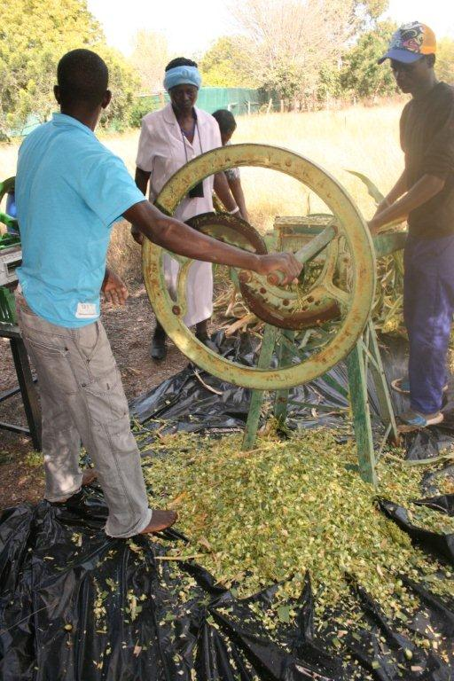
LDCF and SCCF: new strategy and operational improvements GEF Secretariat consultation Banjul, The Gambia 28 January 2019
LDCF project in Namibia (UNDP)

Slide 2
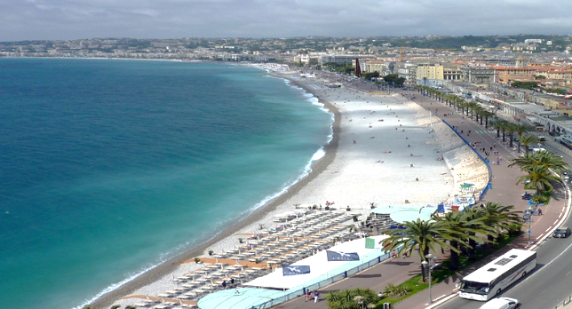
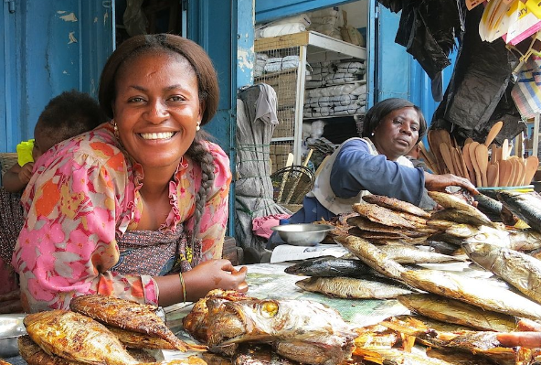
Strategy Highlights
Goal:
To strengthen resilience and reduce vulnerability to the adverse impacts of climate change in developing countries, and support their efforts to enhance adaptive capacity
Aligned with long-term adaptation goal of Paris Agreement
Enable countries to better utilize climate funds to develop harmonized solutions
Offer opportunities to mainstream adaptation
Engage with private sector, enhance resilience
Scenario A: $500 million for LDCF, $250 million for SCCF
Scenario B: $650 million for LDCF, $350 million for SCCF

Slide 3
Key Operational Improvements
LDCF project selection and approval process
Factors for LDCF prioritization
LDCF funding ceiling and cap
Pipeline
Results framework and reporting
Capacity building support for LDC planning and programming
More strategic and predictable programming, multi-Trust Fund (MTF) initiatives such as IPs and adaptation mainstreaming, complementarity with GCF and others

Slide 4
Per-country ceiling to be raised to $50 million
Each LDC can access resources up to initial cap of $10 million
May be raised during GEF-7, based on donor contributions and programming
➔ To maintain practice while ensuring more timely access to as many LDCs as possible
LDCF
Funding
Ceiling

Slide 5
Before:
Council approval by mail, based on non-objection on each project
Each project approved on first-come, first-served basis
After:
Council approval of work program, from December 2018
Work program constitution based on strategic prioritization
➔ To follow same calendar as GEF TF for PIF technical clearance, Council approval..
LDCF
Project Selection and Approval

Slide 6
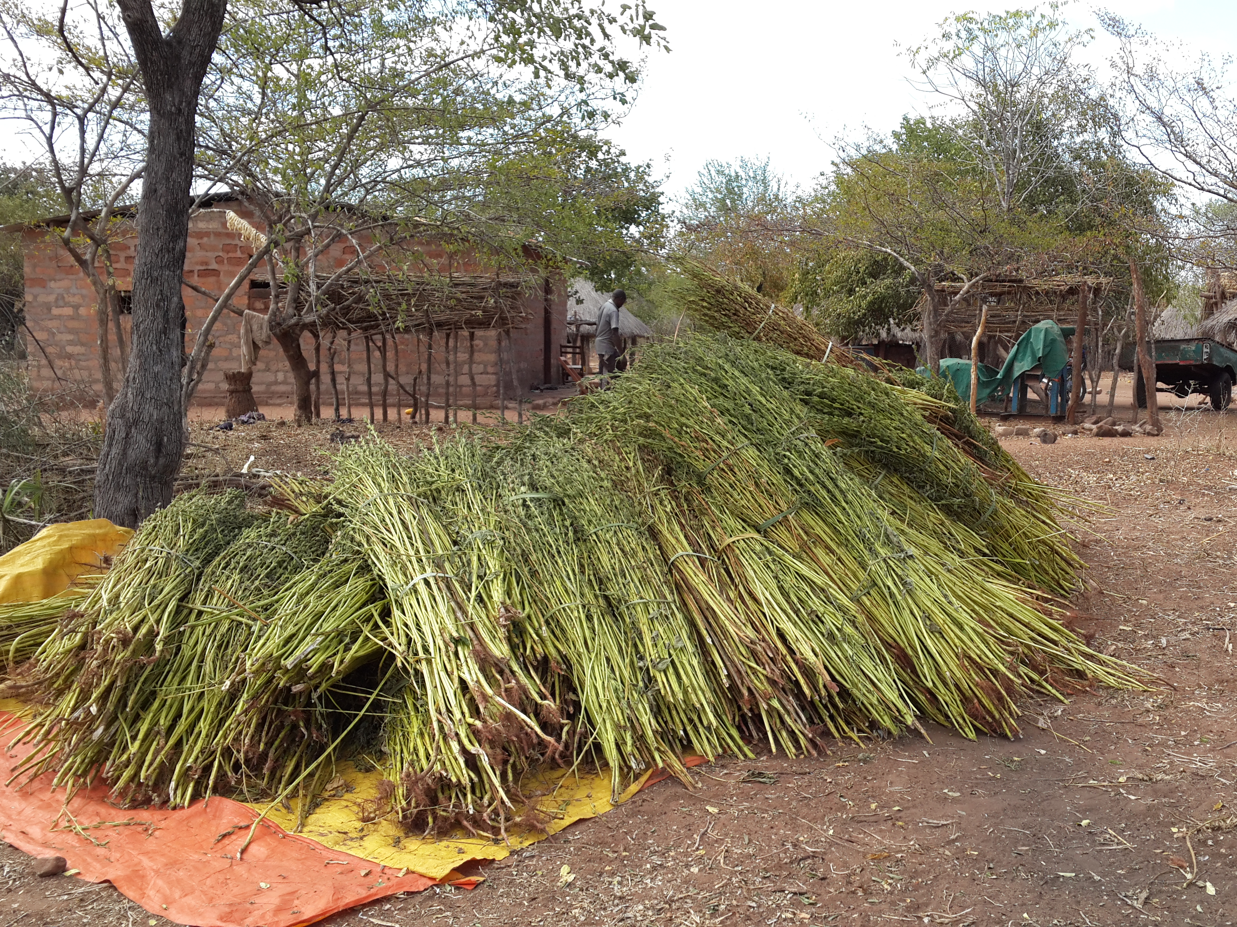
Factors for Enhanced LDCF Strategic Prioritization
Alignment with needs and priorities in national plans
Alignment with Programming Strategy
Opportunities to leverage/catalyze support
Level of LDCF resources accessed
Additional factors:
Potential for private sector engagement
Geographical balance
Extenuating circumstances
Timing of technical approval
➔ To enable timely Council approval of MTFs and priorities (i.e., COP guidance)
LDCF project in Zambia (UNDP)

Slide 7
No GEF-7 LDCF pipeline developed!
Consulting with 17 countries with GEF-6 pipelined projects to define GEF-7 priorities
Develop national plan for LDCF support:
Explore synergistic and harmonized programming with GEF TF and other sources (GCF, etc.)
Re-evaluate whether and how pipelined project remain viable
17 countries to develop or revisit, and (re) submit proposals based on current national plans and priorities
30 other LDCs to submit new proposals
GEF-6 Pipeline
Shutterstock, 112117097

Slide 8
LDCF Objectives and Entry Points
Innovation in priority sectors, themes & private sector
Climate security
Incubation and accelerator support
Objective 1
Reduce vulnerability and increase resilience through innovation and technology transfer for adaptation
Objective 2
Mainstream adaptation across GEF focal areas and IPs
Innovative partnerships
Mainstream adaptation and resilience for systemic impact
Objective 3
Support to NAP process
Support for LDC work programme
Support for enabling activities
Foster enabling conditions for effective and integrated adaptation

Slide 9
SCCF Modalities
Challenge Program
$10 million call for proposals and themes forthcoming
GEF Secretariat to screen (pre-select) concepts and invite further development
Approval following regular project cycle
2. Incentive
Managed outside pre-selection
Developed and aligned with regular GEF projects and programs
Follows regular project cycle
SCCF project in Zimbabwe (UNDP)

Slide 10
For further information
Please contact:
Chizuru Aoki: LDCF/SCCF Manager
Fareeha Iqbal: SIDS and Asia
Aloke Barnwal: Asia and Cities
Katya Kuang-Idba: Francophone Africa
Dustin Schinn: Anglophone Africa

