Slide 1
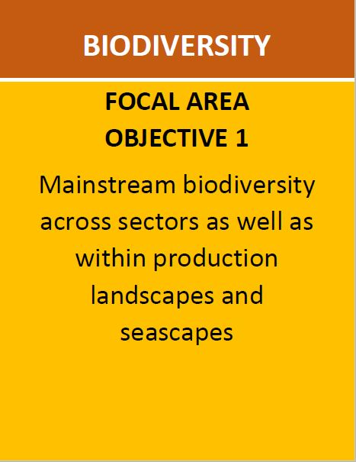
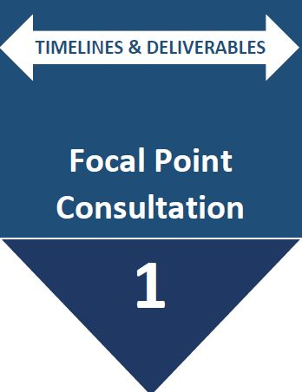
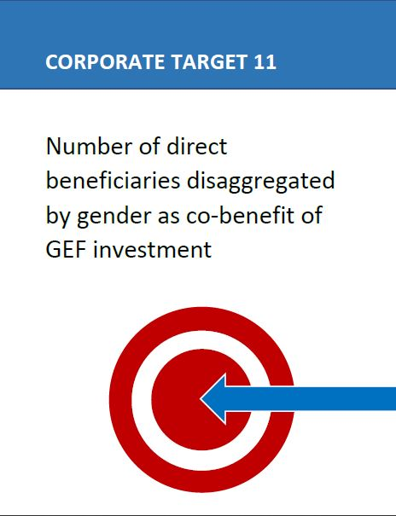
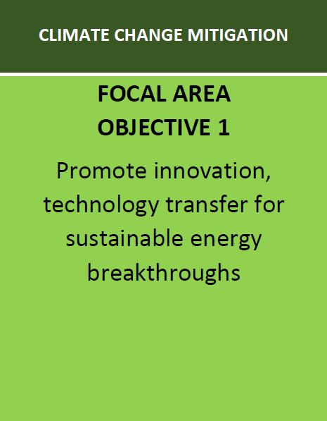
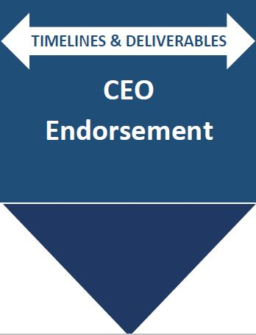
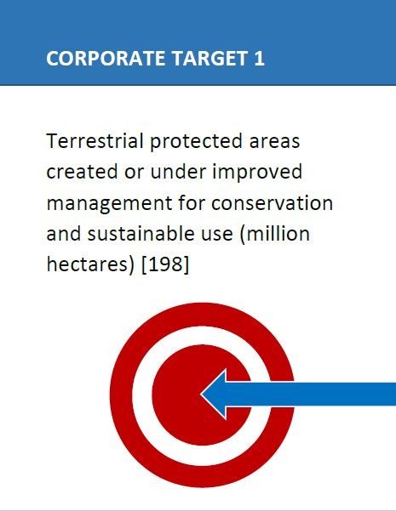
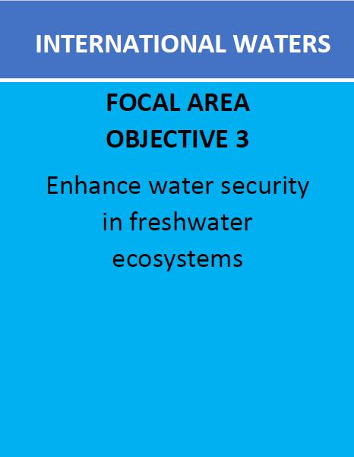
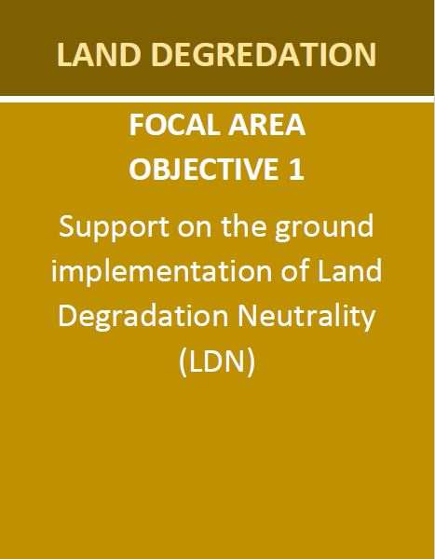
Project Life-Cycle Cards
There are 4 types of cards
Focal Area Objective cards
Timeline and Deliverable cards
Target Cards (Results)
Agency cards

Slide 2
Project Life-Cycle Game
Step 1: Agree on a project.
Step 2: Use the cards to illustrate the project, the targets (Results) and where key deliverables appear in the project life-cycle

Slide 3
Project Life-Cycle Game
This activity is designed to visually create a GEF project and its life-cycle based on focal area objectives, deliverables and results.

