Slide 1
Country Support Programme
GEF Expanded Constituency Workshop
Managua, Nicaragua
March 3-4, 2015

Slide 2
Country Support Programme (CSP)
The Country Support Progamme (CSP) is the main tool for carrying out Country Relations Strategy and has the following components:
    GEF National Portfolio Formulation Exercises
    GEF National Dialogues
    GEF Workshops
    GEF Constituency Meetings
    GEF Introduction Workshops
    Pre-Council Meetings for Recipient Countries

Slide 3
National Portfolio Formulation Exercises
(NPFE)
In GEF-6 the objective of this activity is to further help GEF OFPs to engage relevant national stakeholders and line ministries, in the planning process for developing national priorities for GEF support, including specific project ideas
Voluntary and not a pre-requisite for GEF funding
Final NPFD to be submitted to GEF – who will review and provide comments as appropriate.

Slide 4
GEF National Dialogues
National Dialogues continue to be a strategic tool for promoting the incorporation of the global environment concepts into national thinking, accounting and regular work.
They bring together a wide array of national and local level stakeholders to discuss and understand how protecting the global environment is key to their national interest
National Dialogue are organized at the request of the OFP. May include a component on GEF6 programming

Slide 5
GEF Workshops - ECWs
The purpose of Expanded Constituency Workshops (ECW)is to keep GEF OFPs, Convention FPs and other stakeholders, (CSOs) abreast of GEF Strategies, policies and procedures
ECWs are organized by GEF Secretariat with up to 7 participants –GEF FPs, 4 Convention FPs and CSO rep.
GEF may also design and organize other workshops to facilitate work on trans-boundary collaboration, regional programming and other issues based on thematic or geographic need.

Slide 6
GEF Constituency Meetings
During GEF-6 Constituency Meetings will continue to be the main tool for the Council Members to engage their Constituency members in the preparations for decision making at the GEF Council
Each constituency may request 2 meetings per year – before each Council meeting
Organised at the request of the Council Member – who prepares the agenda and chairs the meeting
GEF responsible for all logistical arrangements

Slide 7
GEF Introduction Seminars
GEF Introduction Seminars (previously GEF familiarization seminars) are organized to provide necessary information and training to new GEF Agency staff, Convention Secretariat staff, new GEF Focal Points and selected stakeholders on the GEF-6 strategies, policies and procedures.
The seminars also reach out to other audiences that are critical for the GEF to succeed e.g line ministries, media, private sector where possible.
Organized by the GEF Secretariat once a year in Washington DC.

Slide 8
Pre-Council Meeting for Recipient Country Constituencies
The purpose of these meetings is to enable Council members from recipient countries to meet immediately prior to the Council Meeting to exchange views, positions and perspectives in relation to the Council documents and to receive clarification from Secretariat staff, as necessary.

Slide 9


Slide 10

Agency Stakeholders
Global Environmental Facility (GEF)
United Nations Development Programme (UNDP)
United Nations Office for Project Services (UNOPS)
Notes:
GEF: – Financing; Chair of SGP Steering Committee
United Nations Development Programme (UNDP) – Implementing Agency; Co-financing
United Nations Office for Project Services – Executing Agency

Slide 11
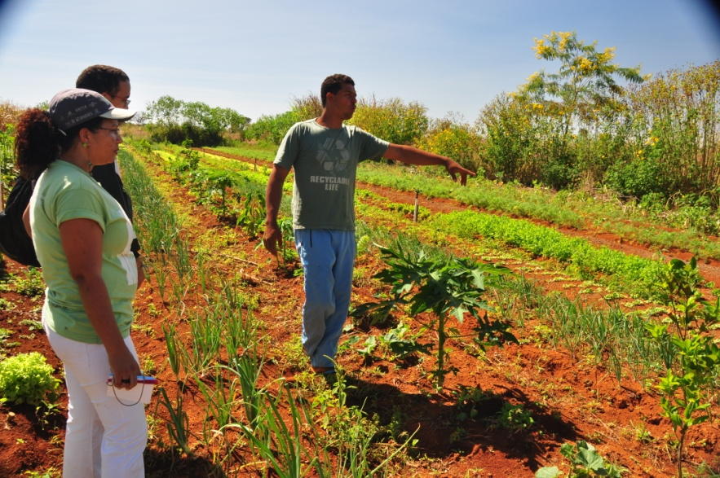

What is SGP?
A program, which:
Believes that local solutions to global environmental problems exist.
Supports community-based initiatives and action.
That the process of implementation leads also to poverty reduction and local empowerment.

Slide 12
Nature of SGP Grants
Planning grants: $2,500
Small grants projects: up to $50,000
Strategic grants: up to $150,000
Local CBOs, NGOs, communities, civil society organizations;
Review and approval of proposals done at country level through National Steering Committee
Notes:
From planning grants of $2,500 to full small grants projects of up to $50,000; average of $20,000; strategic grants up to $150,000
Grantees are local CBOs, NGOs, communities, civil society organizations; priority for poor and vulnerable communities – international NGOs can be partners giving support but not grantees
Projects must be prepared by and implemented by communities or civil society organizations (CSOs)
Projects must be within the GEF Focal Areas –
Release of funds direct to grantee bank account; direct agreement with community possible
Review and approval of proposals done at country level through the multi-sectoral National Steering Committee

Slide 13
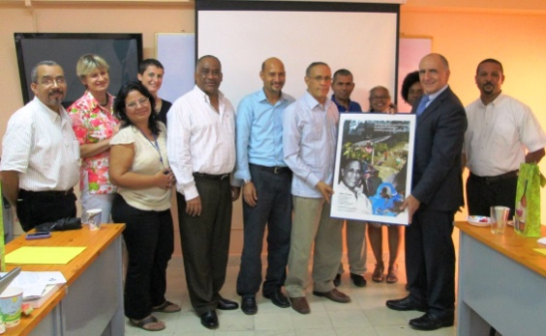
SGP Country Governance Structure
National Steering Committee (NSC):
Country driven
Capacity-building for CSOs
Review and approval of projects
Mobilize resources, link SGP to policy and planning
Majority non-governmental
OFP and UNDP CO are ex-officio
All volunteers of various expertise
Tenure 2 years; exceptionally renewable
Notes:
Selection is consultative facilitated by the SGP National
Coordinator and UNDP RR/RC
Final approval by SGP Global Manager at initial stage, by CPMT
in later stages

Slide 14
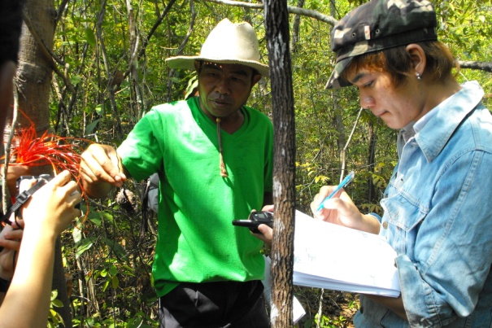
SGP Country Governance
Technical Advisory Group (TAG):
Get more involvement;
Expert review group;
NGO experts, academia, reps of Conventions
Focal Points;
Quality of proposals.
Notes:
Assure that proposals that get to NSC are well prepared and decisions of approval based on merit.

Slide 15
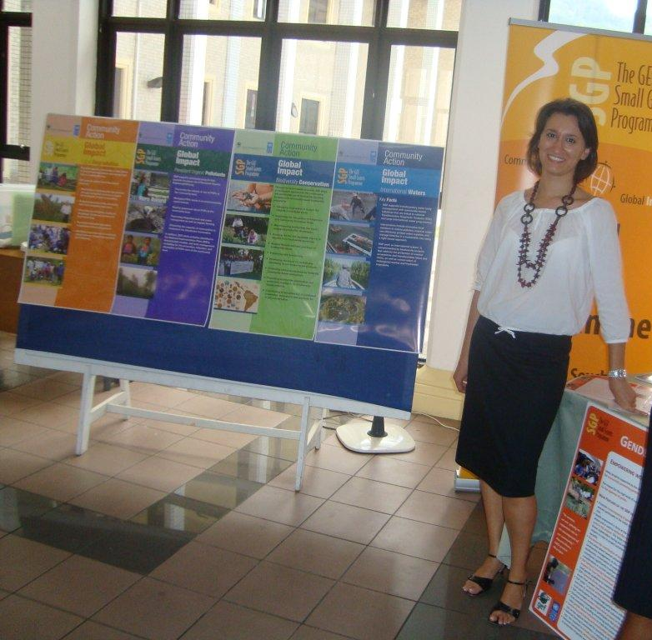
SGP Country Management
SGP Country Team:
National Coordinator (NC)
Competitively selected
UNOPS contracted
Implements decisions and policies of NSC
Primary supervisor is SGP Global Manager on programmatic matters.
Programme Assistant (PA)
Competitively selected and UNOPS contracted
Supports the NC and reports to the NC
Notes:
SGP Country Team:
National Coordinator (NC)
Competitively selected
UNOPS contracted
Implements decisions and policies of NSC
Primary supervisor is SGP Global Manager on programmatic matters; UNDP CO supervises on admin and adherence to UN professional and ethical standards
Programme Assistant (PA)
Competitively selected and UNOPS contracted
Supports the NC and reports to the NC

Slide 16
SGP Global Management
Central Programme Management Team (CPMT)
Provide guidance on meeting the commitments of SGP to GEF
Maintain global coherence
Raise global co-financing
Link country outcomes to global environmental governance
Global Manager and DGM plus focal area experts that also serve as Regional Focal Persons
SGP Steering Committee
GEF Secretariat (Chair), Oficina de UNDP-GEF (NY) and the GEF CSO Network
Provides strategic guidance

Slide 17
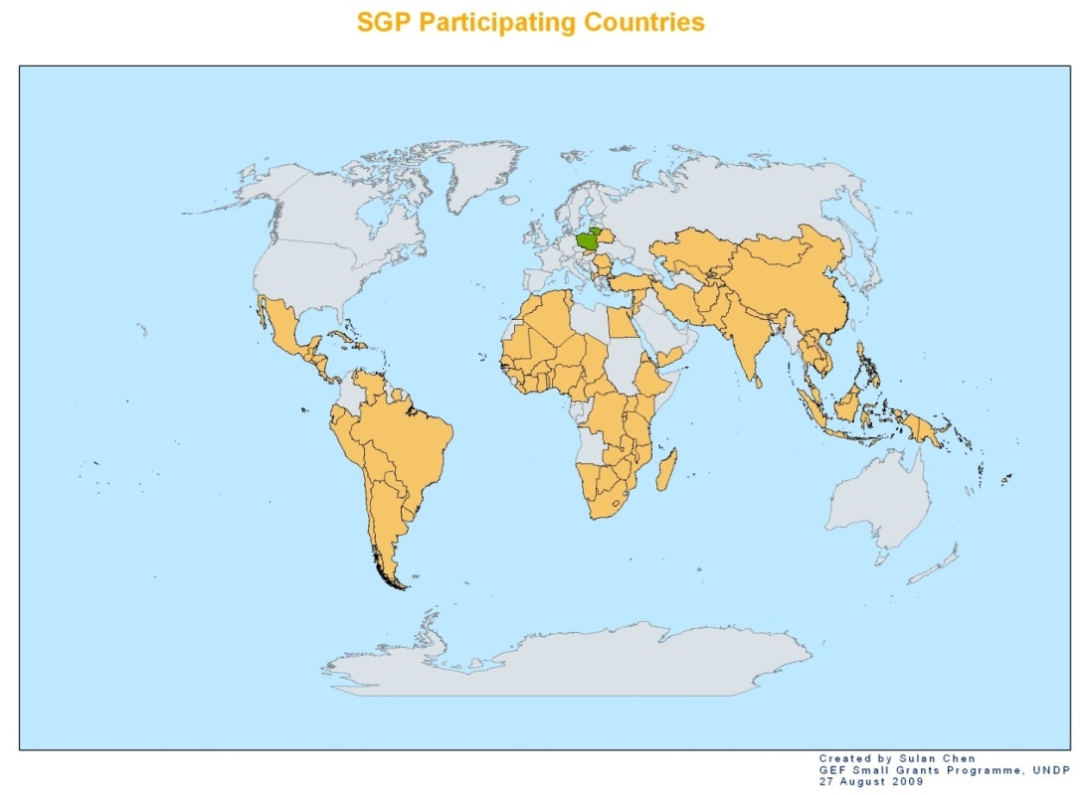
SGP as a Global Programme
22 new countries joined during OP4 (2008-2010)
8 new countries started up during 5th Operational Phase (OP5) from 2010-2014 for a total of 136
More than 19,000 projects globally
Notes:
In GEF-6, SGP will have a three-pronged approach
Focus on globally recognized ecosystems
Set up institutional and financial support mechanisms
Systematically develop the capacity of local and national civil society stakeholders.

Slide 18
Integration with National Efforts
Development of the Country Programme Strategy (CPS)
a. endorsed by the NSC and shared with the GEF OFP and
Convention Focal Points;
b. links with other planning and priority processes in the country
Involvement in NPFEs, NBSAPs, NAPAs, etc.
a. input SGP lessons learned
b. position CSO/community stakeholders into strategic roles
Linkages with MSPs/FSPs
Notes:
Development of the Country Programme Strategy (CPS)
a. endorsed by the NSC and shared with the GEF OFP and
Convention Focal Points;
b. links with the NBSAPs, NIPs, other National Communications to
Conventions, results of NCSAs, and GEF resources allocation
strategy; other relevant government and NGO projects and programs
Involvement in NPFEs, NBSAPs, NAPAs, etc.
a. input SGP lessons learned
b. position CSO/community stakeholders into strategic roles
Linkages with MSPs/FSPs

Slide 19
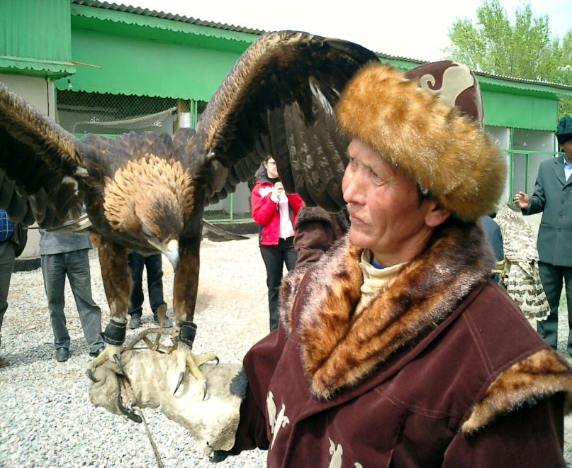
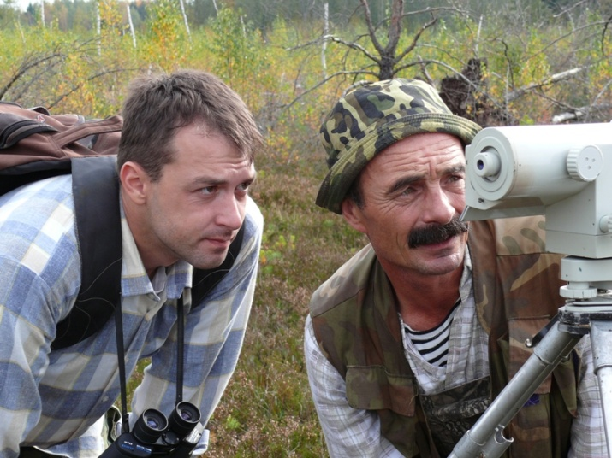
SGP OP6 Programming directions
In GEF-6, SGP will have a three-pronged approach
Focus on globally recognized ecosystems
Set up institutional and financial support mechanisms
Systematically develop the capacity of local and national civil society stakeholders.

Slide 20
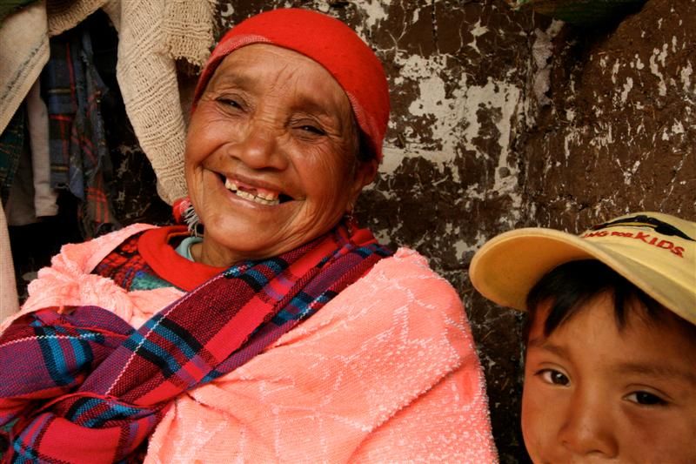
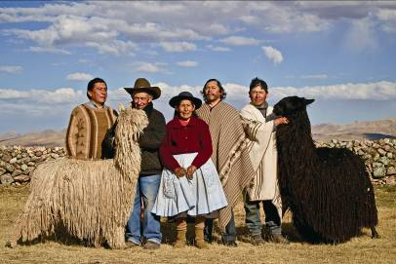
SGP OP6 Programming directions
For greater efficiency in the use of limited resources and to promote mainstreaming and scaling up, SGP country programmes can select from a set of four (4) multi-focal strategic initiatives:
Community Landscape and Seascape Conservation
Climate Smart Innovative Agro-ecology
Low Carbon Energy Access Co-benefits
Local to Global Chemical Management Coalitions

Slide 21

Partnerships
Grantees
National Governments
State/Local Governments
Regional Governments
Bilateral aid
Corporations
Multilateral agencies
Foundations
NGOs
Notes:
UNDP
UNEP
UNV
World Bank
European Commission
New Zealand Aid
AusAID
United Nations Foundation
Government of Japan
German Government
Swiss Agency for Development and Cooperation
ASEAN Center for Biodiversity
National Environmental Funds
International NGOs (RSBP/Birdlife, etc.)
ICRAN
IPEN
Women’s Groups
British Petroleum, Coca-Cola, Expedia
Development Bank of Southern Africa, HSBC
Hotel Associations

