Slide 1


Using the GEF to Achieve Transformation
Raul Alfaro-Pelico, World Bank Group
GEF Caribbean Expanded Constituency Workshop: Grenada - May 17, 2017
Notes:
The reason that we are looking at this issue is because GEF 7 needs to refocus attention on achieving transformative impacts- some call it tipping or flipping – but ultimately it means departing from business as usual to achieve a new lasting and impactful preferred state. Easy examples of this include the shift from incandescent lamps to CFLs and now to LED lamps. In the GEF we are now looking to achieve transformative impacts which cut across multiple focal areas to achieve multiple benefits aligned to the SDGs.
A question: Who of you have witnessed a transformative GEF supported program in your country… hands up… and ask a bit about them – the name and why transformative
This session is based on World Bank report titled “ Supporting Transformational Change for Poverty Reduction and Shared Prosperity”
https://ieg.worldbankgroup.org/Data/reports/WBGSupportTransformationalEngagements.pdf

Slide 2
Four Mechanisms Supporting Transformation
Removal of binding constraints/barriers: towards achieving an objective / innovation
Use of cross sectoral approaches: Key to addressing multiple issues/ (achieving depth to transformation)
Scaling up: Scaling up is needed to achieve impact
Behavioral change: Created through combination of incentives, regulation, use of market forces and information flow (sustain transformation)
Notes:
The World bank has undertaken an extensive review of the mechanisms which achieve transformative impacts. Either one or all of these mechanisms need to be engaged to achieve transformation:
Removing binding constraints or barriers: something which from GEF perspective you are all familiar with.
Use of cross sectoral approaches: binding constraints are very often require concerted action on several fronts. For instance stopping illegal poaching of elephant requires action on multiple fronts. We need to address the supply side of the ivory trade by stopping poaching through enforcement, creating eco-tourism livelihoods and real value for communities to maintain wildlife. On the demand side we need to persuade countries to stop the import of ivory, and educate those buying ivory about the impact they are having on elephants and communities.
Scaling up: the GEF has been highly successful at supporting innovation and at piloting but the ultimate success of new ideas is whether they can be scaled up – and so we placing increased attention on asking what the replication, scaling up and lessons learnt and dissemination plan is in GEF supported projects
Behavioral change: Unless stakeholders change their behavior, transformation does not occur – again the ivory example is a good example – it is only once we change to the new way of doing things that transformation comes about

Slide 3


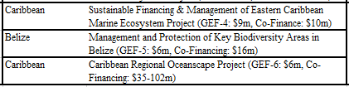

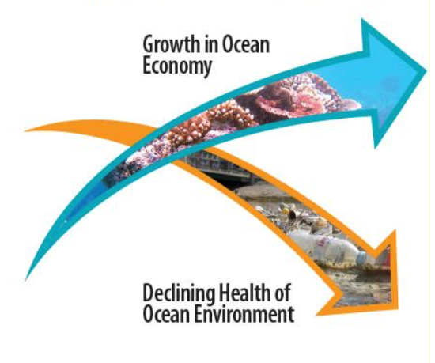
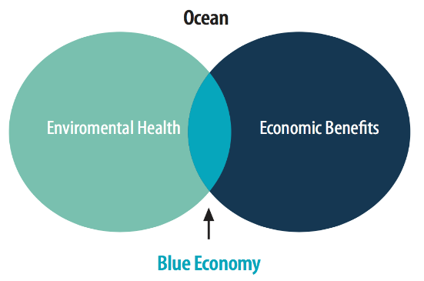
Towards a Blue Economy: A Promise for Sustainable Growth in the Caribbean
Caribbean Sea Supports 37 Coastal Countries’ Economies
and 40 million people that live on the coast
The $407 Billion USD/Yr. Caribbean Ocean Economy is Dominated by Shipping & Tourism, Oil/Gas, Fisheries and Aquaculture
166 million people live within 100 kilometers of the Caribbean coast
The Fisheries sector generates $1.2 billion USD annually in export earnings;
Tourism across Caribbean Islands generates approx. $47 billion USD annually;
Sea-based oil and gas generates approximately $40 billion USD annually.
The Proposed Policy Framework For A Caribbean Blue Economy
IDA-18 $75 billion
Climate Investment Funds
Leveraging Opportunities (GEF-7, IBRD, Donors)
The vast economic value derived from the Caribbean Sea is projected to continue growing in the coming decades. The economic growth and sustainable development of the region is however threatened by the continued degradation of the marine environment…
Minerals, Sand, Gravel
Seafood
Energy
Biodiversity
Marine Biotechnology
Transport and Trade
Coastal Protection
Waste Disposal
Carbon Sequestration
Tourism and Recreation
Two Parallel Trends In The Global Oceans

Slide 4
What else may be required to support transformation?
Enabling environment and political economy: Need to address difficult issues in the political economy to push through reforms
Upstream analytics, strong design and implementation is essential
Sustained and continuous engagement needed
Innovative approaches: need to scale innovation correctly and use adaptive practices to reduce risks
Notes:
Now there are several other factors which also prove important for transformation to take off – these are all factors which you have previously encountered:
Enabling environment and political economy: in its simplest form I am sure that you have often felt that you can not do something because the law, policy or powerful vested interests are not on your side …. Yet we know that with political and effort these can be changed. Question give me some examples?
Need for upstream analytical work: often we do need to undertake analytical work- get the facts on the table to understand a sector, the size and scale of the issue and the stakeholders to be engaged
Sustained and continuous engagement: all too often we only deal with part of the problem or do not sustain engagement over time – only to see a good project or program not achieving transformation because it is not sustained or continued and so things return back to where they were. Question give me some examples?
Innovative approaches: Transformation requires innovation and calculated risk taking/ mitigation

Slide 5
Towards a Blue Economy: A Promise for Sustainable Growth in the Caribbean
Grenada’s Transition to A Blue Economy
First Caribbean country to develop a Blue Growth Vision and Master Plan
Committed to conserve at least 25% of its Coastal Area; Tops in the OECS
New Integrated Coastal Zone Policy supports sustainable tourism, high-value fish export, and future ocean aquaculture
Recognition that Blue Economy leads to Blue Growth

Slide 6
What does this mean for you and the GEF Agencies supporting your country?
Use rigorous diagnostics to identify binding constraints
Design the program around the most strategic binding constraints
Agencies should focus on addressing the binding constraints/barriers where they have a comparative advantage
Build on mechanisms which support transformation including coalitions with key stakeholders
Stay the course: Continue longer term program support as needed
Notes:
Rigorous diagnostics: Sometimes needed to ensure that we understand the problem correctly and the theory of change to design the program correctly
GEF Agencies and countries need to pay more careful attention to recognizing the comparative advantages of the different GEF agencies so that you use GEF resources to achieve transformative impacts. We have 3 broad types of agencies:
UN agencies including UNEP, UNDP, FAO with strong capacity building skills and some science and technical skills
NGOs - smaller scale niche activities including execution.
MDB which have the capability to support large transformative programs working especially with your ministries of finance/ the economy infrastructure and the private sector to help deliver transformative results. The MDBs will be delivering over $400 billion of development assistance towards the SDGs over 4 years compared to the GEFs $4 billion over that period…. think about that size and scale to deliver transformative results.
Build on mechanisms which support transformation: In the GEF we more often see sustained engagements in the transboundary water sector which is often positive – at the same time we sometimes see project after project with no transformative results achieved.
- Coalitions: These are often important for achieving results – and often the best results are achieved where substantial coalitions are built and engaged. At the same time we all see partnerships being built and falling apart because they have no real goals.
- Staying the course - We have spoken about this already

Slide 7
THANKS - Discussion
IMPLEMENTATION: would this type of transformative program be effective on the ground in your country/the Caribbean region?
RELEVANCE: would this type of interventions help you respond to your convention obligations?
BARRIERS: what are the key binding constraints in the Caribbean?
GEF Caribbean Expanded Constituency Workshop: Grenada - May 17, 2017

