Slide 1
GEF-6 Biodiversity Strategy
Notes:
GEF-6: The Global Environment Facility 6th Replenishment (Every 4 years since inception).

Slide 2
GEF-6 Biodiversity Strategy
Global Context and the GEF-6 Replenishment
Big tent: Strategic Plan and the GEF
Biodiversity Strategy
Notes:
GEF: The largest donor in support of Biodiversity Conservation
GEF: The Financial Mechanism of the CBD providing funding to parties to implement the Strategic Plan for Biodiversity 2011-2020.
GEF Biodiversity Strategy 2014-1018. Approved by the GEF Council in Mexico June 2014.

Slide 3
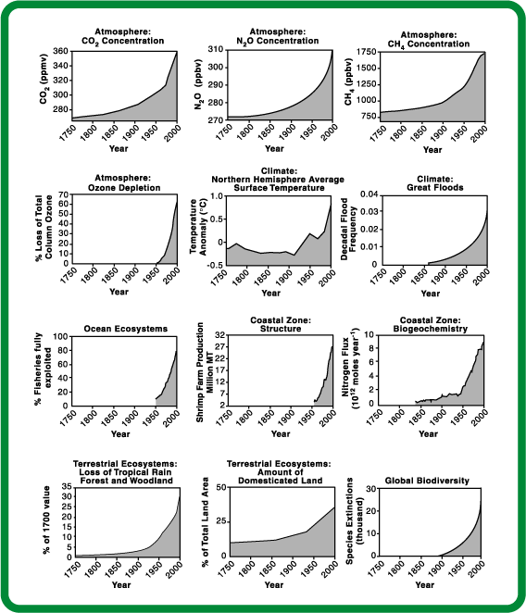
Global change
with multiple effects
CO₂, N₂O, CH₄ concentrations
Overfishing
Land degradation
Loss of Biodiversity
Water Depletion
Unsustainable consumption
2010-2020
The Planetary Response to the drivers of the Anthropocene
1900 1950 2000
Notes:
We can see an increase not just in green house gas emissions but also Increase in overfishing and loss of biodviersity etc in the same time,

Slide 4
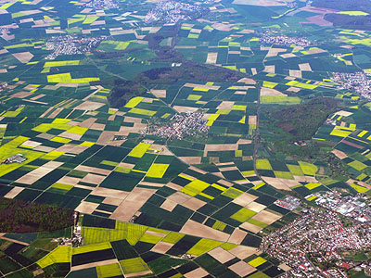
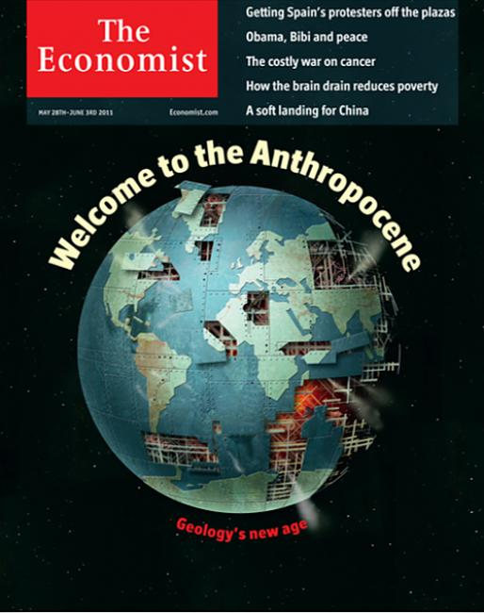
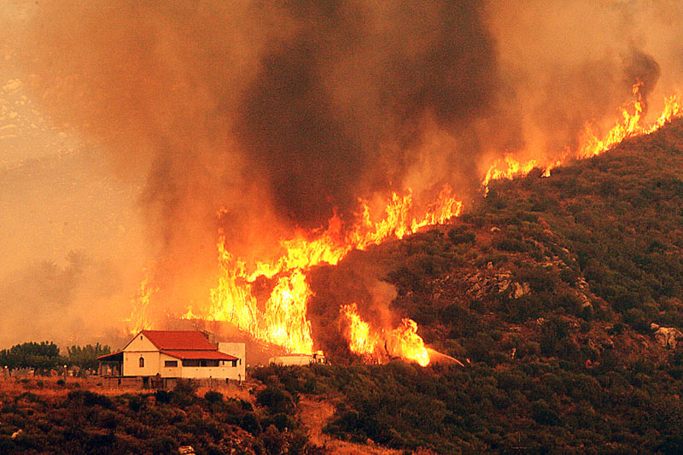
Antrophocene – humans influence
the functioning of the Earth
Notes:
The reason for the Rio+20 conference was that it is more and more clear that we are now in a A new global era, human activities have expanded to the degree that we are not only shaping local and regional ecosystems, but now also the functioning of Earth as a whole, reflected e.g. in the climate change debate

Slide 5
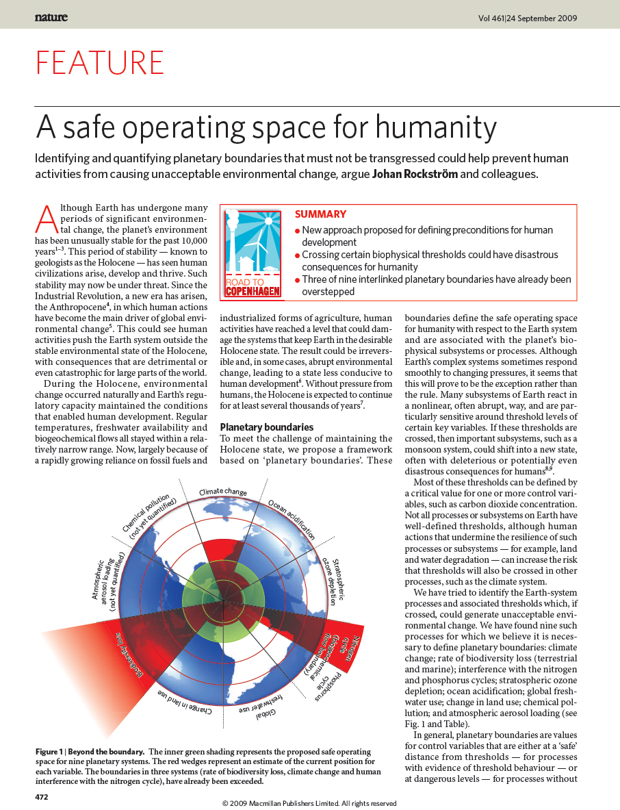
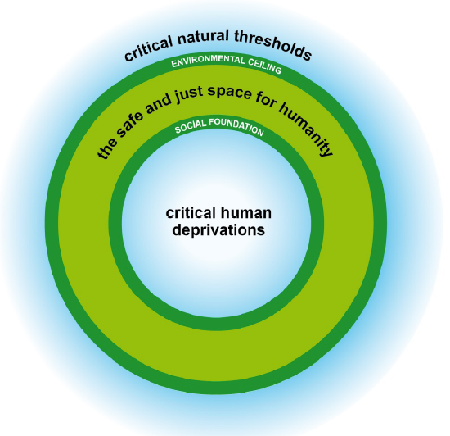
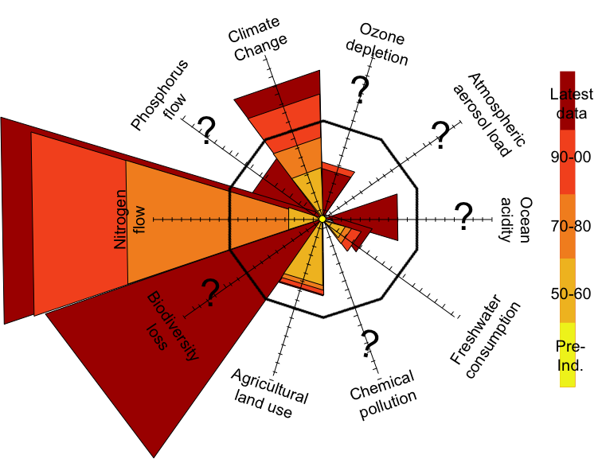
Planetary Boundaries
Oxfam, 2012
Notes:
At 2009 Johan Rockström at the Stockholm Resilience Centre brought together a group of leading scientist and they came up with the concept of planetary boundaries. They identified nine earth system processes that are ciritical to keep the earth in a stable state, We do not know where the exact tipping points are, they should more be seen as zones where tipping points could happen. We know that all the boundaries are interlinked, and we know that for example the biodiversity and climate are at risk. The rates of changetaht we observe cannot continue without significantly eroding the resilience of major components of Earth-system functioning.
These bounderie sets the limits for any economic development. Oxfam have taken the planetary boundary idea and added social boundaries, and argue just the same as the planet provides biophysical limits, the world has agreedin rio on critical social foundations below which people should not live, based on human rights, poverty alleviation and equity aspects.
I just wanted to start with this slide to set the scene regarding social ecological system and resilience thinking.
Resilience has under the Convention been mainly been mentioned related to Cliamte change for example Target 15: By 2020, ecosystem resilience and the contribution of biodiversity to carbon stocks have been enhanced, through conservation and restoration, including restoration of at least 15
per cent of degraded ecosystems, thereby contributing to climate change mitigation and adaptation and to combating desertification.
In this side event we will present some of the ideas related to resilience and Resilience assessment.
We are also now trying to see how we could use this concept to contribtue to the development of Sustainable development goals
Continued biodiversiy loss
Aichi Biodiversity Targets under CBD, to halt the loss of biodiversity to ensure that by 2020 ecosystems are resilient and continue to provide essential services, thereby securing the planet’s variety of life, and contributing to human well-being, and poverty eradication.
According to Global Biodiversity Outlook 3:
Species which have been assessed for extinction risk are on average moving closer to extinction. Nearly a quarter of plant species are estimated to be threatened with extinction.
Crop and livestock genetic diversity continues to decline in agricultural systems.
The ﬁve principal pressures directly driving biodiversity loss (habitat change, overexploitation, pollution, invasive alien species and climate change) are either constant or increasing in intensity.

Slide 6
Drivers and pressures
Underlying
socioeconomic trends
Indirect environmental drivers
Direct
environmental drivers
Environmental pressures
Changes in state of environment
Demand for food production
Agriculture production processes that produce food
Pollution e.g., GHG’s & ozone-depleting substances
Atmosphere (climate)
Population growth
Demand for buildings
Change in habitat and species loss
Biodiversity
Provision/use of transportation
Rising middle class
Demand for energy
Construction & use of buildings & other infrastructure
Land
Introduction of invasive species
Demand for
transportation
Oceans
Production of electricity
Over exploitation and harvesting
Urbanization
Other
Other
Other
Freshwater
Driver interventions
Pressure interventions
Changes in human welfare
Notes:
What’s driving this change are sectors outside the realm of Environment Ministries for the most part as you can see in this illustrative but not exhaustive graphic with food production responsible for 69% of the environmental pressure that is driving land use change, land degradation and the concomitant BD loss.
This analysis points to a need for GEF investments to be less opportunistic and more strategic with regards to the appropriate entry points and levers for GEF projects and programs to push to effect change at greater scales—thematically, geographically, and temporally.

Slide 7
Strategic targeting of drivers and pressures within GEF interventions is needed to deliver global environmental benefits at scale: impacts what we do, who we work with, and how we do it.
One-off, site specific driver-based intervention
Driver-based intervention
at scale
One-off, site specific, pressure-based intervention
Pressure-based intervention at scale
Notes:
More focus on drivers of environmental degradation has three implications on the GEF’s operating model.
First of all, we must become more targeted in “what” the GEF invests in. This is already underway with a greater focus on drivers and a balance between drivers and pressures within the GEF-6 focal area strategies and proposed integrated approaches.
Secondly, we must be more strategic about “who” we work with. Our partners must include champions in economic development, finance, and sector ministries, as well as leaders in major cities, CSO stakeholders. Perhaps most critically, we must articulate a clear private sector engagement plan. Across food, cities and power, the private sector – be it corporations, investors and financial intermediaries – are key players and the GEF must work with the private sector for higher impacts.
Finally, we must be more proactive in “how” we operate. Focusing more on scalable opportunities and operational modalities that support scalable solutions.
We know see this evolution in the GEF-5 BD portfolio with more emphasis on BD mainstreaming and a portfolio that is better balanced on drivers and pressures. In addition, many of the MFA and SFM projects that draw resources from the CC, LD, IW focal areas and mostly focused on production sectors and the production landscape/seascape also include balanced investments on drivers and pressures.

Slide 8
GEF-6
Refreshed Focal Area Strategies and “Integrated Approaches”
SD Themes
Food Security
Sustainable Cities
Forests
Fisheries
Integrated
Approaches
Commodities
Sub-Saharan
Africa FS
Cities
Biodiversity
International Waters
Climate Change
Land Degradation
Sustainable Forest Management
Chemicals
Focal Area Strategy Delivery
Notes:
The Bases: Focal Area Strategies
Building on the bases: The Integrated Approaches
They relate to the themes the GEF is working on

Slide 9
Strategic Plan for Biodiversity, 2011-2020
Notes:
What is under this Glossy and Calculated Name looking into the future? And we are half way through…

Slide 10
5 Goals and 20 Aichi Biodiversity Targets
Strategic goal A. Address the underlying causes of biodiversity loss
Target 1: By 2020, People are aware of the values of biodiversity and the steps they can take to conserve and use it sustainably.
Target 2: By 2020, biodiversity values are integrated into national and local development and poverty reduction strategies and planning processes and national accounts.
Target 3: By 2020, incentives, including subsidies, harmful to biodiversity are eliminated, phased out or reformed.
Target 4: By 2020, Governments, business and stakeholders have plans for sustainable production and consumption and keep the impacts resource use within safe ecological limits.
Strategic goal B. Reduce the direct pressures on biodiversity and promote sustainable use
Target 5: By 2020, the rate of loss of all natural habitats, including forests, is at least halved and where feasible brought close to zero, and degradation and fragmentation is significantly reduced.
Target 6: By 2020 all stocks managed and harvested sustainably, so that overfishing is avoided.
Target 7: By 2020 areas under agriculture, aquaculture and forestry are managed sustainably, ensuring conservation of biodiversity.
Target 8: By 2020, pollution, including from excess nutrients, has been brought to levels that are not detrimental to ecosystem function and biodiversity.
Target 9: By 2020, invasive alien species and pathways are identified and prioritized, priority species are controlled or eradicated, and measures are in place to manage pathways to prevent their introduction and establishment.
Target 10: By 2015, the multiple anthropogenic pressures on coral reefs, and other vulnerable ecosystems impacted by climate change or ocean acidification are minimized, so as to maintain their integrity and functioning.
Strategic goal C: To improve the status of biodiversity by safeguarding ecosystems, species and genetic diversity
Target 11: By 2020, at least 17 per cent of terrestrial and inland water, and 10 per cent of coastal and marine areas are conserved through systems of protected areas.
Target 12: By 2020 the extinction of known threatened species has been prevented and their conservation status, particularly of those most in decline, has been improved and sustained.
Target 13: By 2020, the genetic diversity of cultivated plants and farmed and domesticated animals and of wild relatives is maintained.
Strategic goal D: Enhance the benefits to all from biodiversity and ecosystem services
Target 14: By 2020, ecosystems that provide essential services, including services are restored and safeguarded.
Target 15: By 2020, ecosystem resilience and the contribution of biodiversity to carbon stocks has been enhanced, through conservation and restoration, including restoration of at least 15 per cent of degraded ecosystems.
Target 16: By 2015, the Nagoya Protocol on Access and Benefits Sharing is in force and operational.
Strategic goal E. Enhance implementation through participatory planning, knowledge management and capacity building
Target 17: By 2015 each Party has developed, adopted as a policy instrument, and has commenced implementing an effective, participatory and updated NBSAP.
Target 18: By 2020, the traditional knowledge, innovations and practices of indigenous and local communities and their customary use, are respected.
Target 19: By 2020, knowledge, the science base and technologies relating to biodiversity, its values, functioning, status and trends, and the consequences of its loss, are improved, widely shared and transferred, and applied.
Target 20: By 2020, the mobilization of financial resources for effectively implementing the Strategic Plan for Biodiversity 2011-2020 from all sources,, should increase substantially.
Notes:
What are these 20 Aichi Biodiversity Targets?
The Aichi Biodiversity Targets are a set of 20, time-bound, measureable targets agreed by the Parties to the Convention on Biological Diversity in Nagoya, Japan, in October 2010, that are now being translated into revised national strategies and action plans by the 193 Parties to the Convention.
Nagoya = The Capital of the Aichi Prefecture
Does the GEF BD Strategy support work on all 20 Targets?

Slide 11
Biodiversity mainstreaming
Protection
ABS
Understand values
Sustainable fisheries
Protected areas
Implement Nagoya Prot.
Prevent extinctions
Mainstream biodiversity
Manage within limits
Enabling
Conserve gene pool
Revise NBSAPs
Address incentives
Reduce pollution
Restoration
Respect and conserve TK
Sustainable production
Reduce
invasive spp.
Restore ecosystems
Improve knowledge
Halve rate of loss
Minimize reef loss
Mobilize resources
Enhance resilience
Notes:
A different way to visualize the clustering of the 20 Aichi Targets and the alignment with the GEF BD Strategy to be described in detail in the next slide

Slide 12
GEF-6 Biodiversity Strategy
Goal: To maintain globally significant biodiversity and the ecosystem goods and services that it provides to society
BD1: Improve Sustainability of Protected Area Systems
BD 2: Reduce Threats to Globally Significant Biodiversity
BD 3: Sustainably Use Biodiversity
BD4: Mainstream Biodiversity Conservation and Sustainable Use into Production Landscapes/ Seascapes and Sectors
1. Improving financial sustainability and effective management of the national ecological infrastructure
3. Preventing the extinction of known threatened species
6. Ridge to Reef+: Maintaining integrity and function of globally significant coral reefs
9. Managing the human-biodiversity interface
4. Prevention, control, and management of invasive alien species.
7. Securing Agriculture’s Future: Sustainable use of plant and animal genetic resources.
10. Integration of biodiversity and ecosystem services into development and finance planning
2 . Nature’s Last Stand: Expanding the reach of the global protected area estate.
5. Implementing the Cartagena Protocol of Biosafety
8. Implementing the Nagoya Protocol on Access and Benefit Sharing.
Notes:
The GEF-6 Biodiversity Strategy:
4 Objectives
10 Programs
These are the windows to be used when structuturing GEF Biodiversity or MFA projects.

Slide 13
Biodiversity Strategy: Objectives and Programs
Focal Area Objective | Focal Area Programs
Objective One: Improve sustainability of protected area systems | Program 1: Improving Financial Sustainability and Effective Management of the National Ecological Infrastructure
 | Program 2: Nature’s Last Stand: Expanding the Reach of the Global Protected Area Estate
Notes:
Impacts:
Flow of ecosystem services increased or maintained
Sustained crop, livestock, and forest production
Sustainable livelihoods (development benefit)
Sustainable Land Management (SLM) in production landscapes
Food Security – improving and increasing food crop production in vulnerable regions
Climate-Smart Agriculture – enhancing resilience and climate change mitigation in crop and livestock systems
Forest Landscape Management and Restoration – increasing forest and tree cover

Slide 14
Program 1: Sustainability of PA Systems
Notes:
The GEF-6 strategy prioritizes the development and implementation of comprehensive, system-level financing solutions.
Individual GEF projects must be part of a larger sustainable finance plan and context, and countries may require a sequence of GEF project support over a number of GEF phases.
GEF-6, support to improving protected area financial sustainability and effective management will be explicitly directed towards globally significant protected areas within the national system, per the criteria in Annex 3 (Next slide)
GEF-supported interventions will use tools and revenue mechanisms that are responsive to specific country situations (e.g., conservation trust funds, systems of payments for environmental services, debt-for-nature swaps, economic valuation of protected area goods and services, access and benefit sharing agreements, etc.)

Slide 15
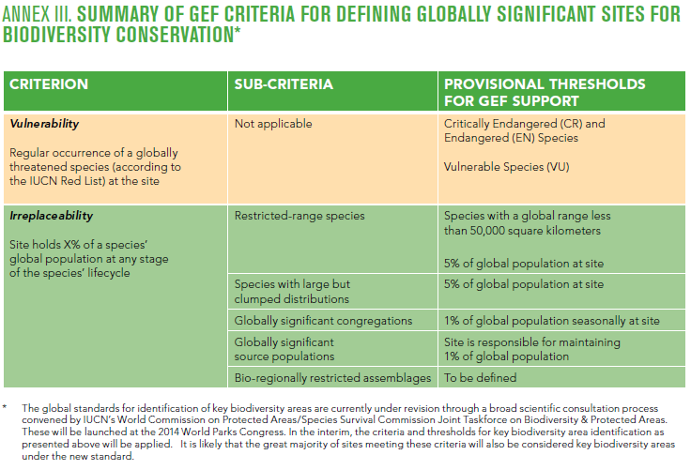
Program 2: Expanding the Reach
Notes:
This program will contribute to the achievement of Aichi Target 11 to conserve 17% of terrestrial and inland water, and 10% of coastal and marine areas.
The program will require that protected areas established with GEF support are globally significant, as defined by the criteria in Annex 3.
This program will allow for expansion of the estate and management of these new sites. Projects will be expected to link plans for expansion with the associated financing strategies supported through Program One, as has been the practice in GEF-5.

Slide 16
Biodiversity Strategy: Objectives and Programs
Focal Area Objective | Focal Area Programs
Objective Two: Reduce threats to globally significant biodiversity | Program 3: Preventing the Extinction of Known Threatened Species
 | Program 4: Prevention, Control and Management of Invasive Alien Species
 | Program 5: Implementing the Cartagena Protocol on Biosafety (CPB)
Notes:
Impacts:
Flow of ecosystem services increased or maintained
Sustained crop, livestock, and forest production
Sustainable livelihoods (development benefit)
Sustainable Land Management (SLM) in production landscapes
Food Security – improving and increasing food crop production in vulnerable regions
Climate-Smart Agriculture – enhancing resilience and climate change mitigation in crop and livestock systems
Forest Landscape Management and Restoration – increasing forest and tree cover

Slide 17
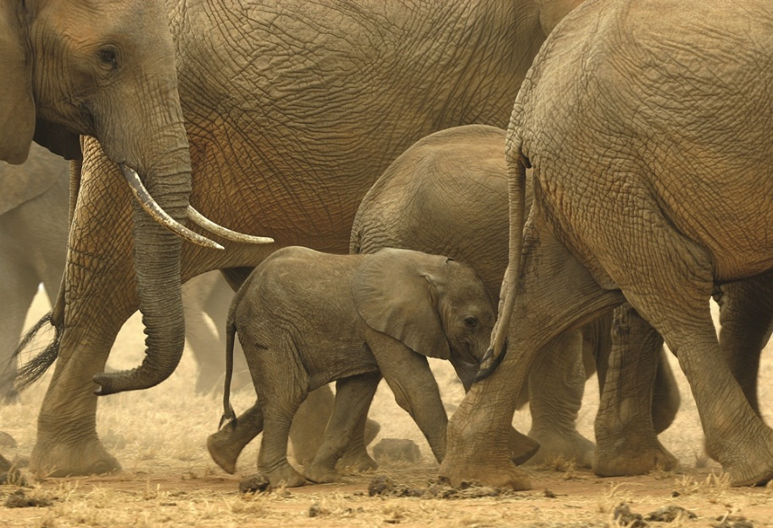
Program 3: Preventing Extinction
Notes:
This program will address both supply and demand aspects of poaching to build monitoring and enforcement capacity and using social media, education, and awareness-raising to staunch the demand for these products and pressure Governments to improve enforcement of existing laws.
Support will include:
■■building the capacity of environmental law enforcement agencies and the judiciary to reduce poaching inside and outside of the protected area system and improving border enforcement through cross-sectoral collaboration;
■■developing action plans where governments commit to an adequate budget for their implementation, effectively contributing to the sustainability of these activities;
■■increasing cooperation within and between law enforcement agencies and relevant international organizations to mobilize political support for environmental law enforcement.
The program will make a concerted effort to respond to the threat of extinction of species that are critical for the ecological and economic sustainability of many protected areas in sub-Saharan Africa. This will not preclude the submission of proposals from other countries or regions where poaching and illegal trade
poses an imminent danger to a threatened species. For example, wildlife poaching and illegal trade in Eurasia, including Asia, Russia, and Central Asia, is also increasing dramatically.

Slide 18
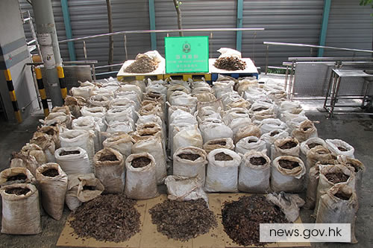
Program 3: Preventing Extinction
Notes:
The program will make a concerted effort to respond to the threat of extinction of species that are critical for the ecological and economic sustainability of many protected areas in sub-Saharan Africa. This will not preclude the submission of proposals from other countries or regions where poaching and illegal trade
poses an imminent danger to a threatened species. For example, wildlife poaching and illegal trade in Eurasia, including Asia, Russia, and Central Asia, is also increasing dramatically.

Slide 19
Program 4: IAS
Notes:
The GEF will support the implementation of comprehensive prevention, early detection, control and management frameworks that emphasize a risk management approach by focusing on the highest risk invasion pathways.
Targeted eradication will be supported in specific circumstances where proven, low-cost, and effective eradication would result in the extermination of the IAS and the survival of globally significant species and/or ecosystems.
While the program will focus on island ecosystems and will strongly engage with island states to advance this agenda, projects submitted by continental countries that address IAS management through the comprehensive pathways approach outlined above will also be supported.

Slide 20
Program 5: Biosafety
Notes:
GEF-6 will provide the opportunity for implementation of the National Biosafety Frameworks (NBFs) to comply with the provisions of the Cartagena Protocol on Biosafety.
The GEF will provide support to eligible countries through regional or sub-regional projects when there are opportunities for cost-effective sharing of limited resources and for coordination between biosafety frameworks to support CPB implementation.
The GEF will support thematic projects addressing some of the specific provisions of the Cartagena Protocol. These projects should be developed at the regional or sub-regional level and build on a common set of targets and opportunities to implement the protocol beyond the development and implementation of NBFs.
The GEF will support the ratification and implementation of the Nagoya-Kuala Lumpur Supplementary Protocol on Liability and Redress to the CPB.

Slide 21
Biodiversity Strategy: Objectives and Programs
Focal Area Objective | Focal Area Programs
Objective Three: Sustainably use biodiversity | Program 6: Ridge to Reef+: Maintaining Integrity and Function of Coral Reef Ecosystems
 | Program 7: Securing Agriculture’s Future: Sustainable Use of Plant and Animal Genetic Resources
 | Program 8: Implement the Nagoya Protocol on ABS
Notes:
Impacts:
Flow of ecosystem services increased or maintained
Sustained crop, livestock, and forest production
Sustainable livelihoods (development benefit)
Sustainable Land Management (SLM) in production landscapes
Food Security – improving and increasing food crop production in vulnerable regions
Climate-Smart Agriculture – enhancing resilience and climate change mitigation in crop and livestock systems
Forest Landscape Management and Restoration – increasing forest and tree cover

Slide 22
Program 6: Ridge to Reef+
Notes:
The GEF will support increasing the area of coral reefs situated within MPAs. An important spatial factor for coral reef resilience is the connectivity among and within coral reefs. Therefore, the development of MPA networks or of large MPAs will be targeted.
The GEF will support the development, adoption and enforcement of policy and regulatory frameworks and legislation to mitigate marine-based pollution and damage to coral reef ecosystems. The GEF will also support national and international trade regulations for reef products, e.g., aquarium fish, corals, and shells.
This could include support to capacity building and encouraging certification and monitoring systems. The GEF will support the implementation of integrated coastal management that better addresses local marine pressures on coral reef ecosystems. This will include support for the development of community level rights-based management areas at the boundaries of MPAs

Slide 23
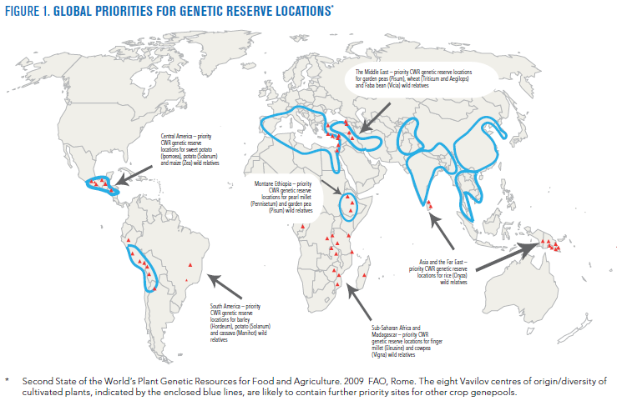
Program 7: Agrobiodiversity
Notes:
The GEF will concentrate it support on the sustainable use of plant genetic resources in Vavilov centers of diversity. Results from this program may also generate important co-benefits for the International Treaty on Plant Genetic Resources for Food and Agriculture.
The GEF will focus on innovations to current production systems and practices that:
■■Maintain and strengthen different production systems and their elements, including agriculture practices based on local and traditional knowledge, that allow continued evolution and adaptation.
■■Link genetic diversity maintenance to improved food security and economic returns for rural communities and farmers (including local market access and market regulations);
■■Develop policies, strategies, legislation, and regulations that shift the balance in agricultural production in favor of diversity rich approaches. These include support for the adoption of appropriate fiscal and market incentives to promote or conserve diversity on-farm and across the production landscape;
■■Strengthen capacity of the agricultural development, extension and research communities and institutions that are needed for in-situ conservation
■■Strengthen the capacities of community and smallholder organizations and farmers (both men and women) to participate in the identification, development, and implementation of solutions.

Slide 24
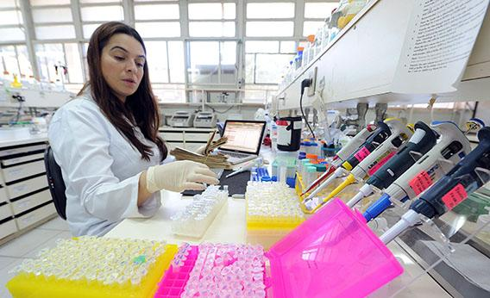
Program 8: ABS
Notes:
The GEF will support national and regional implementation of the Nagoya Protocol and, if still required, targeted capacity building to facilitate ratification and entry into force of the Protocol. As such, the GEF will support the following core activities to
comply with the provisions of the Nagoya Protocol:
■■ Stocktaking and assessment. The GEF will support gap analysis of ABS provisions in existing policies, laws and regulations, stakeholder identification, user rights and intellectual property rights, and assess institutional capacity including research organizations.
■■Development and implementation of a strategy and action plan for the implementation of ABS measures. (e.g. policy, legal, and regulatory frameworks governing ABS, National Focal Point, Competent National Authority, Institutional
agreements, administrative procedures for Prior Informed Consent (PIC) and Mutually Agreed Terms (MAT), monitoring of use of genetic resources, compliance with legislation and cooperation on trans-boundary issues); and
■■Building capacity among stakeholders (including indigenous and local communities, especially women) to negotiate between providers and users of genetic resources. Countries may consider institutional capacity-building to carry out research and development to add value to their own genetic resources and traditional knowledge associated with genetic resources. The GEF will also support the participation in the ABS Clearing- House mechanism as soon as the Clearinghouse
is operational, including in its piloting.

Slide 25
Biodiversity Strategy: Objectives and Programs
Focal Area Objective | Focal Area Programs
Objective Four: Mainstream biodiversity conservation and sustainable use into production landscapes and seascapes and sectors | Program 9: Managing the Human-Biodiversity Interface
 | Program 10: Integration of Biodiversity and Ecosystem Services into Development & Finance Planning
Notes:
Impacts:
Flow of ecosystem services increased or maintained
Sustained crop, livestock, and forest production
Sustainable livelihoods (development benefit)
Sustainable Land Management (SLM) in production landscapes
Food Security – improving and increasing food crop production in vulnerable regions
Climate-Smart Agriculture – enhancing resilience and climate change mitigation in crop and livestock systems
Forest Landscape Management and Restoration – increasing forest and tree cover

Slide 26
Program 9: Human-Biodiversity Interface
Notes:
The GEF has for the past decade worked to embed biodiversity conservation and sustainability objectives in the management of wider production landscapes and seascapes. This process, referred to as “biodiversity mainstreaming”, has focused primarily on the following suite of activities:
a) developing policy and regulatory frameworks that remove perverse subsidies and provide incentives for biodiversity-friendly land and resource use that remains productive but that does not degrade biodiversity;
b) spatial and land-use planning to ensure that land and resource use is appropriately situated to maximize production without undermining or degrading biodiversity;
c) improving and changing production practices to be more biodiversity friendly with a focus on sectors that have significant biodiversity impacts (agriculture, forestry, fisheries, tourism, extractives); and d) piloting an array of financial mechanisms (certification, payment for environmental services, access and benefit sharing agreements, etc.) to help incentivize actors to change current practices that may be degrading biodiversity.
The GEF will continue to support these activities during GEF-6 but with a renewed emphasis on ensuring that interventions are spatially targeted and thematically relevant to conserving or sustainably using globally significant biodiversity. Sustaining biodiversity in the production landscape and seascape which will simultaneously secure the ecological integrity and sustainability of protected area systems.

Slide 27
Program 10: Integration of BD and ES into Development and Finance Planning
Notes:
This program will complement the work undertaken in Program Nine and will pilot national level interventions that link biodiversity valuation and economic analysis with development policy and finance planning.
The outcome from these projects will be biodiversity valuation that informs policy instruments and fiscal reforms designed to mitigate perverse incentives leading to biodiversity loss. These may be linked to larger policy reforms being undertaken as part of the development policy dialogue, development policy operations, or other efforts. It will also include specific support to reform finance flows, for instance through public expenditure reviews, and to operationalize innovative finance mechanisms such as payments for ecosystem services, habitat banking, aggregate offsets, and tradable development rights and quotas.
BIOFIN, WAVES AS EXAMPLES

Slide 28
Sustainable Forest Management GEF-6 Strategy
SFM Objective 1: To maintain forest resources
Integrated land use planning; Identification and monitoring of HCVF;
Identifying and monitoring forest loss
SFM Objective 2: To enhance forest management
Capacity development for SFM within local communities; Supporting sustainable finance mechanisms for SFM
SFM Objective 3: To restore forest ecosystems
Building of technical and institutional capacities to identify degraded forest landscapes and monitor forest restoration; integrating plantation management in landscape restoration
SFM Objective 4: To increase regional and global cooperation
Private sector engagement
Global technologies for national progress
Target 7
Target 14
Target 15
Notes:
Overall trying to use a simple model of response to the 3 forest conditions
what’s pristine should as far as possible remain that way, but clearly focusing on HCVF as the critical pieces to support
what is already being managed or mismanaged we should support improvement of management to secure the resource and maintain services
what’s already damaged should where possible be stabilized and services rehabilitated
The fourth Objective responds to GEF-5’s inability to get the portfolio, as a individual pieces of a jig-saw puzzle, to address some of the big topics facing the forest community today e.g. MRV for REDD, how to openly balance multiple benefits, large scale community managed forests. We have had few regional and global projects due to the SFM/REDD+ incentive being seen as an extension of STAR resources so no-one is willing to support the cross-boundary elements.
INCENTIVE: 2:1 (STAR-SFM). Minimum STAR = $ 2M. Maximum SFM = $10M

Slide 29
International Waters Strategy: Objectives and Programs
Goal: To promote collective management of transboundary water systems and implementation of the full range of policy, legal and institutional reforms and investments contributing to sustainable use and maintenance of ecosystem services
Objective 1: Catalyze Sustainable Management of Transboundary Waters
Objective 2: Balance Competing Water-uses in the Management of Transboundary Surface and Groundwater
Objective 3: Rebuild Marine Fisheries, Restore and Protect Coastal Habitats, and Reduce Pollution of Coasts and LMEs
1. Foster Cooperation for Sustainable use of Trans- boundary Water Systems & Economic Growth
3. Advance Conjunctive Management of Surface & Groundwater systems
5. Reduce Ocean Hypoxia
Target 14
6. Prevent the Loss and Degradation of Coastal Habitat
2 .Increase Resilience & Flow of Ecosystems Services in Context of Melting High Altitude Glaciers
4. Water/Food/Energy/
Ecosystem Security Nexus
Target 6
7. Foster Sustainable Fisheries
Notes:
GEF 6 IW Strategy

Slide 30
Land Degradation Strategy: Objectives and Programs
LD-1: Agriculture and Rangeland Systems
Agro-ecological Intensification
SLM for Climate-Smart Agriculture
LD-2: Forest Landscapes
Landscape Management and Restoration
LD-3: Integrated Landscapes
LD-4: Institutional and Policy Frameworks
Scaling up SLM
Mainstreaming SLM in Development
Target 7 & 8
Target 14
Target 15
Notes:
Agro-ecological Intensification – efficient use of natural capital (land, soil, water, and vegetation) in crop and livestock production systems
SLM in Climate-Smart Agriculture – innovative practices for increasing vegetative cover and soil organic carbon
Landscape Management and Restoration – community and livelihood-based options for increasing forest and tree cover
Scaling-up SLM – moving appropriate interventions to scale for crop and rangeland productivity
Mainstreaming SLM in Development – influencing institutions, policies, and governance frameworks for SLM

Slide 31
GEF-6 CCM Strategy
Goal: To support developing countries to make transformational shifts towards low emission, resilient development path
Objective 1: Promote innovation & technology transfer
Objective 2: Demonstrate systemic impacts of mitigation options
Objective 3: Foster enabling conditions to mainstream mitigation concerns into SD strategies
1. Low carbon technologies and mitigation options
3. Integrated low-carbon, urban systems
5. Convention obligations for planning and mitigation contributions
2 . Innovative policy packages and market initiatives
4. Forests and other land use, and climate smart agriculture
Notes:
Notice Program 4.
Emerging innovative solutions, including technologies, mgt practices, supportive policies and strategies and financial tools. Examples include advanced E tec, reduction of short-lived climate forces (SLCFs) and promotion of de-risking tools.
Most recent guidance in COP 19 in Warsaw, Poland in 2013 (p51)
Especially funding for SIDS and LDCs
Prep for intended nationally determined contributions and continued support for the BURs (biennial update reports to UNFCCC)
Consult with the Climate Technology Centre and Network
3 objectives
Tech transfer, policies & strategies
Mitigation options w systemic impacts
Enabling conditions to mainstream mitigation into sus dev strategies

Slide 32
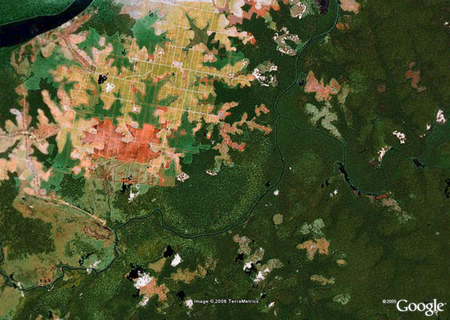
Integrated Approach
Taking Deforestation Out of the Supply Chain: Beef, soy, palm oil, pulp and paper
Target 2,3,4
Target 5,7
Target 14,15
Agricultural inputs
Financial institutions, producers, buyers, and consumers
Agricultural production
Refining, processing & trading
Consumer goods manufacturing
Distribution and retail
Notes:
It makes a huge amount of sense trying to reduce the destructive footprint of this small number of very impactful commodities by working with all the players in the value chain.
This proposed signature program intends to take deforestation out of the supply chains of a few critical commodities by supporting action with the different sets of actors committed to this overall goal, including producers, traders, processors, brands and retailers, and eventually to the consumers. This program will achieve results on the ground by sending clear market signals to reward primary producers who improve their performance and eliminate deforestation.

Slide 33
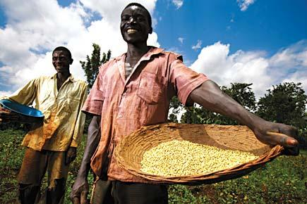
Integrated Approach:
Sustainability and Resilience for Food Security in Sub-Saharan Africa
Target 7 & 8
Target 14
Target 15
Notes:
Target 7, 15,8

Slide 34
Strategic Plan Implementation and Aichi Target Achievement Will Benefit from Multiple Funding Streams in GEF-6
Integrated Approaches: Commodities, Food Security
CC Strategy
SFM Strategy
BD Strategy
IW Strategy
LD Strategy

Slide 35
THANK YOU
Mark Zimsky
GEF Biodiversity Program Coordinator
Senior Biodiversity Specialist

