Slide 1
Facilitating synergies in implementing multilateral environmental agreements towards sustainable development at the National Level
GEF Expanded Constituency Workshop
for Asia
5 April 2017

Slide 2
Session objectives?
To understand milestone global agreements and recent MEA guidance to the GEF;
To enhance synergies among MEAs and promote GEF program integration;
To discuss needs, barriers, and country priorities to integrated programming.
Notes:
THIS SLIDE PRESENTS AGAIN THE SESSION STRUCTURE – SKIP AS NEEDED
After this slide, the participating MEA secretariat representatives (whoever made it to this specific ECW), will have an opportunity to present on key agreements and their guidance to the GEF.
Then, GEF will present on the remaining Conventions who are not able to participate today, and their guidance, before providing an overview of the available tools and modalities under the GEF to support synergy elements.
Finally, and most importantly, we will have a discussion that will include elements of the entire morning’s session, including on GEF-7, transformational programming, and synergies between Conventions. This discussion is meant to give you an opportunity to really start thinking about what could be done with GEF-7 resources – including by learning from lessons from GEF-6 and discussing impactful programming.

Slide 3
Time for Conventions…
Notes:
DEFER TO CONVENTION REPRESENTATIVES TO DO THEIR PRESENTATION(S)
AFTER MEA PRESENTATIONS, START OVER WITH NEXT SLIDE (SLIDE 7)

Slide 4
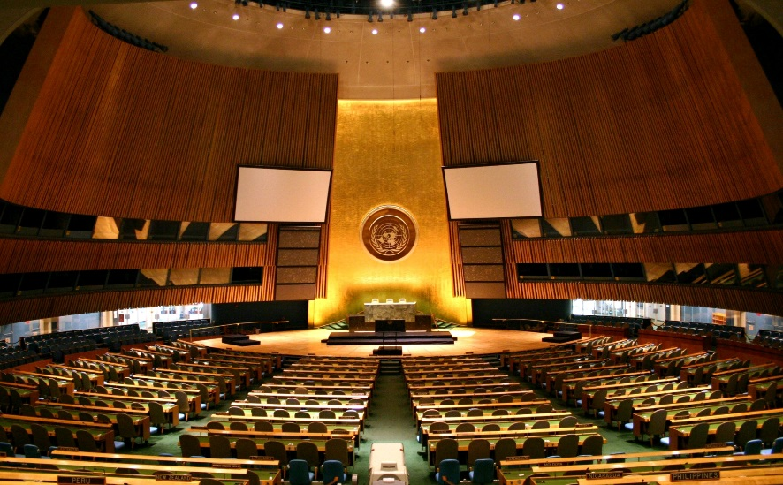
Key agreements and GEF guidance
UN General Assembly:
Noted the need for enhanced cooperation among the Rio Conventions (2009);
Adopted The Future We Want (Rio+20), encouraging coordination and cooperation between MEAs.
Notes:
Thanks to Sakhile from CBD for the slide.

Slide 5
Key agreements and GEF guidance
Convention on Biological Diversity:
“Encourages Parties to promote synergies between biodiversity and climate-change policies and measures” (decision XI/21);
“Requests the Global Environment Facility […] to support projects and activities to improve synergies among relevant multilateral environment agreements” (decision XI/6);
Notes:
CBD guidance and decision related to synergy elements.

Slide 6
Key agreements and GEF guidance
Convention on Biological Diversity:
GEF to provide financial resources for:
“Capacity-building with the aim of increasing the effectiveness in addressing environmental issues through their commitments under the CBD, UNFCCC, and the UNCCD, inter alia, by applying the ecosystem approach”
“Developing synergy-oriented programmes to conserve and sustainably manage all ecosystems, such as forests, wetlands and marine environments, that also contribute to poverty eradication” (decision X/24)
Notes:
…Continued

Slide 7
Key agreements and GEF guidance
UN Framework Convention on Climate Change:
“Encourages the Global Environment Facility […] to align […] programming with […] nationally determined contributions, where they exist, during the seventh replenishment, and to continue to promote synergies across its focal areas.”
“Requests the Global Environment Facility […] to take into consideration climate risks in all its programmes and operations […].” (decision 11/CP.22)
(I)NDCs frequently mention biodiversity, ecosystem-based approaches, land degradation…
Notes:
UNFCCC guidance related to the GEF and synergistic programming.

Slide 8
Key agreements and GEF guidance
Stockholm Convention and Minamata:
“Stressed that the sound management of chemicals and wastes has a global environmental benefit and is an essential element of sustainable development;
“Encouraged the Facility to continue to enhance synergies in its activities”
“Identification of possible elements of guidance from the Stockholm Convention to the GEF that also address the relevant priorities of the Basel and Rotterdam conventions.” (decision SC-7/21)
Notes:
The chemicals conventions also deal with synergies in their decision language. But: the synergy language mostly relates to synergy WITHIN/BETWEEN the chemicals conventions (Basel, Rotterdam, Stockholm and Minamata Conventions). Not so much with other MEAs beyond chemicals.

Slide 9
Land as a central element
SDG 15, Target 15.3: Land Degradation Neutrality
→ “by 2030, combat desertification, and restore degraded land and soil, including land affected by desertification, drought and floods, and strive to achieve a land-degradation neutral world.”
Land agenda embodies the importance of tackling complex, interdependent issues in an integrated manner
How we protect and manage land resources sustainably will have impacts on multiple goals
UNCCD COP 12 (2015):
Addressing LDN will be priority area for GEF support;
LDN guiding principle for implementation of Convention.
Notes:
Target 15.3: By 2030, combat desertification, restore degraded land and soil, including land affected by desertification, drought and floods, and strive to achieve a land degradation-neutral world.
This slide and land degradation really is just one example of an area where GEF support for SDG implementation, hand-in-hand with MEA implementation (in this case UNCCD), becomes clear.
GEF has been requested to support LDN target setting at the national level.

Slide 10
Key agreements and GEF guidance
UN Convention to Combat Desertification:
“Invites the GEF to continue its support for the implementation of the convention […] in light of the 2030 Agenda for Sustainable Development, in particular target 15.3”;
“Invites the GEF to […] consider technical and financial support for voluntary national land degradation neutrality target-setting”
“Invites country Parties to formulate and integrate in their National Adaptation Plan voluntary targets to achieve LDN in accordance with their specific national circumstances and development priorities.” (COP 12)
Notes:
… and this is the associated guidance text adopted by UNCCD COP 12.

Slide 11
Seeking Synergy and Multiple Benefits
Growing interest by countries in cross-cutting projects with multiple benefits
47 out of 74 land degradation projects (FY13-15) are multi-focal;
$227 million from land degradation, $300 million from biodiversity, climate change, SFM, etc.
41 more projects addressing land agenda supported by funds for climate change (LDCF, SCCF, AF)
$297 million from climate-related funds
Synergy among Rio Conventions on the ground
Notes:
Practically speaking, synergy elements are increasingly being envisaged by recipient countries, as can be seen by increasing multi-focal area and multi-trust fund projects related to land degradation.

Slide 12
Seeking Synergy and Multiple Benefits
Example of institutional arrangements at the national/regional level:
Informal and/or formal committees to coordinate between national focal points, different ministries and agencies, and other stakeholders.
National GEF committees as mechanisms for national focal points to foster the coherent implementation of the MEAs and SDGs.
National strategy for the implementation across MEAs and SDGs.
Regional initiatives including learning and peer-to-peer exchange, regional centers of excellence in data monitoring and reporting, implementation of large-scale, cross-cutting impact programs.
Notes:
Some practical examples of institutional arrangements that strengthen synergy at the national/regional level.

Slide 13
Seeking Synergy and Multiple Benefits
Additional entry points for synergies at the national level:
Sustainable Development Goals: Coordinating framework for achieving multiple goals. Integration of MEAs and SDGs in national development.
Implementation of ecosystem-based approaches to climate change adaptation: EbA enable people to adapt to the impacts of climate change by sustainably managing, conserving and restoring ecosystems.
National planning and reporting (e.g. links between UNFCCC NAPs, CBD NBSAPs, and UNCCD NAPs, national reports)
Sustainable land management: links with biodiversity, climate change and land degradation, relevant to all 3 Rio Conventions.
Ecosystem restoration: contributes to biodiversity conservation, climate change adaptation and mitigation and combatting land degradation, relevant to most MEAs.

Slide 14
GEF-6 Programming Structure
Integrated Approach Pilots:
Sustainable Cities
Food Security
Commodity Supply Chain
Other cross-cutting initiatives:
Sustainable fisheries
Illegal wildlife trade
Amazon sustainable landscapes
Commodities
Food Security
Cities
Biodiversity
Land Degradation
Climate Change
Sustainable Forest Management
International Waters
Chemicals & Waste
Biodiversity
Notes:
The GEF evolved over time
In GEF-4 and GEF-5, mostly single-focal area projects
(ANIMATION)
In GEF-6, we had focal areas and – on top of the focal areas – a few Integrated Approach Pillots and some other cross-cutting initiatives
(ANIMATION)
Going forward, we believe it is important to continue and strengthen these IAPs and perhaps expand them further

Slide 15
Assessing national priorities as expressed in INDCs, NBSAPs and COP guidance
 | AFR | ASIA | ECA | LAC | SIDS | Total
Restoration and Reforestation | 98% | 100% | 96% | 100% | 97% | 98%
Energy | 98% | 100% | 88% | 90% | 97% | 95%
Food Security | 98% | 100% | 83% | 100% | 91% | 94%
Sustainable Cities | 96% | 94% | 83% | 80% | 94% | 91%
Environmental and Water Security | 94% | 100% | 58% | 95% | 91% | 88%
Resilience | 98% | 100% | 63% | 80% | 91% | 88%
Fisheries | 75% | 82% | 67% | 85% | 85% | 78%
Natural Capital | 73% | 76% | 50% | 85% | 71% | 71%
Healthy Oceans and Coastal Systems | 58% | 71% | 54% | 80% | 76% | 66%
Green Financing | 60% | 65% | 50% | 80% | 56% | 61%
Green Infrastructure | 40% | 53% | 25% | 60% | 29% | 39%
Commodities | 6% | 18% | 0% | 50% | 3% | 12%
Amazon Landscapes | - | - | - | 89% | - | 89%
Notes:
This is just a reiteration of a slide that was presented earlier today in the GEF-7 overview session. It presents an analysis of the country priorities for future programming, which seem to converge around a number of distinct areas – READ LIST

Slide 16
Questions for today’s discussion
What is an example of cross-cutting/integrated GEF financing in your country, past or present, and was it helpful?
10 min discussion in small groups (each table)
…then short reporting back (1 person per table)
Notes:
Each table to report back with not more than 2-3 examples of cross-cutting, multi-focal or multi-benefit, multi-trust fund, or Integrated Approach Pilot projects in their country.

Slide 17
Questions for today’s discussion
What is an example of cross-cutting/integrated GEF financing in your country, past or present, and was it helpful?
What cross-cutting, transformational impact programs could be most helpful in your country/region and could be practically feasible in GEF-7?
10-15 min discussion in small groups (each table)
…then reporting back with short list of priorities for GEF-7 programming
Notes:
Ask 3 tables to step up and volunteer to report back; then ask rest of the tables to add or comment in case they feel that additional programming priorities are needed in GEF-7.
Take notes and summarize briefly a list of Impact Programs that would address all the priorities that were raised during the discussion. They should hopefully match the Impact Program list for GEF-7 replenishment which the GEF Secretariat developed. But if not, equally good to know.
Thank participants for active and rich discussion. They were heard.

