Slide 1
GEF Portal
A New Ability to Support
Knowledge Management
Washington, DC
November 30, 2017

Slide 2
Background
Commitment to Council – “state of the art”
Upgrade to existing PMIS
By next July (GEF-7)!

Slide 3
General Features
Automated system for project processing
Direct entry into “fields” of Project Proposals (Concepts), Requests for CEO Endorsements/Approval and Implementation Reports
Real-time dashboard and reports; inter-connected to website; horizontal access to information in the system
Modern search function and updated taxonomy-tags to find and organize relevant data and information

Slide 4
Putting Knowledge into the System . . .
Integrating KM into projects at an early stage (building on current practice)
KM plan entered as part of project proposal (PIF, etc.)
KM plan elaborated at CEO Endorsement/Approval stage
Improved opportunity to record lessons & best practices during project implementation
Knowledge, lessons and best practices entered in PIRs (voluntary basis), building on initial KM Plan
Categories will be created by key KM categories to organize and facilitate entry.

Slide 5
How it will look . . .
See Entry Fields

Slide 6
Sharing the Knowledge – Opportunities
Enhanced ability to share this information in real-time
E.g., Agencies and GEF program managers can access this information in real-time to inform their analysis and thinking on project proposals
Enhanced ability to have this knowledge available to inform broader policy dialogues

Slide 7
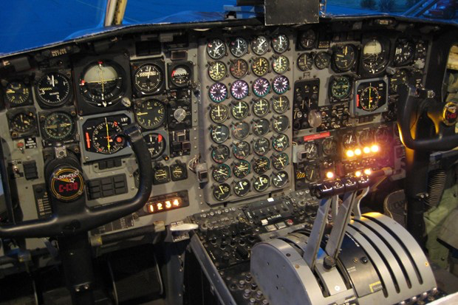
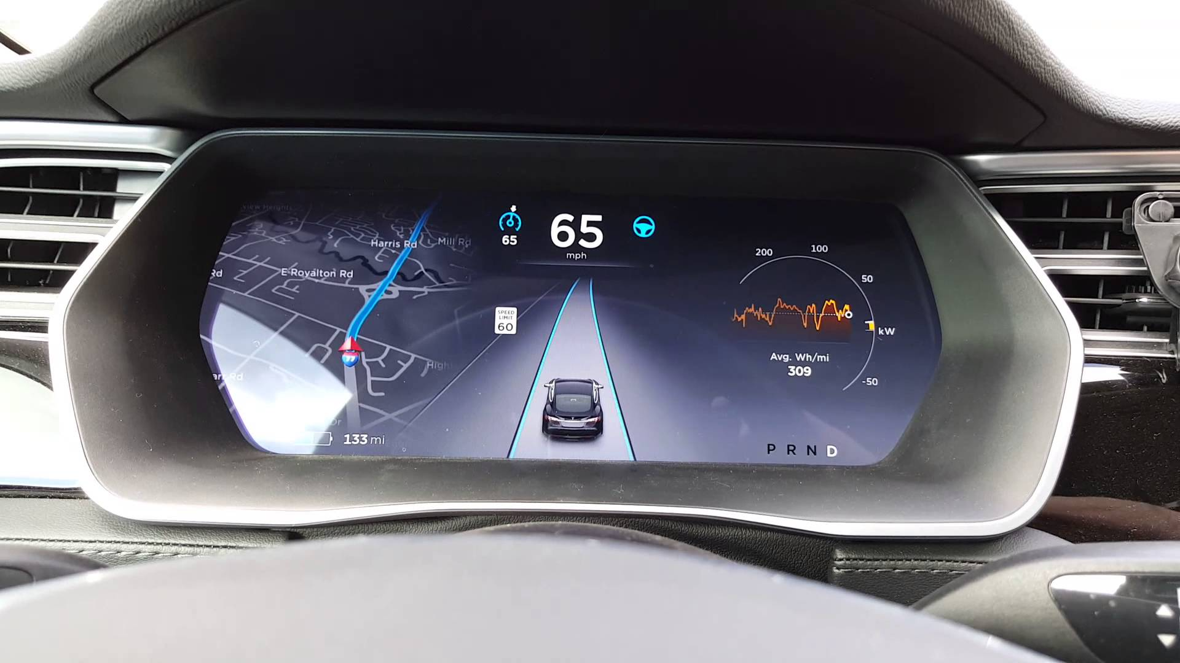
Moving ahead
Defining the categories – what knowledge do we want to record and share . . . ?
Thoughts and ideas appreciated

