Slide 1
GEF Conflict Resolution Function
GEF Introduction Seminar
Washington, D.C.
January 23, 2019
Notes:
Hello and good morning to all!
I would like to express my big thanks and appreciation to all of the sponsors for the kind invitation to join this exciting and important event, and especially to the government of Jamaica for their wonderful and gracious hospitality.
It’s wonderful to be here and together with all of you, to see if we can hatch some new ideas and generate greater momentum toward an effective and supportive environmental rule of law in the Americas - - a rule of law which advances and supports our efforts to protect and nourish the amazing, beautiful and astonishingly diverse nature and people of this hemisphere

Slide 2
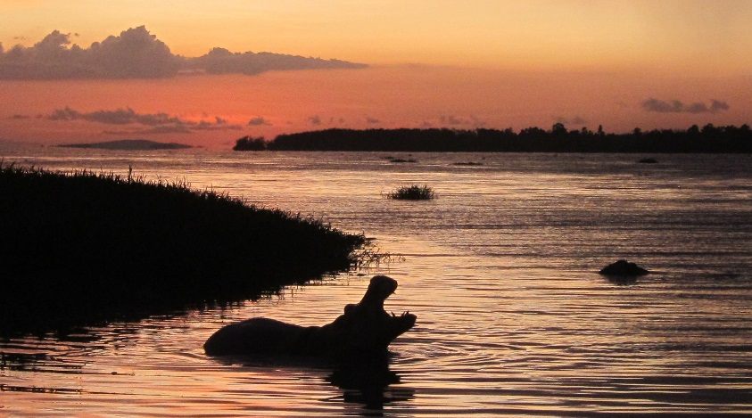
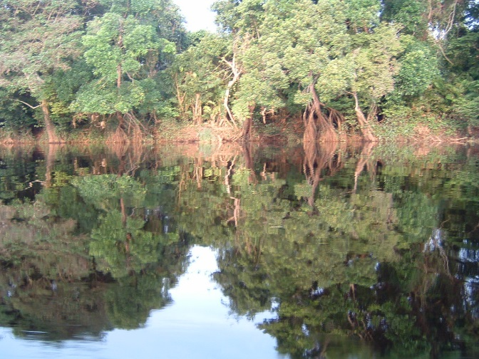
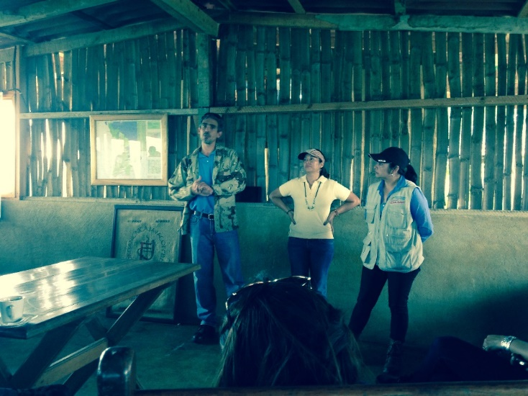
GEF - - working for the global environment . . .
Includes addressing conflicts and responding to concerns of affected people

Slide 3
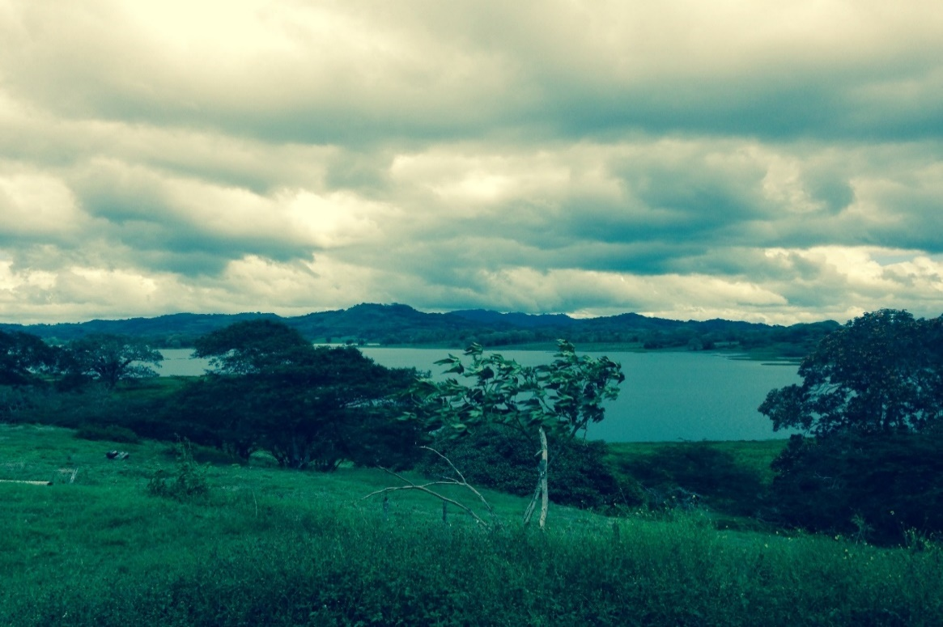
Projects to protect the global environment - - but it’s complicated out there and things can go wrong
A project in the highlands of Nicaragua
Notes:
A GEF supported Integrated Watershed Management project in the mountain highlands of Nicaragua is another illustration of the importance of a good enabling environment. The project seeks to restore and protect a beautiful and economically important watershed, including a Ramsar site, after years of serious impacts, mis-uses and water diversions.
The project has several components: (1) working with ministries and stakeholders on watershed protection and restoration planning; (2) supporting agro-forestry and silvo-pastoral practices consistent with ecological and livelihood goals, including shade grown coffee and SFM certification; and (3) not least, third, establishing a mechanism for payment of environmental services (PES), for example for use of the lake and river waters that previously were diverted to farmers at little cost. In other words, putting value on natural capital.
The project manager mentioned that this last part, in particular, is hard - - it requires lots of dialogue and really a change in culture . . . but the better understanding of the full and alternative values of the ecosystems, and the commitment of the participants, is giving it a much stronger chance (see also GEF publication on PES schemes)
An important “lesson” here is that work upstream should take on board “best practices”, such as PES schemes, but that these are also evolving and - - critically - - vary according to country, place and situation! And the knowledge about this is with the people there.
In another illustration, a GEF project many years ago (the GEF National Biodiversity Project in Brazil) helped to establish what eventually became the Secretariat of Biodiversity and Forests within Brazil’s Ministry of Environment, which has been instrumental in developing Brazil’s legal framework for biodiversity and in formulating the National Biodiversity Strategy . . . In sum, work upstream can lead to many things . . .

Slide 4
GEF Framework – Responding to Problems
Two parts: Agency mechanisms; GEF CRC
Available to receive and respond to complaints
More than just managing risk
Making the system better, more responsive
Resolving problems
Giving people a voice, enlisting their expertise
Meeting other GEF policies: gender, IPs, SE

Slide 5
Important features – and challenges
Accessibility - - any language, simple and fair process
Independence and integrity
Facilitation + independent check on policy compliance – resolving disputes, accountability, learning . . .

Slide 6
Examples of concerns raised
Conflict Resolution Commissioner - claims
Lack of public engagement (Guyana, Brazil)
Concerns about project design & goals (Carib. beekeepers)
CSO network issues - - and limits of role
Agency mechanisms - claims
Procurement issues
Community rights and protected areas
Retaliation

Slide 7
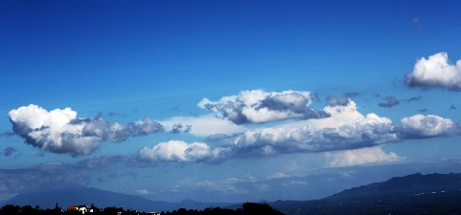
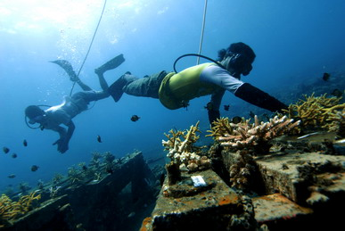
Concluding thoughts . . .
Requirement to have a good system in place to respond to grievances and help resolve problems; report to Council!
Being responsive - - things can go wrong
Participation of and benefits to local communities
Importance of building awareness . . .www.thegef.org, Conflict Resolution
Notes:
A key theme of this presentation is that international efforts need to consider and address both upstream and downstream issues, including issues of governance (norms, institutions, implementation, accountability). This is all fair enough, of course - - the importance of a holistic and integrated approach.
But what it means is not always obvious. The next time I present these ideas we might reverse the presentation, so that the “IPN part” comes upstream and the “GEF part” comes downstream. This is because the two “parts” of the stream are inter-connected, so that action on one end (or in the middle) reinforces the other (both normatively and ecologically). Eduardo would want me to say, for example, that IPN findings provide important lessons for upstream work in the future (if heeded!). Similarly, the work of the GEF can just as well be viewed as “downstream” implementation of MEAS!
BUT here there is also another dimension, where the feedback loop may not be so positive. In the “real world” there can also be an inverse relationship between the stringency of norms and the strength of accountability. For, example, the development of stronger downstream accountability/enforcement can lead to pressure to weaken the upstream norms and enabling environment, and vice versa. There is literature on this, but I offer this thought because: (a) I’ve seen and heard it in action, from influential legal offices in the course of working on these issues; and (b) because Rio 1992 to Rio 2012 may be an example of a mirror image between strong policies/weak accountability (1992) and pressure now on policies as accountability has gained ground . . . We need to keep a watch on this!
A second core theme running through my remarks is that meaningful public and community participation is core to GEF, IPN and this broader work. Firstly, the interests of people and the environment are closely intertwined, as the Brundtland Report vivified and we see every day. Secondly, local people have expertise, knowledge, and rights that need to be recognized and integrated into international decisions that affect them. This is the idea in this presentation about “trails, streams and rivers”, the need to be out there in a supportive way together to do this work, up the river, on the roads, along the trails, where the people live. The contact between different places and worlds is amazing, there’s so much potential to learn and help each other
And finally, I would like to say one or two words about the contributions of law and lawyers. The good news, I think, is that law and lawyers have a big potential contribution to make in this work. As we’ve been discussing, LAW is a key part of an enabling environment - a way to advance values, key strategic goals and priorities - and a basis to enforce and implement. And LAWYERS have much to offer, but watchwords here might be humility and openness to working with colleagues. As I’ve seen it, a key role is not just advising on risk or even fighting/advocating to protect rights, but also using knowledge and training to help build and create the enabling environments upstream (whether in treaties, national laws or elsewhere). We also need to work in an inter-disciplinary way - - lawyers may think in a certain way, but to address global and local environmental problems we need other ways too. And lastly, I think of what young Mahatma Gandhi said when practicing law in South Africa: I’ve discovered the true role of lawyers, to join two parties torn asunder. In a field of work where political will and negotiating tensions are so high, let us see if we can help on this too!

Slide 8
Thank you
Notes:
Now let’s turn to the second part of this presentation, through the lens of the work of the Inspection Panel (IPN).
Originally my colleague and former Executive Secretary of the Inspection Panel Eduardo Abbott was going to join us to make the second half of this presentation, but he could not make it So I shall try to fill in his (big) shoes as I did once before when I succeeded him as Panel ES ! A bit of déjà vu . . .!

