Slide 1
GEF 2020 – Strategy and GEF 6 strategic priorities
GEF Expanded Constituency Workshop
Managua, Nicaragua
March 3-4, 2015

Slide 2
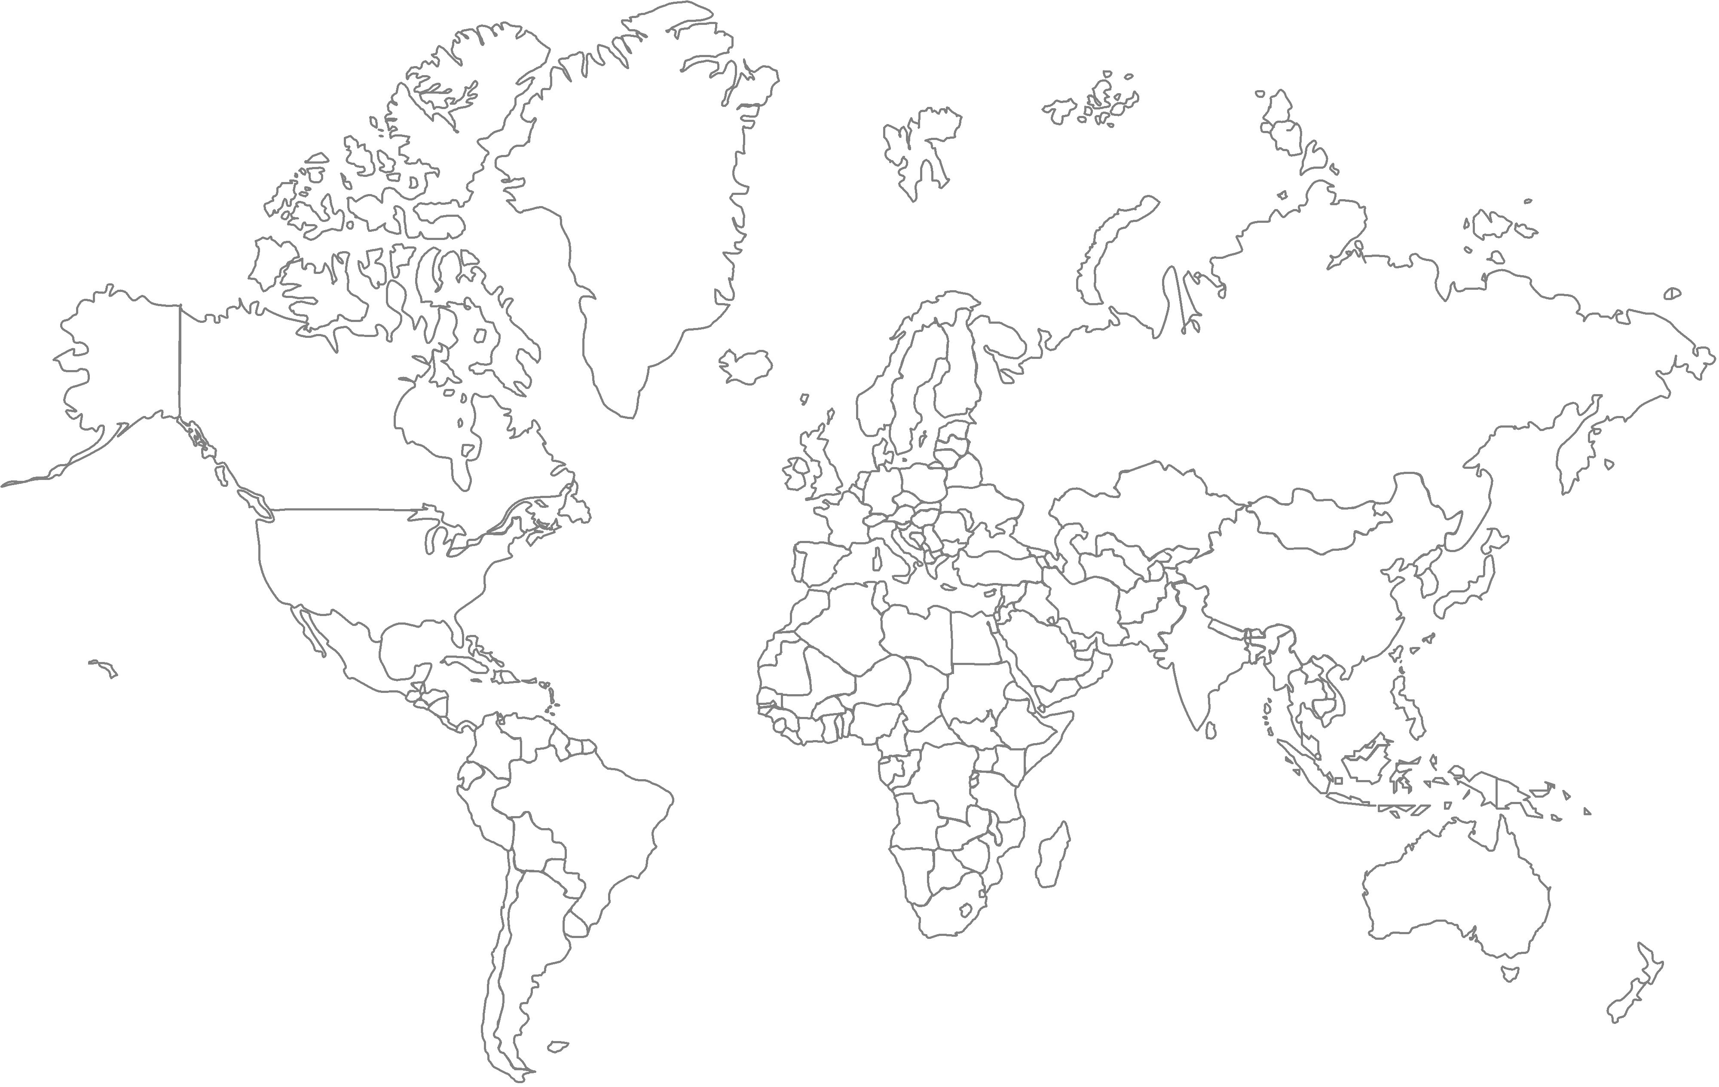
Key Earth systems are near or beyond “tipping points”
Climate change
Chemical pollution
Ocean acidification
Atmospheric
aerosol loading
Stratospheric
ozone depletion
Biodiversity loss
Nitrogen
cycle
(biogeochemical
flow boundary)
Phosphorus
cycle
Change in land use
Glob
freshwater use
Not yet quantified
Planetary boundaries have been crossed or nearly crossed
al
Proposed safe operating space for humanity in planetary systems
Source: Rockstrom et al, “A Safe Operating Space for Humanity,” Nature (2009)
Notes:
I want to emphasize three points here. First, some of key earth ecosystems are near or beyond tipping points.
Second, the GEF is operating in almost all of identified ecosystems and have mandate from MEAs.
Third, the GEF is in a prime position to tackle those tipping points most effectively by adopting an integrated approach.
WE ARE THE ONLY INSTITUTION TO BE ABLE TO ADDRESS THESE CHALLENGES IN AN INTEGRATED AND HOLISTIC APPROACH

Slide 3
GEF2020 Strategy
A new strategy aimed at making the GEF an even more centralized actor in the international environmental arena and at achieving impacts at the scale
Outline of GEF2020 Strategy
Focus on drivers of environmental degradation
Deliver integrated solutions, given that many global challenges are interlinked
Enhance resilience and adaptation
Ensure complementarity and synergies in climate finance
Choose the right “influencing model”

Slide 4

1. Address Drivers of Environmental Degradation
Underlying
socioeconomic trends
Indirect environmental drivers
Direct
environmental drivers
Environmental pressures
Changes in state of environment
Demand for food production
Agriculture production processes that produce food
Pollution e.g., GHG’s & ozone-depleting substances
Atmosphere (climate)
Population growth
Demand for buildings
Biodiversity
Provision/use of transportation
Change in habitat and species loss
Rising middle class
Demand for energy
Construction & use of buildings & other infrastructure
Land
Introduction of invasive species
Demand for
transportation
Oceans
Production of electricity
Over exploitation and harvesting
Urbanization
Other
Other
Other
Freshwater
Driver interventions
Pressure interventions
Changes in human welfare
Notes:
**This slide is animated**
Animation 1
How we can most effectively address degradation of global environment? Let us start with our immediate concerns; degradation of global environment.
Animation 2
In order to explore the most impactive way to address degradation, let us look at the trends behind these tipping points.
There are three mega-trends; Population growth, rising middle class, and urbanization. This will have incredible implications on global consumption and production patterns, which will go on the collision course with nature if BAU continues.
At the end of this causal chain, we know that these underlying trends result in degradation of the global environment. The question is– what happens in between?
Animation 3
First you have the drivers of environmental degradation– deriving from 3 mega-trends. How to meet doubling demand for food, transport and energy? Specifically, agriculture, buildings, power, transportation and other sectors like oil & gas contribute to unsustainable production and consumption.
Animation 4
These drivers result in direct pressures on the environment. These we are all familiar with: the GHG emissions that lead to climate change; the deforestation that leads to biodiversity loss, etc.
So as you look at the whole chain, you can see how this story plays out.
For example, the rise of an urban, middle class is leading to higher demand for and production of beef and palm oil. This has led to loss of natural forests and draining of peat lands, more usage of chemical fertilizer and water, which affects several aspects of the global environment.
Animation 5
This science helps us narrow our focus on what is most important. I believe the GEF needs to focus on tackling drivers, not just the direct environmental pressures of degradation. There are 3 reasons.
First of all, drivers will have more systemic impact than addressing direct environmental pressures will. “An ounce of prevention is worth a pound of cure.” The same can be said for addressing global environmental issues.
Secondly, drivers deliver multiple global environmental benefits at scale. Food production, for example, contributes to significant greenhouse gas emissions, uses large amounts of freshwater, is a major contributor to water pollution, and introduces many toxic chemicals into the environment through use of pesticides and herbicides.
Finally, drivers better position the GEF to articulate how global environmental goals contribute to broader socio-economic development goals. This approach is supportive of the global community’s efforts to eradicate poverty and transform economies through sustainable development as part of the Post-2015 Development Agenda.
SO YOU CAN SEE HOW IMPORTANT IT IS FOR US TO FOCUS ON THE DRIVERS IF WE HOPE TO HAVE THE IMPACT WE NEED

Slide 5

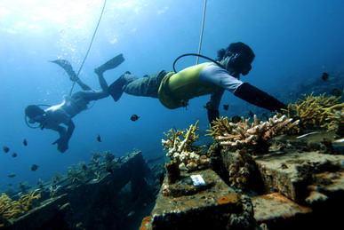
2. Deliver Integrated Solutions
Ex: Integrated approach programs (IAPs) in GEF-6:
  Sustainable Cities
  Deforestation out of Commodity Supply
  Fostering Sustainability and Resilience for Food Security in Sub-Saharan Africa
An increasing portfolio of multi-focal area projects and programs

Slide 6


3. Enhance Resilience
GEF Adaptation Program:
  LDCF, SCCF
  124 countries worth
  US$1.2 billion
  National adaptation plans (NAPs)
  Ecosystem based adaptation

Slide 7

4. Ensure Complementarity in Climate Finance
Increasingly complex climate finance architecture
GEF “niche”:
  Transforming policy and regulatory environments; build institutional capacity
  Demonstrate new technology and business models
  De-risk partner investments
  Build multi-stakeholder alliances

Slide 8
Choosing the Right Influencing Model
Transforming policy and regulatory environments
Strengthening institutional capacity and decision-making processes
Convening multi-stakeholder alliances.
Demonstrating innovative approaches.
Deploying innovative financial instruments

Slide 9
Three Key Operational Priorities
Work closely with local and global stakeholders (national and local governments, private sector, civil society)
Improve GEF operational efficiencies
Strengthen Results Management
Underpinned by Focal Area Strategies

Slide 10
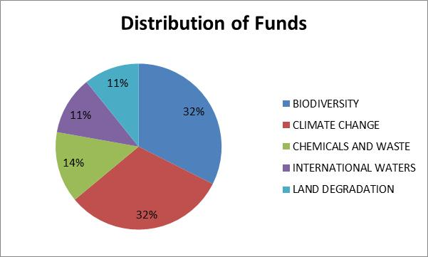
Implementing GEF-6
GEF-6 operational July 1, 2014 - June 30, 2018
Donor countries pledged USD 4.43 billion, the record funding level
Main changes from GEF-5:
More for Chemical (Minamata);
Less for Climate (GCF?);
Biodiversity now largest FA
Note: Excludes Corporate Programs and Non-Grant Instrument Pilot. Also, does not include LDCF/SCCF

Slide 11
Implementing GEF-6
Through strategic partnerships
Address global environmental issues where a country plays a pivotal role
Activities that cut across multiple focal areas and sectors, and promote integrated approach in achieving your national development objectives. Identify those areas in your National Plans where GEF can support policy, market or behavioral transformations.
Combine GEF resources with other existing resources from other donors and the government, and thus leveraging the impact in advancing national environmental priorities

Slide 12
Implementing GEF-6 - Use of funds (recipient countries)
=> Trade-off: “Impact” vs ”equity”?

