Slide 1
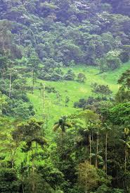
GEF-7 Programming Directions Overview
Kigali, Rwanda, 12 February 2019
Pascal Martinez
Sr. Environmental Specialist

Slide 2
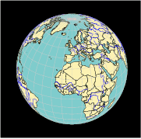
























What is the Global Environment Facility (GEF) ?
1- Financial Mechanism of the Environmental Multilateral Agreements
2- Global Partnership
3- Massive Track record of projects
183 countries
GEF Focal Point
GEF created in 1991
Over $17.9 billion in grants + $93.2 billion in co-financing
More than 4500 projects in 170 countries.
18 Implementing Agencies
+ Private sector, Academic institutions…

Slide 3

GEF-7 at a glance
GEF 7 commenced on July 1, 2018
$4.1 billion total replenishment for the next 4-year period (2018 –2022)
Reiterating GEF’s unique position and mandate with multilateral environmental agreements
Promoting the next step from integration towards transformation based on lessons learned from IAPs
Context: a fast changing global situation -scale and urgency of environmental threats as well as opportunities
Country Driven Process
$$$=Country allocation

Slide 4
GEF-7: a sharper focus on where the GEF can have the biggest impact
…collective efforts to transform key social and economic systems that put the planet at risk,
•food
•urban
•energy
•production and consumption, etc.
•Multiple, global environmental benefits:
•Biodiversity
•Land & Water
•Climate change
•Chemicals & waste
Impact Programs
Carefully targeted, transformative investments contribute towards…
Thereby maximizing the GEF’s positive impact on the global commons

Slide 5
GEF7
Programming
Framework
 | Biodiversity Focal Area | Climate Change Focal Area | Land Degradation Focal Area | International Waters Focal Area | Chemicals and Waste Focal Area
 | Programming Areas to be addressed through Focal Area Investments
 | Biodiversity mainstreaming Wildlife for sustainable development Natural capital Agrobiodiversity Inclusive conservation Invasive species Protected areas Preventing species extinction Biosafety ABS Enabling Activities | CBIT Enabling Activities Technology Transfer NDC preparation and implementation Sustainable energy | Creating Enabling Environments for LDN Enabling Activities LDN Target setting | Strengthening Blue Economy Opportunities Improve Governance in ABNJs Enhancing Water Security in Freshwater Ecosystems | Industrial Chemicals Agricultural Chemicals LDC/SIDS support Enabling Activities
Impact Programs | Objectives to be addressed through Impact Programs aligned with convention priorities
Food, Land Use, and Restoration Impact Program | Manage biodiversity in production landscapes Harnessing biodiversity for sustainable agriculture | Land-based and value chain GHG mitigation (sequestration and avoidance) | Sustainable land management Diversification of crop and livestock systems Restoration of degraded production landscapes | Integrated land and water management Prevention of nutrient pollution | Replacement of POPS and relevant HHP’s used in the global food supply chain, including agricultural plastics contaminated by these chemicals with alternatives, preferably non-chemical alternatives. Disposal of obsolete agricultural chemicals that are POPs.
Sustainable Cities Impact Program | Integrating biodiversity and ecosystem values in urban planning | Urban-related GHG emissions avoidance | Sustainable management of production systems in urban and per-urban areas | Decreased pollution of rivers, deltas and coastal areas Advance efficient water use and re-use | Reduction of POPS, ODS, and Mercury in built infrastructure, industry and products and materials used in cities.
Sustainable Forest Management Impact Program | Protection of HCV forests Manage biodiversity in forest landscapes | Protection of carbon-rich stocks Forest related GHG emissions avoidance | Sustainable management of dryland landscapes | Integrated land and water management | In forests where ASGM that uses mercury occurs, reduction or elimination of mercury in these areas.
3 Impacts Programs
+ 50 % $ incentive
5 Focal Areas

Slide 6
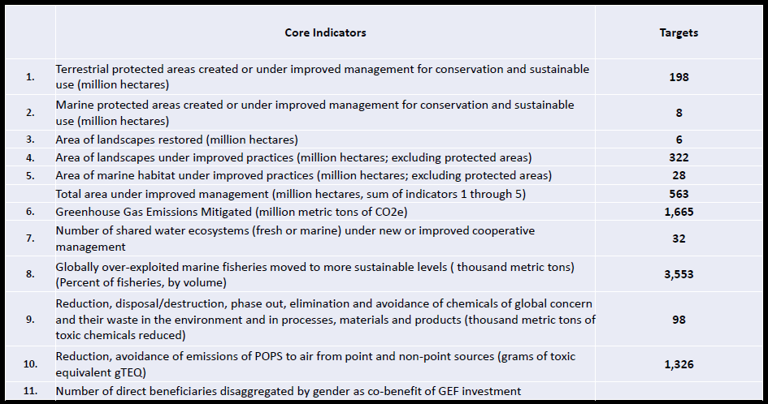
GEF-7 Core indicators and targets

Slide 7
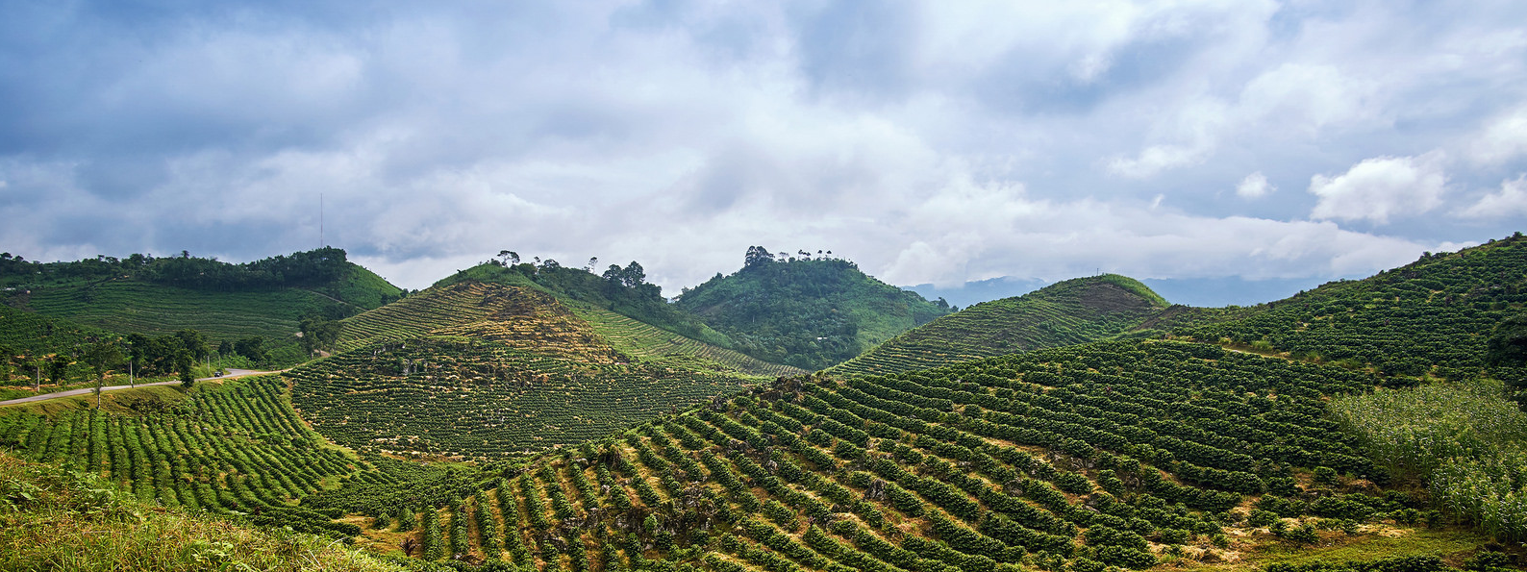
Impact Programs
Food Systems, Land Use and Restoration (FOLUR)
Sustainable Cities
Sustainable Forest Management

Slide 8
Food Systems, Land Use and Restoration Impact Program “FOLUR”
Vision:
Sustainable integrated landscapes and efficient food value/supply chains

Slide 9
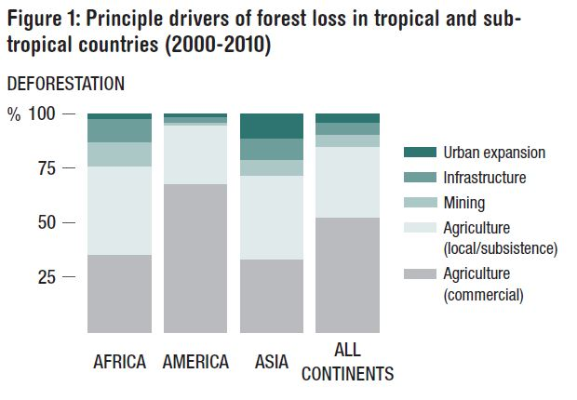
Causes of Deforestation: ~80% Food Systems
Food systems
1/4 of GHG emission
Risk of growing demand?
Forests hosts
80% terrestrial
biodiversity
Source: McFarland et al, 2015, ODI,
Source: McFarland et al, 2015, ODI,
Notes:
Scale is the issue and challenge is the deforestation (80% from agriculture)

Slide 10
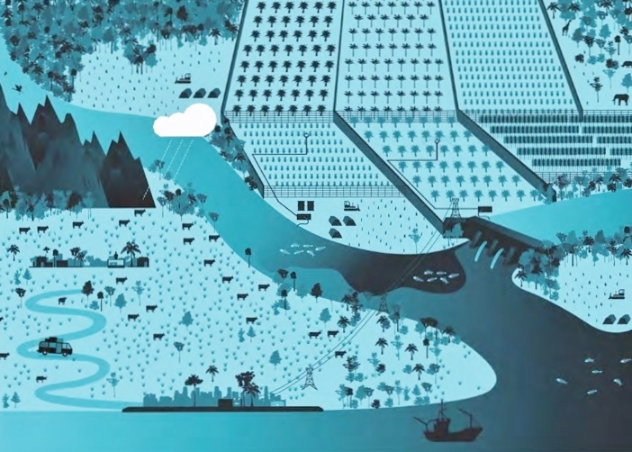
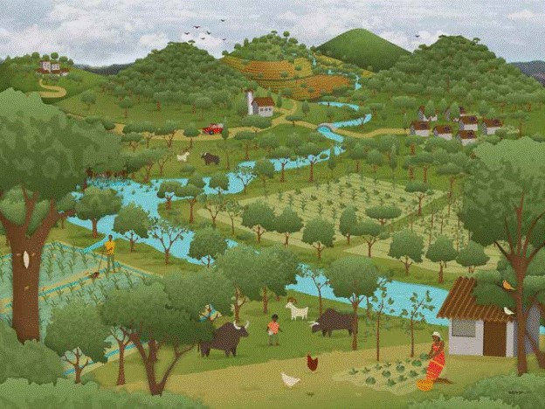
The Vision: Achieve Transformational Shift – “Sustainability”
Source: The Little Sustainable Landscapes Book
Comprehensive
integrated
Sustainable
landscapes
Planning
Source: Landscapes for People, Food and Nature
Notes:
What try to avoid: inconsistent planning leading to environmental degradation to achieve shift toward rational land use planning
Intensive land use (e.g. heavy use of chemicals in agriculture) near the river’s edge leads to polluted and sediment-laden runoff water entering water bodies, harming the humans and animals that rely on these water sources.
Poorly managed or overgrazed rangelands lead to soil erosion, increased greenhouse gas emissions from grasslands, and decreased livestock yields, harming human livelihoods, grassland biodiversity, and the climate.
Deforestation, forest degradation, and poor agricultural practices cause erosion into waterways that lead to costly siltation behind hydroelectric dams. Siltation reduces the service life and efficiency of hydropower facilities, hurting growth and increasing reliance on fossil fuels.
The uncontrolled logging of primary forests for timber or agricultural expansion threatens the livelihoods of people who depend on the forest for their survival. It also causes heavy erosion that can lead to landslides and flooding.
Deforestation contributes to loss of biodiversity by destroying the habitat of a range of species; it accelerates climate change by releasing CO2 stored in trees and healthy soils; and reduces the capacity of the soil to retain water. Forests are invaluable to humanity in that they provide economic goods (such as food, timber and fuel wood), and ecosystem services at local, regional and global scales.
A sustainably integrated landscape simultaneously meets a full range of local needs, including water availability, nutritious and profitable crops for families and local markets, and enhancing human health; while also contributing to national economic development and policy commitments (e.g. NDCs, LDN, Aichi targets for biodiversity conservation, Bonn Challenge); and delivering globally to the maintenance of biodiversity, climate change mitigation and adaptation, and provision of food, fiber, and commercial commodities to international supply chains.

Slide 11
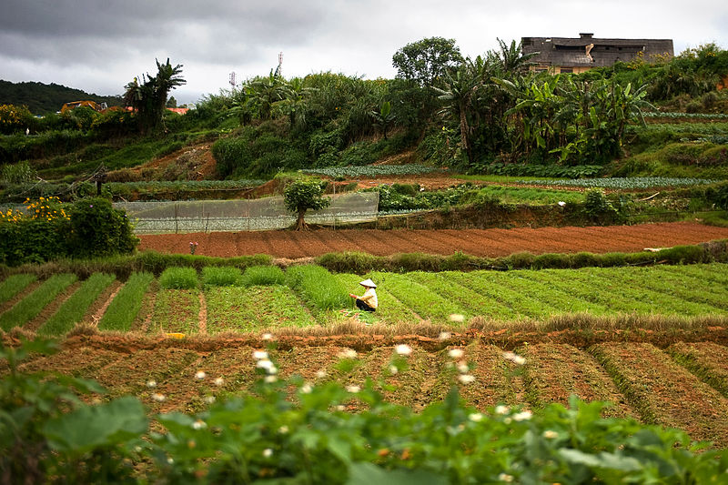
What needs to happen?
Develop efficient and sustainable food value chains
Remove deforestation from commodity supply chains
Expand restoration of degraded lands
Provide Global Environment Benefits
Underpinned by: Comprehensive land use planning that reconciles competing land use, considers trade-offs, and harnesses synergy.
Notes:
Efficient and effective food value chains (Improving natural resources use – land, soil, water, and biodiversity; Removing negative externalities – GHG emissions, nutrient pollution, waste; and Minimizing loss and wastage)
Removing deforestation from commodity supply chains (Improve management of existing production systems; Shift expanding production toward degraded lands; Align commitments made by all actors (government, financing institutions, businesses)
Expand restoration of degraded lands

Slide 12
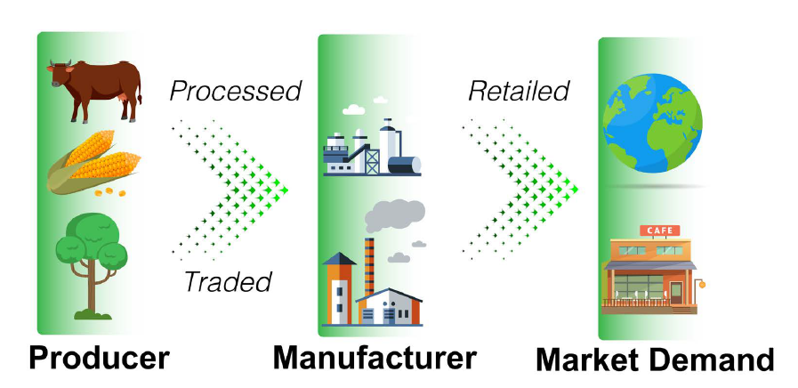
The how: Supply Chain Approach
Notes:
Supply Chain approach: each step in the chain has an influence to what happens in forests -> We aims to act in each step

Slide 13
The target: Sustainable Integrated Landscapes
Spatially explicit geographies where food and ecological systems are integrated, requiring implementation at scale of a suite of related strategies and interventions, and demonstrating the following characteristics:
Evidence of environmental threat from commodity driven deforestation or unsustainable agricultural systems
Potential for applying a comprehensive land use approach linking production, biodiversity conservation, and restoration at scale
Willingness to work across national borders for supply chain needs and other market driven demands.
Focus on Comprehensive Land Use Planning
To balance demands for increased food production with potential for harnessing ecosystem services
Improve targeting of landscapes for delivering integrated solutions at scale
Notes:
Definition of eligible Sustainable Integrated Landscape
“Potential for applying a comprehensive land use approach”: There should be already something in place, we don’t begin from scratch.

Slide 14
The Entry Points for Countries
Globally important tropical forest country and major producer of a global commodity (i.e. oil palm, beef, soy, coffee, and cocoa) + Commitment to taking deforestation out of the supply chain, restore degraded lands, protect high value BD and CS forests
OR
Globally important food crop (e.g. rice, wheat, maize, etc.) or livestock production systems + Commitment to increase the sustainability, efficiency and effectiveness in the food system, restore degraded lands for production and halt encroachment into intact ecosystems
PLUS
The agriculture and/or food sector identified by the country as a major target for delivering global environmental benefits linked to the MEAs that GEF serves (for CCM, BD, SLM and C&W)
The country has established targets for landscape restoration, including commitments under an existing global initiatives (Bonn Challenge, AFR100, 20X20, etc.)
Countries demonstrate alignment or consistency with relevant platforms focused on addressing long-term sustainability of the agricultural commodities and food crops (such as the Tropical Forest Alliance, the Consumer Goods Forum, and the Good Growth Partnership)
Notes:
Globally important tropical forest country and major producer of a global commodity (i.e. oil palm, beef, soy, coffee, and cocoa), with commitment to taking deforestation out of the supply chain (policies / incentives / investments to reduce or eliminate clearance of forests for new plantations, restore degraded lands, protect high value BD and CS forests)
OR
Globally important food crop (e.g. rice, wheat, maize, cassava) or livestock production systems, with commitment to increase the sustainability, efficiency and effectiveness in the food system (policies / incentives / investments to improve use of chemical inputs, reduce use of fossil fuel technologies, promote SL&WM, increase on farm biodiversity, restore degraded lands for production and halt encroachment into intact ecosystems).
PLUS
The agriculture and/or food sector has been identified by the country as a major target for delivering global environmental benefits linked to the MEAs that GEF serves (for CCM, BD, SLM and C&W)
The country has established targets for landscape restoration, including commitments under an existing global initiatives (Bonn Challenge, AFR100, 20X20, etc.)

Slide 15
Ensuring Diversified Country Portfolio
Commodity production landscapes that remain critical for GEBs but where remaining forests are threatened by expansion of commercial production
Globally important food crops or livestock landscapes where production creates high intensity negative externalities
“Frontier” landscapes where opportunity exists to preempt expansion and get ahead of commercial commodity-driven forest loss
Highly degraded landscapes that are in need of restoration for the ecosystem services they provide to agricultural production
Notes:
Limited to GEF priority deforestation-causing commercial commodities: beef, coffee, cocoa, palm oil, and soy.
This includes production of wheat, rice, maize, and other globally significant crops.

Slide 16
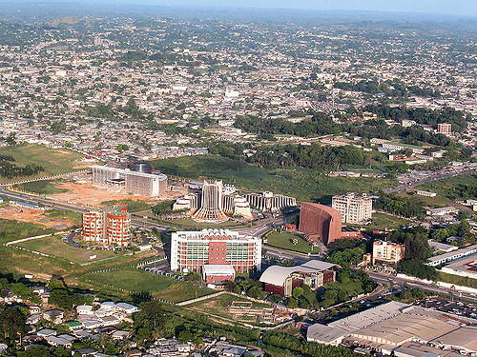
Impact Programs
Food Systems, Land Use and Restoration
Sustainable Cities
Sustainable Forest Management

Slide 17

Sustainable Cities Impact Program
Rapid and unplanned urban growth is one of the key drivers of environmental degradation.
  70% of global GHG emissions
  Direct implication on food systems
  Urban sprawl affecting natural infrastructure and biodiversity
Cities offer effective entry points for major investments in global environmental benefits (GEBs).
They offer natural integrated systems, power of innovation and wide stakeholder base to achieve large scale GEBs.
Notes:
- Cities produce 80% of the world’s GDP. They consume over 75% of global energy supply and generate 70% of GHGs. They are increasingly choked by traffic, air pollution and waste production.
Meeting the production and consumption needs of urban populations strains rural and urban ecosystems both locally and globally.
Unplanned physical expansion of urban areas can directly compromise the provision of vital ecosystem services, provided by forests and biodiversity.
If managed well, compact, resilient, inclusive and resource-efficient cities could become drivers of green economy.
Cities have inherent advantages- they provide massive sustainable investment opportunities, are naturally integrated and hotbed of innovation. They also offer strong public private partnership opportunities.
Together, these could result in improving livability and achieving large scale GEBs in terms of protecting global commons, avoid GHGs and protect our biodiversity.

Slide 18

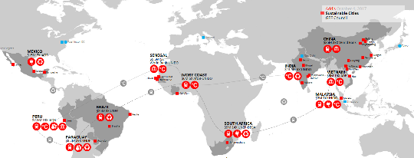











GEF-7 Approach- Sustainable Cities
Adopt an integrated approach for sustainable urban development across sectors and governance levels.
Dual support provided by GEF
  Specific grant support to selected cities for integrated urban development
  Global support on decision tools, knowledge, policy, finance, etc.
GEF 6- City-level Projects (27 cities, 11 countries)
Notes:
- The GEF’s Sustainable Cities Impact Program aims to bring about opportunities for greater integration, efficiency, synergy and increased returns of investment in cities.
It will support an integrated approach for sustainable urban development across sectors and levels of governance – from national to local municipalities.
Building of GEF 6 experience, we will continue to engage with wide set of partners to provide two-fold support.
It will directly support city-level investments to pursue spatially integrated solutions for interdependent urban systems that generate multiple global environmental benefits,
Provide global support through the Global Platform on Sustainable Cities (GPSC) to cities on sustainability decision tools, knowledge, policies and financing.

Slide 19
Expectations from SC IP projects
Program aspects | Country Level | City level
Transformational Impact | Potential to deliver global environmental benefits for the country | Adoption of an integrated planning approach for systemic change. Linkage with the Global Platform on Sustainable Cities (GPSC)
Leveraging resources | - Commitment to leverage financial resources to support the city | Commitment to finance specific sustainability solutions Mechanisms to crowd-in more finance through private sector
Political Will | A clear political will towards sustainable urban growth. Political will to support cities through enabling policy environment. | City level political commitment towards sustainability Proactive engagement with global networks
Notes:
In GEF 7, projects will be selected to achieve the objectives of
Transformational systemic change towards sustainability,
Mobilize and catalyze large scale city level investments for a sustainable future and
Greater policy engagement across different levels especially local.

Slide 20
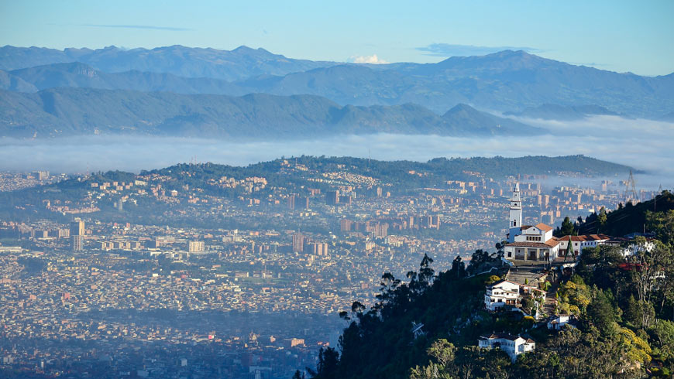
GEF-7 Categories of Investments
Evidence-based Spatial Planning—Cities and surrounding landscapes
Infrastructure Integration at National, Regional, and Local Scales
Building Deep Resilience with smart systems and slum solutions
Financing Solutions for Urban Sustainability.
Notes:
Tentative categories of investments will include the following. (as in the slide).
We expect innovative approaches from countries and cities to adopt integration approaches.
Integrated approach may imply- area based development and rejuvenation, cross sectoral infrastructure integration and potentially focusing on one or two key urban systems e.g. energy, food, transport.
If asked in Q&A on systems:
Food system: Integrated land use planning to prevent agricultural land loss; logistics/transport system for food distribution.
Energy system: Infrastructure integration, improved urban planning and adoption of low carbon technologies can optimize energy demand
Transport: Integrated planning and interconnected infrastructure can reduce pressure on transport infrastructure.

Slide 21
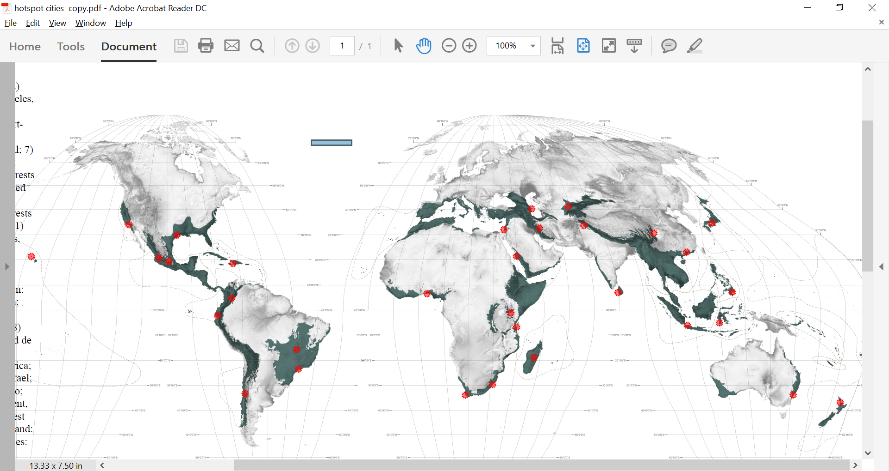
Global Environmental Benefits
Climate Change Mitigation: Decarbonization of cities through low carbon solutions
BD and LD: Integrated land use planning to prevent habitat loss/degradation in peri-urban areas
Food system: Integrated land use planning to prevent agricultural land loss; logistics/transport system for food distribution
Marine plastics: employing a circular economy approach that addresses material and design engineering; consumer use; and recovery and recycling
32 cities in the world’s biological hotspots
Notes:
The Sustainable Cities Impact Program is one of the flagship initiatives in GEF 7 to achieve GEF’s GEB targets. The primary focus remains on GHG reduction. We also encourage projects which expands GEBs in the areas of Biodiversity and Land Degradation.
Resilience and adoption of circular economy approach in projects is important and therefore desired in GEF 7 projects.

Slide 22
Impact Programs
Food Systems, Land Use and Restoration
Sustainable Cities
Sustainable Forest Management

Slide 23

Sustainable Forest Management: Overview
Focus on globally important forests
Amazon Forest
Congo Basin Forest
Dryland Forests
Require regional, ecosystem-scale approach to
maintain integrity of the entire Biome
Notes:
The Amazon, the Congo Basin, and some important Dryland landscapes around the world are globally important for biodiversity and carbon storage, provide livelihoods and subsistence to communities that rely on forests and agriculture for their survival and as such qualify as “key ecosystems” where a concerted SFM approach can have value. In these globally important ecosystems, we have the opportunity to change the future development trajectory from natural resource depletion and biodiversity erosion, to one based on natural capital management and productive landscapes. The latest science also indicates that these globally important ecosystems require integrated ecosystem-scale management for maintaining their “ecological integrity and functioning” and delivering Global Environmental Benefits. Fragmented and isolated projects will not be sufficient in these large ecosystems as has been the case for much of the past SFM set of investments. The time is now ripe for the SFM program to evolve into an Impact Program with a clear geographical focus to better harness time-bound opportunities for impact on critical forest biomes and systems. These 3 key forest regions are the major ecosystems and perhaps the last places where an integrated and concerted SFM approach can truly transform the course of development and produce multiple benefits for biodiversity, climate change, and land degradation.

Slide 24

Sustainable Forest Management: Overview
Creating a better enabling environment for forest governance;
Supporting rational land use planning across mixed-use landscapes;
Strengthening of protected areas;
Clarifying land tenure and other relevant policies;
Supporting the management of commercial and subsistence agriculture lands to reduce pressure on adjoining forests; and
Utilizing financial mechanisms and incentives for sustainable forest utilization such as markets, REDD+ and other PES
Notes:
GEF investment will emphasize the following:
Regional transnational coordination of biome level actions
Create a better enabling environment for forest governance;
Support rational land use planning across mixed-use landscapes;
Strengthening of protected areas;
Ensure environmentally-friendly agriculture to reduce pressure on forests; and
Utilizing markets, REDD+, and other PES for sustainable forest utilization

Slide 25

Common elements of the Impact Programs…

Slide 26
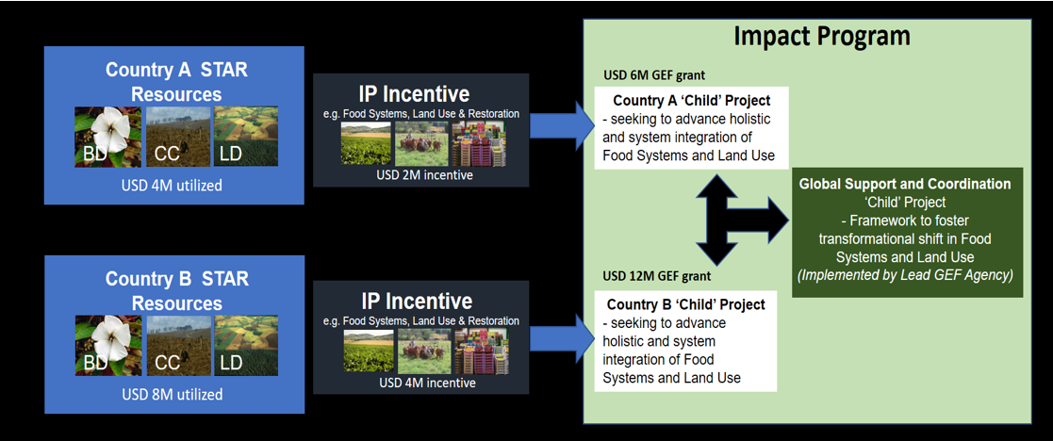
The Incentive: Resource Allocation to Impact Programs
FOLUR
Sustainable Cities
STAR | 265
Incentive Mechanism | 133
Global support | 32
Total | 430
STAR | 91
Incentive Mechanism | 46
Global support | 18
Total | 156
(million $)
(million $)
SFM
STAR | 156
Incentive Mechanism | 78
Global support | 27
Total | 261
Co-financing
1/7
(million $)

Slide 27
Key Elements of Impact Program Guidance
Crucial rationale of the IPs: Deliver transformational change in an integrated manner across the focal areas
Only countries accepted to join the programs will be able to design IP child projects
Lead Agencies: FOLUR, SFM Amazon => World Bank; SFM Congo Basin => UN Environment & SFM Drylands => FAO; Sustainable Cities => TBC
NB: Lead agencies facilitate the process, Child Projects can be managed by any other agency.
Maximum results prioritized: Because the incentive funds are limited, resource programming for each of the IPs will be prioritized to maximize potential for achieving the GEF-7 targets.

Slide 28
Key Elements of Impact Program Guidance
Results oriented assessment: The GEF-7 Results Framework and proposed GEB targets approved by council will serve as the basis for assessing potential contributions by country
Minimum of USD 4 million from STAR: Required for any country to trigger the incentive mechanism to ensure significant results coming from IPs
Private sector engagement: Potential to influence sustainable businesses and to catalyze investment opportunities that can scale-up innovative technologies
Gender integration: All GEF investments are required to address gender equality as a priority.
Commitment with the IP Regional/Global Platform: countries must commit to work closely with the global/regional technical assistance and knowledge management component.

Slide 29
Timeline and Process for Operationalizing the Impact Programs
GEF Assembly on 26-28 June, GEF-7 Programming Directions adopted
STAR Allocations published on July 1st
30 August 2018: guidance note on programming IPs
November 2018: release of a call and template for “Expression of Interests” (EOIs) for participation in the IPs
31 January 2019: Initial deadline for submission of EOIs
February 2019: Selection of an initial batch of submissions for each of the IPs
March-April 2019: Finalization and validation of the Program (PFD)
May 2019 Council meeting: Inclusion in the Work Program (if resources allows)
Notes:
the 7th Replenishment Phase of the GEF Trust Fund (GEF-7) has now officially started. With the initial STAR Allocations now published, countries’ plans and priorities for GEF-7 programming are getting underway. To help planning, this note sets forth the following timeline and some key deadlines for operationalizing the Impact programs (IPs):
• a guidance note on programming IPs will be published by 30 August 2018 and will include details on priorities and approach for each IP, which countries can use to assess their interest and eligibility to participate;
• the official call and template for “Expression of Interests” (EOIs) for participation in the IPs will be released by 30 September 2018, by which time a Lead Agency for each IP will have been identified; the EOI will contain detailed instructions and requirements for each IP so interested countries can provide the best possible representation of their commitment to contribute toward program targets and outcomes, and the agency they choose to work with for their child project;
• the initial deadline for submission of completed EOIs will be 30 December 2018;
• in accordance with the GEF-7 Programming Directions Document, the Lead Agency in consultation with GEF Secretariat, will evaluate and select an initial batch of qualified submissions for each of the IPs by end January 2019; subject to availability of funds, these will be included in the respective IP Program Framework Document for consideration at the June 2019 Council meeting, following the regular calendar for composition of Work Program;
• an additional deadline for EOIs will be established during 2019 for countries that need more time to express their interests, after which a second batch of qualified submissions will be presented in an updated PFD for consideration at a subsequent Council meeting.

Slide 30
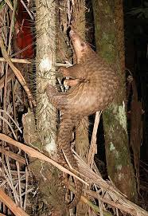
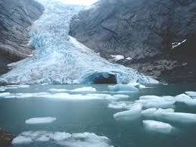
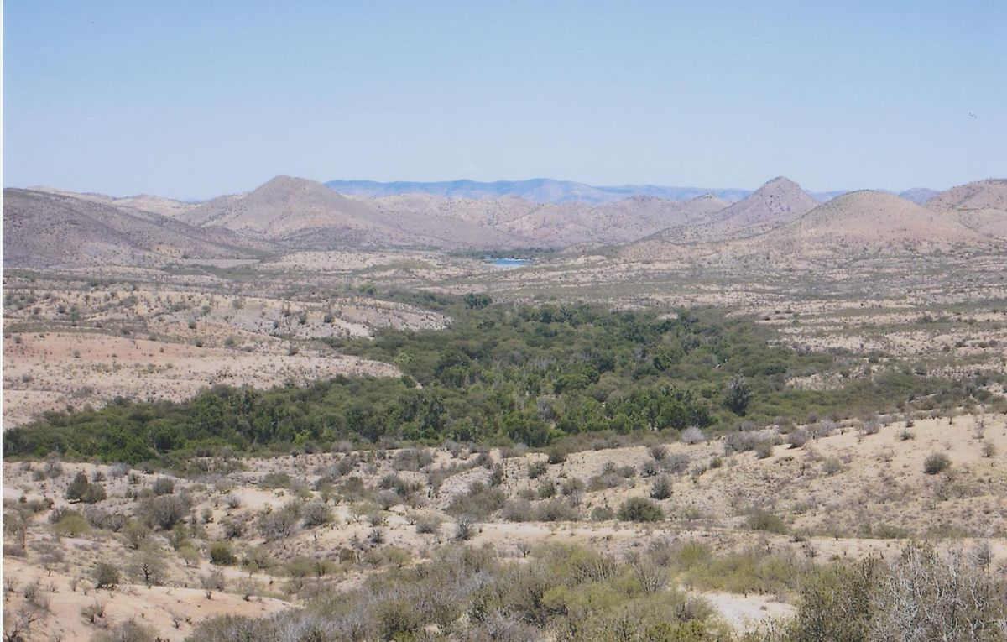
Focal Areas
Biodiversity
Climate Change Mitigation
Land Degradation
International Waters
Chemicals and Waste

Slide 31


Biodiversity Focal Area
I. Mainstream biodiversity across sectors as well as within production landscapes and seascapes (Biodiversity Mainstreaming in Priority Sectors; Global Wildlife Program; (IWT and Wildlife and Tourism); Natural Capital Assessment and Accounting; Sustainable Use of Plant and Animal Genetic Resources; and Inclusive Conservation)
II. Address direct drivers to protect habitats and species (Prevention, Control and Management of Invasive Alien Species; Improving Financial Sustainability, Effective Management, and Ecosystem Coverage of the Global Protected Area Estate)
III. Further develop biodiversity policy and institutional framework framework (Biosafety, Access and Benefit Sharing of Genetic Resources, and Enabling Activities)
Notes:
The goal of the GEF-7 Biodiversity Focal Area strategy is to maintain globally significant biodiversity in landscapes and seascapes. To achieve this goal, GEF investments will contribute to the following three objectives identified in the CBD COP 13 Guidance to the GEF:
• Mainstream biodiversity across sectors as well as landscapes and seascapes;
• Address direct drivers to protect habitats and species; and
• Further develop biodiversity policy and institutional frameworks.
In its entirety, the set of programming options included in the strategy also responds directly to the Strategic Plan for Biodiversity, 2011-2020, particularly with regards to the increasingly important biodiversity mainstreaming agenda.
In their totality, the Biodiversity Focal Area investments, the Food Systems, Land Use, and Restoration Impact Program, the Sustainable Cities Impact Program, the Sustainable Forest Management Impact Program, and the International Waters Focal Area investments will collectively contribute to achieving the goal and the three objectives of the biodiversity focal area strategy.

Slide 32
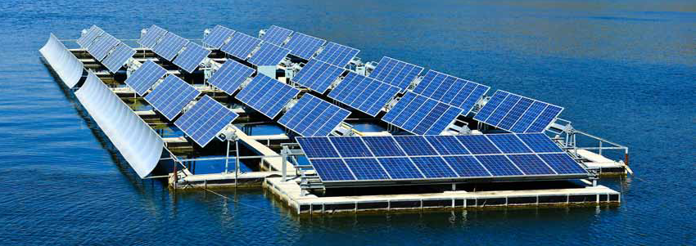
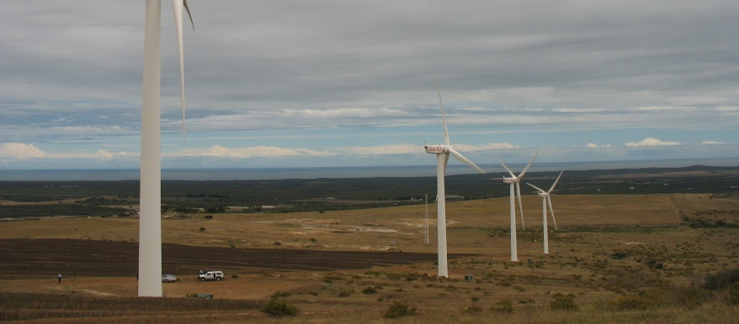
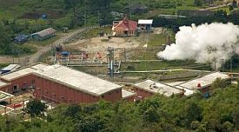
Climate Change
Mitigation Focal Area
I. Promote innovation, technology transfer for sustainable energy breakthroughs (de-centralized renewables with storage; electric mobility; accelerating energy efficiency; and cleantech innovation)
II. Demonstrate mitigation options with systemic impacts (through impact programs)
III. Foster enabling conditions for mainstreaming mitigation concerns into sustainable development strategies, including CBIT, NDCs, Enabling Activities
Notes:
The goal of the Climate Change Focal Area Strategy is to produce significant mitigation results as measured by GHG emissions reductions or avoided. We will accomplish this with a combination of focal area investments in new and innovative technologies, by investing in Impact Programs, and through enabling conditions. More specifically, this strategy will
Promote innovation, technology transfer, and supportive policies and strategies such as:
De-centralized power with energy storage
Electric drive technologies and electric mobility
Accelerating energy efficiency adoption
Cleantech Innovation
We will also dmonstrate mitigation options with systemic impacts though the impact programs.
And Finally, we will foster enabling conditions for mainstreaming mitigation concerns into sustainable development strategies.
Capacity-building Initiative for Transparency
NDC preparation and implementation
National Communications and Biennial Update Reports

Slide 33
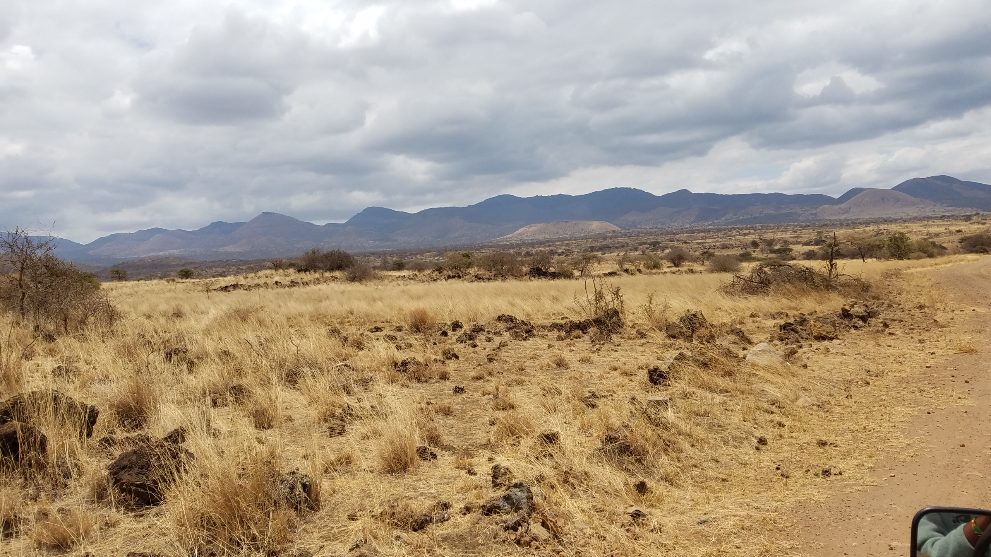
Land Degradation Focal Area
Vision:
Land Degradation stopped and reversed in production landscapes where agricultural and rangeland management practices underpin the livelihoods of poor rural farmers and pastoralists
Notes:
LDFA investment will be consistent with and complement the work of the Impact programs, in particular the FOLUR IP and the Drylands IP under the SFM IP program.
Support on the ground implementation of Land Degradation Neutrality (LDN)
The support of LDN implementation is a broad objective that will include several different more specific objectives that are all contribute to land degradation neutrality, such as
Sustainable land management (SLM),
Sustainable forest management (SFM),
Forest and landscape restoration (FLR), and
Integrated natural resource management (INRM) for resilient agro-ecosystems
Creating an enabling environment to support LDN implementation globally
Supporting enabling environments for all of the above topics
In addition, the LDFA will support UNCCD enabling activities (EA) (please note the difference to enabling environments. As usual, UNCCD EA will be funded by GEF and are outside the STAR allocation)
It is noteworthy that the GEF-7 allocation for the LD FA has significantly increased by 10% as compared to GEF-6. This also indicates the importance that the GEF places on this focal area and its potential to create multiple enviromental benefits while also securing livelihoods for smallholders and local communities.

Slide 34
Land Degradation Focal Area Objectives
1- Support on the ground implementation of Land Degradation Neutrality (LDN)
Outcomes:
Dryland Sustainable Landscapes
Diversified agro-ecological food production systems
Integrated landscape management and restoration
2- Creating an enabling environment to support LDN implementation globally, including UNCCD EAs
Notes:
LDFA investment will be consistent with and complement the work of the Impact programs, in particular the FOLUR IP and the Drylands IP under the SFM IP program.
Support on the ground implementation of Land Degradation Neutrality (LDN)
The support of LDN implementation is a broad objective that will include several different more specific objectives that are all contribute to land degradation neutrality, such as
Sustainable land management (SLM),
Sustainable forest management (SFM),
Forest and landscape restoration (FLR), and
Integrated natural resource management (INRM) for resilient agro-ecosystems
Creating an enabling environment to support LDN implementation globally
Supporting enabling environments for all of the above topics
In addition, the LDFA will support UNCCD enabling activities (EA) (please note the difference to enabling environments. As usual, UNCCD EA will be funded by GEF and are outside the STAR allocation)
It is noteworthy that the GEF-7 allocation for the LD FA has significantly increased by 10% as compared to GEF-6. This also indicates the importance that the GEF places on this focal area and its potential to create multiple enviromental benefits while also securing livelihoods for smallholders and local communities.

Slide 35
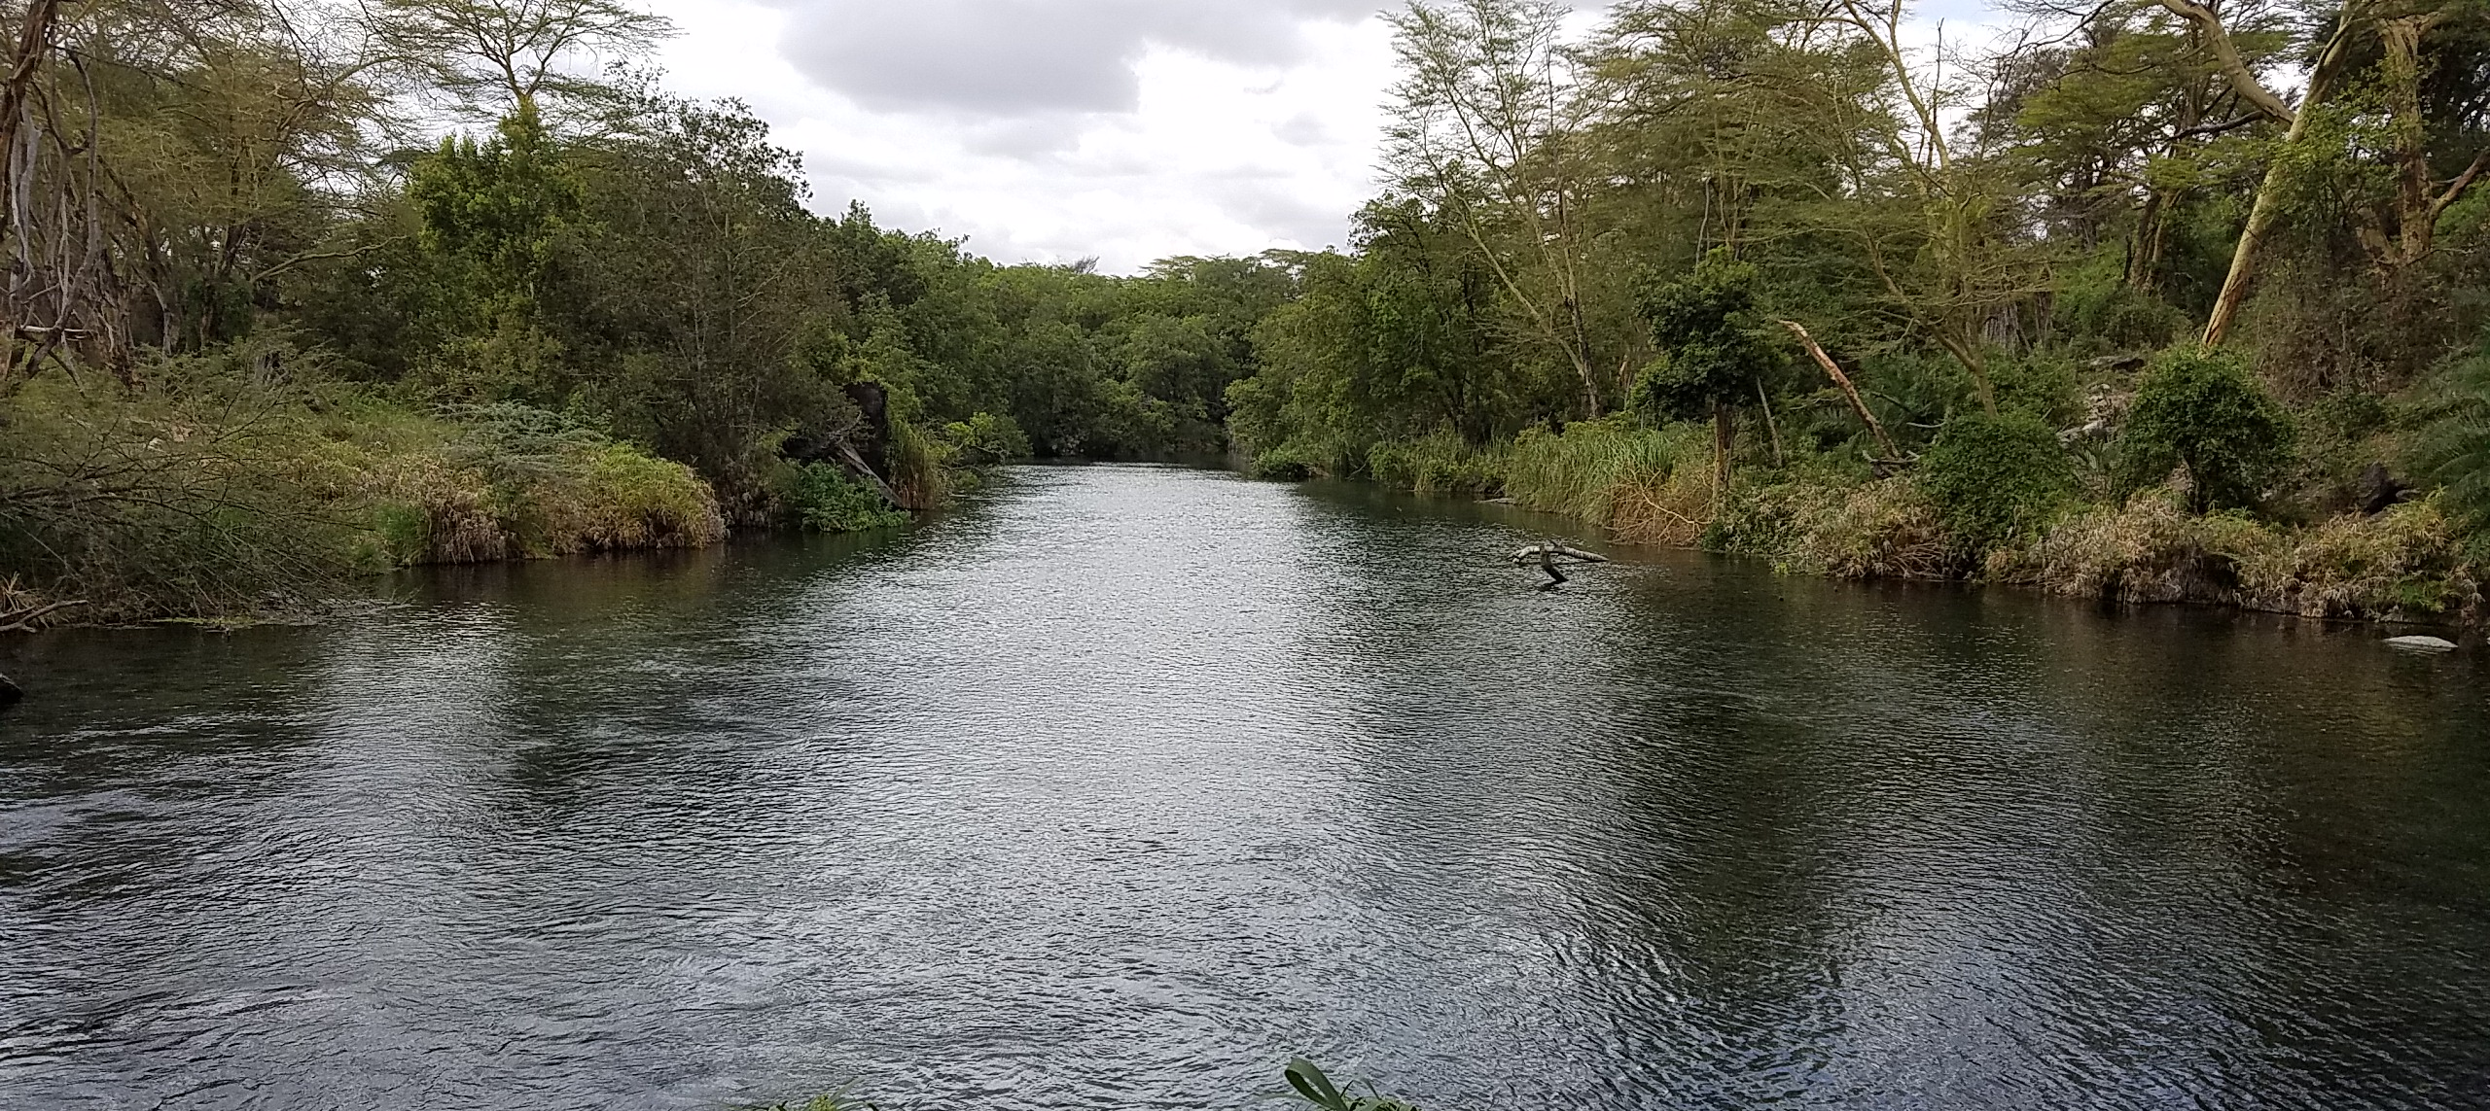
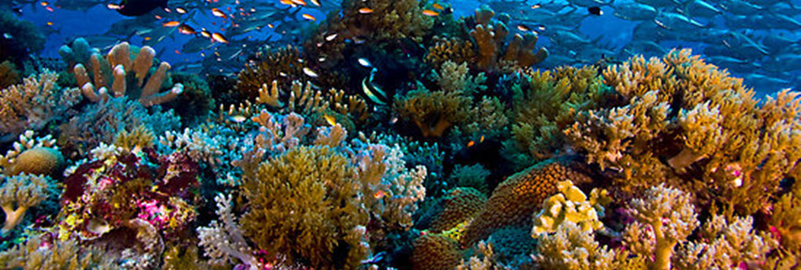
International Waters Focal Area
I. Strengthening Blue Economy opportunities
II. Improve governance in the Areas Beyond National Jurisdiction (ABNJ)
III. Enhance water security in
freshwater ecosystems
Notes:
The International Waters Focal Area has three main objectives: First, strengthening Blue Economy opportunities in key coastal habitats, including marine protected areas, deltas and large marine ecosystems, developing sustainable fisheries, and reducing pollution.
Second, Improve governance in the Areas Beyond National Jurisdiction (ABNJ).. .This will include catalyzing governance reforms to end IUU and overfishing and sustainably manage marine capture fisheries, support policy work to reduce harmful fishing subsidies, and foster collaboration among LMEs, Regional Seas conventions and RFMOs on area-based management in national waters and ABNJs.
Lastly, we will enhance water security in freshwater ecosystems by advancing information exchange and enhancing regional and national governance and cooperation on shared freshwater surface and groundwater basins.

Slide 36
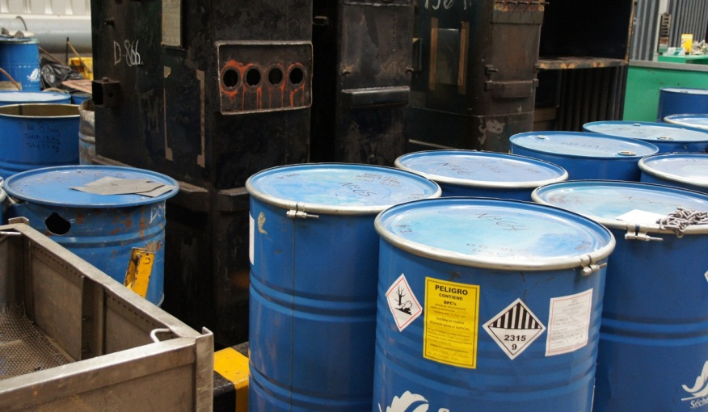
Chemicals and Waste Focal Area
I. Industrial Chemicals
II. Agricultural Chemicals
III. SIDS/LDCs program - Least Developed Countries and Small Island Developing States
IV. Enabling Activities
Notes:
The Chemicals and Waste Focal Area contains 4 eligible programs or entry points for countries to access resources and deliver on the proposed results in this area.
In the Industrial Chemicals Program, we will seek to eliminate and avoid POPS, Mercury and Ozone Depleting Substances by focusing on major industrial sectors that use or produce chemicals covered by the MEAs including gold, textiles, consumer products etc
Secondly, in the Agricultural Chemicals Program, we will seek primarily to eliminate harmful chemicals in agriculture such as obsolete POPs and mercury based agricultural chemicals and introduce low or non-chemical alternatives and practices. This program will also focus on the management and safe disposal of agricultural plastics contaminated by POPs and mercury based agricultural chemicals
We also have a program specifically focusing on Least Developed Countries and Small Island Developing States. Here we will foster regional approaches, incubate technologies that are developed in these countries and seek to create economies of scale for achieving the sound management of chemicals and waste.
And finally ,we will also fund Enabling Activities related to the different conventions and the countries’ obligations. This includes…
Stockholm Convention, including National Implementation Plans (NIPs) and NIP Updates
Minamata Convention, including Minamata Initial Assessments (MIAs) and artisanal and small-scale gold mining National Action Plans (ASGM NAPs)
Global Monitoring of chemicals, related to effectiveness evaluation under the Chemical Conventions

Slide 37

Thank you for your attention!
Questions?
Main references:
GEF-7 Programming directions: doc GEF/R.7/19
IP guidance note sent to countries and GEF Implementing Agencies
GEF-7
Guidance
Note
Template for Expression of Interest
E o I
Notes:
the 7th Replenishment Phase of the GEF Trust Fund (GEF-7) has now officially started. With the initial STAR Allocations now published, countries’ plans and priorities for GEF-7 programming are getting underway. To help planning, this note sets forth the following timeline and some key deadlines for operationalizing the Impact programs (IPs):
• a guidance note on programming IPs will be published by 30 August 2018 and will include details on priorities and approach for each IP, which countries can use to assess their interest and eligibility to participate;
• the official call and template for “Expression of Interests” (EOIs) for participation in the IPs will be released by 30 September 2018, by which time a Lead Agency for each IP will have been identified; the EOI will contain detailed instructions and requirements for each IP so interested countries can provide the best possible representation of their commitment to contribute toward program targets and outcomes, and the agency they choose to work with for their child project;
• the initial deadline for submission of completed EOIs will be 30 December 2018;
• in accordance with the GEF-7 Programming Directions Document, the Lead Agency in consultation with GEF Secretariat, will evaluate and select an initial batch of qualified submissions for each of the IPs by end January 2019; subject to availability of funds, these will be included in the respective IP Program Framework Document for consideration at the June 2019 Council meeting, following the regular calendar for composition of Work Program;
• an additional deadline for EOIs will be established during 2019 for countries that need more time to express their interests, after which a second batch of qualified submissions will be presented in an updated PFD for consideration at a subsequent Council meeting.

