Slide 1
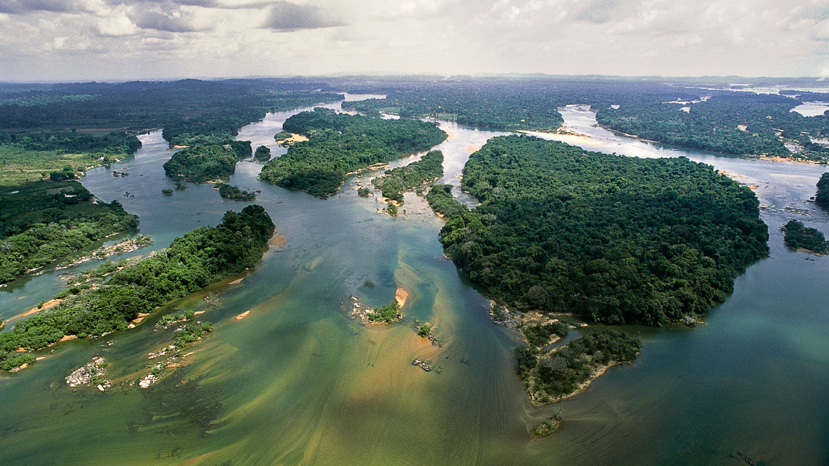

Expanded Constituency Workshop
Session of the Independent Evaluation Office, GEF
Kyoko Matsumoto - Senior Evaluation Officer
Juan Jose Portillo - Senior Operations Officer
2017

Slide 2


Slide 3
GEF Council
M&E in the GEF
Guided by the M&E Policy
STAP
GEF Secretariat
GEF IEO
GEF Agency Evaluation Offices
GEF Agencies
Participating Countries
Policy, standard-setting and/or oversight function
Country Stakeholders
Reporting or provision of information

Slide 4
GEF Independent Evaluation Office
Functions
Independent evaluation
Setting of minimum standards (normative)
Quality control (oversight)
Knowledge sharing and dissemination

Slide 5
Enhancing global environmental benefits through excellence in evaluation

Slide 6
Update on the
Sixth Comprehensive Evaluation of the GEF (OPS6)

Slide 7
OPS6 Update
1 Context
2 Performance and Impact
3 Policies and Institutional Issues
4 Financing, Governance and Partnership

Slide 8
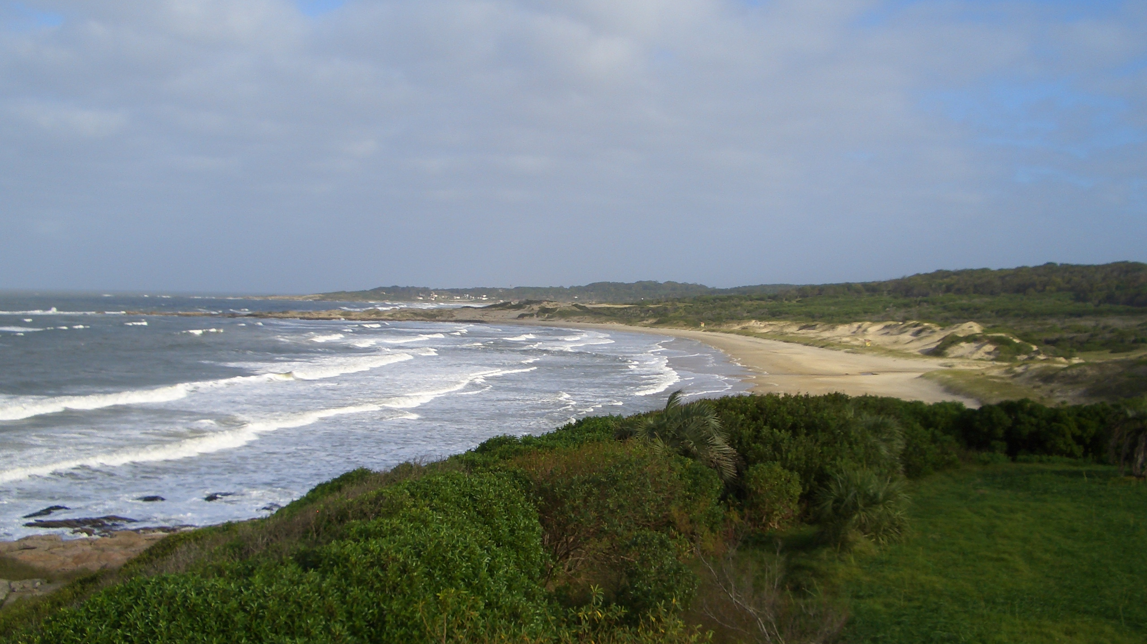
SECTION 1
Context

Slide 9
Completed (17/29)
March
April
May
June
July
August
September
Focal Area Studies
International waters
Land degradation
Climate change
Chemicals and waste
Biodiversity
Mainstreaming / Cross cutting
Joint GEF-UNDP Evaluation of the Small Grants Programme
The GEF Non-grant Instrument
GEF Engagement with the Private Sector
Evaluation of the Gender Mainstreaming Policy
Review of the GEF Agency Minimum Standards on Environmental and Social Safeguards
Review of the Indigenous Peoples Policy
Review of the Resource Allocation System STAR

Slide 10
Completed (17/29)
March
April
May
June
July
August
September
Performance and Impacts
Trends in Performance (replacing APR 2017)
A Value for Money Analysis of GEF Interventions in Land Degradation and Biodiversity
Measuring Environmental Outcomes Using Remote Sensing and Geospatial Methods
Program Evaluation of the Least Developed Countries Fund
Impact Evaluation of GEF Support to Protected Areas and Protected Area Systems
Impact of GEF Support on National Environmental Laws and Policies in Selected Countries
Transformational Engagements
Program Evaluation of the Special Climate Change Fund
Evaluation of Programmatic Approaches in the GEF
Project-Level Accomplishments/ Progress toward Impact
Evaluation of Integrated Approach Pilots
Evaluation of the Illegal Wildlife Trade Program Study
Evaluation of the Multiple Benefits of GEF Support through Its Multifocal Area Portfolio

Slide 11
Completed (17/29)
March
April
May
June
July
August
September
Institutional Issues
Evaluation of the Expansion of the GEF Partnership
Evaluation of the GEF CSO Network
Review of the GEF Approach to Results-Based Management
GEF6 Strategy, Global Relevance
Evaluation of the Knowledge Management System
Review of the Comparative Advantage, Financing, and Governance of the GEF Partnership
OPS6
Early findings
Full OPS6 report
Notes:
We had 113 respondents to a survey on a variety of questions related to overall partnership. Through this presentation I will be drawing on the results of the survey.

Slide 12
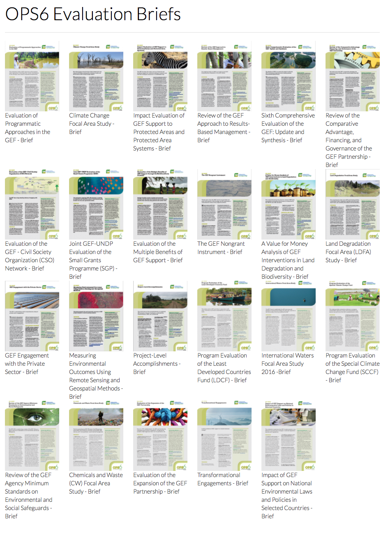
GEF IEO website
23 briefs
Notes:
23 briefs; 22 studies ongoing or completed

Slide 13
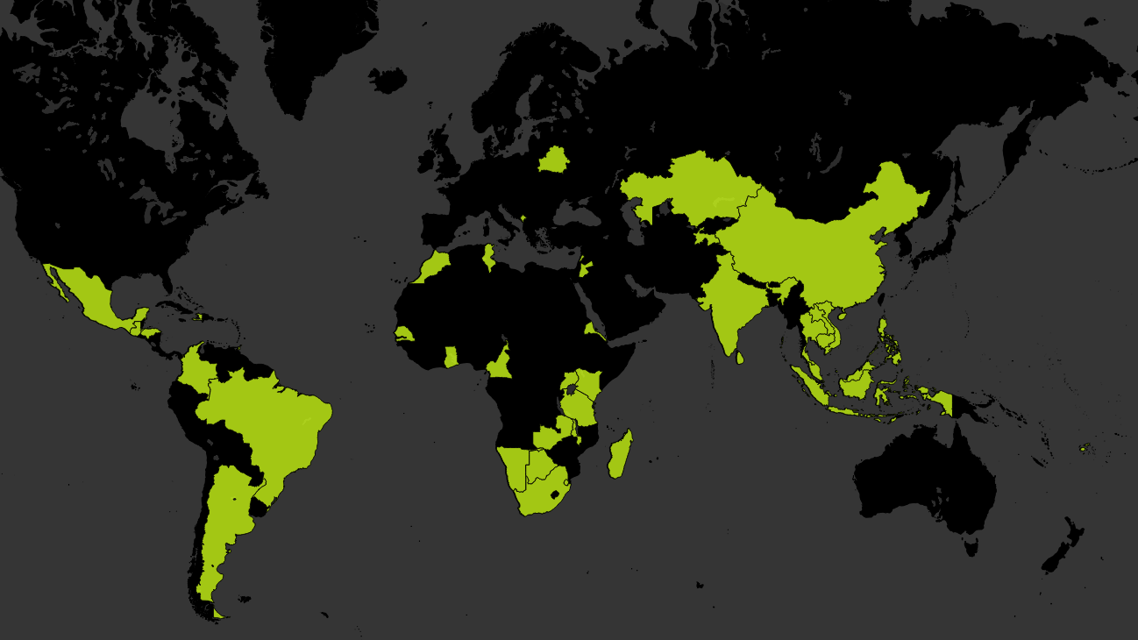
Terminal evaluations for all GEF countries
Site visits to 41 countries

Slide 14






GEF relevance
Evolution of the focal areas strategies
Commitment to the mandate alongside innovation
Spread across countries and sectors
Responsiveness to convention secretariats
Notes:
Relevance of focal area strategies, responsive to Convention secretariats, but sometimes perceived as delayed in responding

Slide 15
SURVEY RESULTS
Comparative advantages of the GEF
95%
91%
Broad coverage of environmental issues
Alignment with MEAs and conventions
Notes:
2 greatest advantages of the GEF from the survey results

Slide 16
SURVEY RESULTS
Comparative advantages of the GEF
Broad coverage of environmental issues
Alignment with MEAs/conventions
Ability to help countries meet commitments to MEAs/conventions
Ability to support innovative programming/projects cutting across focal areas
Ability to quickly respond to convention requests
Flexibility in addressing new and emerging environmental issues
Diversity of agencies
Ability to work with civil society
Pursuit of innovative approaches to environmental finance
Ability to engage the private sector

Slide 17
STRATEGIC DIRECTIONS
Toward an integrated approach
Multifocal projects
Programmatic approach
Addressing the drivers of environmental degradation
… while meeting Convention requirements
Notes:
Number of programs and multifocal projects increased over time

Slide 18

SECTION 2
Performance and Impact

Slide 19
Continued good performance
79%
of the 581 completed projects have satisfactory outcome and implementation ratings
63%
sustainability ratings of moderately likely or above
Notes:
581 projects that closed in the OPS6 period
Challenge in sustainability (need for longer term interventions)

Slide 20

FOCAL AREA STUDIES
International waters
74% satisfactory outcomes
Highly relevant
Challenging transboundary conditions require cooperation
A catalyst for integration
Limited funding
Portfolio imbalance
Challenge in engaging the private sector
Missed opportunities in linking regional priorities with STAR

Slide 21
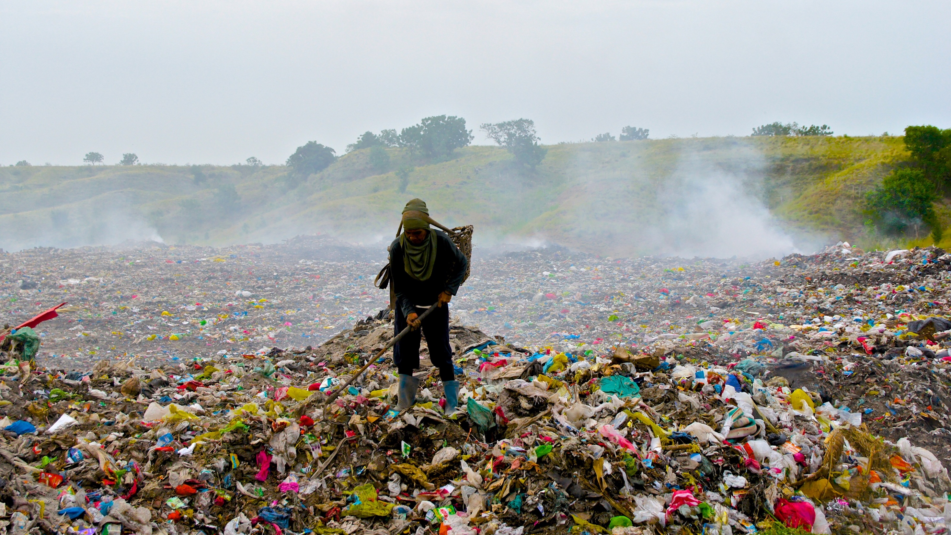
FOCAL AREA STUDIES
Chemicals and waste
78% satisfactory outcomes
Highly relevant
An improved partnership
Good private sector engagement
Scaling up results need improvement
Challenges in sector-wide approaches and regulatory reform focus
Need for better results tracking

Slide 22

FOCAL AREA STUDIES
Land degradation
78% satisfactory outcomes
Highly relevant
Effective in producing global environmental benefits
Greater scope leads
to greater benefits
Inadequate attention to socioeconomic drivers
Need to integrate land degradation neutrality
M&E tools could be strengthened

Slide 23
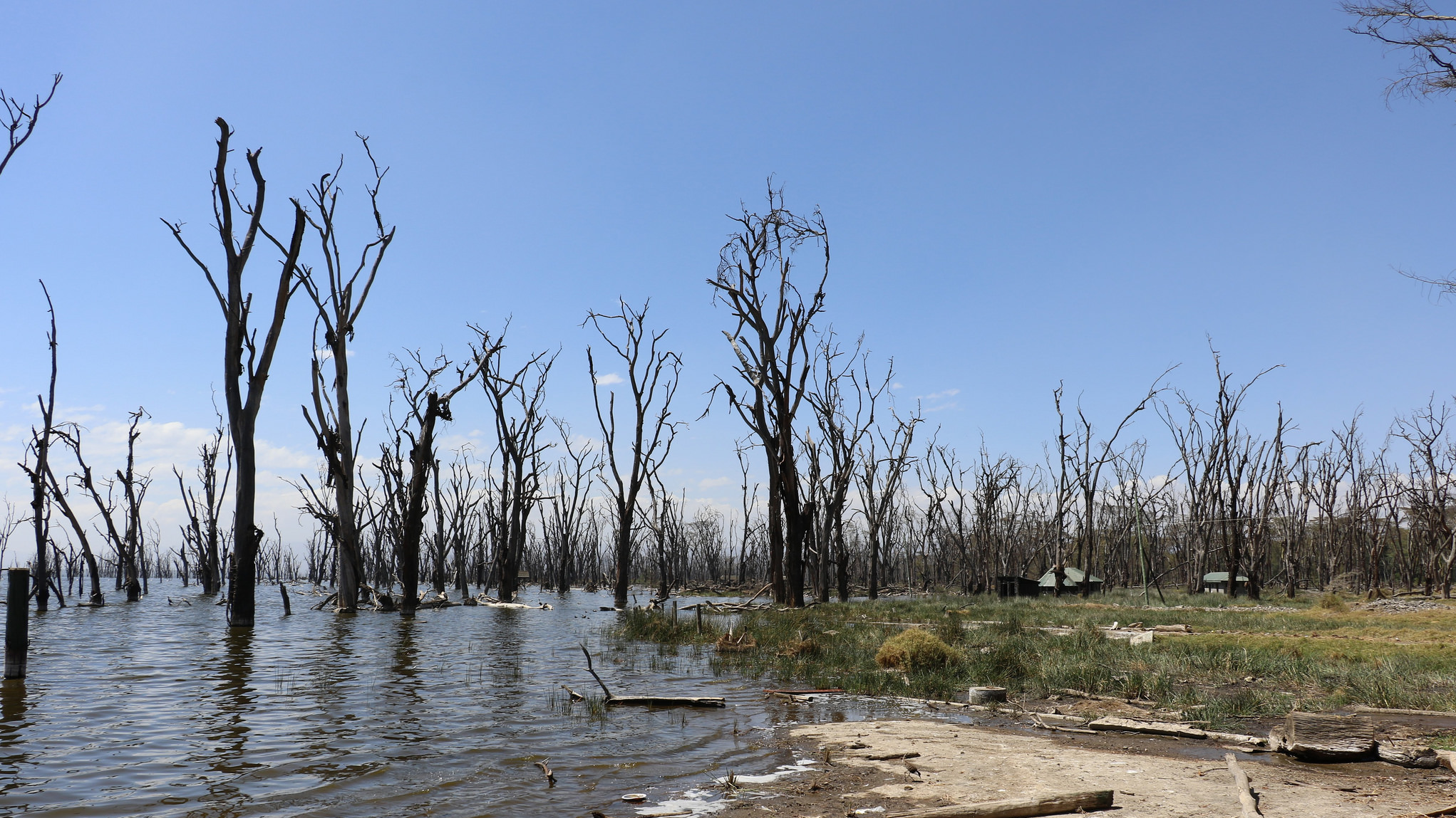
FOCAL AREA STUDIES
Climate change
77% satisfactory outcomes
Integrated approaches
Multifocal area approaches
Strengthening the
enabling environment
Private sector engagement
Identification of synergies with other funds

Slide 24
Multifocal area
Designed to produce multiple benefits
Emphasis on integration
Most common combination
Challenges from complexity
77% satisfactory outcomes
BD+LD+CC
Notes:
27 percent of the interventions are BD+LD+CC

Slide 25
Multifocal area
86%
88%
86%
Achieved positive environmental outcomes consistent with the combination of focal areas
Achieved positive socioeconomic outcomes
(primarily increased income or access to capital)
Reported some form of broader adoption (mainly through mainstreaming and sustaining)

Slide 26
Programmatic approaches
Addresses environmental drivers
Perform better than standalone projects, except in complex programs
Improved program coherence
Efficiency declines with increased complexity

Slide 27
ISSUES
Programmatic approaches
Managing complexity
Managing coordination effectively
Measuring program performance
Program design

Slide 28
Small grants program
Success in securing Global Environmental Benefits
Attention to community level benefits, poverty and livelihoods
More successful at mainstreaming gender than other GEF projects
Differing views on the extent to which SGP should address socio-economic priorities
The upgrading policy brought challenges
M&E remains too complex
Notes:
/

Slide 29
4 NECESSARY CONDITIONS
for successful transformational change
1
$$$$
Ambitious objectives
High-quality implementation
Self-sustaining mechanism
Financially sustainable

Slide 30

STRONG POINTS
Legal and regulatory reform
GEF has contributed to enactment of environmental laws
Many factors influence reform
Often overly optimistic about the likelihood and pace of legal reform

Slide 31
ISSUES
Legal and regulatory reform
Capacity building and enabling activities
Institutional capacity and political will
Stability of government
Technical capacity
Ownership

Slide 32
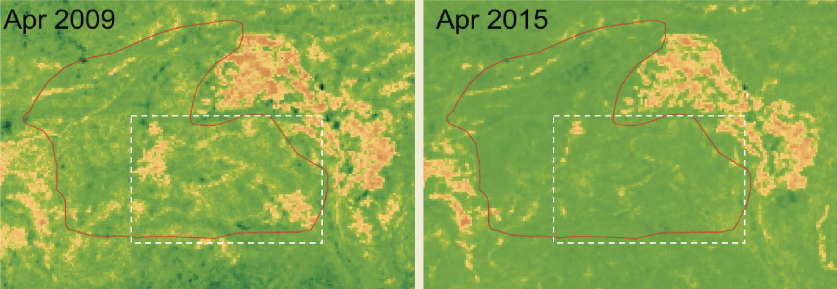
DEMONSTRATING IMPACT
Land Degradation (multifocal): Madhya Pradesh, India
Notes:
India: SLEM PMIS 3472(2009-2015)
Vegetation productivity maps from before the start of the project and around the end of the project show restored natural bamboo forest areas (lower panel) with the help of communities.

Slide 33
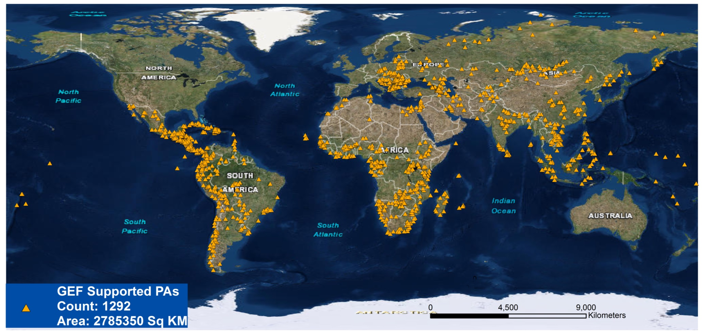
DEMONSTRATING IMPACT
Biodiversity

Slide 34
DEMONSTRATING IMPACT
Biodiversity: Global

Slide 35
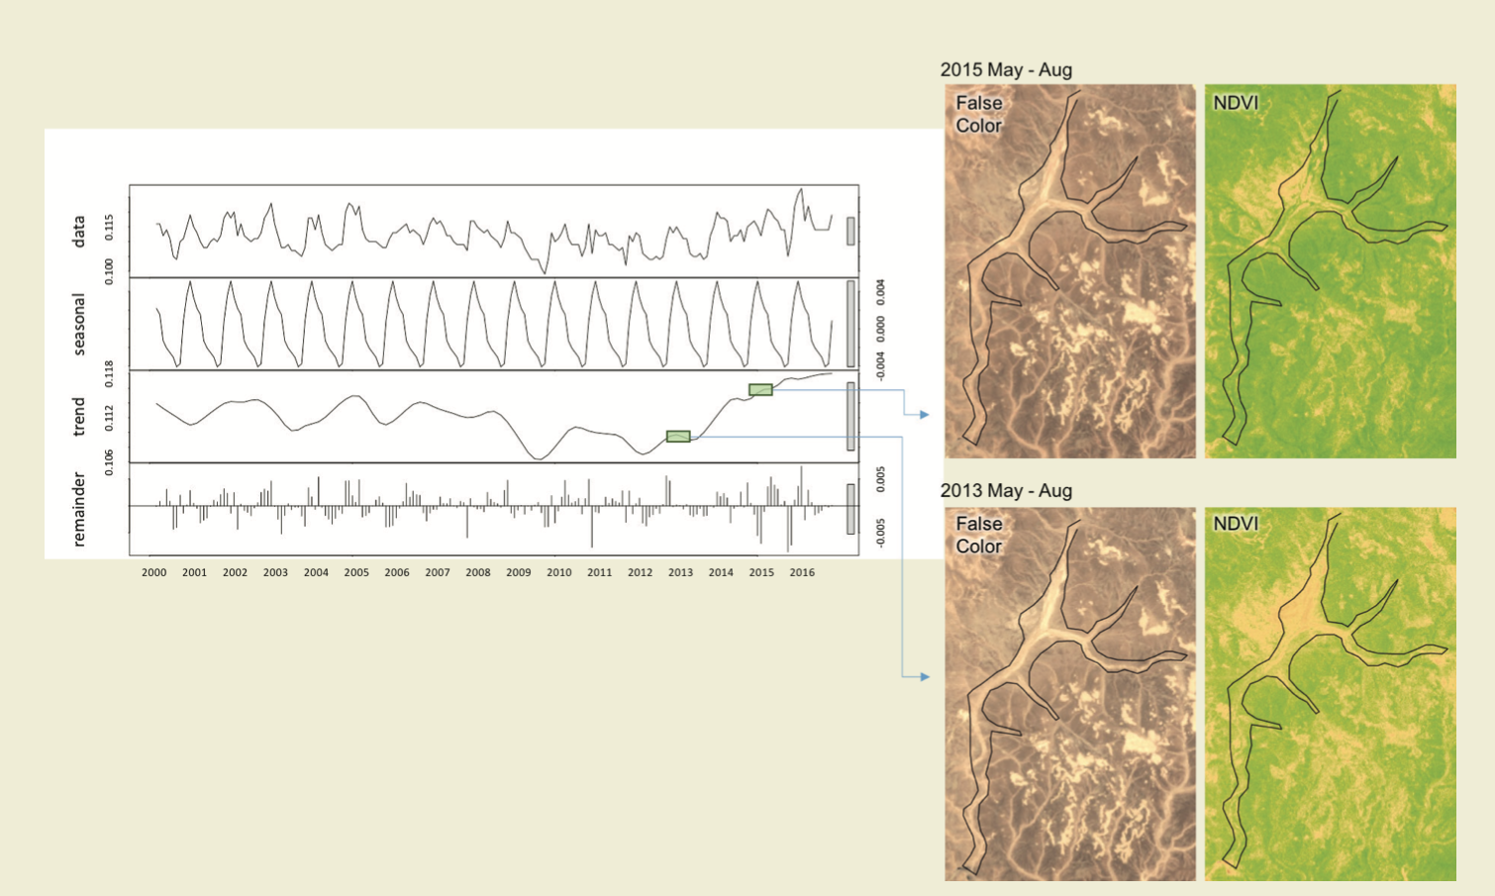
Al Hashemiah Reserve, Jordan GEFID#5026 (2013-2017)
DEMONSTRATING IMPACT
Biodiversity (multifocal): Jordan
Notes:
Photo: GEF IEO https://www.flickr.com/photos/gefieo/32929282690/in/dateposted/
Vegetation productivity maps from before the start of the project and around the end of the project show restored areas (lower panel).

Slide 36
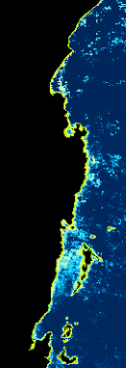
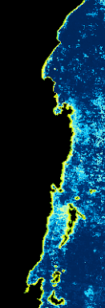

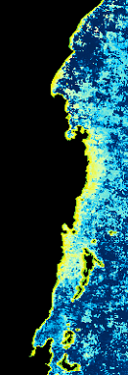
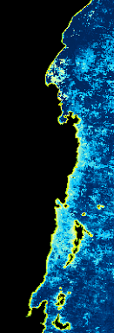
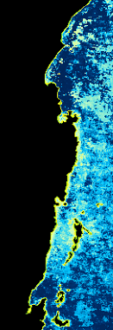
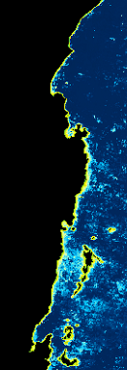


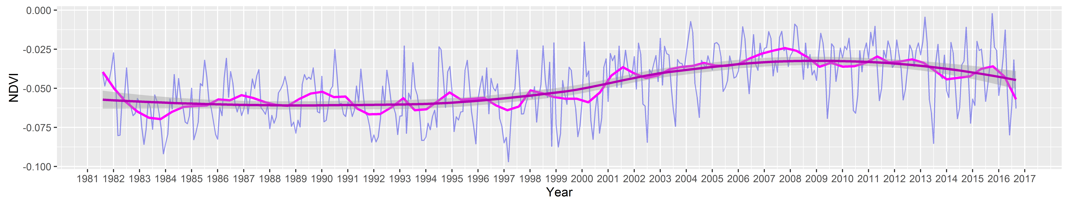
Water
DEMONSTRATING IMPACT
International waters: Lake Victoria
Vegetation
2000
2003
2005
2007
2009
2011
2013
2015
2016
GEF ID 88
GEF ID 2405
GEF ID 3399

Slide 37
VALUE FOR MONEY
Land degradation
$1:1.08
Globally positive impacts on forest cover
Lag time of 4.5-5.5 years for larger impact
Access to electricity associated with larger impact
Larger impact observed in areas with poor initial conditions

Slide 38
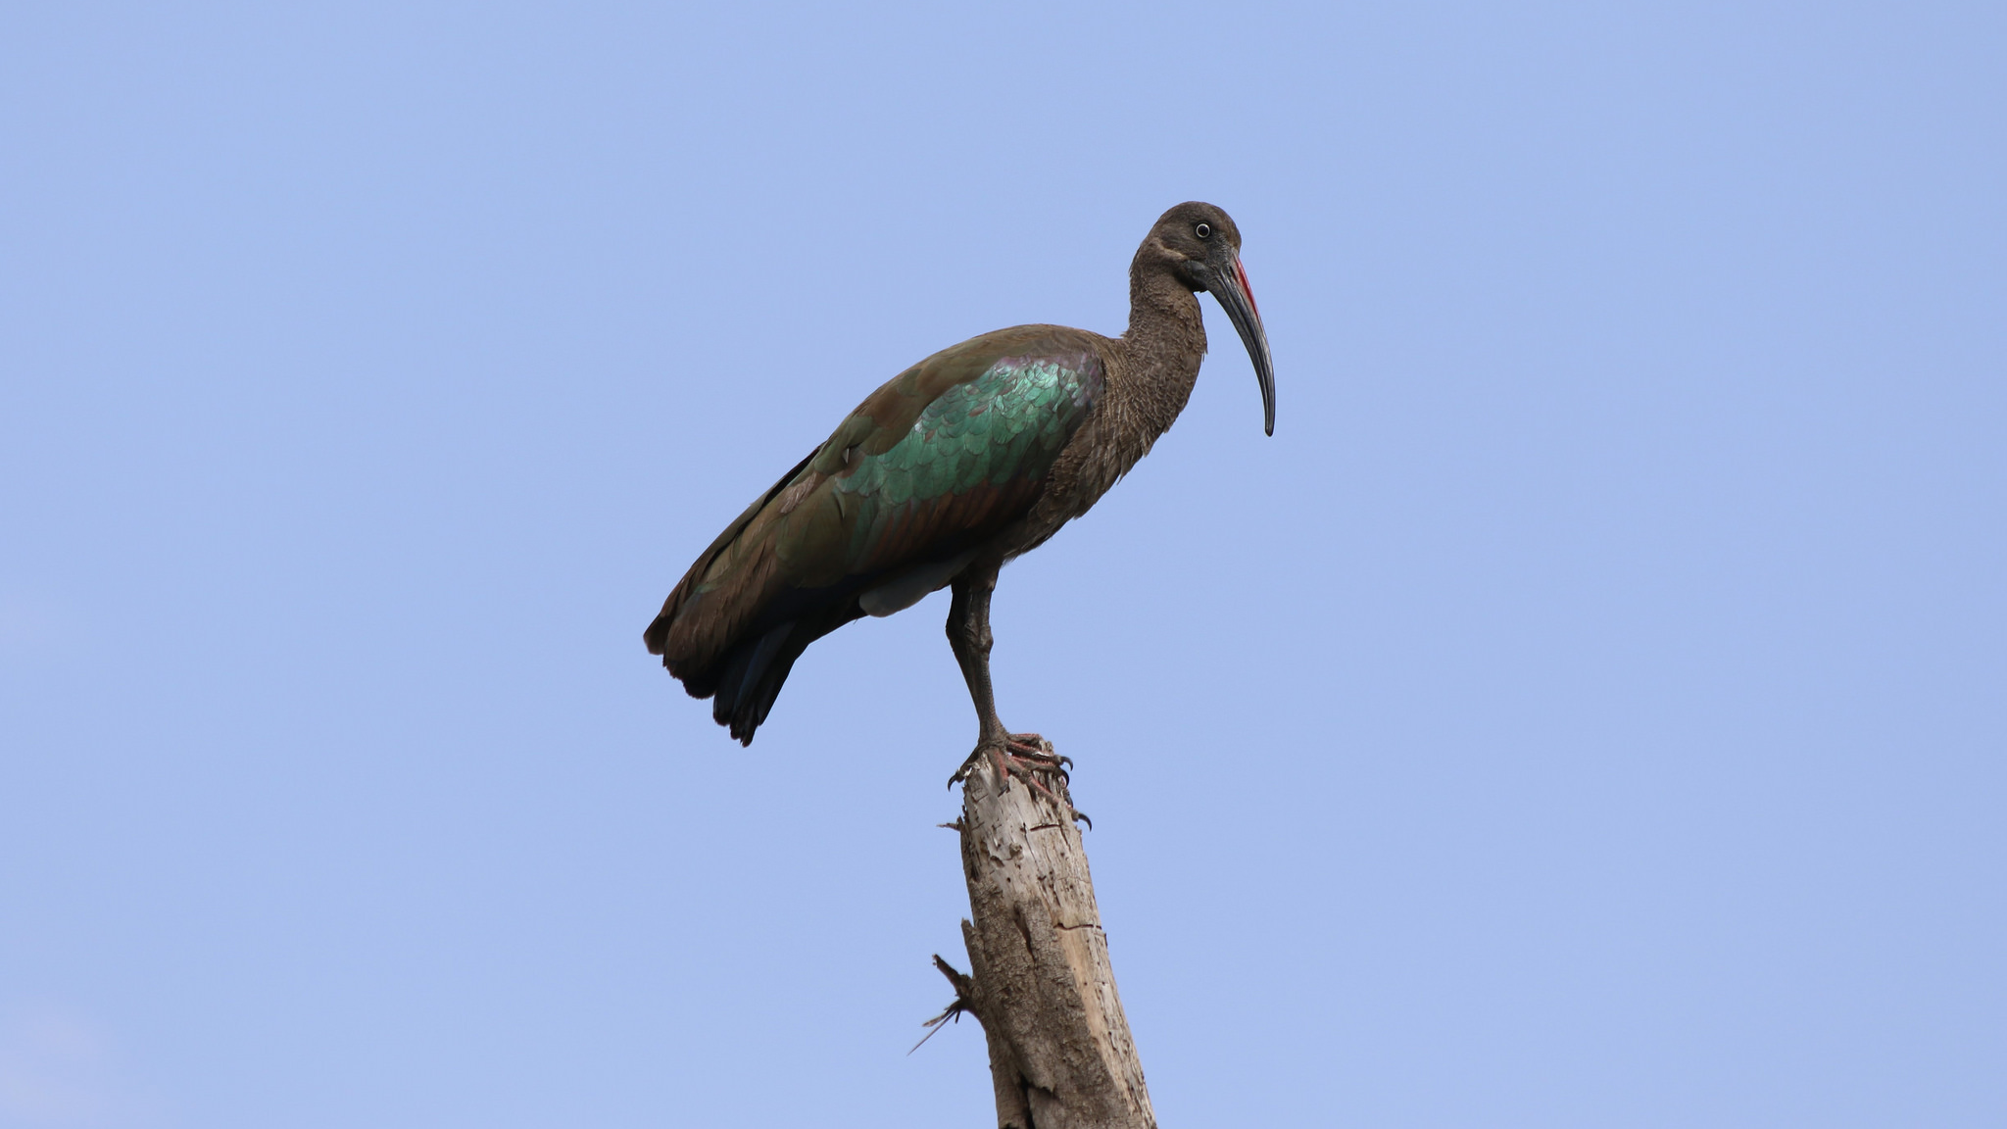
VALUE FOR MONEY
Biodiversity
$1:1.04
Positive impact on forest cover and vegetation productivity
Noticeable impact after 1st year
Access to electricity linked to larger impact
Performance improved as projects increased in size

Slide 39
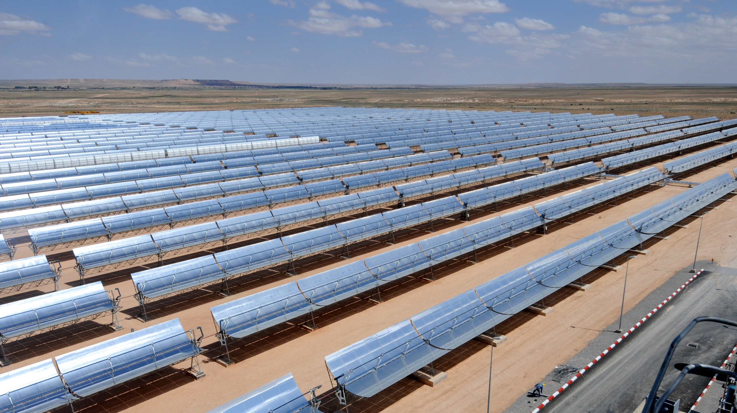
STRONG POINTS
Private sector programs
80% satisfactory outcomes
GEF is a valued partner
Helps mitigate risk
Flexible financing instruments
High co-financing ratio of 8:1
Technical knowledge

Slide 40
CHALLENGES
Private sector programs
80% satisfactory outcomes
Skewed portfolio
Need to find comparative advantage
Raise awareness of the GEF
Improve processes and mechanisms
Notes:
“Many actors in environmental/climate finance. GEF needs to find a particular comparative advantage”

Slide 41
Nongrant instruments
78% satisfactory outcomes
ISSUES
Diversification beyond climate change
Monitoring complexity in financial structures
Setting realistic targets for reflows
Defining a niche for the GEF
LOAN
Most popular
EQUITY
More prevalent recently
GUARANTEES
Mixed evidence on effectiveness
Notes:
Co-financing: The non-grant portfolio has the co-financing ration of 10:1, the overall portfolio including non-grant is 8:1, with $3 of that $8 coming from private sector.
Loan: Most popular financing structure in the non-grant portfolio and often blended with finance from an MDB
Equity: Recently become more prevalent. GEF offering appropriate risk mitigation by taking equity positions.
Guarantees: Often used in conjunction with loans. Mixed evidence on effectiveness with sometimes limited demand from Banks.

Slide 42
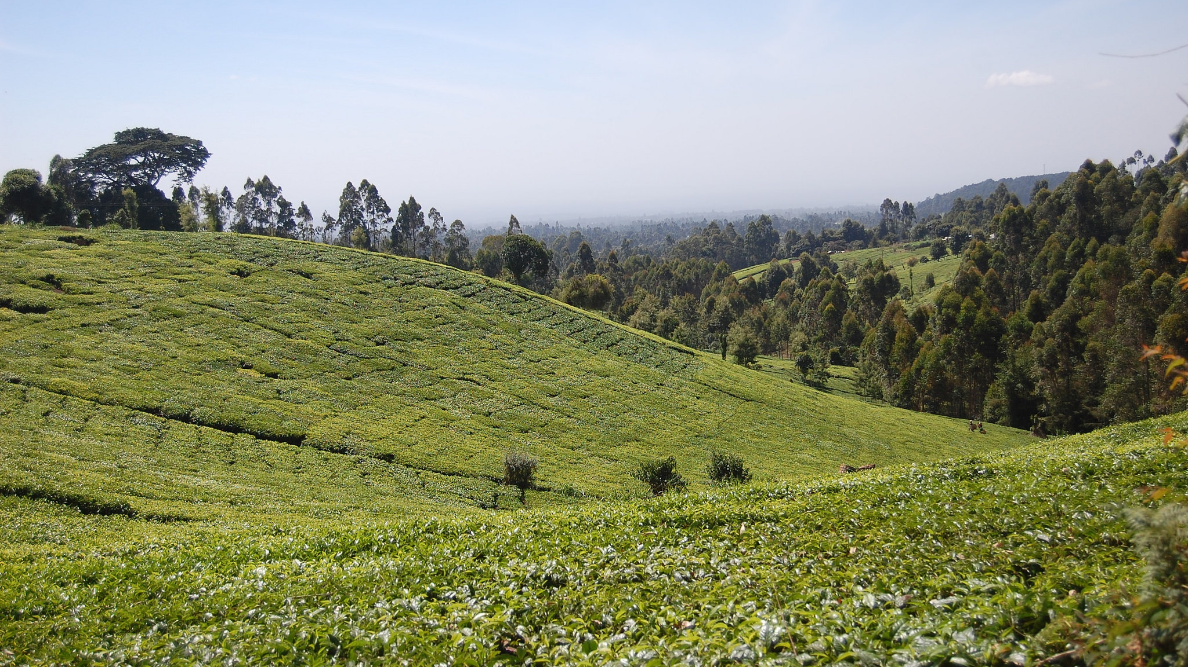
SECTION 3
Policies and Institutional Issues

Slide 43
New policies have positive impact
Consolidation of the project cycle
Cancellation policy
Harmonization pilot with the World Bank

Slide 44
Results-based management system
Streamlining the results framework
Remains complex
Improved corporate reporting
Focus on shorter-term results
PMIS database needs upgrading

Slide 45

BUT
Knowledge management is getting attention
Only 1 in 3 respondents happy with mechanisms in place
Recognition of shortcomings and efforts under way
Positive contribution of STAP

Slide 46
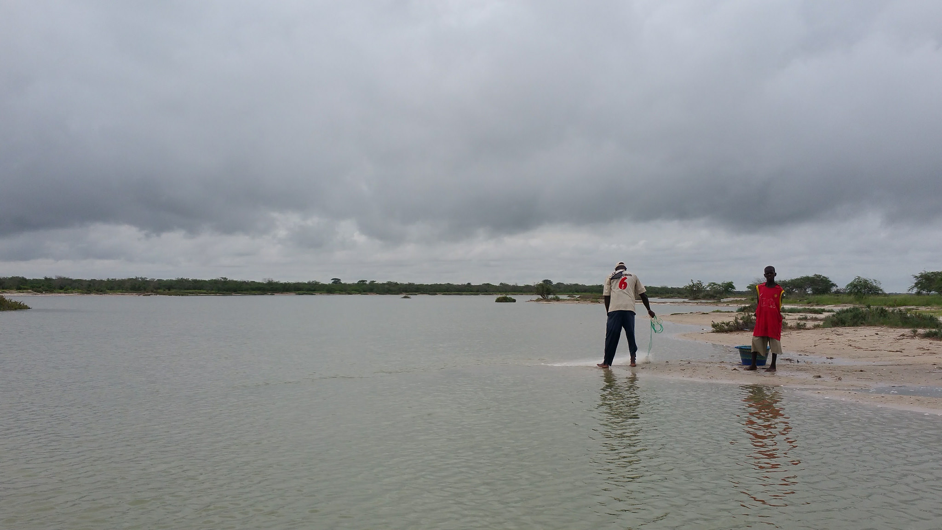
Safeguard policies
Catalyst among many GEF Agencies to strengthen existing safeguard policies
Gaps in the GEF Minimum Standards
Need for enhanced monitoring and reporting

Slide 47
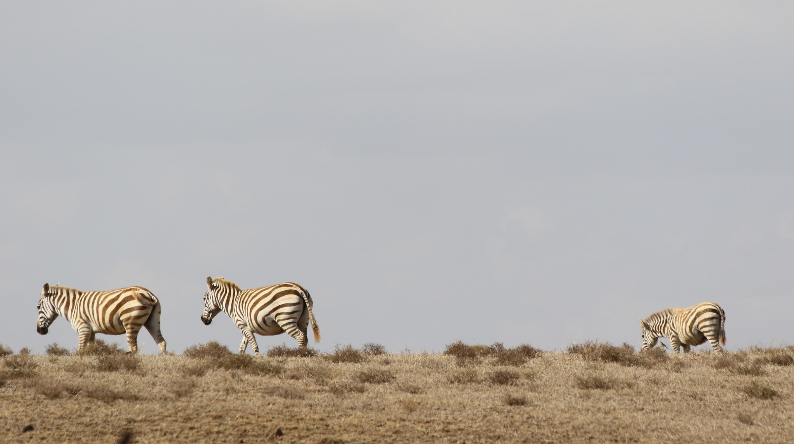
SECTION 4
Financing, Governance, and Health of the Partnership
Notes:
Picture: https://www.flickr.com/photos/gefieo/32564551761/in/dateposted/

Slide 48
Financing
$
62%
of completed projects
$
$
Co-financing consistent with policy (6:1)
STAR encourages country ownership but leads to fragmentation of resources
Modest funding to meet global needs
Notes:
Cofinancing data
62%
Meet or exceed
8.8:1
Ave for GEF-6
5.6: 1
Median ratio for FSPs

Slide 49
Financing: STAR
STAR is a key component of GEF’s ability to support environmental activities in a wide range of countries
STAR is a key component of GEF’s ability
to meet country objectives
STAR ensures an equitable resource allocation overall
STAR is being implemented efficiently
STAR enables the delivery of regional projects
STAR enables partnerships between the public and private sectors
Notes:
Picture: https://www.flickr.com/photos/gefieo/32564551761/in/dateposted/
Perceptions on STAR (chart)
Paper on governance, comparative advantage

Slide 50
Partnership
From 10 to
18 agencies
Increase in access to new capacities and networks
More competition and higher transaction costs
Notes:
mention gaps (CW, LDCs, SIDS)
State shares of original agencies; 2nd generation agencies and 8 new project agencies

Slide 51
Partnership
Second expansion
First expansion
Original agencies
Notes:
State shares of original agencies; 2nd generation agencies and 8 new project agencies

Slide 52
Civil Society Organizations Network
Strong points
Issues
Governance
Continues to
be relevant
Lack of a shared vision
Good credibility
Lack of connectivity to the country level
Influence on GEF policy agenda

Slide 53
Good governance
No opinion
Strongly disagree
Strongly agree
Disagree
Neither
Agree
Overall, the GEF is effectively governed
Notes:
69 percent of respondents felt GF is effectively governed. 70 percent felt that the Council is diverse,.
50 percent of respondents felt that the decision making in the GEF Secretariat was not transparent.

Slide 54
Update on the
Sixth Comprehensive Evaluation of the GEF (OPS6)

