Slide 1
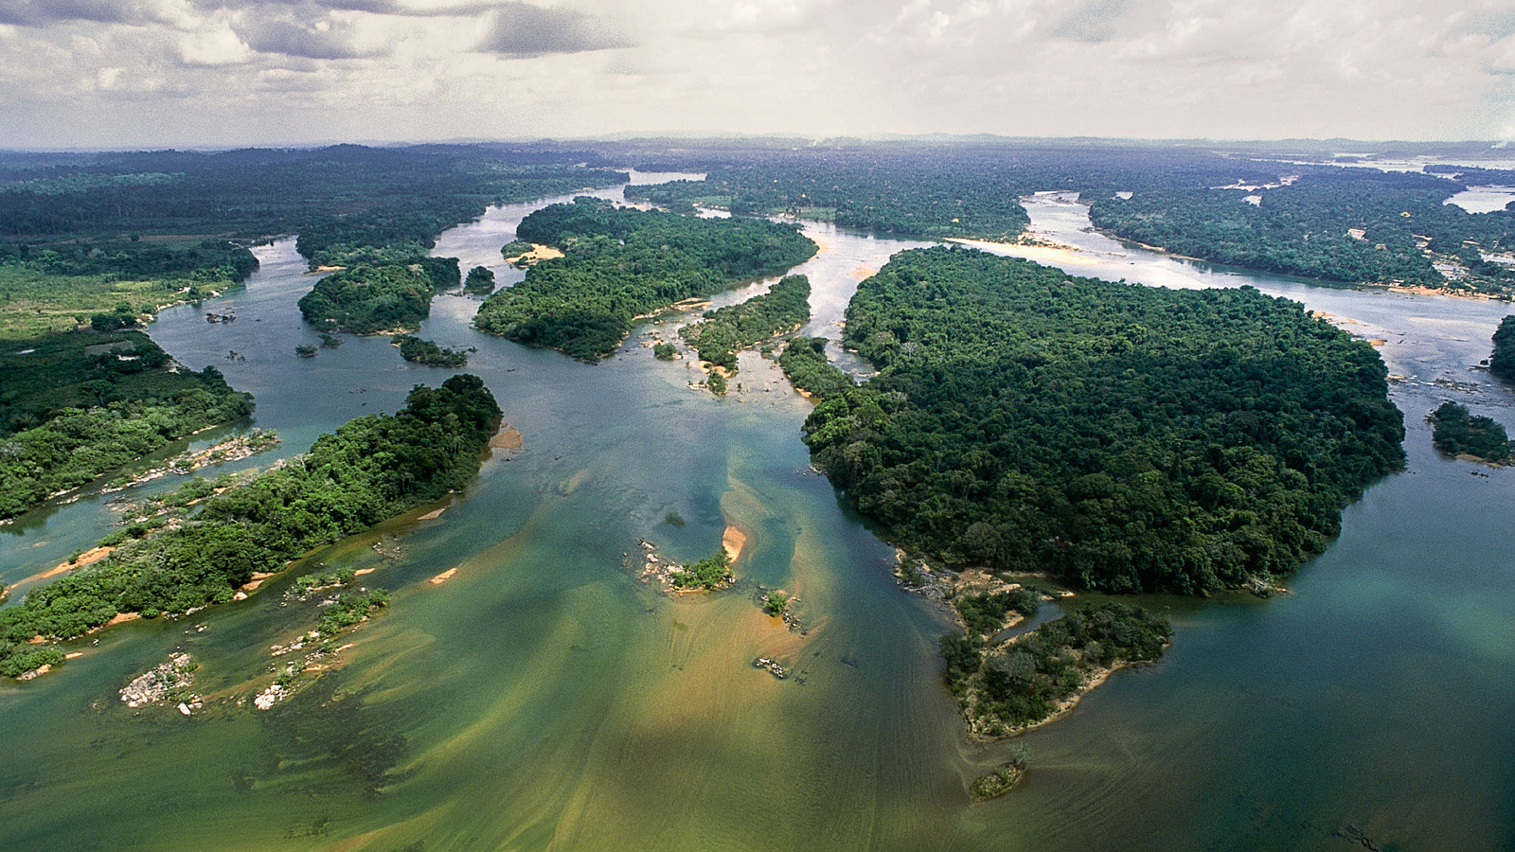
Expanded Constituency Workshop
Session of the Independent Evaluation Office, GEF
Anupam Anand, Ph.D
Evaluation Officer
GEF Independent Evaluation Office
Malac Kabir
Research Assistant
GEF Independent Evaluation Office
Swaziland, February 2017

Slide 2
GEF Council
M&E in the GEF
Guided by the M&E Policy
STAP
GEF Secretariat
GEF IEO
GEF Agency Evaluation Offices
GEF Agencies
Participating Countries
Policy, standard-setting and/or oversight function
Country Stakeholders
Reporting or provision of information

Slide 3
GEF Independent Evaluation Office
Functions
Independent evaluation
Setting of minimum standards (normative)
Quality control (oversight)
Knowledge sharing and dissemination

Slide 4
Outline
I: M&E Quiz
II: Comprehensive Evaluation of the GEF (OPS6):
Completed Evaluations
Emerging Findings
III: Tell your story
IV: Putting it together

Slide 5
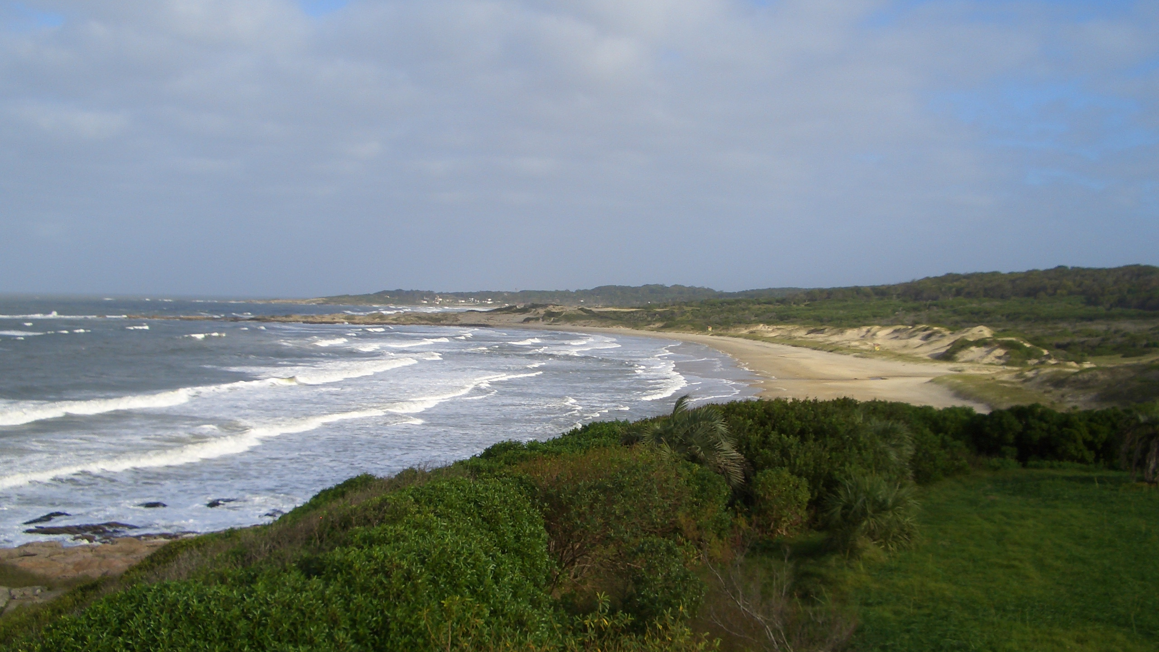
II
6th Comprehensive Evaluation (OPS6)

Slide 6
October
November
December
January
February
March
April
May
June
July
Focal Area Studies
International waters
Land degradation
Chemicals and waste
Biodiversity
Climate change
Mainstreaming / Cross cutting
< CSO Network (June)
Private Sector and GEF
Safeguards and Indigenous Peoples Policy
Gender
Impacts
GEF's Support in Policy, Legal and Regulatory Reform in Countries
The Transformational Role of the GEF
Trends in Performance (replacing APR 2017)

Slide 7
October
November
December
January
February
March
April
May
June
July
Institutional Issues
Reform Process – Results Based Management
Reform Process – Knowledge Management
GEF6 Strategy, Global Relevance
Governance, Financing, Health of the Partnership
Thematic Evaluations
Programmatic approaches
Multiple Benefits of GEF support
Integrated approaches
OPS6
Early findings
Full report >
(September)

Slide 8
Completed Evaluations

Slide 9
International Waters Focal Area Study
Mexico

Slide 10
Rehabilitation of the Black Sea Northwest Shelf dead zone
Support the process leading to the Stockholm and Minamata Conventions
Adoption of the Ballast Water Convention on Alien Species, the Pacific Tuna Treaty, the Guarani Aquifer Agreement
Establishment of the Benguela Current Commission
Contributions

Slide 11
$$$
Decline of the funding envelope
Dominance of marine and ocean investments
No funding for project or program preparation
Lack of Agency participation in strategy definition
Areas of concern

Slide 12
Value for money analysis of GEF Land degradation projects

Slide 13
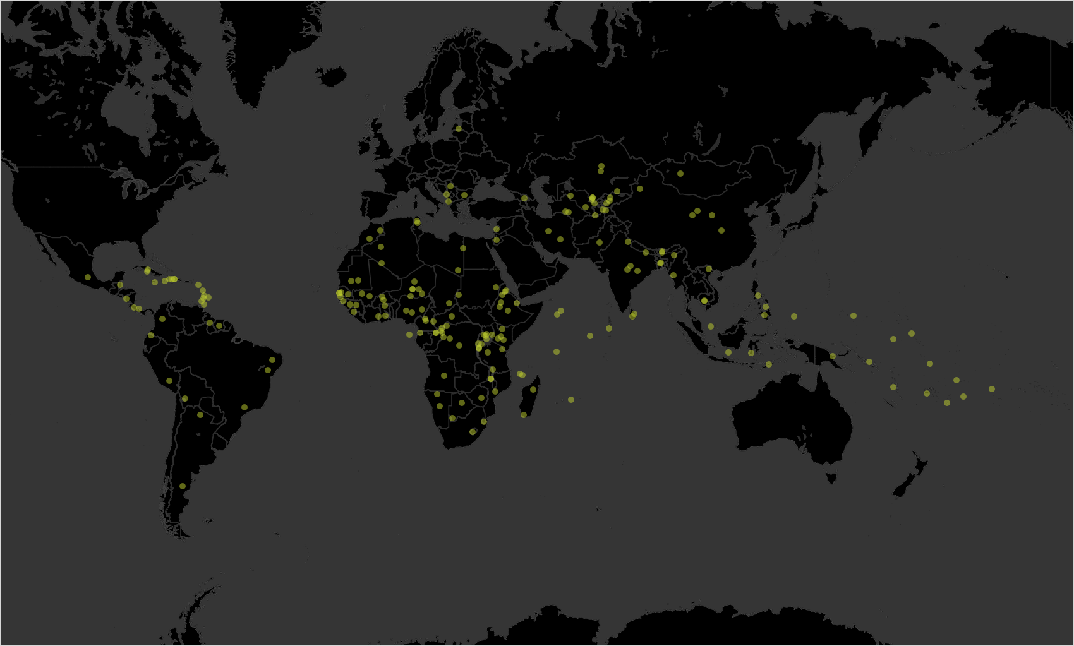
GEF Land Degradation Projects

Slide 14
43.52
tons of carbon sequestered
per hectare
$7,500,000
Average contribution per project from sequestration alone
43.52
tons of carbon sequestered
per hectare
108,800
tons of carbon sequestered per project location
$7,500,000
contributed to sequestration alone
Findings

Slide 15
Less effective near urban areas
Time
required
Multifocal
Initial conditions
Environmental and Economic characteristics
Findings: Vegetation

Slide 16
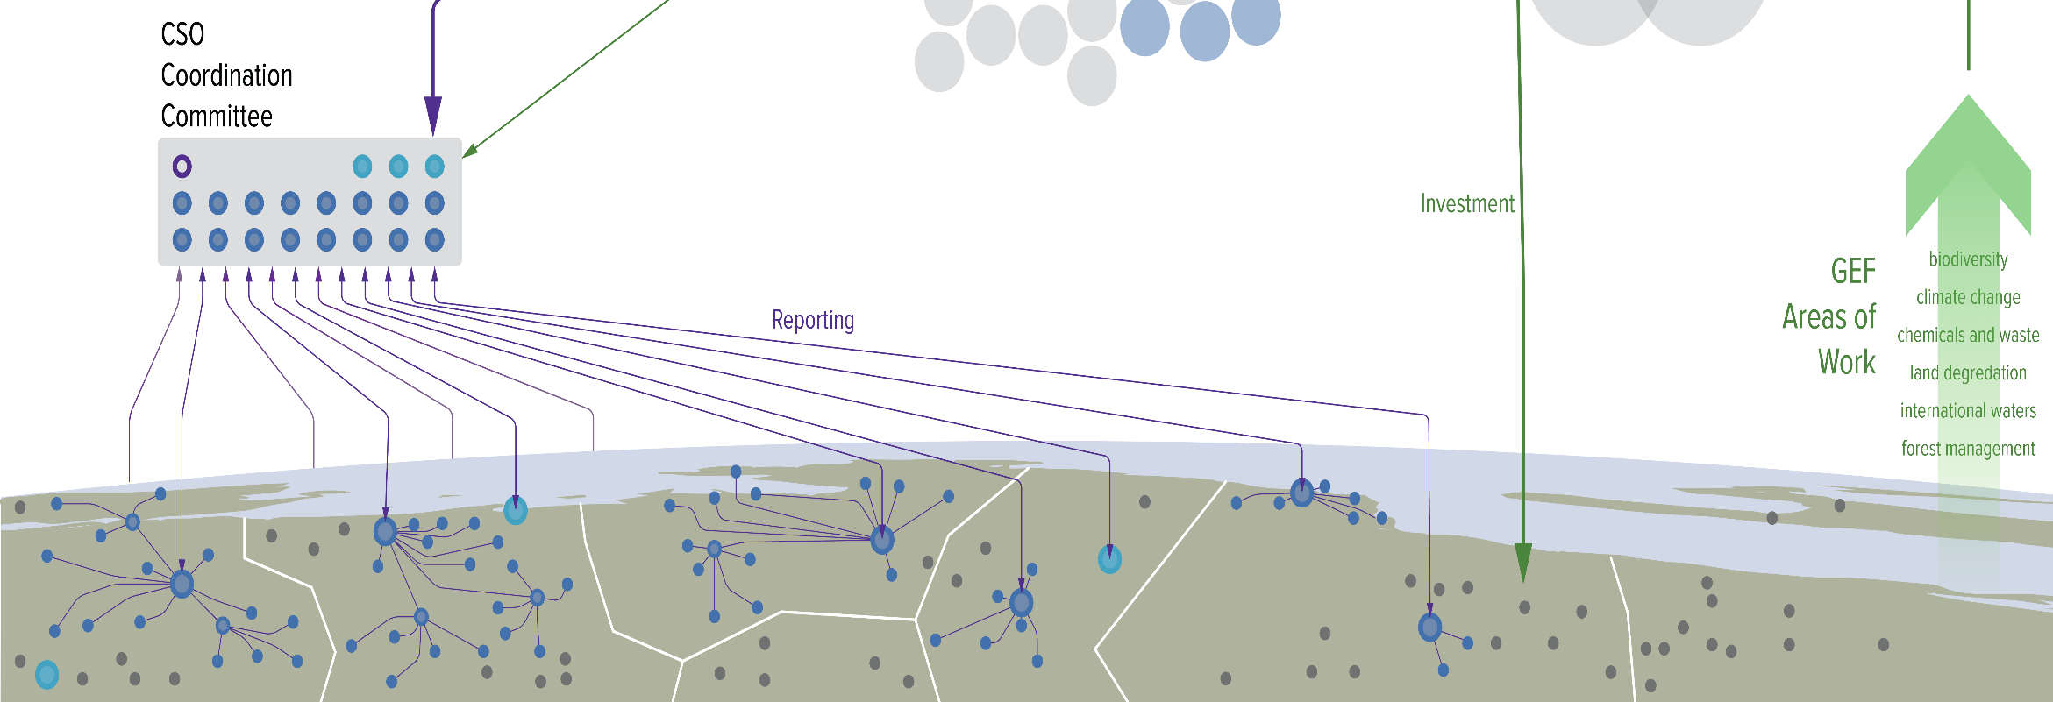
Evaluation of the GEF CSO Network
CSO Network prepares for and reports back on the Council meetings to the wider CSO community in countries and regions
enhancing the role of civil society in safeguarding the global environment,
strengthening GEF Program implementation through partnership with civil society
building the capacity of the GEF CSO Network
474 member organizations
across 122 countries
Country Contact Points in 20 countries

Slide 17
Conclusions:
Conclusion 1: Network remains relevant and is delivering results
Conclusion 2: Network is distant from the country level. As such, the Network is compromised in its ability to bring forward country perspectives
Conclusion 3: The CSO Network is operating in an expanding GEF Partnership without a shared contemporary vision of its role
Conclusion 4: Within an increasingly complex operating environment, the Network has strengthened organizationally but governance challenges remain

Slide 18
Joint Evaluation of the GEF/UNDP Small Grant Programme
Support programs with high levels of success in securing Global Environmental Benefits
Significant attention to community level benefits, poverty and livelihoods, yielding positive results
SGP has been more successful at mainstreaming gender than other GEF projects
Differing views amongst stakeholders on the extent to which SGP should address socio-economic priorities

Slide 19
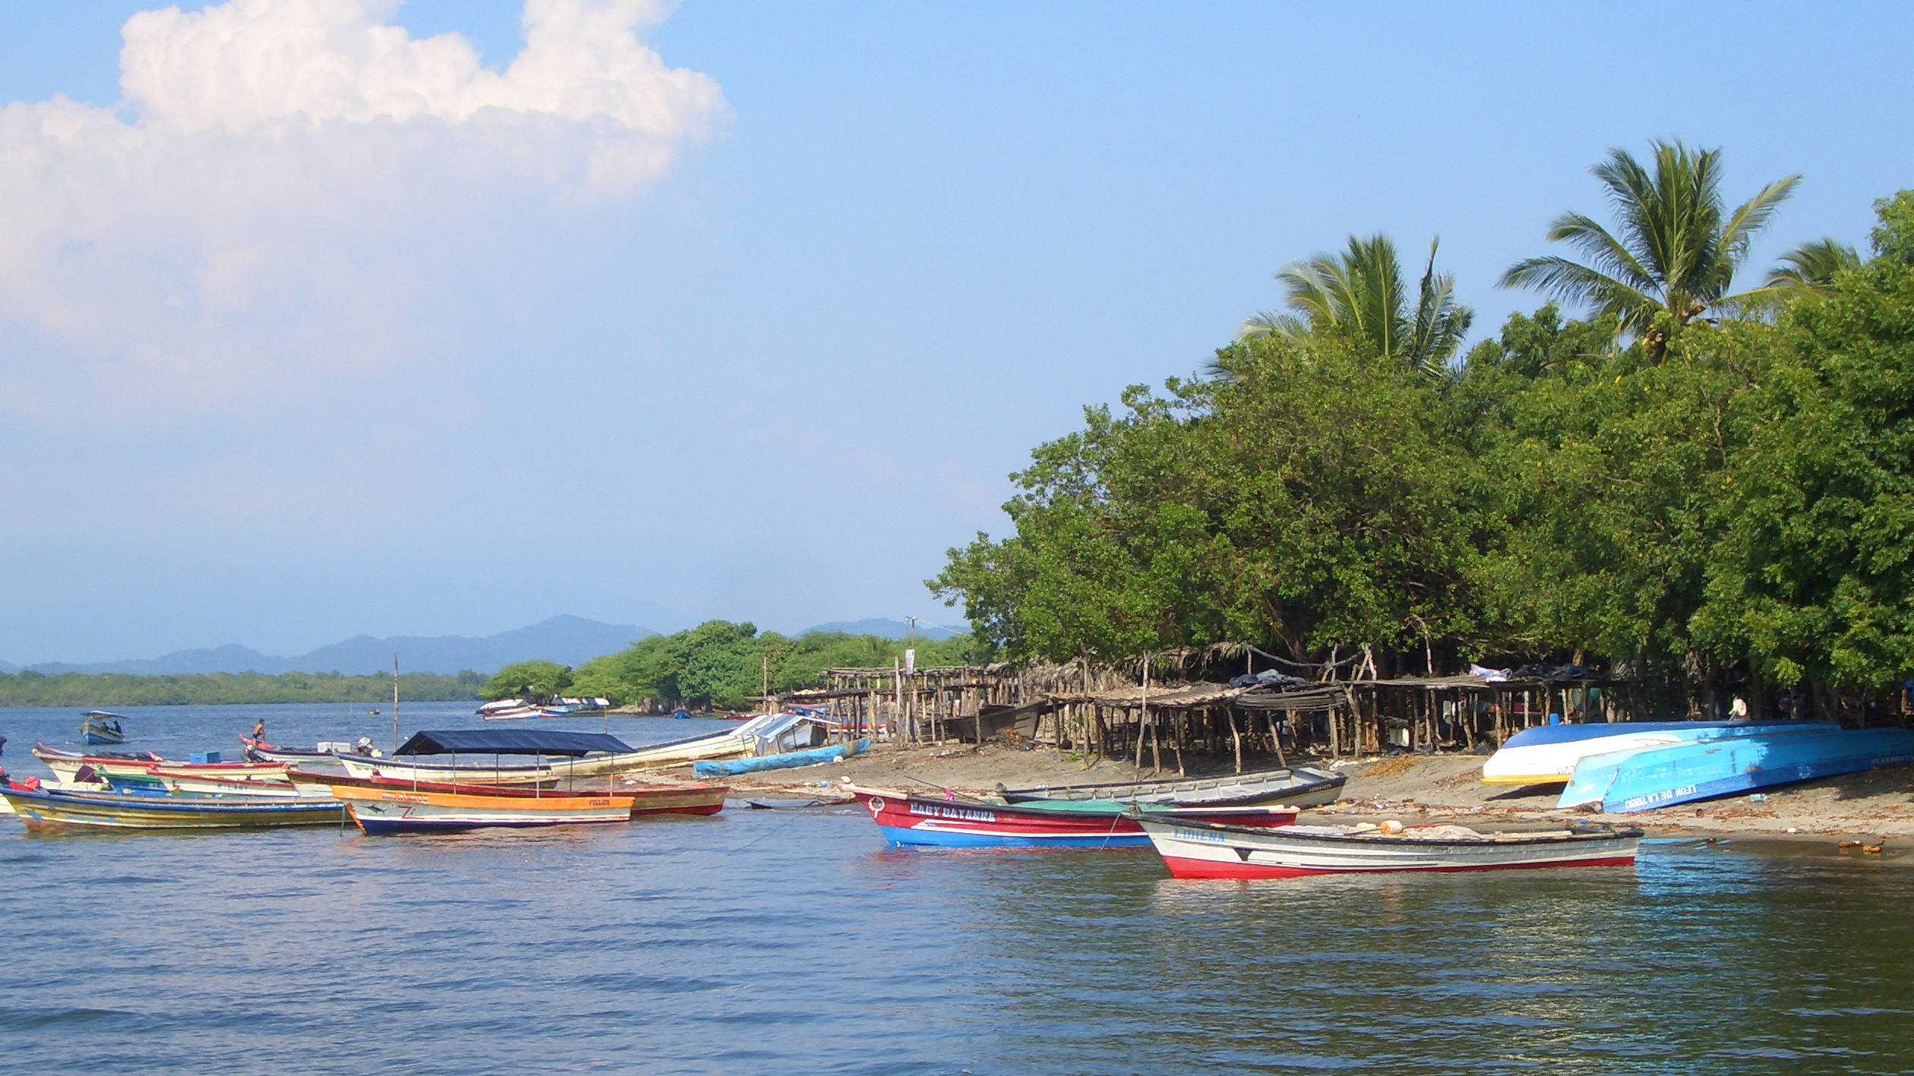
Emerging Findings
El Salvador

Slide 20
GEF Role in Supporting Legal and Regulatory Reform in Countries
GEF: Important role in supporting policy and legal reform
Regulatory reforms take time: potential for mismatch between project duration and legislative and/or rule-making process needs to be considered
Rule-making is inherently political process involving constituents with often competing and/or different interests
There is much that can be done under existing statutes either through policies or administrative actions
In some countries, the necessary institutional machinery and authority for enforcement also need strengthening
Turnover within ministries can impact the continuity of the rule-making process

Slide 21
III Tell your story:
Legal and Regulatory Reform
Has GEF influenced policy or legal reform in your country?
What were the factors affecting the outcomes? (positive and negative)
What could GEF have done differently to improve the results?

Slide 22
IV How would you measure outcomes? Let’s work with a hypothetical project that is aimed to reform environmental policy/legal framework
Inputs
Activities
Outputs
Outcomes
Impacts
??
Context
Assumptions

Slide 23
Inputs
Activities
Outputs
Outcomes
Impacts
??
Context
Assumptions

Slide 24
WRAP UP: Important Reminders
Develop a clear theory of change
Outcomes should clearly be a reflection of the objectives with appropriate indicators/tracking tools
Monitoring should be done throughout implementation with adequate resources
Evaluation should address: Relevance, Efficiency, Effectiveness, Impact and Sustainability (just learnt in the quiz)
Source: GEF Annual Performance Report 2013

Slide 25
Thank you!
For more information, visit www.gefieo.org

