Slide 1
Knowledge and Learning at the GEF and the GEF Partnership
Notes:
GEF KM objectives; how KM can be best incorporated into GEF projects and programs and; how the GEF partnership can leverage their existing KM systems

Slide 2
What is Knowledge?
At the GEF, knowledge is the experience and lessons learned related to projects and programs.

Slide 3
What is KM?
At the GEF, “Knowledge Management” is defined as the systematic processes, or range of practices, used by organizations to identify, capture, store, create, update, represent, and distribute knowledge for use, awareness, and learning across the organization and its ecosystem.”

Slide 4
Why KM?
It is an Essential condition for GEF finance to make a lasting impact.
Notes:
The GEF’s added value includes supporting the development of programs and initiatives that underpin the generation and sharing of knowledge, and facilitating the synthesis, exchange and uptake of knowledge within and beyond the GEF Partnership.
GEF’s comparative knowledge advantage relies on its potential for distinctive multi-sectoral breadth, the diversity of the Partnership, and a long and rich history of projects to draw from.
The GEF partnership model offers a unique platform from which to gather, organize and share experiences and related expertise on global environmental issues.

Slide 5
Knowledge FLOWS
CSOs & the public
Conventions
GEF Council
Media
?
Trustee
?
?
Donors
Global Decision Makers
GEF Project Portfolio
?
GEF Sec
Recipient OFPs
IEO
Recipient Beneficiaries?
STAP
?
Think tanks, forums & industry associations
Panel
Secretariat
?
Science & Academia
Large project
Executers
GEF Agencies
Private Funders, Investors & Companies

Slide 6
GEF Partnership
Informing National, Regional and Global Dialogues
Portfolio level
Program Level
Project Level
GEF Partnership
Improving Project Quality

Slide 7
Challenges
Gaps in knowledge capture and dissemination from project and programs-level interventions.
Fragmentation of knowledge related to GEF projects and programs across countries, agencies and focal areas and not easily accessible to both internal and external stakeholders.
Perception exists that the knowledge shared does not fully reflect the potential collective experience.
Missed opportunities for learning from experiences gained outside of the GEF partnership. Examples include academia, think-tanks, partner countries, civil society outside of the GEF network, other funds and development agencies, the private sector, and global dialogues

Slide 8
Objectives
Objective 1: To inform global, regional and national policy dialogues on options and approaches to reverse the course of environmental degradation.
Objective 2: To improve the impact of GEF-supported projects and programs.
Notes:
Key challenges include
Gaps in knowledge capture and dissemination from project and program-level interventions. KM is sometimes neglected, even within projects that have knowledge generation and innovation as main goals.
(b) Fragmentation of knowledge related to GEF projects and programs across countries, agencies and focal areas and not easily accessible to both internal and external stakeholders. There is limited portfolio-level knowledge syntheses of project and program experiences across all GEF focal areas – or systems to share them when they exist, including lessons learned to inform key global
debates, technical lessons to inform typical project interventions6 and sufficient information on results achieved. As such, while the GEF is heavily engaged in many global dialogues, the perception exists that the knowledge shared does not fully reflect the potential collective experience.
(c) Missed opportunities for learning from experiences gained outside of the GEF partnership. Examples include academia, think-tanks, partner countries, civil society outside of the GEF network, other funds and development agencies, the private sector, and global dialogues

Slide 9
Enhancing GEF Data
Expand existing GEF Database so that it can store lessons learned
Make data accessible in a way that is easily searchable.
Mapping GEF project data with advanced search/report generation capabilities

Slide 10
Improve Data Uptake
Improve PIF and M&E reporting templates to enable submission of lessons learned during and after project implementation.

Slide 11
KALEO – “Ask an Expert”
Proposed:
Questions asked in Kaleo return accurate, bite-sized answers
Knowledge is actively updated by GEF experts.
Knowledge experts can include media from existing systems while adding expert commentary in real-time when answering questions.

Slide 12
Mapping “Spatial Agent”
Spatial Agent is an app designed to visualize and map open data
1000’s of datasets from more than 300 institutions.
Data includes statistical information, ground-based monitoring, satellite earth observation and model outputs (e.g. climate change projections) visualized in innovative ways
(What is the difference in the climate model projections for rainfall in the next century across models?)
Notes:
Solutions to many of the existing and evolving development challenges faced across the globe are hampered by the poor availability of critical spatial and temporal data. There are many new high-quality datasets (e.g. from earth observation and systematic collation and analysis of national data) available from a number of institutions (e.g. UN agencies, NASA, NOAA, CIESIN, IRI, The World Bank, etc.) that still are little-known especially in the developing world.
What is the difference in the climate model projections for rainfall in the next century across models?

Slide 13
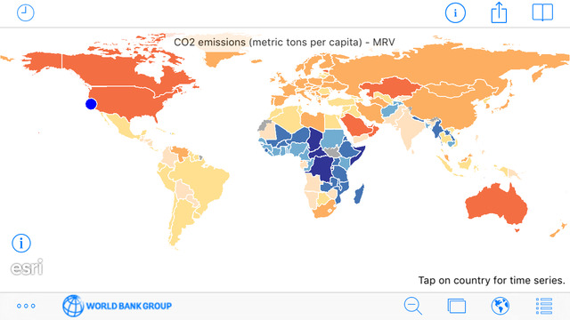
Spatial Agent

Slide 14
Actions & Opportunities
Reinforce actionable knowledge at the program/project level -across the GEF Partnership.
Improve capacity of GEF’s technology platforms – including an open-access approach to data
Maximize impact from the IEO, STAP and the GEF CSO network
Form new partnerships with the private sector, think-tanks, science organizations and academia
Create opportunities for south-south knowledge exchanges

Slide 15
Knowledge Products
Proposed:
GEF “Lessons in a Nutshell” Series (objectives 1&2)
GEF publications and multi-media series (objective 1)
Lessons learned for inclusion in GEF’s AMR (objective 2)
GEF knowledge products repository (objectives 1&2)

Slide 16
Ultimate Product: Learn Apply Scale
Proposed:
GEF KM and Learning Partnership
The GEF Partnership KM and Learning System will enable uptake of lessons learned in the GEF and improve the GEF Partnership’s ability to learn by doing, enhancing its impact over time.

Slide 17
Knowledge and Learning Questions
What are the key GEF-relevant Knowledge and Learning needs of your country?
How can the GEF Secretariat and agencies better meet the GEF-relevant Knowledge and Learning needs of your country?
What is the demand in your institution for GEF Knowledge and Learning Products (GEF publications, newsletters, website, project generated documents, events/seminars, etc.)?
How do you find the quality of existing GEF Knowledge and Learning Products that you currently access and use?
How can countries better contribute to meet Knowledge and Learning needs of GEF stakeholders locally and globally and to improve Knowledge Flow across the GEF partnership?
How can Knowledge and Learning be better integrated into GEF projects?

Slide 18
Thank You!

