Slide 1
Facilitating synergies in implementing multilateral environmental agreements towards sustainable development
GEF Expanded Constituency Workshop
for Eastern Africa
19 April 2017
Notes:
The objective of this session is to encourage all participants to start thinking about the GEF in a different manner from the past, with more emphasis on programs for impact and less on a collection of individual projects. (This should also help them have better understanding of the ideas discussed at the replenishment and to give their views to their representatives at the replenishment negotiations.)
What we will show in our presentation today is how the Conventions are taking this synergistic approach, how the GEF is facilitating the move in this direction and during our group work encourage all the focal points in the countries to actually do the same at home and to promote discussion on how best to do this for the benefit of all.

Slide 2
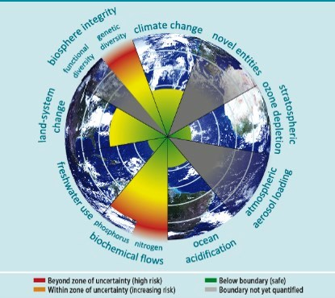
MEAs and SDGs: Coordinating response to safeguard planet
Continued, rapid deterioration of the global commons…
Holocene → Anthropocene
Urgent action required to avoid tipping points and irreversible damage
Stockholm Resilience Centre
Notes:
I am showing you this slide again before we get into the presentation to remind you about what we spoke about this morning on the global commons and WHY WE NEED TO CHANGE OUR APPROACH TO DOING BUSINESS – TO MAINTAIN A SAFE OPERATING SPACE FOR HUMANITY WE NEED TO USE DIFFERENT, MORE IMPACTFUL APPROACHES
If necessary:
The diagram depicts the issue. It shows the direction in which we are heading in relation to the Global Commons-ecosystems, biomes, process that regulate our natural environment. These are all the foundation of life on earth, our societies and economies. Our actions in these different spaces can and are leading to potentially irreversible damage to the 9 planetary boundaries (in the diagram) that we depend on for life. These include boundaries related to climate, deforestation, biodiversity, ocean acidification, chemical pollution, ozone, water, fertilizer use and aerosols. The red and yellow areas show where we are slowly moving out of a safe space and risky territory – biogeochemical cycles, biodiversity (the closet to the tipping point) and land system change and climate change (very close behind).

Slide 3
The world is responding...
SOCIETY
ECONOMY
BIOSPHERE
Paris Agreement UNFCCC
Stockholm Convention
Minamata Convention
CBD
UNCCD
Notes:
How is the world responding
1) In response, MEAs and SDGs are coordinating a response to safeguard the planet
2) Only by integrating our collective response, we can have the collective effect we are seeking
3) Important to note in this diagram that the biosphere underpins all the other goals- Climate Action, Life on Land, Life on Water which are the basis for achieving all these other goals.
4)The successful implementation of the SDGs can only be achieved by fulfilling the objectives of the legally-binding conventions
5) GEF is the financial mechanism which exists to support the objectives of these Conventions, to which your countries are party.

Slide 4
Session objectives?
To understand milestone global agreements and recent MEA guidance to the GEF;
To enhance synergies among MEAs and promote GEF program integration;
Discussion around the Convention synergies.
Notes:
So with all of that in mind on synergies and collaborative action we will be looking at how this relates to the MEAs
Give you an understating of milestone global agreements and recent MEA Guidance to the GEF that relate to synergies and collaborative action.
We will then touch on some of the modalities used within GEF as well as on the ground at country level to facilitate this synergistic approach
3) Finally, and most importantly, we will give you all a chance to discuss and share amongst yourselves and with us on what could be done with GEF-7 resources using this synergistic approach. We will ask you to discuss in your country tables two questions and share back to the plenary. – including by learning from lessons from GEF-6 and discussing impactful programming.

Slide 5
Convention Guidance
Notes:
Normally we would have Convention Secretariat representatives joining us for this session and we did indeed have Lisa Janishevski CBD Secretariat who confirmed to attend, but she had to change her plans at the last minute.
So I will go through the Convention Guidance related to synergies not only for the CBD but also for the other major global environment agreements.

Slide 6
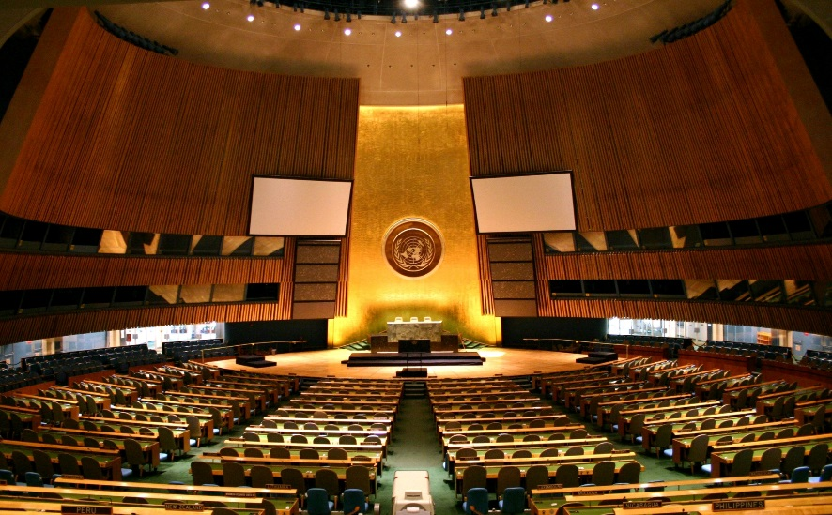
Key agreements and GEF guidance
UN General Assembly:
Noted the need for enhanced cooperation among the Rio Conventions (2009);
Adopted The Future We Want (Rio+20), encouraging coordination and cooperation between MEAs.
Notes:
Overall the UN General Assembly has noted the need for coordination and cooperation among the MEAs and made specific reference to this in 2009 and has since reiterated this thinking in the Rio+20 outcome document.

Slide 7
Key agreements and GEF guidance
Convention on Biological Diversity:
“Encourages Parties to promote synergies between biodiversity and climate-change policies and measures” (decision XI/21);
“Requests the Global Environment Facility […] to support projects and activities to improve synergies among relevant multilateral environment agreements” (decision XI/6);
Notes:
CBD guidance has not only encouraged parties to promote synergies at the national level b/w BD and CC, but also has given guidance to the GEF to support these types of integrated projects that improve synergies with CBD and other MEAs

Slide 8
Key agreements and GEF guidance
Convention on Biological Diversity:
GEF to provide financial resources for:
“Capacity-building with the aim of increasing the effectiveness in addressing environmental issues through their commitments under the CBD, UNFCCC, and the UNCCD, inter alia, by applying the ecosystem approach”
“Developing synergy-oriented programmes to conserve and sustainably manage all ecosystems, such as forests, wetlands and marine environments, that also contribute to poverty eradication” (decision X/24)
Notes:
The Convention also specifies that GEF financing should be geared towards capacity building as well as integrated programmes.

Slide 9
Key agreements and GEF guidance
UN Framework Convention on Climate Change:
“Encourages the Global Environment Facility […] to align […] programming with […] nationally determined contributions, where they exist, during the seventh replenishment, and to continue to promote synergies across its focal areas.”
“Requests the Global Environment Facility […] to take into consideration climate risks in all its programmes and operations […].” (decision 11/CP.22)
(I)NDCs frequently mention biodiversity, ecosystem-based approaches, land degradation…
Notes:
UNFCCC guidance again like CBD, encourages GEF to focus on promoting synergies w/i GEF 7 and to align all programming with NDCs, along with taking into consideration climate risks.

Slide 10
Key agreements and GEF guidance
Stockholm Convention and Minamata:
“Stressed that the sound management of chemicals and wastes has a global environmental benefit and is an essential element of sustainable development;
“Encouraged the Facility to continue to enhance synergies in its activities”
“Identification of possible elements of guidance from the Stockholm Convention to the GEF that also address the relevant priorities of the Basel and Rotterdam conventions.” (decision SC-7/21)
Notes:
The chemicals conventions also deal with synergies in their decision language. But: the synergy language mostly relates to synergy WITHIN/BETWEEN the chemicals conventions (Basel, Rotterdam, Stockholm and Minamata Conventions). Not so much with other MEAs beyond chemicals.

Slide 11
Key agreements and GEF guidance
UN Convention to Combat Desertification:
“Invites the GEF to continue its support for the implementation of the convention […] in light of the 2030 Agenda for Sustainable Development, in particular target 15.3”;
“Invites the GEF to […] consider technical and financial support for voluntary national land degradation neutrality target-setting”
“Invites country Parties to formulate and integrate in their National Adaptation Plan voluntary targets to achieve LDN in accordance with their specific national circumstances and development priorities.” (COP 12)
Notes:
GEF has been requested (by the UNCCD) to support LDN target setting and the processes around this at the national level. LDN is also the central focus of SDG Target 15.3 (click to next slide)
UNCCD COP 12 (2015):
Addressing LDN will be priority area for GEF support;
LDN guiding principle for implementation of Convention.

Slide 12
Example: Land as a central element
SDG 15, Target 15.3: Land Degradation Neutrality
“by 2030, combat desertification, and restore degraded land and soil, including land affected by desertification, drought and floods, and strive to achieve a land-degradation neutral world.”
Land agenda embodies the importance of tackling complex, interdependent issues in an integrated manner
How we protect and manage land resources sustainably will have impacts on multiple goals
UNCCD COP 12 (2015):
Addressing LDN will be priority area for GEF support;
LDN guiding principle for implementation of Convention.
Notes:
This slide shows two things
How GEF’s guidance from the Convention is directly related to a specific SDG target (15.3) showing synergy b/w the two agendas or mandates
Integrative nature of the land itself. It underpins and influences many other areas/targets (goes back to the first slide)
This slide and land degradation really is just one example of an area where GEF support for SDG implementation goes hand-in-hand with MEA implementation (in this case UNCCD).
Target 15.3: By 2030, combat desertification, restore degraded land and soil, including land affected by desertification, drought and floods, and strive to achieve a land degradation-neutral world.

Slide 13
Practical Action: Synergy and Multiple Benefits
Growing interest by countries in cross-cutting projects with multiple benefits
47 out of 74 land degradation projects (FY13-15) are multi-focal;
$227 million from land degradation, $300 million from biodiversity, climate change, SFM, etc.
41 more projects addressing land agenda supported by funds for climate change (LDCF, SCCF, AF)
$297 million from climate-related funds
Notes:
Practically speaking, synergy elements are increasingly being envisaged by recipient countries, as can be seen by increasing multi-focal area and multi-trust fund projects related to land degradation. This has also shown synergy among Rio Conventions on the ground.

Slide 14
Practical Action: Synergy and Multiple Benefits
Example of institutional arrangements at the national/regional level:
Informal and/or formal committees to coordinate between national focal points, different ministries and agencies, and other stakeholders.
National GEF committees as mechanisms for national focal points to foster the coherent implementation of the MEAs and SDGs.
National strategy for the implementation across MEAs and SDGs.
Regional initiatives including learning and peer-to-peer exchange, regional centers of excellence in data monitoring and reporting, implementation of large-scale, cross-cutting impact programs.
Notes:
Ask participants to give examples of how you can use institutional arrangements at the national/regional level to demonstrate synergy
Some practical examples of institutional arrangements that strengthen synergy at the national/regional level.

Slide 15
Practical Action: Synergy and Multiple Benefits
Additional entry points for synergies at the national level:
Sustainable Development Goals: Coordinating framework for achieving multiple goals. Integration of MEAs and SDGs in national development.
Implementation of ecosystem-based approaches to climate change adaptation: EbA enable people to adapt to the impacts of climate change by sustainably managing, conserving and restoring ecosystems.
National planning and reporting (e.g. links between UNFCCC NAPs, CBD NBSAPs, and UNCCD NAPs, national reports)
Sustainable land management: links with biodiversity, climate change and land degradation, relevant to all 3 Rio Conventions.
Landscape restoration: contributes to biodiversity conservation, climate change adaptation and mitigation and combatting land degradation, relevant to most MEAs.

Slide 16
GEF-6 Programming Structure
Integrated Approach Pilots:
Sustainable Cities
Food Security
Commodity Supply Chain
Other cross-cutting initiatives:
Sustainable fisheries
Illegal wildlife trade
Amazon sustainable landscapes
Commodities
Food Security
Cities
Biodiversity
Land Degradation
Climate Change
Sustainable Forest Management
International Waters
Chemicals & Waste
Biodiversity
Notes:
The GEF evolved over time:
In GEF-4 and GEF-5, mostly single-focal area projects
(ANIMATION)
In GEF-6, we had focal areas and – on top of the focal areas – a few Integrated Approach Pilots and some other cross-cutting initiatives
(ANIMATION)
Going forward, we believe it is important to continue and strengthen these IAPs and perhaps expand them further

Slide 17
Questions for today’s discussion
We think the IPs are one of the ways of achieving these convention synergies is there another way?
2)What are some of the challenges you have faced in implementing Convention synergies the ground?
3) How do you see the CBD Convention blending with the other Conventions and vice versa?

Slide 19
Assessing national priorities as expressed in INDCs, NBSAPs
 | AFR | ASIA | ECA | LAC | SIDS | Total
Restoration and Reforestation | 98% | 100% | 96% | 100% | 97% | 98%
Energy | 98% | 100% | 88% | 90% | 97% | 95%
Food Security | 98% | 100% | 83% | 100% | 91% | 94%
Sustainable Cities | 96% | 94% | 83% | 80% | 94% | 91%
Environmental and Water Security | 94% | 100% | 58% | 95% | 91% | 88%
Resilience | 98% | 100% | 63% | 80% | 91% | 88%
Fisheries | 75% | 82% | 67% | 85% | 85% | 78%
Natural Capital | 73% | 76% | 50% | 85% | 71% | 71%
Healthy Oceans and Coastal Systems | 58% | 71% | 54% | 80% | 76% | 66%
Green Financing | 60% | 65% | 50% | 80% | 56% | 61%
Green Infrastructure | 40% | 53% | 25% | 60% | 29% | 39%
Commodities | 6% | 18% | 0% | 50% | 3% | 12%
Amazon Landscapes | - | - | - | 89% | - | 89%
Notes:
This is just a reiteration of a slide that was presented earlier today in the GEF-7 overview session. It presents an analysis of the country priorities for future programming, which seem to converge around a number of distinct areas – READ LIST

Slide 20
Questions for today’s discussion
What is an example of cross-cutting/integrated GEF financing in your country, past or present, and was it helpful?
10 min discussion in small groups (each table)
…then short reporting back (1 person per table)
Notes:
Each table to report back with not more than 2-3 examples (change to one per table if group is large) of cross-cutting, multi-focal or multi-benefit, multi-trust fund, or Integrated Approach Pilot projects in their country.

Slide 21
Questions for today’s discussion
2) What cross-cutting, transformational impact programs could be most helpful in your country/region and could be practically feasible in GEF-7?
10-15 min discussion in small groups (each table)
…then reporting back with short list of priorities for GEF-7 programming
Notes:
Ask 3 tables to step up and volunteer to report back; then ask rest of the tables to add or comment in case they feel that additional programming priorities are needed in GEF-7.
Take notes and summarize briefly a list of Impact Programs that would address all the priorities that were raised during the discussion. They should hopefully match the Impact Program list for GEF-7 replenishment which the GEF Secretariat developed. But if not, equally good to know.
Thank participants for active and rich discussion. They were heard.

Slide 22
Practical Action: Synergy and Multiple Benefits
Examples of institutional arrangements at the national/regional level:
Informal and/or formal committees to coordinate between national focal points, different ministries and agencies, and other stakeholders.
National GEF committees as mechanisms for national focal points to foster the coherent implementation of the MEAs and SDGs.
National strategy for the implementation across MEAs and SDGs.
Regional initiatives including learning and peer-to-peer exchange, regional centers of excellence in data monitoring and reporting, implementation of large-scale, cross-cutting impact programs.

Slide 23
Practical Action: Synergy and Multiple Benefits Additional entry points for synergies at the national level:
Implementation of ecosystem-based approaches to climate change adaptation:
Sustainable Development Goals: Coordinating framework for achieving multiple goals. Integration of MEAs and SDGs in national development.
National planning and reporting (e.g. links between UNFCCC NAPs, CBD NBSAPs, and UNCCD NAPs, national reports)
Sustainable land management: links with biodiversity, climate change and land degradation, relevant to all 3 Rio Conventions.
Landscape restoration: contributes to climate change adaptation and mitigation, combatting land degradation and biodiversity conservation, relevant to most MEAs.

