Slide 1
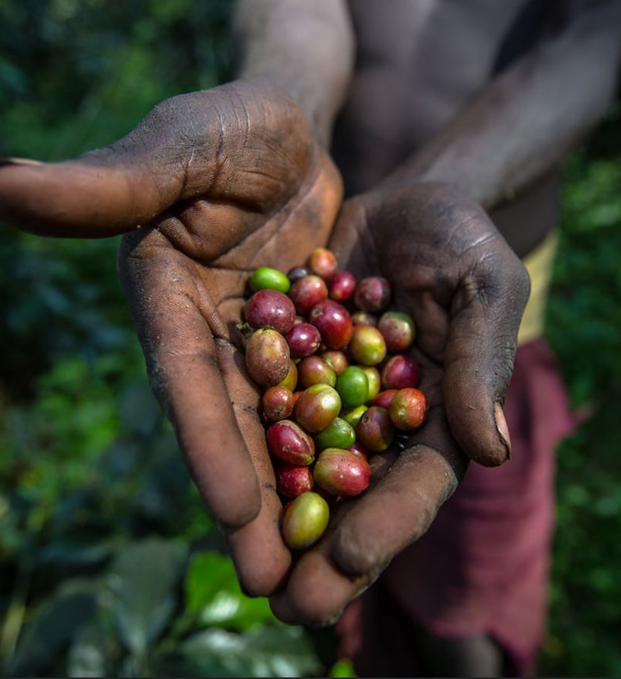
CABO VERDE’s RESOURCES USE and PORTFOLIO PERFORMANCE Pilot Country Factsheet
National Dialogue July 23, 2020

Slide 2
We are sharing the pilot Cabo Verde Factsheet Designed to assist your country in accessing and using resources
Better knowledge of resources utilization
Enhancing the focus on portfolio performance
Coordinating better with the secretariat and agencies
Strengthening performance culture with data
Taking steps to improve delivery and portfolio oversight

Slide 3
Pilot factsheet focusing on resources uses and oversight We have grouped indicators under three categories
Basic country information
Lower Middle Income Country & Small Island States
GEF COUNTRY FACTSHEET | CABO VERDE
Country data
Income: | LMIC |  | LDC: | N | SIDS: | Y | Natl dialogue in GEF-7: | Y
Operational Focal Point: |  | Alexandre Nevsky GOMES RODRIGUES Ministry of Agriculture and Environment |  |  | Political Focal Point: | Gilberto SILVA Ministry of Agriculture and Environment
GEF-7 allocations and commitments
GEF-7 STAR
 |  | Total | Climate Change |  | Biodiversity | Land Degradation
Allocation ($m) |  | 8.5 | 1.0 |  | 6.3 | 1.2
… of which available ($m|%) |  | 8.5 | 100 | 1.0 | 100 |  | 6.3 | 100 | 1.2 | 100
… of which utilized ($m|%) |  | 0 | 0 | 0 | 0 |  | 0 | 0 | 0 | 0
Additional GEF-7 resources
By focal area & type (nb|$m) |  |  |  | Least Developed Countries Fund (LDCF)
Impact Program incentive | 0 | 0 |  |  | Approved | Allocation ($m|$m) |  | 1.2 | 10 | NA
Chemical and waste | 0 | 0 |  |  | Special Climate Change Fund (SCCF)
International water (regional) | 0 | 0 |  |  | Use from inception to date ($m) |  | NA | NA
Enabling Activity | 1 | 0.9 |  |  | Small Grant Program |  |  | Global Project
CBIT | 0 | 0 |  |  | Allocation ($m) |  | 0.3-0.4
GEF-7 allocation & commitments
100% of STAR resources is left to be used, with $6.3m available for Biodiversity
Part of the SGP Program
Ongoing portfolio of projects
Portfolio distribution
By project type (number) |  |  | By focal area (%) |  |  | National | Regional | Regional | By agency (%) | National | National | Regional
Full-sized project |  | 9 | Climate Change |  |  | 100 | 3.69 | 4 | UNDP | 0 | 19.6 | 29
– of which child | regional |  | 3 | 8 | Biodiversity |  |  | 0 | 20.1 | 20 | FAO | 0 | 30.0 | 43
Medium-sized project |  | 2 | Land Degradation |  |  | 0 | 0 | 0 | UNIDO | 100 | 4.3 | 0
– of which child | regional |  | 0 | 1 | International Water |  |  | 0 | 34.18 | 34 | UNEP | 0 | 24.58 | 28
Enabling Activity/CBIT |  |  | Chemical & Waste |  |  | 0 | 29.68 | 30
 |  |  | Multi-focal area |  |  | 0 | 12.36 | 12 |  |  | 12.2
GEF-managed trust funds |  |  |  |  |  | Small Grant Program in GEF-6
Least Developed Countries Fund (nb | $m) |  |  | 98 | NA |  | Active grants (nb)
Special Climate Change Fund (nb | $m) |  |  | 0.75 | 0.96 | NA | NA |  | $m amount (core | STAR | upgraded) |  |  |  |  | | |
Portfolio performance (excludes Enabling Activities)
 | Size |  |  | Key Performance Indicators | Key Performance Indicators | Key Performance Indicators |  |  | Projects rated satisfactorily
 | Project number | Value ($m) | Co-financing (1:X) | Disbursement rate (%) | Disbursement rate (%) | Disbursement rate (%) | Average age (year) |  | Implementation progress (%) |  | Development outcomes (%)
National | 2 | 3.5 | 1:6 | 45 | 85 | 45 | 4.4 |  | 50 |  | 50
Regional | 9 | 52.0 | 1:3 | 39 | 40 | 39 | 5.8 |  | 62 |  | 62
Project portfolio under implementation
Cabo Verde is part of 8 regional projects, which are aging (5.8 average age), have yet to disburse half of the financing available (40% average) and have low ratings
2 national projects focusing on Climate Change, including one nearly reaching completion

Slide 4
Focus on GEF-7 allocations and commitments Covers STAR, additional GEF resources, LDCF and SCCF
Climate
Change
Biodiversity
GEF COUNTRY FACTSHEET | CABO VERDE
GEF-7 allocations and commitments
GEF-7 STAR
 |  | Total | Climate Change |  | Biodiversity | Land Degradation
Allocation ($m) |  | 8.5 | 1.0 |  | 6.3 | 1.2
… of which available ($m|%) |  | 8.5 | 100 | 1.0 | 100 |  | 6.3 | 0 | 1.2 | 100
… of which utilized ($m|%) |  | 0 | 0 | 0 | 0 |  | 0 | 0 | 0 | 0
Additional GEF-7 resources
By focal area & type (nb|$m) |  |  |  | Least Developed Countries Fund (LDCF)
Impact Program incentive | 0 | 0 |  |  | Approved | Allocation ($m|$m) |  | 1.2 | 10 | NA
Chemical and waste | 0 | 0 |  |  | Special Climate Change Fund (SCCF)
International waters | 0 | 0 |  |  | Use from inception to date ($m) |  | NA | NA
Enabling Activity | 1 | 0.9 |  |  | Small Grant Program |  |  | Global Project
CBIT | 0 | 0 |  |  | Allocation ($m) |  | 0.3-0.4
Resources allocated to Cabo Verde
Land
Degradation
Additional resources: International Waters and Chemicals & Waste

Slide 5
Focus on the project portfolio under implementation Provides update on performance indicators
International Waters, Chemicals & Waste and Biodiversity account for the largest share of the portfolio
GEF COUNTRY FACTSHEET | CABO VERDE
Ongoing portfolio of projects
Portfolio distribution
By project type (number) |  |  | By focal area (%) |  | National |  | Regional | By agency (%) | National | Regonal
Full-sized project |  | 9 | Climate Change |  | 100 |  | 4 | UNDP | 0 | 29
– of which child | regional |  | 3 | 8 | Biodiversity |  | 0 |  | 20 | FAO | 0 | 43
Medium-sized project |  | 2 | Land Degradation |  | 0 |  | 0 | UNIDO | 100 | 0
– of which child | regional |  | 0 | 1 | International Water |  | 0 |  | 34 | UNEP | 0 | 28
Enabling Activity/CBIT |  |  | Chemical & Waste |  | 0 |  | 30
 |  |  | Multi-focal area |  | 0 |  | 12
GEF-managed trust funds |  |  |  |  | Small Grant Program in GEF-6
Least Developed Countries Fund (nb | $m) |  |  | 98 | 0 | 0 | Active grants (nb) |  |  |  | 13
Special Climate Change Fund (nb | $m) |  |  | 0.75 | 0.96 | NA | 0 | 0 | $m amount (core | STAR | upgraded) |  |  |  | 0.9 | 0.2 | NA
Portfolio performance (excludes Enabling Activities)
 | Size |  |  | Key Performance Indicators | Key Performance Indicators |  |  | Projects rated satisfactorily
 | Project number | Value ($m) | Co-financing (1:X) | Disbursement rate (%) | Disbursement rate (%) | Average age (year) | Average age (year) | Implementation progress (%) | Development outcomes (%)
National | 2 | 3.5 | 1:6 | 85 | 45 | 4.4 | 7.2 | 50 | 50
Regional | 9 | 52.0 | 1:3 | 40 | 39 | 5.8 | 6.3 | 62 | 62
Majority of regional projects
Portfolio progress by national and regional projects

Slide 6
Projects in GEF-7 and about to start implementation
Project number | Project name | National grant | Regional / global grant | Focal Area | Lead Agency
10226 | Fourth National Communication and First Biennial Update Report for the Republic of Cabo Verde under the UNFCCC | 932,940 |  | Climate Change | UNDP
9705 | Managing Multiple Sector Threats on Marine Ecosystems to Achieve Sustainable Blue Growth |  | 3,787,864 | Biodiversity | UNDP

Slide 7
Projects under implementation
Project number | Project name | National grant | Regional / global grant | Focal Area | Lead Agency | Implem-entation Progress rating | Develop-ment Outcome rating | Disbursement (%) | Project duration (year)
5524 | Mainstreaming biodiversity conservation into the tourism sector in synergy with a further strengthened protected areas system in Cape Verde |  | 3,664,640 | Biodiversity | UNDP | MU | MU | 26% | 3.8
4740 | Disposal of Obsolete Pesticides including POPs and Strengthening Pesticide Management in the Permanent Interstate Committee for Drought Control in the Sahel (CILSS) Member States |  | 7,450,000 | Chemicals and Waste | FAO | MS | MS | 39% | 5.5
5344 | Removing Barriers to Energy-Efficiency in the Cape Verdean Built Environment and for Appliances |  | 1,918,400 | Climate Change | UNDP | MS | MS | 58% | 5
9812 | Sustainable Energy Access to Manage Water Resources: Addressing the Energy-water Nexus | 1,781,484 |  | Climate Change | UNIDO |  |  |  | 1.5
9126 | Coastal Fisheries Initiative- West Africa |  | 6,433,027 | Multi Focal Area | FAO | S | S | 12% | 3
9513 | Support to GEF Eligible Parties (LDCs & SIDs) for the Revision of the NBSAPs and Development of Fifth National Report to the CBD - Phase 1 |  | 6,798,000 | Biodiversity | UNEP

Slide 8
Projects completed in the past two years
Project number | Project name | National grant | Regional / global grant | Focal Area | Lead Agency | Implem-entation Progress rating | Develop-ment Outcome rating | Disbursement (%) | Project duration (year)
3969 | AFLDC: Capacity Strengthening and Technical Assistance for the Implementation of Stockholm Convention National Implementation Plans (NIPs) in African Least Developed Countries (LDCs) of the ECOWAS Subregion |  | 8,000,000 | Chemicals and Waste | UNEP | MU | MU | 43% | 7.2
3923 | SPWA-CC Promoting market based development of small to medium scale renewable energy systems in Cape Verde | 1,758,182 |  | Climate Change | UNIDO | S | MS | 85% | 2.4
2706 | Implementing Integrated Water Resource and Wastewater Management in Atlantic and Indian Ocean SIDS |  | 9,700,000 | International Waters | UNDP | S | S | 46% | 6.1
1909 | Preparation of a Programme for the Protection of the Canary Current Large Marine Ecosystem (LME) |  | 8,090,000 | International Waters | FAO |  |  | 14% | 8.1

Slide 9
What mid-term reviews and terminal evaluations say?
Need for a long-term strategy for Protected areas supported by a robust institutional framework and long-term financing
Promoting dialogue and work with line ministries and stakeholders

Slide 10
Enabling Activities supporting reporting to conventions
Project number | Project name
9981 | GEF Support to UNCCD 2018 National Reporting Process-Umbrella 1
9308 | Minamata Convention Initial Assessment in Cabo Verde and Sao Tome and Principe
9118 | Support to Preparation of the Third National Biosafety Reports to the Cartagena Protocol on Biosafety – Africa Region
9824 | Support to Eligible Parties to Produce the Sixth National Report to the CBD (Africa-2)

Slide 11
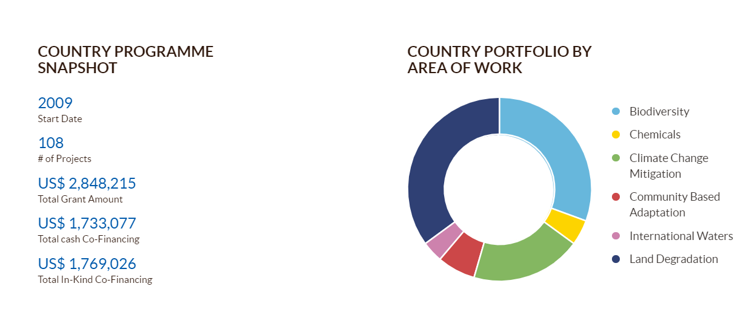
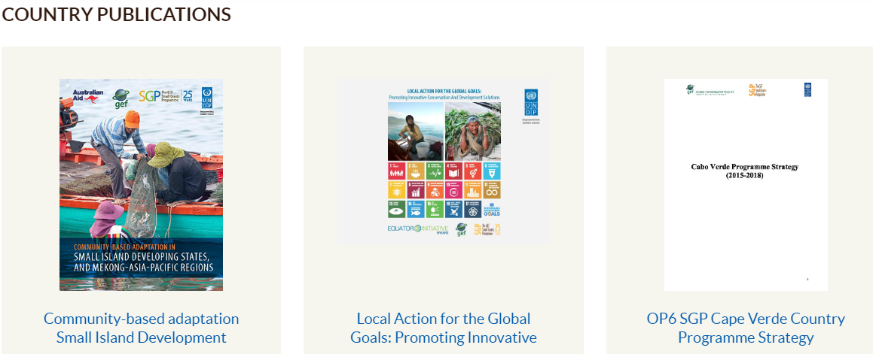
Participating in the Small Grant Programme

Slide 12
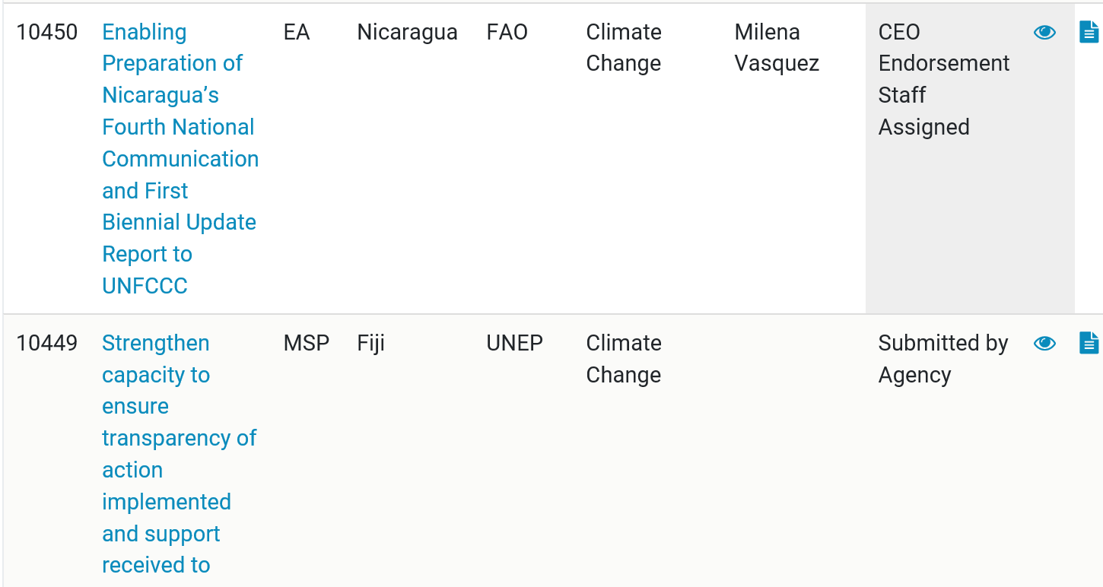
Operational Focal Point can access the GEF Portal Provides real-time project and STAR reporting
Tailored to a specific country
Live interface on project progress
Enhances country engagement
Register through GEF Secretariat colleagues

Slide 13
Way forward for GEF-7
A small number of projects to limit transaction costs
Focus on strategic themes, with large impact and integration across focal areas
Engage in dialogue across sectors at national and local level
Consider joining regional projects to utilize resources
Sustainability and exit to build into project design

Slide 14
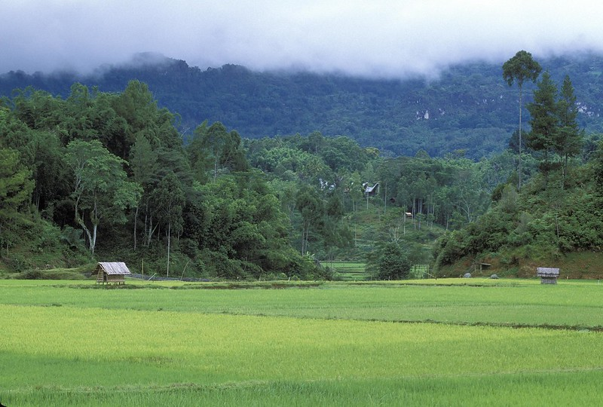
THANK YOU

