Slide 1
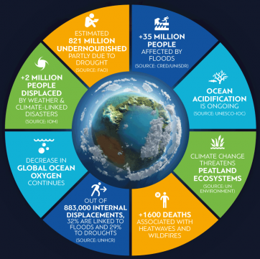
STAP’s guidance on climate risk
GEF & World Bank
Climate Risk Screening & Climate Change
Knowledge Portal Training
Rosina Bierbaum, STAP Chair
September 17, 2020
Notes:
Image: https://public.wmo.int/en/media/press-release/state-of-climate-2018-shows-accelerating-climate-change-impacts

Slide 2
STAP and climate risk
June 2018 STAP’s clarified and codified screening guidelines for GEF projects
June 2019 STAP guidance on climate risk screening
October 2019 GEF agency retreat
March 2020 STAP's further guidance on climate risk screening
April 2020 GEF agency retreat
STAP’s observations on the June 2020 work program

Slide 3
Climate Risk Assessment
Steps in climate risk assessment
IPCC definitions
Risk: potential for adverse consequences where something of value is at stake and associated with uncertainties.
Vulnerability: propensity to be adversely affected encompassing sensitivity to harm and inability to cope.
Notes:
Follows from prior work….
Heard from UNDP, IFAD, etc.

Slide 4
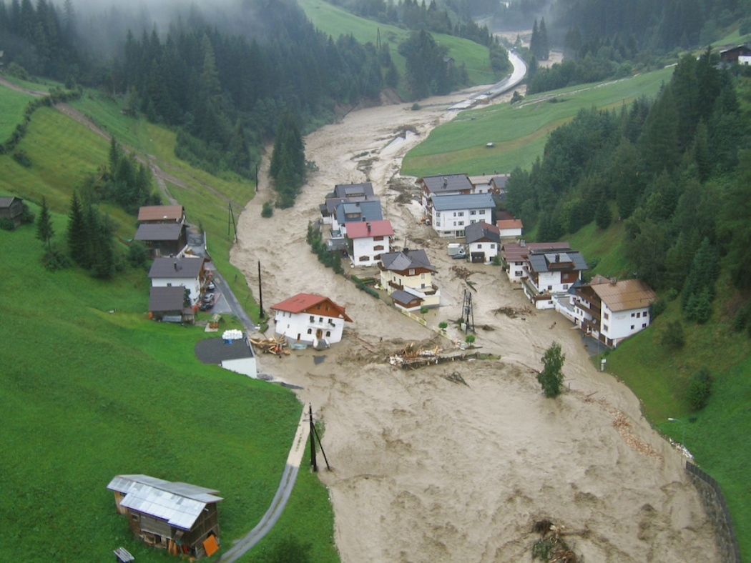
STAP’s Climate Risk Questions
Has the sensitivity to climate change, and its impacts, been assessed?
How will the project be affected by climate risks over the period 2020 to 2050, and have the impacts been addressed adequately?
Have measures to address the risks been considered? How will these risks be dealt with?
What technical and institutional capacity, and information is needed?
https://www.climatecentral.org/news/europe-floods-climate-change-21704
Notes:
https://www.climatecentral.org/news/europe-floods-climate-change-21704

Slide 5
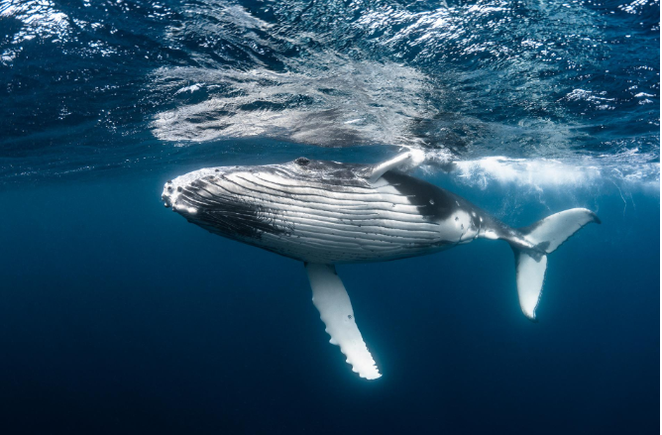
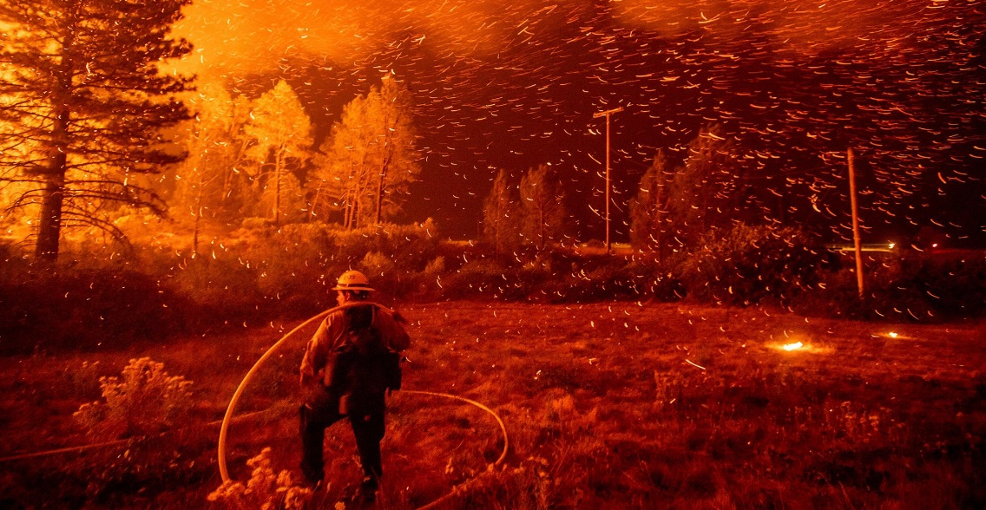
June 2020 work program: observations
Only about 20% of June work program projects had a reasonably good climate risk assessment
About half had considered climate risk to some extent but needed to be strengthened, e.g. by developing mitigation measures.
The remainder did not consider climate risk, or were unclear about what those risks might be and how they were determined.
Risk was not identified for some of the most vulnerable projects.
www.nationalgeographic.com
https://www.telegraph.co.uk/news/2020/01/25/inside-locust-mega-swarms-devouring-crops-africa/
www.nationalgeographic.com
www.nationalgeographic.com
https://www.nationalgeographic.com/science/2019/10/climate-change-california-power-outage/

Slide 6
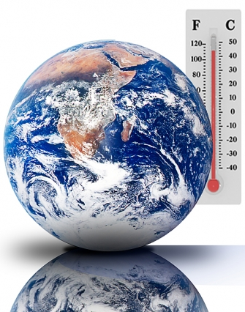
STAP’s Question 1
Has the sensitivity to climate change, and its impacts, been assessed?
Historical and projected climatic conditions
Information on vulnerability
Is climate change a driver of the targeted problem?
Interactions between climate and non-climate stressors
http://news.mit.edu/2010/explained-climate-sensitivity
Notes:
http://news.mit.edu/2010/explained-climate-sensitivity

Slide 7
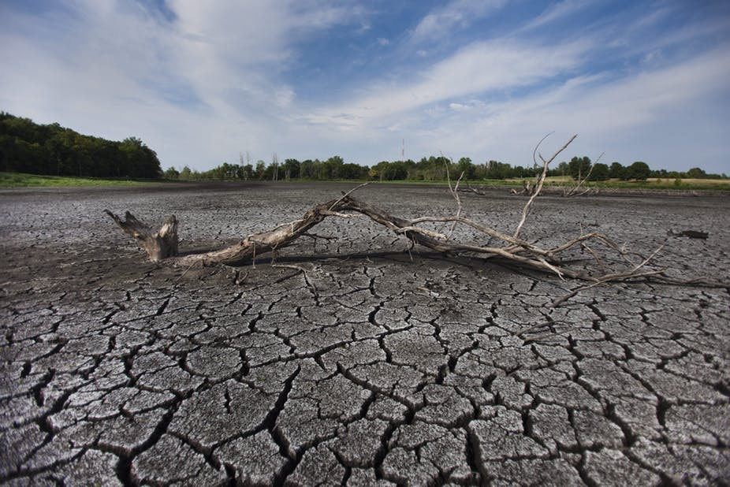
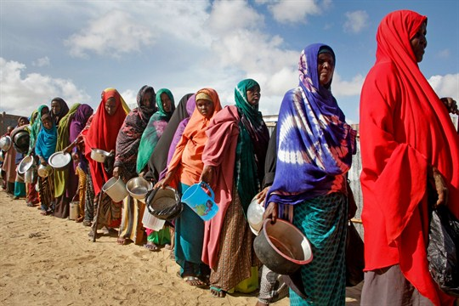
STAP’s Question 2
How will the project be affected by climate risks over the period 2020 to 2050, and have the impacts been addressed adequately?
Expected climate impacts and level of severity on targeted components at project location.
Impacts on the efficacy of proposed interventions.
Will proposed intervention reduce or decrease climate vulnerability?
Potential for maladaptation.
https://theconversation.com/global-drought-has-not-increased-but-climate-change-is-still-a-threat-10751
https://www.worldpoliticsreview.com/insights/28056/the-crippling-african-drought-shows-the-importance-of-climate-change-adaptation
Notes:
https://www.worldpoliticsreview.com/insights/28056/the-crippling-african-drought-shows-the-importance-of-climate-change-adaptation;
https://theconversation.com/global-drought-has-not-increased-but-climate-change-is-still-a-threat-10751

Slide 8
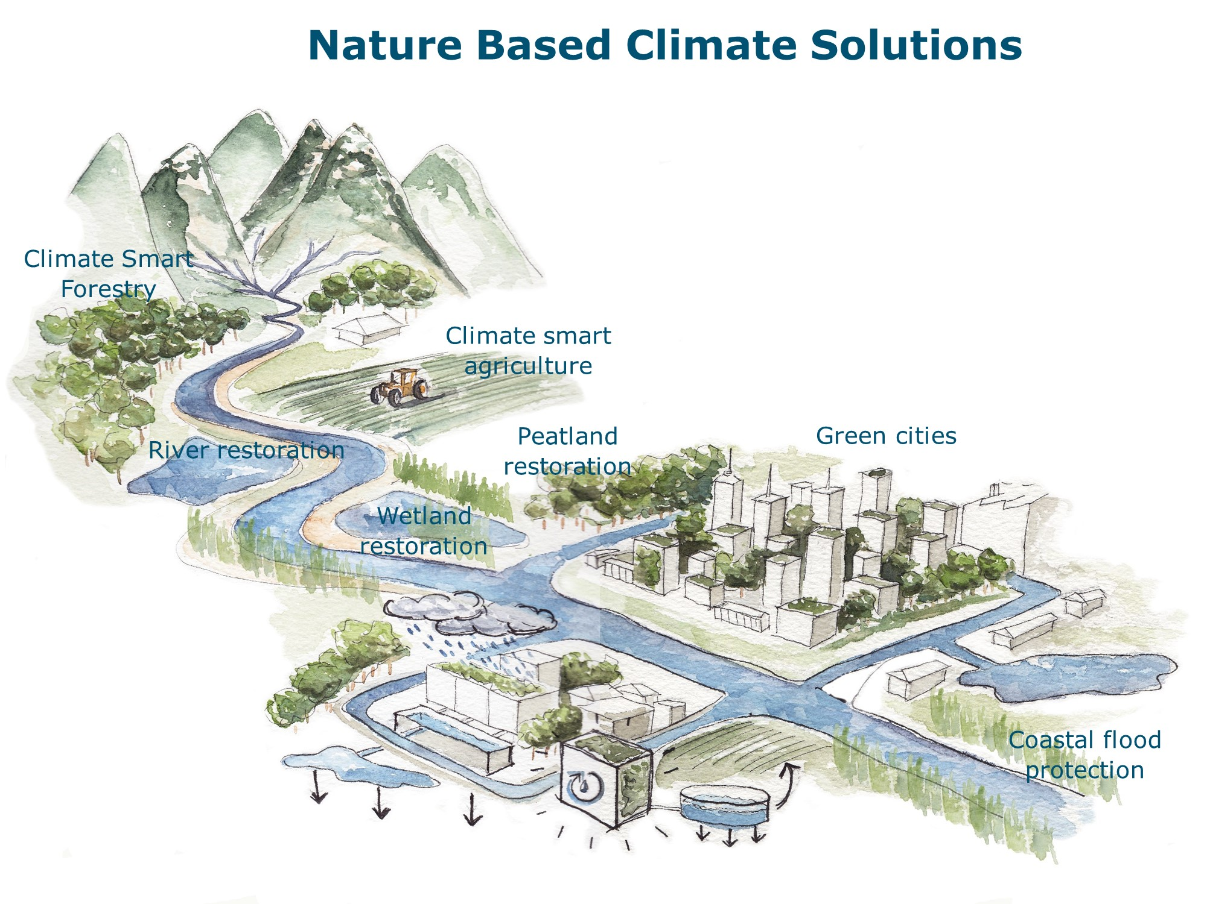
STAP’s Question 3
Have measures to address the risks been considered? How will these risks be dealt with?
What are the climate risk measures?
How will they address the identified vulnerabilities?
Implementation and adaptive management.
Feasibility, effectiveness, economic cost, tradeoffs, and co-benefits.
https://www.wur.nl/en/show-longread/Nature-as-the-inspiration-for-climate-solutions.htm
Notes:
https://www.wur.nl/en/show-longread/Nature-as-the-inspiration-for-climate-solutions.htm

Slide 9
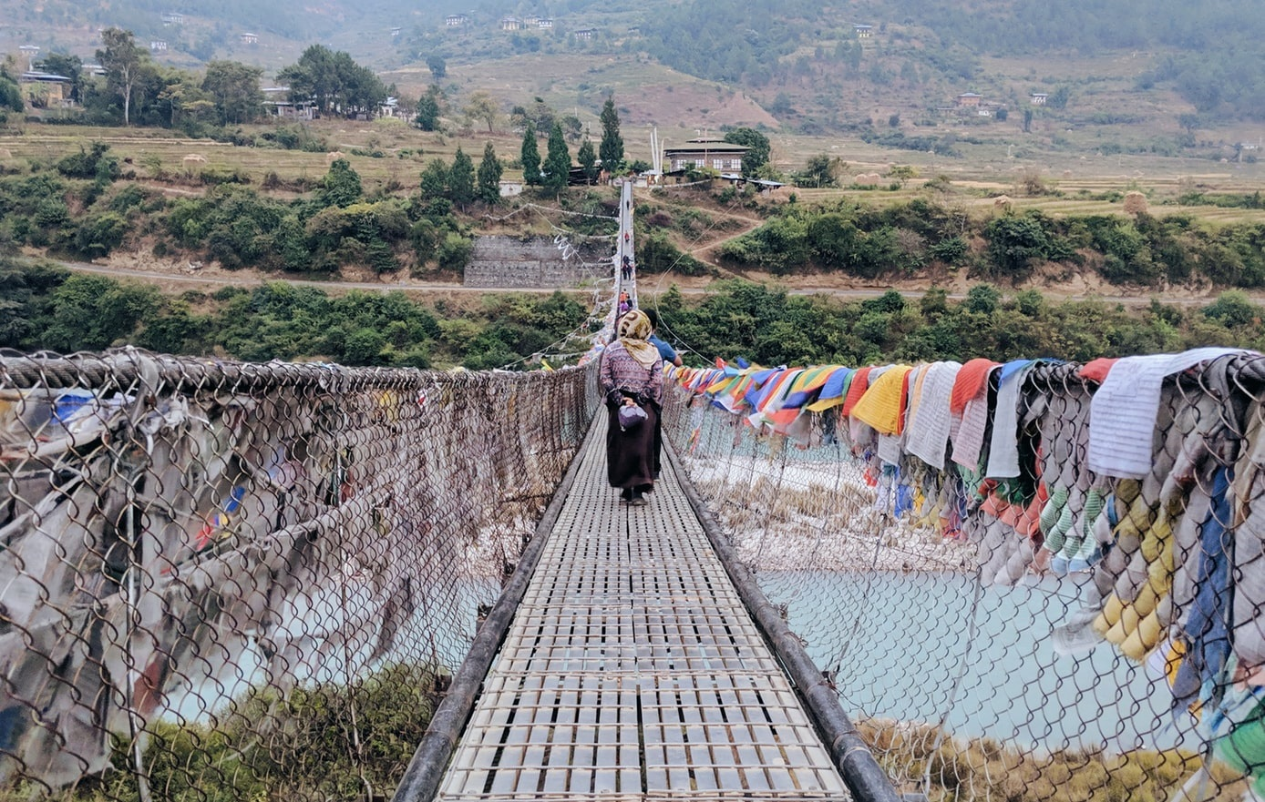
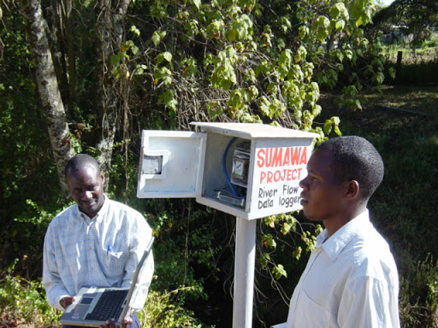
STAP’s Question 4
What technical and institutional capacity, and information is needed?
What are the needed technical and institutional capacities?
Financial implications of climate vulnerability management options.
Mechanisms for monitoring, evaluation and learning.
https://www.oneplanetnetwork.org/strengthening-institutional-and-technical-capacity
http://crsps.net/2012/09/building-the-technical-and-institutional-capacity-to-feed-the-world/
Notes:
https://www.oneplanetnetwork.org/strengthening-institutional-and-technical-capacity ; http://crsps.net/2012/09/building-the-technical-and-institutional-capacity-to-feed-the-world/

Slide 10
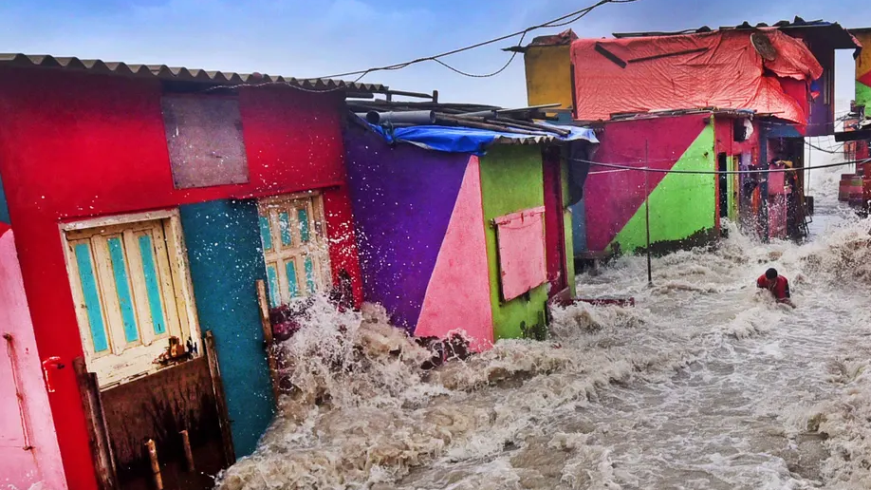
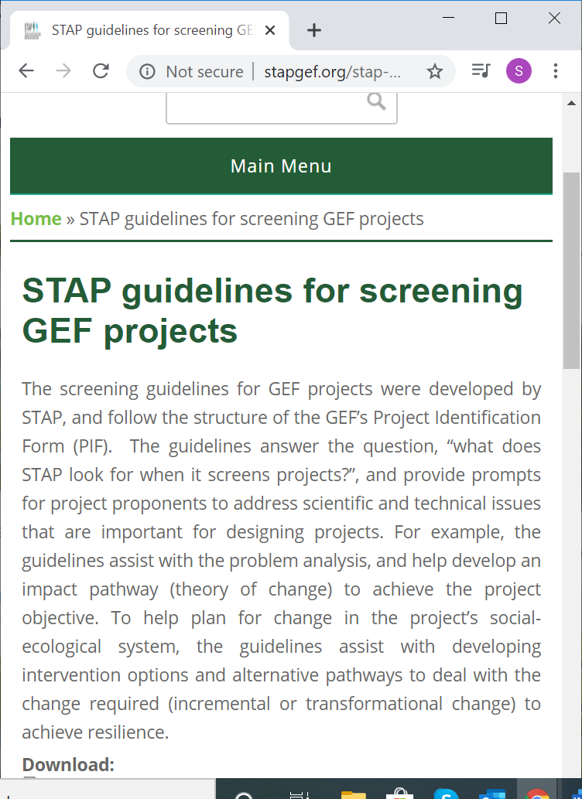
Relevant STAP Resources
http://stapgef.org/stap-guidelines-screening-gef-projects
http://stapgef.org/stap-guidance-climate-risk-screening
http://stapgef.org/stap-guidelines-screening-gefhttps://stapgef.org/stap-chairs-report-gef-agency-retreat-1-april-2020-projects
STAP Secretariat contact: Sunday Leonard (sunday.leonard@un.org)
Photo: SL Shanth Kumar/2019

