Slide 1
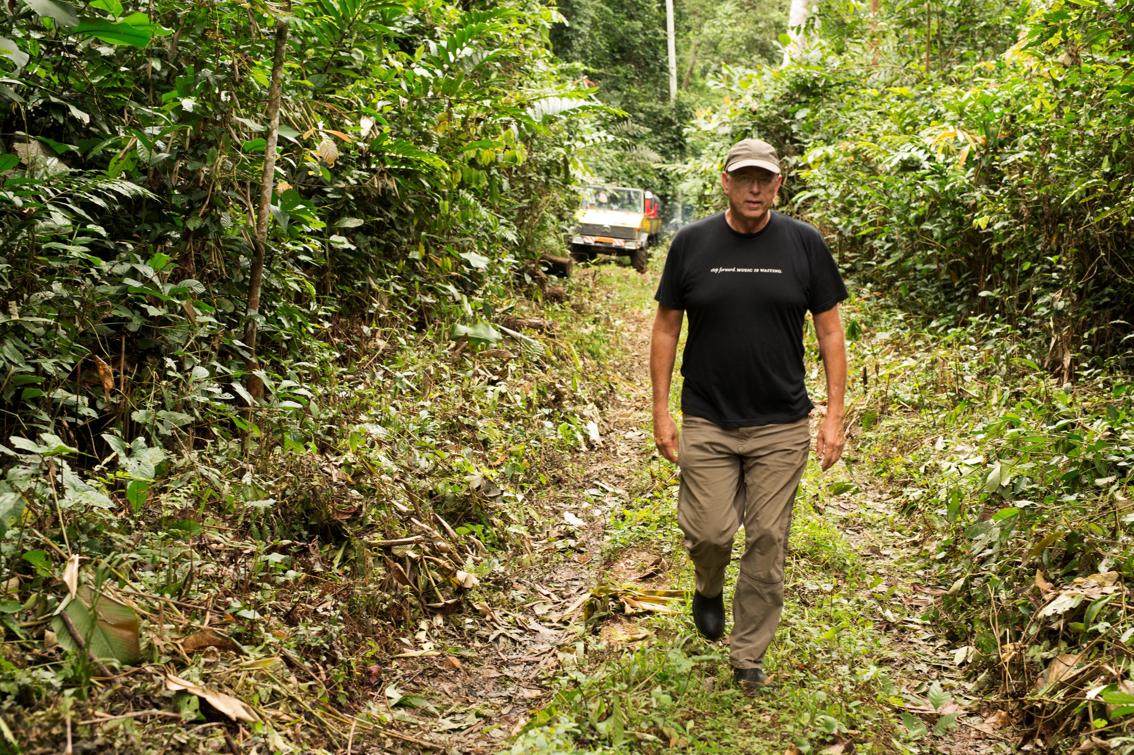
A Business Driven Initiative
for Use, Restoration and
Livelihoods
Notes:
This project begun in 2016 and it is still 100% financed by Bob Taylor of Taylor Guitars. The original objective was to find a way to plant 15,000 ebony trees at a community level in Cameroon but the project has grown to become a possible model for community based restoration more generally.

Slide 2
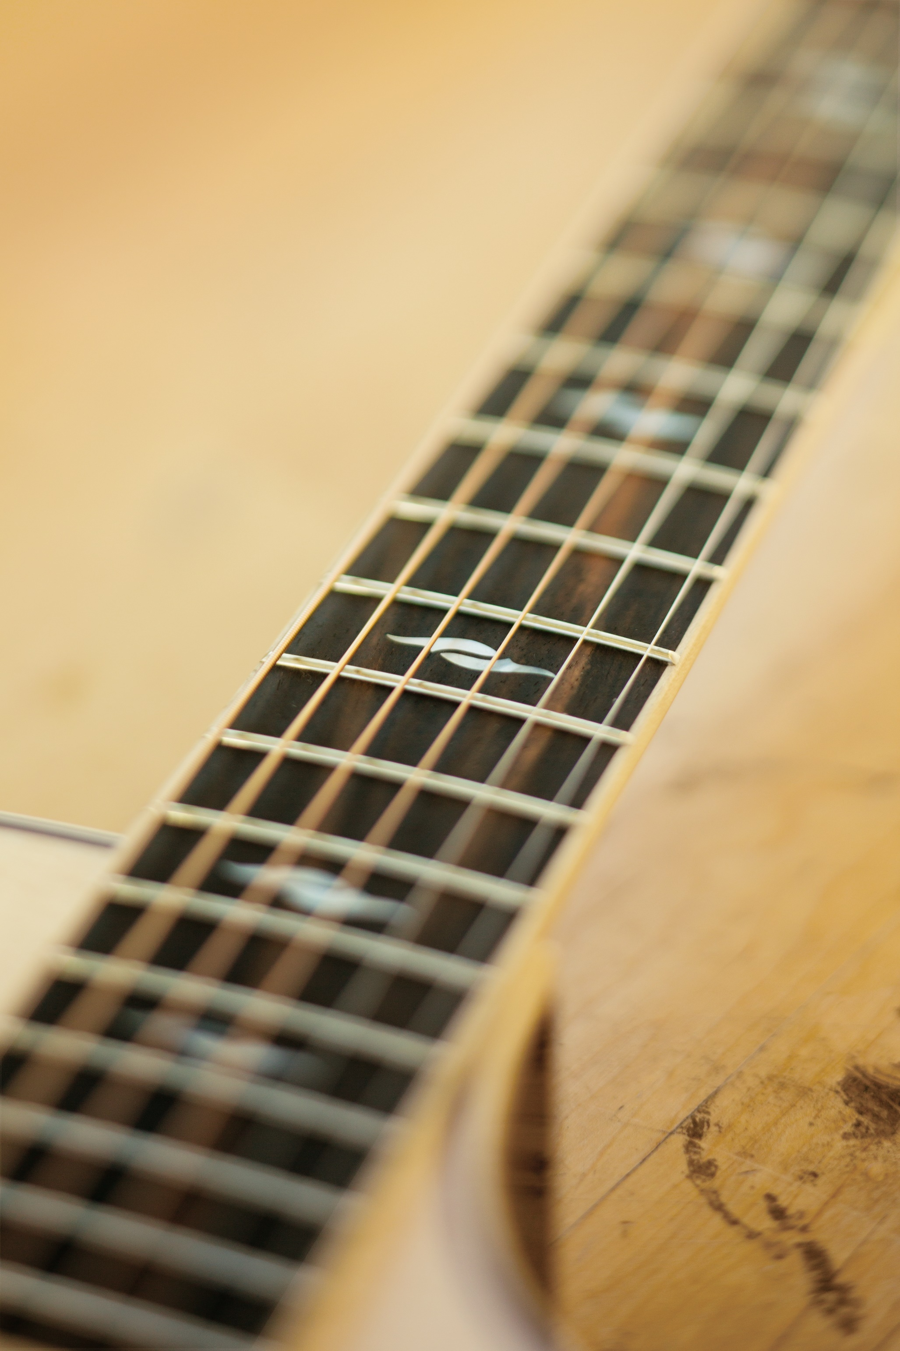
CONTEXT
Ebony is a tonewood uniquely suited for fingerboards on guitar
and violin-family instruments.
It is also used for piano keys.
Taylor Guitars
is the best-selling brand of acoustic guitars in the world and co-owner of the Crelicam ebony mill in Yaoundé, Cameroon.
UCLA and IITA
co-founded The Congo Basin Institute in Yaoundé, a collaborative initiative dedicated to developing durable solutions to Central Africa’s greatest environmental and development challenges.

Slide 3
Notes:
The project has run on slightly more than $200,000 per year, a gift from Bob Taylor of Taylor Guitars, and takes advantage of CBI staff with decades of field experience in agroforestry and forest ecology, and the active in-kind involvement of Taylor Guitars, Madinter and Crelicam staff who bring both business acumen and deep knowledge of the ebony trade to the project.

Slide 4
CONTEXT
“Everyone knows how to cut an ebony tree, few know how to grow one” – Bob Taylor
Objectives
Create a scalable program for sustainable production and stewardship of ebony seedlings in rural areas
Model ebony range and distribution to identify appropriate planting areas and responsible harvesting rate
Understand the basic ecology to enhance natural reproduction and assess restoration approaches
Test alternative plant propagation approaches
Challenges
Lack of scientific data (e.g. lifecycle, pollinators, dispersal agents)
Long return on investment for tropical hardwood species
Plant stewardship in crucial first few years of restoration
Sustained community involvement
Notes:
Many of the challenges listed are historic issues that have stymied tropical forest restoration efforts in the past but the Ebony Project's bottom-up approach holds the promise to overcome them.

Slide 5
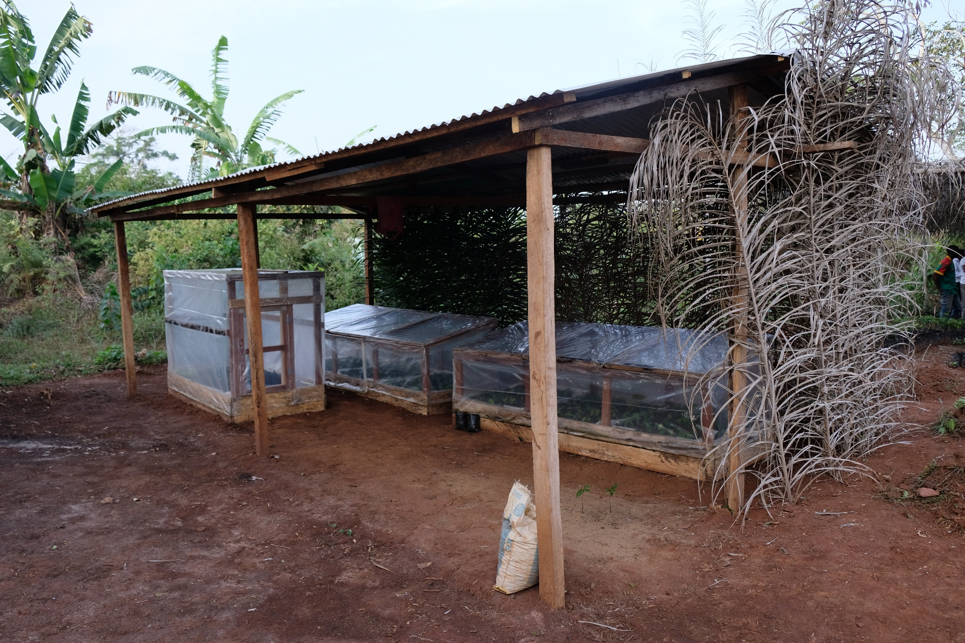
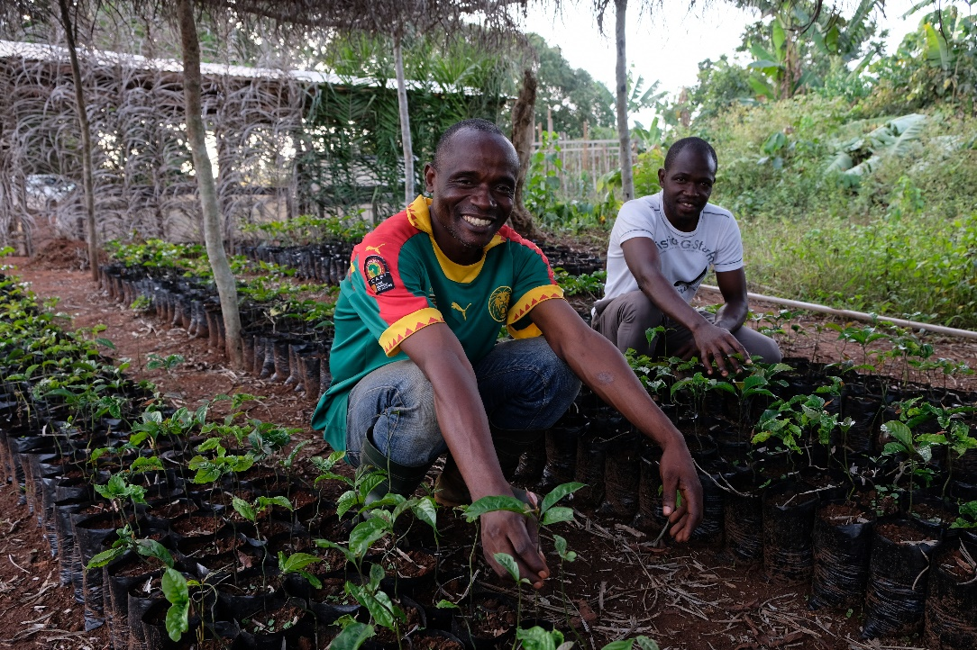
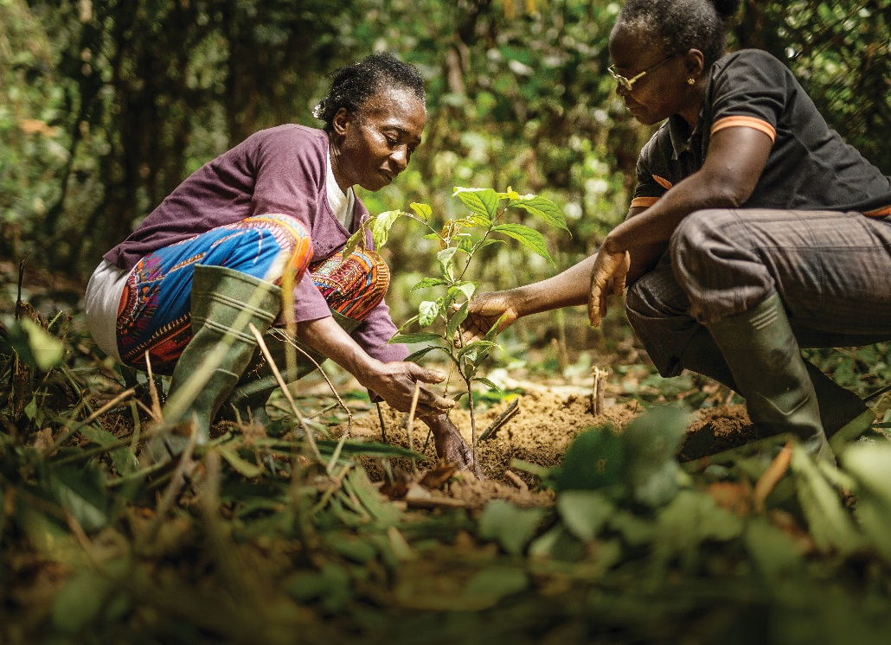
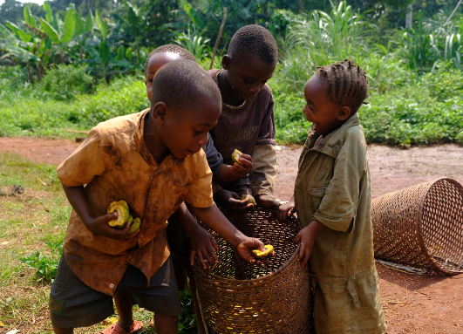
ACTIVITY 1
Crowdsourcing Restoration
At the community level:
Assist in the creation of rural nurseries, teach plant replication techniques, and pay for stewardship of plantlets over first five years
Provide no cost fruit and medicinal plants to participating communities that produce sustaining value within 3 to 5 years
Once planted, trees are recorded in a silvicultural logbook to help establish ownership

Slide 6
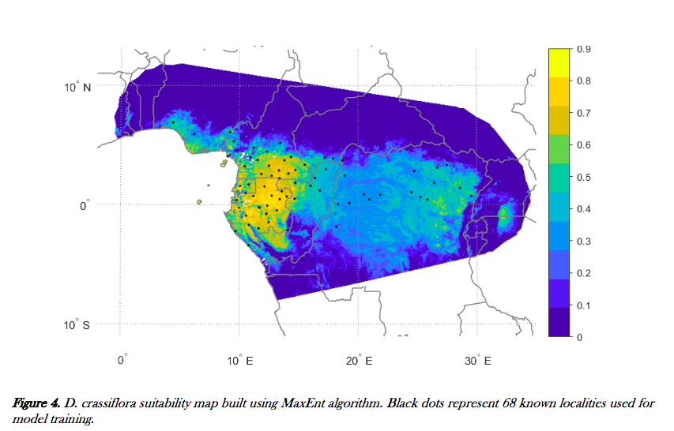
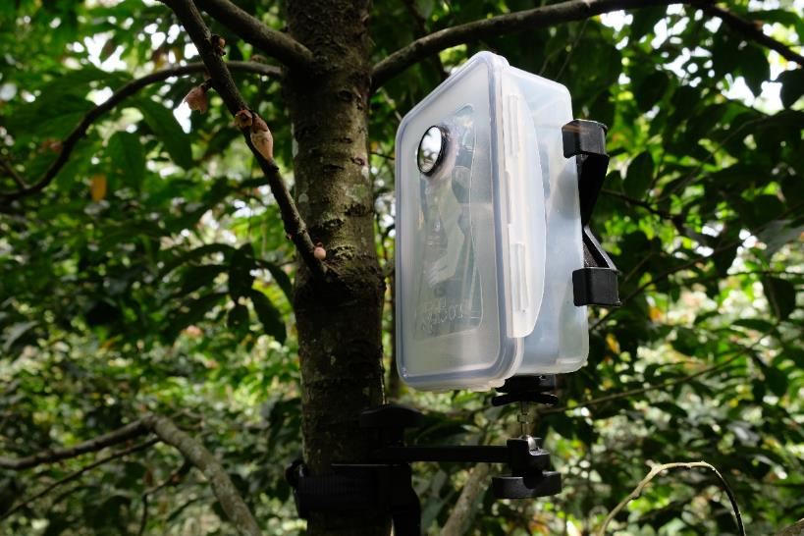
ACTIVITY 2
Understanding Natural
Ebony Reproduction
Chad
Nigeria
Central African Republic
South
Sudan
Benin
Cameroon
Togo
Original Science
Most comprehensive estimate of the range and size of West African ebony (D. crassiflora)
First known identification of ebony pollinators and seed dispersers
Equatorial Guinea
Gabon
Uganda
Democratic Republic
of the Congo
Tanzania
Republic of the Congo
Rwanda
Angola
Burundi
Squirrel
Moth
Bee
Night vision camera
Notes:
Surprisingly, there is little scientific information available on the ecology of West African Ebony. The most comprehensive information that now exists was produced by this project.

Slide 7
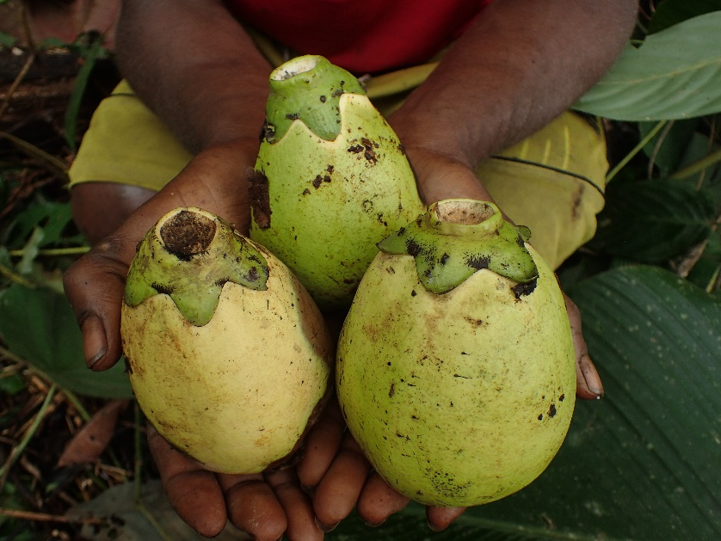
ACTIVITY 3
Ebony Propagation
On-going research propagating ebony
from seed, cuttings and tissue culture.

Slide 8
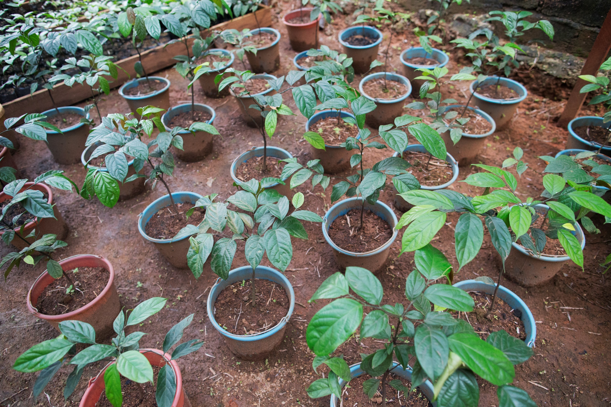
RESULTS
Today
2 villages participating
2,170 ebony saplings planted
4,500 ebony saplings produced and currently in community nurseries
250 fruit and medicinal trees planted
2019 (projection)
5 additional villages participating
3,500 ebony sapling to be planted
15,000 ebony saplings produced and growing in community nurseries
1,150 fruit and medicinal trees growing in community nurseries
Beyond
Communities receive annual payments for their work for the first five years of stewardship, at which point plants should be largely self-sustaining.
As villages transition out, new villages will transition in
“Alumni” villages will be left capable of continued production of ebony as well as fruit and medicinal plants for as long as they wish
Notes:
Next year Bob Taylor will have put in approximately 1 million dollars to finance the startup costs over the first 4 years of the program. This money supports 100% of the project including staff time at UCLA and the Congo Basin Institute. There are seemingly no barriers to expanding the model exponentially across Cameroon and even into neighboring countries. Ebony can be substituted for, or simply augmented with, other valuable hardwood species.

Slide 9
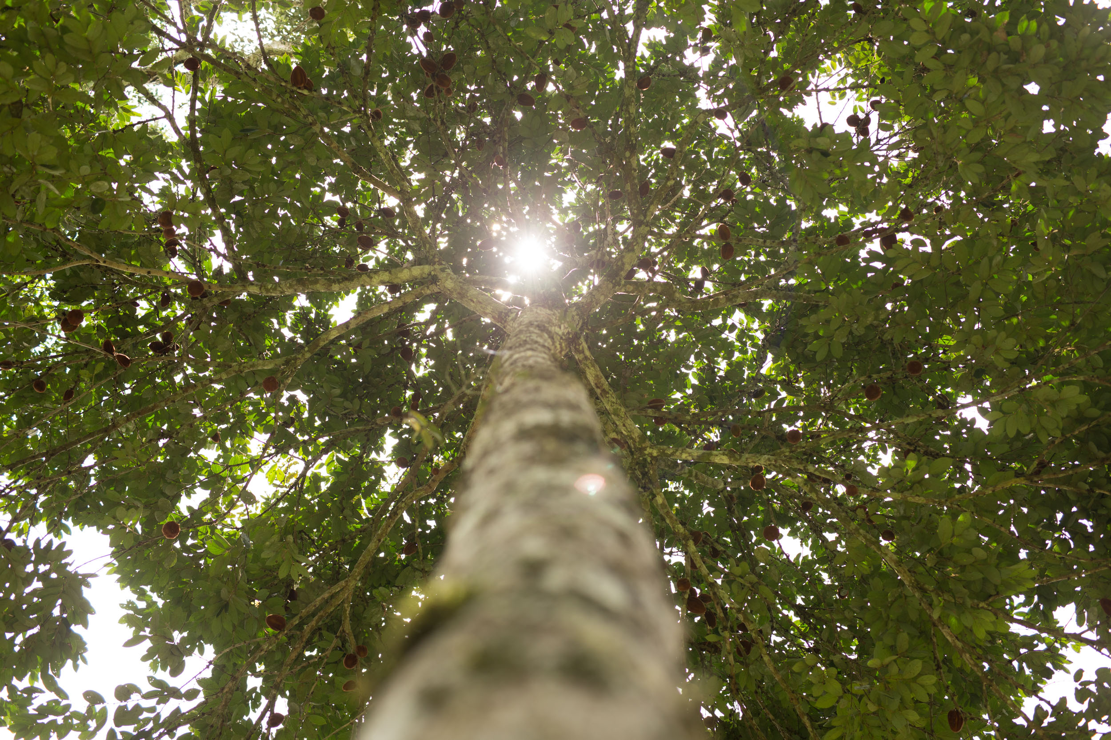
EXPANSION
From inception the program
was designed to scale
Public-Private-Partnership (November 2017)
Taylor Guitars continues to fund existing project
Government of Cameroon commissions Scale-up Feasibility Study
Many more communities (i.e. more of the same)
Different species (i.e. co-cropping other hardwoods)
New geographies and land uses (i.e. different ecological zones/value chains)
Project Scale-up (pending Scale-up Feasibility Study results)
2. Benin in discussion with Congo Basin Institute to apply model substituting ebony for a alternate, regionally appropriate, hardwood species
3. World Bank in Washington, DC interested in exploring concept beyond Cameroon
4. Project exploration between Taylor Guitars and major cocoa producer
Notes:
There are currently four pathways under discussion to expand the project. The first is the result of a public-private-partnership signed between Taylor Guitars and the Cameroonian Ministry of Environment – a deal brokered by The World Bank after visiting the project. This PPP has three basic objects, the second of which is a feasibility study that will examine scaling-up utilizing different species, geographies and land uses.
Completely separately, the government of Benin is in discussion with CBI to develop a similar project; thirdly, the World Bank in Washington, DC has expressed interest in this model elsewhere in the Congo Basin; and finally Taylor Guitars has been approached by a large Cacao producer who is interested in possible partnership opportunities.

