Slide 1
GEF Project & Program Cycle & Key Policies GEF-7 National Dialogue in the Gambia January 28-29, 2019

Slide 2
GEF Partnership
Guidance
Operations
Action
GEF AGENCIES
ADB
AfDB
BOAD
CAF
CI
DBSA
EBRD
FECO
FUNBIO
IADB
IFAD
IUCN
FAO
UNDP
UNEP
UNIDO
WB
WWF-US
GEF ASSEMBLY
183 Countries
Independent Evaluation Office
GEF Trustee
OFPs & PFPs
Convention FPs
Gov’t agencies
NGOs / CSOs
Private Sector
GEF COUNCIL
32 Constituencies
GEF
Secretariat
CONVENTIONS
CBD
UNFCCC
UNCCD
Stockholm(POPs)
Minamata
STAP

Slide 3
GEF Project Modalities
Full-Sized Project (FSP): financing over US$2M
Medium-Sized Project (MSP): financing of US$2 or less
Program: a longer term and strategic arrangement of individual yet interlinked projects that aim at achieving large-scale impacts on the global environment
Enabling Activity (EA): preparation of a plan, strategy or report to fulfill commitments under a Convention

Slide 4
Full-Sized Project Cycle
STAP advisory
Step 2
Council approval
of PIF
Step 1
GEFSEC review
for PIF clearance
Agency:
project concept
development & PIF submission
Trustee sets aside
GEF financing
(commits 40% 20% Agency fee)
In-country
project concept
identification
Step 3
GEFSEC review
for CEO
endorsement
Agency:
project preparation & CEO endorsement request
Step 4
Terminal evaluation
/completion
report
Trustee commits GEF financing & 60% of Agency fee
Agency: internal project approval & Implementation begins
Agency: project closing
& evaluation
Agency:1st disbursement to country. Trustee commits 50% Agency fee
Agency: Mid-term evaluation. Trustee commits 30% Agency fee
Notes:
Start How project concepts are formulated; through national/local consultations; through Agency initiative
Step 1 Mention the PIF template and how to access; Importance of the OFP endorsement letter
Step 2 Cleared PIFs may not all be accommodated; It depends on resources availability, programming, etc.
Step 3 CEO Endorsement template – Project Document - Tracking Tools – Co-financing letters among others; take into consideration Council comments/STAP comments
Step 4 Lessons learned; best practices to feed to similar projects
Policy Measures to Enhance Operational Efficiency, Accountability & Transparency (GEF/C.55/04)

Slide 5
Medium-Sized Project (2 step approval)
Trustee sets aside
GEF financing
Step 1
GEF CEO
Approval of PIF
(Concept)
Agency:
project appraisal
Agency:
PIF (concept) submission
In-country
project concept consultation & development
Agency:
fully developed project submission
Step 2
GEF CEO Approval
Of Fully developed
project
Step 4
Financial Closure
Within 12 mon
from TE
Trustee commits GEF financing & 100% Agency fee
Step 3
Terminal Evaluation
Agency: internal project approval & implementation begins
Agency:
PIR & Mid-term evaluation
Agency: 1st disbursement to country &Trustee commits 100% Agency fee
Notes:
Start How project concepts are formulated; through national/local consultations; through Agency initiative
Step 1 Mention the PIF template and how to access; Importance of the OFP endorsement letter
Step 2 Cleared PIFs may not all be accommodated; It depends on resources availability, programming, etc.
Step 3 CEO Endorsement template – Project Document - Tracking Tools – Co-financing letters among others; take into consideration Council comments/STAP comments
Step 4 Lessons learned; best practices to feed to similar projects

Slide 6
Medium-Sized Project (1 step)
Trustee commits
GEF financing
Step 1
GEF CEO Approval
Of Fully developed
project
Agency:
Fully developed project submission
In-country
project concept consultation & development
Agency:
project appraisal
Step 3
Financial Closure
Within 12 mon
from TE
Agency:
Internal project approval & implementation begins
Step 2
Terminal Evaluation
Agency: 1st disbursement to country &Trustee commits 100% Agency fee
Agency: PIR & Mid-term evaluation
Notes:
Start How project concepts are formulated; through national/local consultations; through Agency initiative
Step 1 Mention the PIF template and how to access; Importance of the OFP endorsement letter
Step 2 Cleared PIFs may not all be accommodated; It depends on resources availability, programming, etc.
Step 3 CEO Endorsement template – Project Document - Tracking Tools – Co-financing letters among others; take into consideration Council comments/STAP comments
Step 4 Lessons learned; best practices to feed to similar projects

Slide 7
Program
Trustee sets aside
GEF financing; commits 20% Agency fee
STAP advisory
Step 2
Council Approval
of Program Concept
Agency:
project appraisal
Step 1
GEFSEC Clearance
Of Program Concept
Agency:
PFD (Program concept) submission
Agency:
fully developed project Child project submission
In-country
project concept consultation & development
Step 3
GEF CEO Approval
Of Child Project
Step 5
Financial Closure
Within 12 mon
from TE
Trustee commits GEF financing
Agency: project approval & implementation begins
Step 4
Terminal Evaluation
Agency: 1st disbursement to country
Trustee commits 50% (FSP) / 80% (MSP) Agency fee
Agency: PIR
Agency: Mid-term evaluation
Trustee commits 30% Agency fee (FSP)
Notes:
Start How project concepts are formulated; through national/local consultations; through Agency initiative
Step 1 Mention the PIF template and how to access; Importance of the OFP endorsement letter
Step 2 Cleared PIFs may not all be accommodated; It depends on resources availability, programming, etc.
Step 3 CEO Endorsement template – Project Document - Tracking Tools – Co-financing letters among others; take into consideration Council comments/STAP comments
Step 4 Lessons learned; best practices to feed to similar projects

Slide 8
GEF-7 policies focus
The Policy Recommendations for GEF-7 are aimed at enhancing
the effectiveness and efficiency in the following areas:
resource allocation
optimizing the use of GEF resources in different countries
Results
Partnership
Governance
private sector engagement
operational efficiency and transparency (fees & cancellation)
improved management of data and information
gender equality
knowledge management, and
responsible investment strategy
Practical Steps to Improve Coordination and Workflow in the GEF Partnership
Notes:
Cancellation policy - that full-sized projects receive actual CEO endorsement within 18 months of Council Approval. Medium-sized projects would need to receive actual CEO approval within 12 months of CEO PIF approval

Slide 9
Key GEF-7 Policies
Project identification | Concept submission (PIF/PFD) | Fully developed project (CEO approval/endorsement) | Implementation (PIF, MTR, TR)
Gender Equality Policy 53rd Council Meeting, https://www.thegef.org/council-meeting-documents/policy-gender-equality
Meaningful consultations w/ stakeholders on the proposed project/program, early screening | Indicative info on gender considerations & any measures to address these, including process to collect sex-disaggregated data & gender info | Gender analysis or equivalent socio-economic assessment that identifies and describes any gender differences, gender differentiated impacts & risks, and opportunities to address gender gaps and promote the empowerment of women, as relevant to the proposed activity Any corresponding gender-responsive measures to address differences, identified impacts & risks, and opportunities through a gender action plan or equivalent If gender-responsive measures have been identified, results framework or logical framework with actions, gender-sensitive indicators & sex-disaggregated targets | Annual reporting on, including through PIRs, mid-term reviews, and terminal evaluations on progress and results

Slide 10
Project identification | Concept submission (PIF/PFD) |  | Fully developed project (CEO approval/endorsement) |  | Implementation (PIF, MTR, TR)
Stakeholder Engagement Policy https://www.thegef.org/council-meeting-documents/policy-stakeholder-engagement (53rd CM)
Meaningful consultations w/ stakeholders on the proposed project/program, early screening | Indicative info on stakeholder engagement, including any consultations conducted during project development, as well as information on how Stakeholders will be engaged in the project/ program, and means of engagement |  | Stakeholder engagement plans or equivalent, with stakeholders who have been and will be engaged, means of engagement, dissemination of information, roles and responsibilities, resource requirements, and timing throughout the project cycle |  | Annual reporting on, including through PIRs, mid-term reviews, and terminal evaluations on progress, challenges and outcomes
Environment & Social Safeguard Policy (in draft) https://www.thegef.org/documents/environmental-and-social-safeguard-standards
Meaningful consultations w/ stakeholders on the proposed project/program, early screening | Indicative info on any environmental and social risks and potential impacts associated with the proposed project/ program; and any measures to address these | Indicative info on any environmental and social risks and potential impacts associated with the proposed project/ program; and any measures to address these | Additional information on relevant risks and impacts, and measures to address these, including any assessments carried out, and any environmental and social management plans or the equivalent |  | Reporting at mid-term and completion on the implementation of relevant environmental and social management measures
Co-financing Policy http://www.thegef.org/council-meeting-documents/updated-co-financing-policy (54th CM)
 | Indicative information on the expected amounts, sources and types of co-financing, and the sub-set of such co-financing that meets the definition of ”investment mobilized” |  | Confirmed information on the expected amounts, sources and types of co-financing and “investment mobilized”, with supporting evidence | Reporting at mid-term and completion on actual amounts, sources and types of co-financing and investment mobilized

Slide 11
Co-Financing Policy
Co-Financing: financing that is additional to GEF financing (excludes recurrent expenditures)
Overall GEF portfolio: at least 7:1
Upper-Middle Income Countries and High-Income Countries - that are not Small Island Developing States or Least Developed Countries - at least 5:1

Slide 12
Co-Financing in the Gambia
 | Number of projects | GEF Grant w/o agency fee ($million) | Co-Finance ($ million) | Ratio of Co-Financing
GEF - 1 | 3 | 0.4 | 0 | 0
GEF - 2 | 4 | 1.7 | 0.9 | 0.5
GEF - 3 | 2 | 0.3 | 0.0 | 0.1
GEF - 4 | 5 | 8.5 | 22.8 | 2.7
GEF - 5 | 9 | 29.4 | 111.4 | 3.8
GEF - 6 | 5 | 20.6 | 44.5 | 2.2
Total | 28 | 61.0 | 179.7 | 2.9
2

Slide 13
Changes to STAR
As of July 1, 2018
Increasing flexibility – full flexibility retained for countries with allocations ≤ US$7m; for others (The Gambia), marginal adjustments of up to 15% of total allocation
Adjustments to the minimum allocation floors in each focal area ($m):
 | Non-LDCs |  | LDCs (The Gambia)
 | GEF-6 | GEF-7 | GEF-6 | GEF-7
Biodiversity | 1.5 | 2 | 2 | 3
Climate Change | 2 | 1 | 3 | 1.5
Land Degradation | 0.5 | 1 | 1 | 1.5
Aggregate Floor | 4 | 4 | 6 | 6

Slide 14
GEF-7 STAR Allocation for The Gambia ($m)
Other windows – IW, C&W, NGI
Impact Programs
Climate Change | 1.50
Biodiversity | 3.00
Land Degradation | 5.33
Total | 9.83
Fully Flexible | no
Marginal Adjustment* | 2.00
Notes:
Development Bank of Southern Africa to set up Climate Finance Facility
2018-10-22
The Development Bank of Southern Africa (DBSA) announced today that it has been awarded funding to the value of USD$55.6m from the Green Climate Fund (GCF) to establish a R2 billion Climate Finance Facility (CFF).
In addition to South Africa, the facility will also extend financing to the common monetary area, which includes Namibia, Swaziland and Lesotho.

Slide 15
 | GEF-5 (US$4,250m) |  | GEF-6 (US$4,433m) |  | GEF-7 (US$4,065m)
 | US$ mill. | Share of Total | US$ mill. | Share of Total | US$ mill. | Share of Total
Biodiversity | 1,210 | 28.5% | 1,296 | 29.2% | 1,291 | 31.8%
STAR Country Allocations | 968 | 22.8% | 1,051 | 23.7% | 1,030 | 25.3%
STAR Set-Aside | 242 | 5.7% | 245 | 5.5% | 261 | 6.4%
- Enabling Activities | 60 | 1.4% | 13 | 0.3% | 46 | 1.1%
- Integrated Programming | 130 | 3.1% | 195 | 4.4% | 160 | 3.9%
- Global and Regional Programs | 52 | 1.2% | 37 | 0.8% | 55 | 1.3%
Climate Change | 1,360 | 32.0% | 1,260 | 28.4% | 801 | 19.7%
STAR Country Allocations | 1,088 | 25.6% | 941 | 21.2% | 511 | 12.6%
STAR Set-Aside | 272 | 6.4% | 319 | 7.2% | 290 | 7.1%
- Enabling activities and CBIT | 80 | 1.9% | 130 | 2.9% | 165 | 4.0%
- Integrated Programming | 100 | 2.4% | 130 | 2.9% | 107 | 2.6%
- Global and Regional Programs | 92 | 2.2% | 59 | 1.3% | 18 | 0.4%
Land Degradation | 405 | 9.5% | 431 | 9.7% | 475 | 11.7%
STAR Country Allocations | 324 | 7.6% | 346 | 7.8% | 354 | 8.7%
STAR Set-Aside | 81 | 1.9% | 85 | 1.9% | 121 | 3.0%
- Enabling Activities | 15 | 0.4% | 15 | 0.3% | 23 | 0.6%
- Integrated Programming | 20 | 0.5% | 60 | 1.4% | 66 | 1.6%
- Global and Regional Programs | 46 | 1.1% | 10 | 0.2% | 32 | 0.8%
Chemicals and Waste | 425 | 10.0% | 554 | 12.5% | 599 | 14.7%
International Waters | 440 | 10.4% | 456 | 10.3% | 463 | 11.4%
Non-Grant Instruments Window | 80 | 1.9% | 115 | 2.6% | 136 | 3.4%
Corporate Programs | 210 | 4.9% | 197 | 4.4% | 149 | 3.7%
Small Grants Program | 140 | 3.3% | 140 | 3.2% | 128 | 3.1%
Country Support Program | 26 | 0.6% | 23 | 0.5% | 21 | 0.5%
Corporate Budgets: Secretariat, IEO, STAP and Trustee | 120 | 2.8% | 125.0 | 2.8% | 151.9 | 3.7%

Slide 16
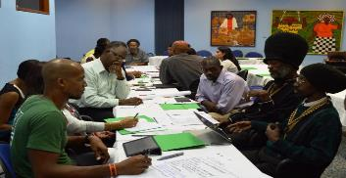
GEF Small Grants Programme (SGP)
Implemented by the UNDP since 1992
Only window for CSOs/CBOs
Decentralized structure
Decision making body: NSC- participating countries
National Steering Committees (NSC) supported by Technical Advisory Groups (TAGs)
Core Funding: $128 M for GEF-7
Countries < $15 M in STAR:
Up to 10% of STAR
Notes:
Core funds are used to support the SGP Global Programme, including Country Programmes in interested and eligible GEF recipient countries. Core funds also cover global coordination, monitoring and evaluation, and knowledge sharing activities. In GEF-7, countries are eligible for core funds if, as of July 1, 2018, (a) they are least developed countries (LDC) or small island developing states (SIDS), (b) they have not had an SGP Country Programme in operation for 15 years or longer, (c) their cumulative SGP grants amount to less than US$6 million, or (d) their GEF-7 STAR country allocation does not exceed US$10 million. Other countries (“upgraded countries”) may participate in the GEF-7 SGP through Upgraded Country Programmes, provided that they have a STAR country allocation and that the Implementing Agency can determine that they: (a) commit to the approach and programming directions of the program; and (b) have a strong and mature civil society.
125 countries, 40 LDCs and 37 SIDS

Slide 17
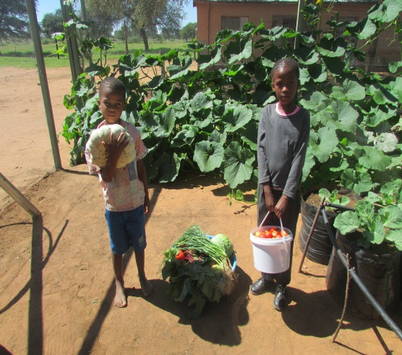
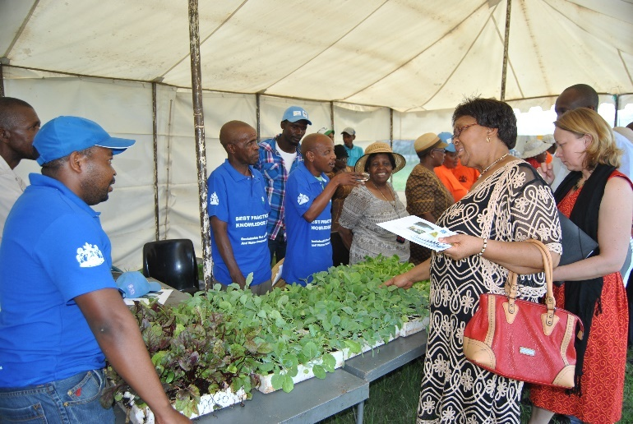
Size of SGP Grants
SGP | The GEF Small Grants Programme
Planning Grants-Maximum $5K
Regular Grants-Maximum $50K
Strategic Grants-Maximum $150K
Global/Regional Grants: $250k to 500k
Innovation Programme

Slide 18
GEF-7 Country Support Program (CSP)
Objective: Strengthen capacity of GEF recipient country Focal Points, Convention Focal Points, civil society and GEF Agencies to understand the GEF policies and programming strategy; assist recipient countries with use of GEF resources effectively and efficiently
CSP Tools:
National Dialogues (National Level)
Workshops (Multilateral level)
Constituency Meetings
Introduction Seminars
Pre-Council Meetings for Recipient Country Council Members & Alternates
Notes:
9-12 April - Sahel West Africa ECW
Burkina Faso, Cape Verde, Chad, Guinea-Bissau, Mali, Mauritania, Niger, Senegal, and The Gambia

