Slide 1
First Report of OPS5:
Cumulative Evidence on Challenging Pathways to Global Environmental Impact

Slide 2
Background
All replenishments have been informed by independent overall performance studies
Since OPS4 they are undertaken by the independent Evaluation Office of the GEF
OPS5 terms of reference and budget were approved by the GEF Council in June 2012
Reporting is split: a first report at the start of the replenishment and a final report at the third meeting
First report is an update of OPS4 through a meta-evaluation of cumulative evidence of the three years since OPS4

Slide 3
Problems and Funding
More authoritative overviews are available than during OPS4
Trends are worse and we are reaching the limits of our natural resources
Conclusion 1: global environmental trends continue to spiral downwards
Yet business as usual continues for complicated reasons, partly due to the financial credit crisis

Slide 4
The Global Gap
The GEF is reaching a level of US$ 1 billion in commitments annually
Current global public funding for Climate Change is US$ 10 billion annually
Funding needs are generally assessed at more than US$ 100 billion annually
An insurmountable problem? Yet…
Global Public Funding on subsidies for fossil fuels, water, fisheries, agriculture are generally assessed at more than US$ 1 trillion annually
Conclusion 2: Global environmental problems continue to be underfunded

Slide 5
Available global public funding> $ 10 billion
Global public funding needs> $ 100 billion
Public spending on over-use of resources> $ 1 trillion

Slide 6
Can $10bn solve the problems created by $1tr?

Slide 7
Available global public funding> $ 10 billion
GEF funding $ 1 billion
GEF + co-funding increases envelop to> $ 13 billion
Co-funding
Co-funding

Slide 8
From outcomes to impact
Completed projects
Satisfactory outcomes range> 80%
Progress toward impact 80%
Local impact> 70%
Broader adoption faces constraints
20% unsatisfactory is due to risk taking: please continue to take risks!
This is the challenge: how to speed up and increase broader adoption, leading to transformational change of systems

Slide 9
Outcome → Impact
Conclusion 3: Compared to the international benchmark norm of 75 percent, more than 80 percent of GEF projects completed during GEF-4 and GEF-5 achieved outcome ratings of moderately satisfactory or higher.
Conclusion 4: More than 70 percent of completed projects show positive environmental impacts, mostly at the local scale.
Conclusion 5: The approaches supported by the GEF have resulted in the reduction of environmental stress at the local scale. GEF support is also contributing to legal, regulatory and institutional changes at higher scales, but improvements in environmental status at these scales requires a much broader adoption of the promoted approaches and technologies.

Slide 10
Broader Adoption
Mainstreaming: Information, lessons, or specific results of the GEF are incorporated into broader stakeholder mandates and initiatives such as laws, policies, regulations, and programs
Replication: GEF-supported initiatives are reproduced or adopted at a comparable administrative or ecological scale, often in another geographical area or region
Scaling-up: GEF-supported initiatives are implemented at a larger geographical scale, often expanded to include new aspects or concerns that may be political, administrative, or ecological in nature
Market change: GEF-supported initiatives catalyze market transformation by influencing the supply of and/or demand for goods and services that contribute to global environmental benefits

Slide 11
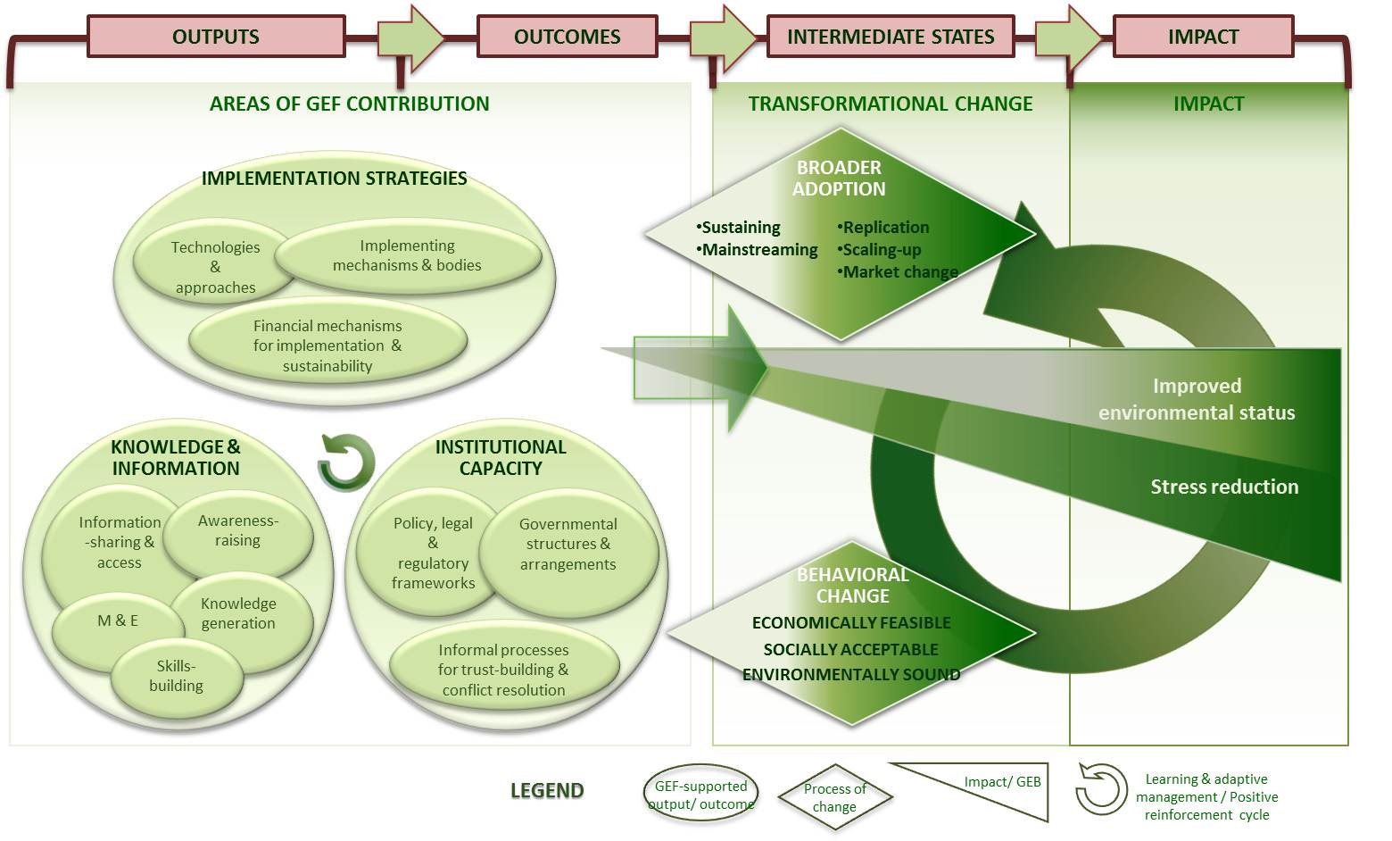

Slide 12
Time Horizons
Focal area | Final Impact | Trend | When impact would be achieved
Biodiversity | Healthy ecosystems in which biodiversity is sustainable | Increasing degradation of ecosystems | While some ecosystems are becoming more sustainable, global biodiversity is still going down and we face mass-extinction of species
Climate Change | Global warming halted | Scenario to remain within 2 degrees seems lost | Not achievable in the next 100 years?
Ozone Layer | Ozone Layer restored | Some restoration of ozone layer is now visible | 60-75
Assembled by from Miller 2009, IPCC 2007, Hofmann 2010

Slide 13
Role of the GEF
GEF project
No GEF support
Eligibility
Stakeholders active
Stakeholders continue to act
Start of local action
Ecosystem services / biodiversity loss
Trends continue downward
Slow recovery
6 years
5 years
10 years

Slide 14
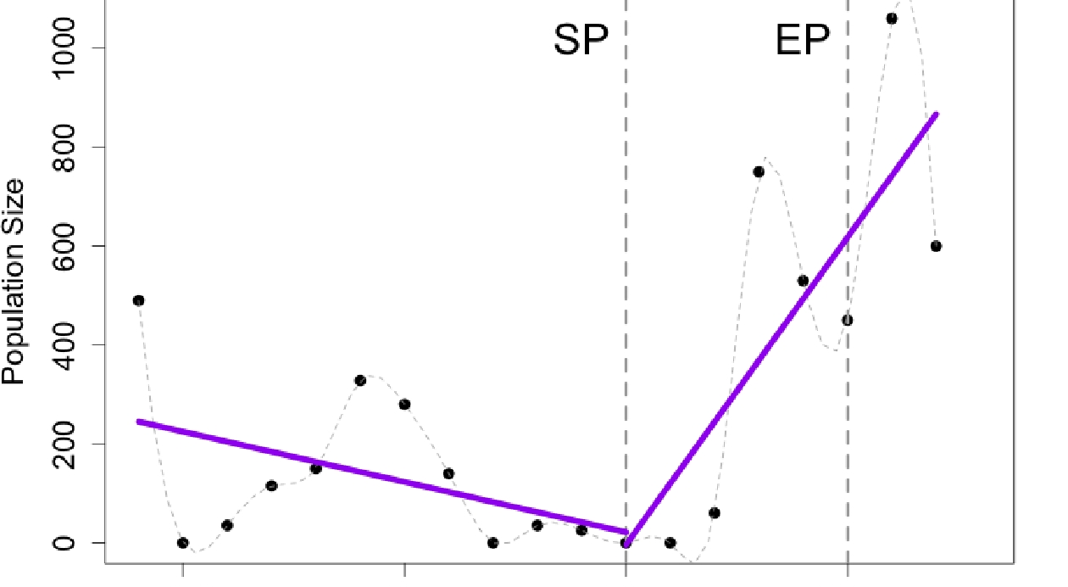
Time series abundance data for a single bird species in the Danube Delta. Black circles are individual data points. Purple lines show population trends before and after GEF involvement. SP: Start of Project date, EP: End of Project date.

Slide 15
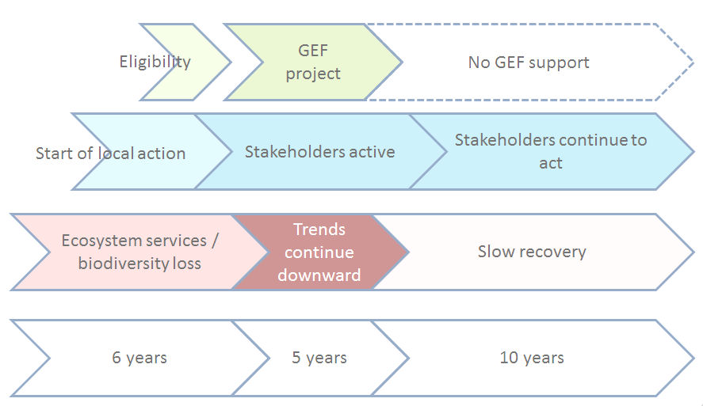
Impact indicator: one species
Impact indicator: ecosystem health
OPS5: at project end some local impact visible, but no system impact
OPS5: after 5-8 years some system impact visible

Slide 16
Climate Change
GEF project
No GEF support
Eligibility
Stakeholders active
Stakeholders continue to act
Start of local action
Global Warming
Trends continue downward
No evidence of reverse trend yet
10 years
5 years
10 years

Slide 17
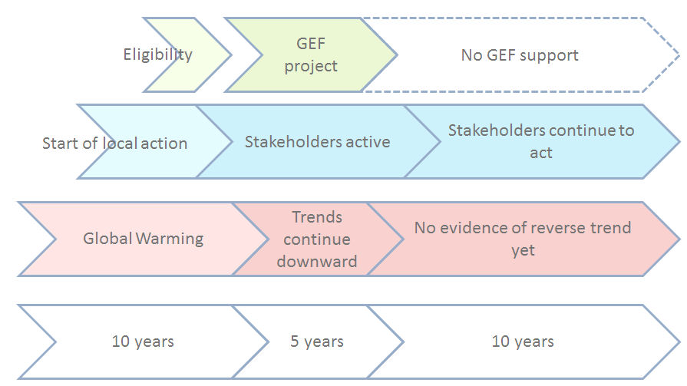
Local impact measured in GHG emissions
Market change measured in GHG emissions
Global GHG emissions
Market change in reduced GHG emissions after 5-8 years
Local impact in reduced GHG emissions at project end

Slide 18
Guidance
Conclusion 6: The overall level of GEF responsiveness to convention guidance is high at both the strategic and portfolio levels
Several features of convention guidance make operationalization by the GEF challenging: ambiguous language, lack of prioritization, cumulative nature, and repetition
At times, convention guidance is not realized due to a lack of resources, including short-term availability between replenishments, or because requests were interpreted as not eligible for GEF funding

Slide 19
Focal Area Achievements
Compared to the indicative allocations of the GEF-5 replenishment, approved funding for activities mainstreaming environmental goals into productive landscapes are significantly higher than expected
GEF strategies and programs have been very consistent over time, and most GEF-5 objectives can be traced back to the original operational programs of 1996.

Slide 20
Continuity and Change
Impact/ROtI
OPS4 Terminal Evaluations Cohort
OPS5 Terminal Evaluations Cohort
Country level & thematic evidence
Pilot
GEF1
GEF2
GEF3
GEF4
GEF5

Slide 21
Country Level Evidence
Conclusion 7: GEF support at the country level is well aligned with national priorities, shows progress toward impact at the local level, and enables countries to meet their obligations to the conventions
Country-level evidence supports impact analysis concerning broader adoption, including the focus on mainstreaming and the role of capacity building
Country-level evidence strongly confirms GEF relevance to national needs as well as to the GEF mandate of achieving global environmental benefits
GEF support provided through enabling activities is highly relevant in helping countries addressing environmental concerns, especially for LDCs and SIDS
Multifocal area projects emerge increasingly in country portfolios, which requires exploring new ways to do business

Slide 22
Paris Declaration
Conclusion 8: GEF support to countries rates well on indicators for meeting the Paris declaration and outperforms bilateral and multilateral donors on alignment with national priorities
International joint evaluation of Paris Declaration, phase 2: slow progress to alignment
CPE evidence: strong alignment (22) or more than moderate (5)
Alignment does not automatically lead to ownership, which scores well but more in line with other donors

Slide 23
Performance Issues
Final report of OPS5 will contain substantive chapter on this, reporting on STAR and NPFE mid-term reviews and providing more analysis
The level of materialized cofinancing vis-à-vis expected cofinancing reported for the OPS5 cohort of completed projects is higher than that for earlier cohorts
Yet complaints about cofinancing persist; more in final report
The Agency fees provided by the GEF for implementation of its project portfolio have dropped compared to earlier periods
There are early indications that compared to GEF-4 the time lag between PIF approval and CEO endorsement of full-size projects has been reduced significantly for the GEF-5 period.
The level of compliance with GEF requirements for M&E arrangements in projects at the point of endorsement has improved compared to earlier periods

Slide 24
Overarching Conclusions
Conclusion 9: Evidence from several evaluations points to the emergence of multifocal area projects and programs as a strong new modality of the GEF. This poses challenges for the formulation of the strategies for GEF-6
Conclusion 10: Impact and country-level evidence show that there is scope for improving progress toward impact through incorporating broader adoption strategies in project and program design

Slide 25
Recommendation
The replenishment meeting should request that the secretariat develop strategies for GEF-6 that would strengthen efforts toward broader adoption and focus on more programmatic multifocal area approaches, within the guidance of the conventions

Slide 26
Key Issues in the Final OPS5 Report
Relevance and added value of the GEF, also in view of other funding channels
Ability of the GEF to mobilize sufficient funding for a meaningful role in focal areas, as well as donor performance
A more in-depth look at impact of the GEF focal area strategies, with a focus on multi-focal area support and on broader adoption of results to achieve system impact
Extent to which the GEF reform processes, such as STAR, NPFE and the project cycle, have achieved enhanced country ownership and improved effectiveness and efficiency
Trends in the involvement of stakeholders, the private sector and civil society
Cross-cutting policies: gender, indigenous people, participation, knowledge sharing, communication
Update of the SGP evaluation (since 2009)
Role of STAP
Health of the GEF Network
The final report will be presented to the third replenishment meeting, December 2013

Slide 27
Thank you
ops5@thegef.org
www.gefeo.org

