Slide 1
GEF 6 Programming Climate Change Adaptation
GEF Expanded Constituency Workshop
Windhoek, Namibia
February 17-18, 2015
Leah Karrer- Sr. Env. Specialist
Notes:
Tell you about the GEF 6 funding available to address climate change adaptation. But before I do I want to ensure we are clear on how CCA fits with the other focal areas that the GEF funds.

Slide 2
GEF- 6: Programming & Funding Sources
 | GEF Trust Fund: STAR Allocation | GEF Trust Fund: Non-STAR Allocation | LDCF / SCCF
Biodiversity (BD) | X
Land Degradation (LD) | X
Climate Change Mitigation (CCM) | X
International Waters |  | X
Chemicals & Waste |  | X
Integrated Approach Pilots (IAPs) | X | X
Sustainable Forest Management (SFM) | X | X
Climate Change Adaptation (CCA) |  |  | X
Notes:
As you may recall from William’s presentation, there are several focal areas.
Separate funding cycle.

Slide 3
Adaptation Programming Strategy: LDCF & SCCF
LDCF – Least Develop Countries Fund
Southern Africa eligible countries: Angola, Lesotho, Malawi, Mozambique, Zambia
SCCF – Special Climate Change Fund
Southern Africa eligible countries: All
Notes:
The LCDF and SCCF were established in recognition of the global need to address not only to mitigate CC through CCM, but also to enable countries to adapt to CC. Actually on a separate cycle of funding that is revolving. And project funding depends on countries providing funding on a regular basis.
Over last 10 years global portfolio of adaptation projects in
124 countries totaling $1.18B.
Supported 51 LDCs, 34 SIDS and 39 fragile states.
------
FYI: LDCF – has much more $$ than SCCF (only had $15M last year?). So SCCF projects tend to be $3Mish. All LDCF countries have up to $30M to implement their NAPAs and no deadlines.

Slide 4
Adaptation Programming Strategy: Goal & Objectives
Goal: “increase resilience to the adverse impacts of climate change in vulnerable developing countries, through both near- and long-term adaptation measures in affected sectors, areas and communities…”
1) Reduce the vulnerability of people, livelihoods, physical assets and natural systems
2) Strengthen institutional and technical capacities
3) Integrate climate change adaptation into relevant policies, plans and associated processes
Notes:
Seeking innovative, on-the-ground adaptation solutions with potential for scale-up

Slide 5
Adaptation Programming Strategy: 2 Core Pillars & Innovations
Pillars:
Integrating CCA into relevant policies, plans, programs
LCDF: implementation of National Adaptation Programmes of Action
2) Pursing initiatives that cut across both adaptation and other GEF focal areas.
Innovations:
Private sector engagement & Ecosystem-based adaptation
Notes:
In doing so – committed to an integrated approach through two strategic pillars
integrating CCA into relevant policies, plans, programs and decision-making processes
Addressing urgent needs, gaps in climate information, monitoring and evaluation capacity, and medium and long-term needs
The GEF has already funded the process of preparing National Adaptation Programmes of Action and now moving into implementation of theose Programmes
2) Hear throughout today and tomorrow, GEF… pursing initiatives that cut across both adaptation and other GEF focal areas.
On an operational level, the GEF will explore new mechanisms for innovation through greater private sector collaboration, particularly risk transfer and insurance. There is an increased focus on areas of heightened vulnerability, such as SIDS and urban centers. Private sector engage is a growing priority throughout the GEF and that includes in CCA.
Also emphasize ecosystem-based adaptation approaches, such as projects that help to maintain and restore natural infraustrures. Wetlands for example, provide coastal protection from flooding and wind damage.
------
Building on past experience, the GEF will seek opportunities to expand private sector engagement through:
Awareness raising, including of potential risks and response measures
Capacity building to help private entities manage CC risks
Efforts to improve policies & regulatory environments and institutional infrastructure
Public-private partnerships that promote private sector responses to CC; and,
Entreprenaurship dev to open and seize emerging private sector opportunities to reduce CC vulnerabilities
Projects that propose use of tools for engagement with the private sector could include a range of private sector players, such as capital providers, financial intermediaries and industry partners (large copr, sm and M enterprises and innovators). E.g. projects that engage insurance companies in understanding and responding to risks of CC
Risk Transfer & Insurance – within private sector engagement, the ($4.6B) insurance industry presents considerable potential for adaptation b/c the industry plays a key role in determining the financial incentives for any given decisions concerning exposure to and protection from risk of business, public or individual assets. Project might for ex, support regulatory assistance, weather risk models and products and public awareness
Poor and vulnerables communities generally rely more directly on ecosystem services.
Because the GEF is the financial mechanism to several multi-lateral environmental agreements, the GEF is uniquely placed to harness the synergies between CCA and global environmental benefits and to manage potential trade-offs between them.
Consequently, there are a few key opportunities by working across focal areas:
Fosters broad-based partnerships and greater development coherence. Better integrated with national strategies and more stakeholders
May create greater human benefits, for example by working with water initiatives to create greater access to water, or sustainable management of mangroves in face of sea level rise and coastal erosion
Reduce transaction costs and increase cost-effectiveness
Economies of scale

Slide 6
Adaptation Programming Strategy: Thematic Priorities
Agriculture and food security
Water resources management
Coastal zone management
Infrastructure
Disaster risk management
Natural resources management
Health
Climate information services
Climate-resilient urban systems
Small Island Developing States
Notes:
Based on the two pillars and the interest in private sector engagement and EBM, the APS will focus on ten priority areas. The first seven correspond to the core sectors.
Climate service info services is a cross-cutting priority
And the remaining two are priorities across GEF focal areas
Approx 29% of LDCF and 26% of SCCF investments promote adaptation in Agr & Food security , including demo and deployment of innovative, climate resilient techn for agr production and processing.
Water resource management is another important theme that has captured 14% of LDCF project funds and nearly 25% of SCCF providing support to issues of climate-resilient water governance, watershed management , and the transfer and adoption of technologies for water harvesting and efficiency.
Reduce vulnerability of coastal communities to CC impacts through improved land-use planning, climate-resilient coastal infrastuture and the sustainable mgt of strengthening early-warning systems,
Infrasture refers to designing resilient transportation, urban settlements, water supplies, sanitation and energy facilities
Reduce risk from disaster risks across sectors through info services, capacity building and public works.
NRM strengthening environmental management in vulernable areas, such as protecting wetlands that provide shoreline proection.
Health – refers to mainstreaming CCA into the public health sector. To date only 3% of SCCF.
----
Approx 29% of LDCF and 26% of SCCF investments promote adaptation in Agr & Food security , including demo and deployment of innovative, climate resilient techn for agr production and processing.
Projects under this theme include 1) integrating climate-resilient tools and measures into agr policies; policy and regu env as well as reforming incentive structures and subsdidies and expanding access to markets, credit risk and transfer and other financies services along with acess to extension services, agro-meterological info and climate-resilient techn. There are numerous opportunities for linking with all the other GEF focal areas. And tremendous potential for expanding private sector engagement by working throughout the agr supply change and by enhancing access to insurance and micro-finance services.
Water resource magenemtn is another important theme that has captured 14% of LDCF project funds and nearly 25% of SCCF providing support to climate-resilient water governance, watershed mgt, and the transfer and adoption of technologies for water harvesting and efficienty. There are a number of new areas for future consideration, including: 1) adoption of proven technolgoies; 2) enhancing the knowledge based for c-resilient mgt, and strengthening regulatory frameworks and economic incentrive structures.
CZ are at the interface of both land and sea impacts from CC and are therefore highly vulnerable. 13 and 11% of LDCF and SCCF – reduce vulnerability of coastal communities to CC impacts (e.g. sea level rise, storms, floods, erosion) through improved land-use planning, climate-resilient coastal infrastuture and the sustainable mgt of natural infrasturutures. We are looking to strengthening early-warning systems, promoteing diversified and resilient livelihoods, integrating adaption measures into coastal settlmetn planning and infrasturre investments and sacling up private-sector engagement (e.g. climate-proofing ports, coastal roads, tourism.
Infrasture is reflected in the previous sectors and includes not only address CZ Mgt and enhanced flood risk mgt, but also areas of transportation, urban settlements, water supplies and sanitation and energy. GEF funds are seeking to strengthen structural codes and standards and their enforcement, mainstream adaptation tools across infrastructure planning and development and catalyze private sector investments in infrastructure and settlement planning.
DRM – the Adaptation Program has financed measures to reduce CC-induced disaster risks across sectors through info services, capacity building and public works. In particular need to further mainstream DR info, assessment tools and appropriate mitigation measures acros relevant policies, dev frameworks and investment plans, strengthen disaster preparedness for effective response at all levels and disaster contingency planning, increase access to early-warning info, edu and awareness raising on CC-induced hazards at all levels and promote the dev of an access to financial insturments for DRM, including risk transfer.
NRM has served as a means to enhance not only natural assets, but also people and their livelihoods and to reduce the vulnerability of fragile ecoystems. This includes, inter alia, strengthening environmental mgt in vulernable areas; pteocting ecosystem and natural resources that shield communities from cosatal hazards and flood risk (ie reefs and mangroves) and promoting sustainable, resilient and diversified livelihoods.
Health – to date only 3% of SCCF. There is a considerable need to strengthen evidenceto mainstream CCA in the public health sector. The World Health Organization has been a particularly cirtical partner in these efforts in supporting the NAP process in LDCs.
LDCF – least developed
SCCF –
Least Developed Countries Fund (LDCF) and Special Climate Change Fund (SCCF)

Slide 7
GEF 6 Programming International Waters
GEF Expanded Constituency Workshop
Windhoek, Namibia
February 17-18, 2015
Leah Karrer- Sr. Env. Specialist
Notes:
IW – designed to enable countries to jointly mangae their fresh water and marine resources

Slide 8
GEF- 6: Focal Areas & Funding Sources
 | GEF Trust Fund: STAR Allocation | GEF Trust Fund: Non-STAR Allocation | LDCF / SCCF
Biodiversity (BD) | X
Land Degradation (LD) | X
Climate Change Mitigation (CCM) | X
International Waters |  | X
Chemicals |  | X
Integrated Approach Programs (IAPs) | X | X
Sustainable Forest Management (SFM) | X | X
Climate Change Adaptation (CCA) |  |  | X
Notes:
GEF 6 IW Strategy

Slide 9
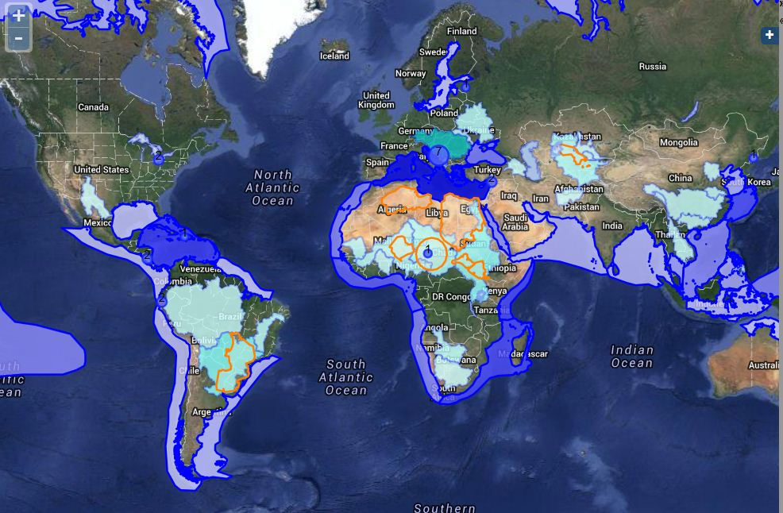
International Waters: transboundary river basins, lakes, aquifers, large marine ecosystems & open oceans
Notes:
Goal: to promote collective management for transboundary water systems and foster policy, legal, and institutional reforms and investments towards sustainable use and maintenance of ecosystem services.
GEF – largest financier of international waters: Approximately $1.4 billion / $8.4 billion in co-financing
Working with more than 170 nations
33 transboundary river basins; 10 transboundary lakes; 7 transboundary groundwater systems; 23 of the Earth’s 66 large marine ecosystems

Slide 10
International Waters Approach
Transformational Change
Implementation of
Strategic Action Program
Development of Regionally-Agreed Strategic Action Program
Foundational Capacity Building / Enabling Environments, Basic Policy and Cooperation /
Issue Identification
Notes:
1 st – foundational process to create and enabling environment for action. building trust and confidence across nations as they identify pressures and drivers… building capacity of regional mechanisms, including inter-ministerial committees
Local demonstration sites
TDA, including economic valuations

Slide 11
International Waters GEF- 6 Strategy
Goal: To promote collective management of transboundary water systems and implementation of the full range of policy, legal and institutional reforms and investments contributing to sustainable use and maintenance of ecosystem services
Objective 1: Catalyze Sustainable Management of Transboundary Waters
Objective 2: Balance Competing Water-uses in the Management of Transboundary Surface and Groundwater
Objective 3: Rebuild Marine Fisheries, Restore and Protect Coastal Habitats, and Reduce Pollution of Coasts and LMEs
Identifying Issues & Strategies
Implementing Freshwater Strategies
Implementing Marine Strategies
1. Foster Cooperation for Sustainable use of Trans- boundary Water Systems & Economic Growth
3. Advance Conjunctive Management of Surface & Groundwater systems
5. Reduce Ocean Hypoxia
6. Prevent the Loss and Degradation of Coastal Habitat
2 .Increase Resilience & Flow of Ecosystems Services in Context of Melting High Altitude Glaciers
4. Water/Food/Energy/
Ecosystem Security Nexus
7. Foster Sustainable Fisheries
Notes:
Freshwater – rivers, lakes, groundwater
Emphasize – groundwater and incorporating groundwater into river and lake initiatives. Focus b/c lack of action on groundwater yet critical for drinking water.
Linkages between water, food, energy and ecosystem security as part of an integrated approach to addressing freshwater issues

