Slide 1
CBD Presentation A Decade for Biodiversity: Implementation of the Strategic Plan for Biodiversity and other Aichi-Nagoya Outcomes
GEF Expanded Constituency Workshop
4 to 6 September 2012
Abidjan, Côte d’Ivoire

Slide 2
Aichi-Nagoya Outcomes
(COP-10 / MOP-5)
47 decisions of COP-10, including:
UN Decade on Biodiversity
Declared 2011-2020 the United Nations Decade on Biodiversity, with a view to contributing to the implementation of the Strategic Plan for Biodiversity 2011-2020
Nagoya Protocol on ABS
X/25. Additional guidance to the financial mechanism
Life in harmony,
into the future

Slide 3
Strategic Plan for Biodiversity 2011-2020
Vision: Living in harmony with nature. By 2050, biodiversity is valued, conserved, restored and wisely used, maintaining ecosystem services, sustaining a healthy planet and delivering benefits essential for all people.”
Mission Take effective and urgent action to halt the loss of biodiversity in order to ensure that by 2020 ecosystems are resilient and continue to provide essential services, thereby securing the planet’s variety of life, and contributing to human well-being, and poverty eradication
20 Aichi Biodiversity Targets
Implementation mechanisms

Slide 4
Aichi Nagoya Targets
Strategic goal A: Address the underlying causes of biodiversity loss
Target 1: By 2020, People are aware of the values of biodiversity and the steps they can take to conserve and use it sustainably.
Target 2: By 2020, biodiversity values are integrated into national and local development and poverty reduction strategies and planning processes and national accounts …
Target 3: By 2020, incentives, including subsidies, harmful to biodiversity are eliminated, phased out or reformed …….
Target 4: By 2020, Governments, business and stakeholders have plans for sustainable production and consumption and keep the impacts resource use within safe ecological limits.
Strategic goal B: Reduce the direct pressures on biodiversity and promote sustainable use
Target 5: By 2020, the rate of loss of all natural habitats, including forests, is at least halved and where feasible brought close to zero, and degradation and fragmentation is significantly reduced.
Target 6: By 2020 all stocks managed and harvested sustainably, so that overfishing is avoided …….
Target 7: By 2020 areas under agriculture, aquaculture and forestry are managed sustainably, ensuring conservation of biodiversity.
Target 8: By 2020, pollution, including from excess nutrients, has been brought to levels that are not detrimental to ecosystem function and biodiversity.
Target 9: By 2020, invasive alien species and pathways are identified and prioritized, priority species are controlled or eradicated, and measures are in place to manage pathways to prevent their introduction and establishment.
Target 10: By 2015, the multiple anthropogenic pressures on coral reefs, and other vulnerable ecosystems impacted by climate change or ocean acidification are minimized, so as to maintain their integrity and functioning.
Strategic goal C: To improve the status of biodiversity by safeguarding ecosystems, species and genetic diversity
Target 11: By 2020, at least 17 per cent of terrestrial and inland water, and 10 per cent of coastal and marine areas are conserved through systems of protected areas…...
Target 12: By 2020 the extinction of known threatened species has been prevented and their conservation status, particularly of those most in decline, has been improved and sustained.
Target 13: By 2020, the genetic diversity of cultivated plants and farmed and domesticated animals and of wild relatives is maintained,
Strategic goal D: Enhance the benefits to all from biodiversity and ecosystem services
Target 14: By 2020, ecosystems that provide essential services, including services are restored and safeguarded,
Target 15: By 2020, ecosystem resilience and the contribution of biodiversity to carbon stocks has been enhanced, through conservation and restoration, including restoration of at least 15 per cent of degraded ecosystems,
Target 16: By 2015, the Nagoya Protocol on Access and Benefits Sharing is in force and operational
Strategic goal E. Enhance implementation through participatory planning, knowledge management and capacity building
Target 17: By 2015 each Party has developed, adopted as a policy instrument, and has commenced implementing an effective, participatory and updated NBSAP.
Target 18: By 2020, the traditional knowledge, innovations and practices of indigenous and local communities and their customary use, are respected.
Target 19: By 2020, knowledge, the science base and technologies relating to biodiversity, its values, functioning, status and trends, and the consequences of its loss, are improved, widely shared and transferred, and applied.
Target 20: By 2020, the mobilization of financial resources for effectively implementing the Strategic Plan for Biodiversity 2011-2020 from all sources,, should increase substantially .

Slide 5
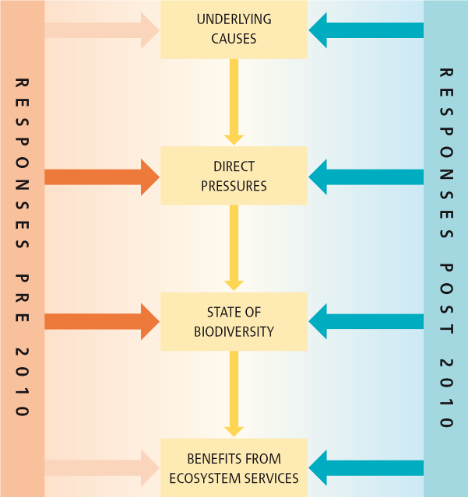
Strategic Goals
Address the underlying causes of biodiversity loss (mainstreaming)
Reduce the direct pressures and promote sustainable use
Directly safeguard ecosystems, species and genetic diversity
Enhance the benefits to all from biodiversity and ecosystem services
Enhance implementation through participatory planning, knowledge management and capacity building
Notes:
The final section of GBO-3 looks at the kind of changes that will be needed, if the current failure to slow biodiversity loss is to be rectified; and consequences such as biodiversity tipping points averted. This diagram helps to summarise the principle behind the suggested changes. On the left, the orange arrows indicate that up until now, action in support of biodiversity has focussed on addressing the direct pressures causing its loss and intervening directly to improve the state of biodiversity, for example in programmes to protect particular endangered species. There has been limited action to address the underlying causes of indirect drivers of biodiversity loss, such as demographic change, consumption patterns or the impacts of increased trade. Equally, action has tended not to be focussed specifically on protecting the benefits provided by ecosystems. The blue arrows on the right show that responses from now on must target these two neglected aspects of biodiversity loss, while continuing and strengthening action to reduce direct pressures and intervene to protect threatened species and ecosystems.

Slide 6
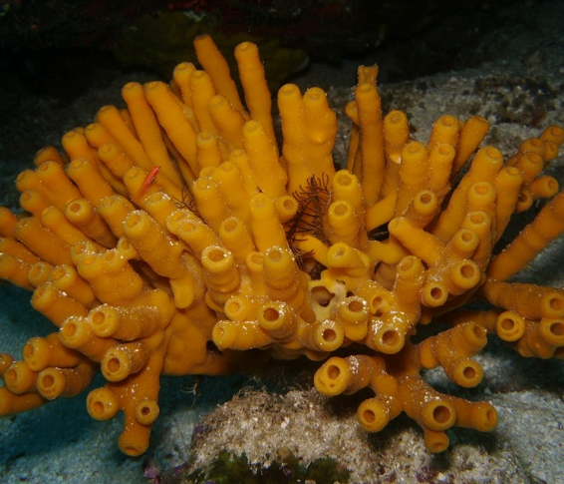
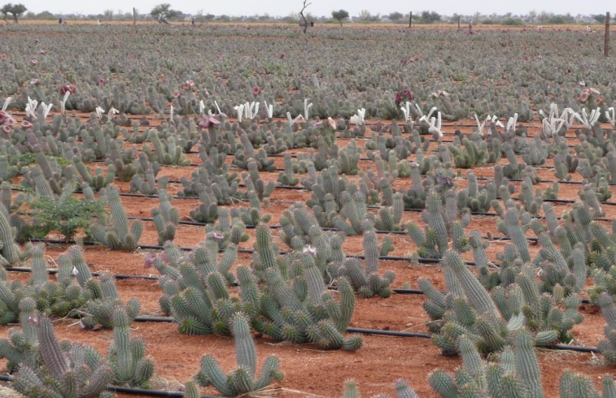
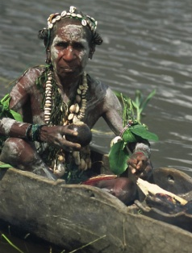
© Queensland Museum
© Johny Keny/Shutterstock
© Rachel Wynberg
© Marsha Goldenberg/Shutterstock
The Nagoya Protocol on Access to Genetic Resources and the Fair and Equitable Sharing of Benefits arising from their Utilization

Slide 7
Status of signatures:
As of 31 March 2012, 92 Parties have signed
Algeria
Antigua and Barbuda
Argentina
Australia
Austria
Bangladesh
Belgium
Benin
Bhutan
Brazil
Bulgaria
Burkina Faso
Cambodia
Cape Verde
Central African Republic
Chad
Colombia
Congo
Costa Rica
Côte d'Ivoire
Cyprus
Czech Republic
Democratic Republic of the Congo
Denmark
Djibouti
Dominican Republic
Ecuador
Egypt
El Salvador
European Union
Finland
France
Gabon
Germany
Ghana
Greece
Grenada
Guatemala
Guinea
Guinea-Bissau
Honduras
Hungary
India
Indonesia
Ireland
Italy
Japan
Jordan
Kenya
Lebanon
Lithuania
Luxembourg
Madagascar
Mali
Mauritania
Mexico
Micronesia (Federated States of)
Mongolia
Morocco
Mozambique
Netherlands
Niger
Nigeria
Norway
Palau
Panama
Peru
Poland
Portugal
Republic of Korea
Republic of Moldova
Romania
Rwanda
Senegal
Serbia
Seychelles
Slovenia
Somalia
South Africa
Spain
Sudan
Sweden
Switzerland
Tajikistan
Vanuatu
Yemen
Thailand
Togo
Tunisia
Ukraine
United Kingdom of Great Britain and Northern Ireland
Uruguay
Notes:
Nagoya Protocol adopted at COP 10, October 2010
Protocol open for signature at UN Headquarters in New York from 2 February 2011 until 1 February 2012
Entry into force 90 days after the date of deposit of the 50th instrument of ratification
COP 11, 8 to 19 October 2012, India
Target for convening the Nagoya Protocol’s first meeting of the Parties
Fiftieth instrument of ratification to be deposited no later than 10 July 2012 to meet this objective

Slide 8
GEF-5 Biodiversity Strategy Objectives
The five objectives of the strategy are to:
Improve the sustainability of protected area systems;
Mainstream biodiversity conservation and sustainable use into production landscapes/seascapes and sectors;
Build capacity to implement the Cartagena Protocol on Biosafety;
Build capacity on access to genetic resources and benefit-sharing; and
Integrate CBD obligations into national planning processes through enabling activities.

Slide 9
Responds to Key Drivers of Biodiversity Loss

Slide 10
Coherence between GEF-5 Strategy & CBD Strategic Plan and Aichi-Nagoya Targets
GEF-5 FY 2011-2014 Strategy Objectives | Strategic Plan Goals | Targets
Objective One: Improve Sustainability of Protected Area Systems: Increase financing of PA systems; Expand ecosystem and threatened species representation within protected area systems; and Improve management effectiveness of existing protected areas. | Strategic Goal A Strategic Goal B Strategic Goal C Strategic Goal D Strategic Goal E | Target 5 Targets 10, 11 and 12 Targets 14 and 15 Targets 18, 19 and 20
Objective Two: Mainstream Biodiversity Conservation and Sustainable Use into Production Landscapes/Seascapes and Sectors: Strengthen Policy and Regulatory Frameworks; Implement Invasive Alien Species Management Frameworks; and Strengthen Capacities to Produce Biodiversity-friendly Goods and Services. | Strategic Goal A Strategic Goal B Strategic Goal C Strategic Goal D Strategic Goal E | Targets 3, 4, 5, and 6 Targets 7,8,9, 10, 11, 12, 13 Targets 14 and 15 Targets 18, 19 and 20

Slide 11
Coherence between GEF-5 Strategy & CBD Strategic Plan and Aichi Targets
GEF-5 FY 2011-2014 Strategy Objectives | Strategic Plan Goals | Targets
Objectives One and Two as above, Objective Four: Build Capacity on Access to Genetic Resources and Benefit Sharing, and Objective Five: Integrate CBD Obligations into National Planning Processes through Enabling Activities Objective Three: Build Capacity for the Implementation of the Cartagena Protocol on Biosafety | Strategic Goal A Strategic Goal D Strategic Goal E | Target 2 Target 17 Targets 19 and 20
Objective Four: Build Capacity on Access to Genetic Resources and Benefit Sharing | Strategic Goal D Strategic Goal E | Target 16 Target 20
Objective Two: Mainstream Biodiversity and Sustainable Use into Production Landscapes and Seascapes and Sectors Objective One: Improve Sustainability of Protected Area Systems: c) Improve management effectiveness of existing protected areas Objective Three: Build Capacity for the Implementation of the Cartagena Protocol on Biosafety | Strategic Goal E | Target 20

