Slide 1
GEF & UNFCCC Cooperation: COP 17 Action Items
GEF Expanded Constituency Workshop
4 to 6 September 2012
Abidjan, Côte d’Ivoire

Slide 2
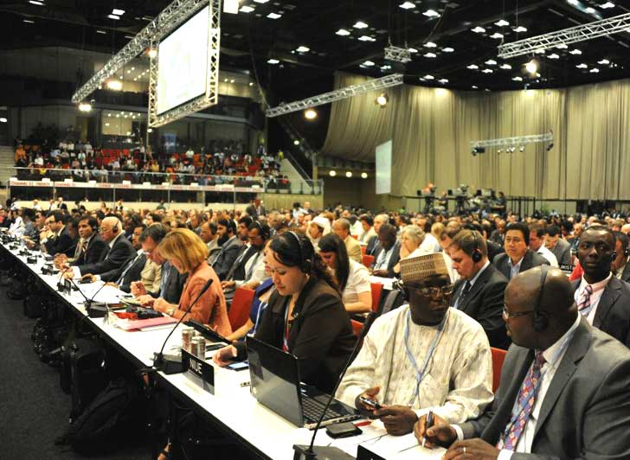
GEF is an Operating Entity of the UNFCCC Financial Mechanism
171 COP Decisions passed to GEF by Parties!

Slide 3
COP 17 Decisions Relevant to GEF
Long-Term Cooperative Action (LCA) under the Convention
Technology Executive Committee (TEC)
Green Climate Fund – report of the Transitional Committee
Financial Mechanism of the Convention (includes decisions on LDCF and “other matters”)
National Adaptation Plans (NAPs)
Adaptation Fund – Review of the Adaptation Fund (Kyoto Protocol)
National Communications for Non-Annex I Parties
Development and Transfer of Technologies: Climate Technology Center and Network (CTCN) Host

Slide 4
Long-term Cooperative Action (LCA)
GEF is requested to support non-Annex I Parties in preparing their 1st Biennial Update Report (BUR)
REDD: GEF is encouraged to provide results-based finance for developing national strategies, action plans, policies and measures, and capacity- building
GEF is requested to participate in Climate Technology Center and Network
GEF will continue support of capacity building activities
Notes:
BUR: Biennial Update Report
NAMAs: Nationally Appropriate Mitigation Action
REDD: Reduction of Emissions from Deforestation and forest Degradation

Slide 5
Technology Mechanism: CTCN
CTCN: Climate Technology Center and Network
2012: Call for proposals to host CTCN
GEF is requested to support, without prejudging host selection
GEF already supports CTCN-related activities
Under Poznan Long Term Programme
ADB-UNEP regional pilot centre project (GTF and SCCF)
Notes:
Second bullet will be changed by mid- March 2012

Slide 6
Green Climate Fund (GCF)
Independent US $100 billion fund to address climate change
GEF and UNFCCC are taking steps to set up interim secretariat of GCF
Interim secretariat: provides technical, administrative, logistical support to GCF Board until independent secretariat is established

Slide 7
Financial Mechanism
COP requests GEF to:
Work with implementing agencies to further simplify procedures, and ensure effectiveness and efficiency of the process through which non-Annex I Parties receive funding to meet their obligations under the Convention, ensuring timely disbursement of funds
Enhance transparency of project review process
Clarify additional cost concept (LDCF/SCCF)
Provide financial resources to developing countries for strengthening and establishing national and regional systematic observation and monitoring networks
Support other non-Annex I Parties, as appropriate, to conduct or update their Technology Needs Assessments (TNAs)
Notes:
Non-Annex I Parties require funding to meet their obligations under Article 12, Paragraph 1 of the Convention: 1. “In accordance with Article 4, paragraph 1, each Party shall communicate to the Conference of the Parties, through the secretariat, the following elements of information: (a) A national inventory of anthropogenic emissions by sources and removals by sinks of all greenhouse gases not controlled by the Montreal Protocol, to the extent its capacities
permit, using comparable methodologies to be promoted and agreed upon by the Conference of the Parties; (b) A general description of steps taken or envisaged by the Party to implement the Convention; and (c) Any other information that the Party considers relevant to the achievement of the objective of the Convention and suitable for inclusion in its communication, including, if feasible, material relevant for calculations of global emission trends.”
Additional Cost principle: adapting to Climate Change imposes an additional cost on developing countries to meet their sustainable development needs; it is additional to business-as-usual development costs. That additional cost of adaptation in a project is what is financed by LDCF and SCCF.

Slide 8
Financial Mechanism (Cont’d)
On LDCF, GEF is requested to:
Continue clarifying “project baselines” and application for accessing funding from LDCF;
Support programmatic approach for NAPA implementation;
Explore further opportunities to streamline LDCF project cycle;
Improve provision of information to LDCs on project development process
Notes:
-The Handbook for Conducting TNAs for Climate Change, was developed by UNDP and UNFCCC and was last updated in November 2010. Available: https://www.thegef.org/gef/TT_tech_needs_assessment

Slide 9
National Adaptation Plans (NAPs)
Introduced at COP16 as means to allow developing countries to “identify medium- and long-term adaptation needs and to develop and implement strategies to address those needs”
GEF is invited to consider how to enable activities for the preparation of the NAPs for the LDCs through the LDCF
Developed country Parties are urged to mobilize financial support for NAPs for LDCs
Non-LDCs are invited to employ NAP modalities
Notes:
Financial support for NAPs should come from developed country Parties and channeled through bilateral and multilateral channels and the LDCF

Slide 10
National Communications
Subsidiary Body of Implementation (SBI) invites GEF to continue reporting activities relating to the preparation of national communications by non-Annex I Parties, including information on the dates of approval of funding and disbursement of funds

Slide 11
Development and Transfer of Technologies
SBI appreciates GEF progress on Poznan Program including support for pilot projects, Technology Needs Assessments (TNAs), and long-term programme
GEF and Parties to expedite process for early implementation of projects.
SBI encouraged Parties to develop and submit project proposals, for technologies adaptation
GEF invited to raise awareness of the long-term programme
Notes:
Long-term Programme (Poznan, COP 14) components:
COP14 requested the GEF to consider a long-term implementation of the strategic program on technology transfer. The GEF stands ready to establish and implement a long-term plan, and submitted a report to COP16. The long-term program may entail elements to scale up investment in ESTs in developing countries in accordance with the GEF-5 climate change mitigation strategy, and to enhance technology transfer activities under the Convention.
Such elements are:
-Support for Climate Technology Centers and a Climate Technology Network
-Piloting Priority Technology Projects to Foster Innovation and Investments
-Private Public Partnership for Tech Transfer
-Technology Needs Assessment
-GEF as a Catalytic Supporting Institution for Tech Transfer

Slide 12
Work in Progress 2012
GEF Report to COP18: under preparation
GEF - UNFCCC retreat: mid-2012
Points of Contact:
Climate and Chemicals Head, Robert Dixon: rdixon1@thegef.org
Head, Adaptation Strategy and Operations, Bonizella Biagini: bbiagini@thegef.org
CC Mitigation Cluster Coordinator, Chizuru Aoki: caoki@thegef.org

