Slide 1
Evaluation in the GEF and
Training Module on
Terminal Evaluations
GEF Expanded Constituency Workshop
Anna Viggh
Senior Evaluation Officer
GEF Independent Evaluation Office
Minsk, Belarus
September 2015

Slide 2
Overview
Evaluation in the GEF:
Monitoring and Evaluation in the GEF
GEF Independent Evaluation Office (IEO)
GEF M&E Policy 2010
Training Module on Terminal Evaluations

Slide 3
M&E in the GEF
Two overarching objectives:
Promote accountability for the achievement of GEF objectives through the assessment of results, effectiveness, processes, and performance of the partners involved in GEF activities.
Promote learning, feedback, and knowledge sharing on results and lessons learned among the GEF and its partners as a basis for decision making on policies, strategies, program management, programs, and projects; and to improve knowledge and performance.

Slide 4
Separate reporting lines for Monitoring (through Secretariat) and Evaluation (through IEO)
GEF Council
Annual evaluation reports
Overall Performance Study
(to Assembly)
Annual Work Program
and Budget
Annual Monitoring Report
Evaluation Management Response
Programming documents and indicators
Results Based Management
Agency evaluation units
GEF Independent Evaluation Office
GEF Secretariat
Corporate evaluations
Project and Program
Independent evaluations
Project and Program
evaluations
Project and Program Implementation Reports
Agency Portfolio Reports
Project documents with M&E plans
Agency GEF coordination units
Project and Program Implementation Reports
Project and Program monitoring documentation
Terminal evaluations
GEF projects and programs

Slide 5
GEF Independent Evaluation Office
Mission:
Enhance global environmental benefits through excellence, independence, and partnership in monitoring and evaluation.
Functions:
Independent GEF Evaluation
Normative function
Oversight function
Knowledge sharing and dissemination
Brief history:
1996 — Initially established as an M&E unit within the GEF Secretariat
2003 — The M&E unit was made independent of the GEF Secretariat
2005 — The unit was renamed as GEF Evaluation Office
2013 — The office was renamed as GEF Independent Evaluation Office
Notes:
Independent GEF Evaluation: The main function of the IEO is to independently evaluate the GEF’s efficiency, effectiveness, relevance, impact, and sustainability.
Normative function: IEO sets minimum monitoring and evaluation standards within the GEF to ensure improved and consistent measurement of the GEF results .
Oversight function: IEO provides quality control for the minimum requirements of monitoring and evaluation practices in the GEF, in full cooperation with relevant units in the GEF Agencies, and tracks implementation of Council decisions related to evaluation recommendations.
Knowledge management and dissemination function: IEO supports knowledge sharing and follow-up of evaluation recommendations. It participates in the development and maintenance of a comprehensive knowledge system based on evaluation findings and lessons.

Slide 6
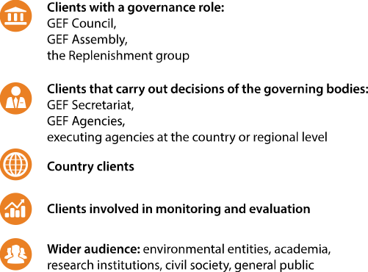
GEF IEO Stakeholders

Slide 7
Types of Evaluations
Project Evaluations | Program Evaluations | Country Level Evaluations
Impact Evaluations | Cross-cutting and thematic evaluations | Process and performance evaluations
Ad-hoc Reviews | Overall Performance Studies (OPS) | Special Studies
Different TORs, scopes, frequency, audiences , methodologies

Slide 8
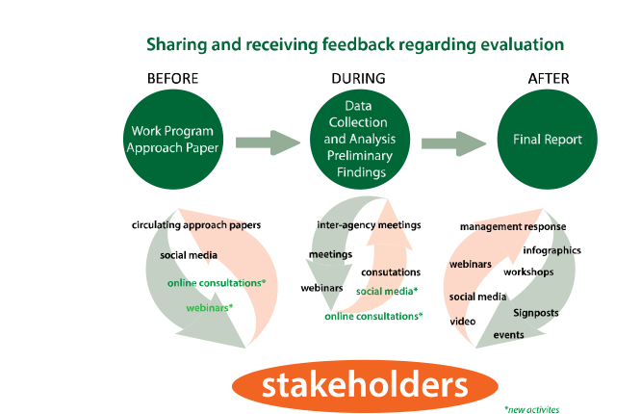
GEF IEO Dissemination and Knowledge Management

Slide 9
IEO Work Program for GEF-6
Mainstreaming of KM and Gender in all evaluations
Notes:
Implementation of GEF M&E Policy
Evaluation Program adjusts to evolving GEF priorities
GEF IEO has started consultation to define the GEF-6 evaluation program
Reporting to the GEF Council
Participation in the GEF Country Support Program
Overall Performance Studies — replenishment process (every 4 years)
Active participation evaluation communities (UN/MDBs/other)

Slide 10
The GEF M&E Policy
Defines the concepts, role, and use of monitoring and evaluation within the GEF
Defines the institutional framework and responsibilities
Indicates the GEF minimum M&E requirements covering:
Project design
Application of M&E at the project level
Project evaluation
Engagement of Operational Focal Points in M&E
Current M&E Policy: Approved by GEF Council in November 2010

Slide 11
Training Module on
Terminal Evaluations

Slide 12
Introduction
Purpose of this module is to:
Discuss importance and utility of terminal evaluations
Characteristics of a good terminal evaluation
Exercise on pre-requisites for preparing a good terminal evaluation
What needs to be done during project preparation and implementation
When a project is prepared
When a project is implemented
What needs to be done during preparation and delivery of a terminal evaluation
When a terminal evaluation is planned
When a terminal evaluation is conducted
When a draft report is prepared

Slide 13
Importance and Utility of Terminal Evaluations
Source of information on project
Results: Outputs, outcomes and progress to impact
Implementation, execution, and project cycle related information
Project finances including co-financing
Recommendations and Lessons for the future
GEF M&E Policy (2010): Minimum Requirement 3
Terminal evaluations mandatory since 1995
For full-size projects required, encouraged for MSPs

Slide 14
Importance and Utility of Terminal Evaluations contd.
Reporting at the project portfolio level (APR, AMR)
Input to other evaluations
STAR’s performance index
About 1000 terminal evaluations completed so far.
Terminal evaluation may be accessed at:
GEF website: http://www.thegef.org/gef/gef_projects_funding
Through PMIS

Slide 15
Characteristics of a Good Terminal Evaluation
GEF IEO criteria for terminal evaluations quality:
Outcomes
Consistency and comprehensiveness
Sustainability
Lessons and recommendations
Project finances
M&E
Other characteristics of good terminal evaluations:
Transparency and timeliness
Candor
Balance
Utility
Question – is good terminal evaluation and good project performance the same?
Terminal Evaluation Guidelines are available at: http://www.thegef.org/gef/Guidelines%20Terminal%20Evaluations
Notes:
Quality: Comprehensive; Consistent; Truthful and Candid; Precise; Timely; Useful

Slide 16
Examples of Good Terminal Evaluations
Links to examples of good terminal evaluations
GEF ID #394: http://www.thegef.org/gef/project_detail?projID=394
GEF ID #1599: http://www.thegef.org/gef/project_detail?projID=1599
GEF ID #1188: http://www.thegef.org/gef/project_detail?projID=1188
GEF ID #1348: http://www.thegef.org/gef/project_detail?projID=1348

Slide 17
Exercise: Pre-requisites for preparing a good terminal evaluation
You will be asked to think about what needs to be done to facilitate preparation of a good terminal evaluation:
At different stages of terminal evaluation preparation
At project preparation and implementation
Each group will discuss the requirements at each of these steps and will record their joint responses as bullets in the response sheet provided to them.
After all stages have been discussed by the groups, one of the groups will present its response for a stage, others may add if their group had an additional bullets not yet covered. Each stage will be presented by a different group.
We will end with a summary that pulls the discussion together

Slide 18
First Discussion: What needs to be done during project preparation and implementation?
1 A. What needs to be done during the project preparation stage?
Development of M&E plan
Tracking tools
1 B. What needs to be done during the project implementation?
Implementation of M&E plan
Gathering of data on tracking tools

Slide 19
Second Discussion: What needs to be done during preparation and delivery of a terminal evaluation?
Consider a situation where a project is about to be complete within one year. What needs to be done at different stages of terminal evaluation preparation to ensure that it leads to a good quality evaluation:
2 A. Commissioning of the terminal evaluation
2 B. Conduct of the terminal evaluation
2 C. Finalization of the terminal evaluation

Slide 20
Short Presentations by Stages
Presentation on group discussion
Summary

