Slide 1
Substances chimiques
Atelier Elargi pour la Circonscription
4 – 6 septembre 2012
Abidjan, Côte d’Ivoire

Slide 2
Le FEM et les substances chimiques Contexte général
Le FEM fournit des ressources dans les domaines suivants de la gestion des substances chimiques
Élimination progressive des polluants organiques persistants – Convention de Stockholm
Élimination progressive des substances appauvrissant la couche d’ozone (SAO), en particulier dans les pays en transition – Protocole de Montréal
Activités pilotes sur le mercure : accompagner et éclairer la négociation de l’instrument sur le mercure
Activités pilotes sur les substances chimiques constituant une menace pour la planète (et problématique connexe) – liées aux objectifs de l’Approche stratégique de la gestion internationale des produits chimiques (ASGIPC)
Notes:
GEF is the Interim Financial Mechanism of the Stockholm Convention on Persistent Organic Chemicals. Currently 22 Chemicals are controlled by the Convention. The first action of Parties is to develop a National Implementation Plan (NIP) that describes the actions and priorities the Party will undertake to address POPs. The GEF has funded 138 parties so far for these NIPs. Parties have submitted projects post NIP to implement capacity building to manage POPs and phase out POPS, including DDT, PCB, Dioxins and Furans and Agricultural POPS.
The GEF is not a Financial Mechanism of the Montreal Protocol. The majority of countries are funded by the Multilateral Fund for their ODS phase out, however when the Protocol was created, the USSR was a party and they were supposed to phase out their ODS by themselves. When the USSR broke up, the resulting CEITS inherited the Montreal Protocol Classification of the USSR and so were not eligible for MLF funding. The GEF Council stepped in to assist these countries and continue to do so.
Mercury is an elemental substance and is highly toxic. Countries are currently negotiating a new agreement on Mercury through an intergovernmental negotiating committee (INC). The GEF supports this process by providing funding to countries to examine specific issues related to the potential convention. Projects include storage of mercury (note that as an element, mercury cannot be destroyed and has to be safely stored – much the same as nuclear waste). The INC has met 3 times and at the 3rd meeting discussions on a Financial Mechanism has started. The GEF put forward its position on this at that meeting.
The Strategic Approach to International Chemicals Management is an overarching set of principles that seek harmonizing chemicals and waste management. The SAICM has a voluntary funding mechanism called the Quick Start Program (QSP) which funds projects up to 250K for countries to do activities such as developing chemical profiles, reviewing or developing national legislation or policy etc. The GEF independently has included funding in GEF 5 to explore issues such as e-waste, lead in paints and chemicals of global concern in products.
The SAICM is an output of the International Conference on Chemicals Management (ICCM) and seeks to cover the gaps in the three Chemical Conventions. Under the QSP developing countries and countries with economies in transition are eligible and can access funds once they officially communicate to the SAICM Secretariat a designated national focal point.

Slide 3
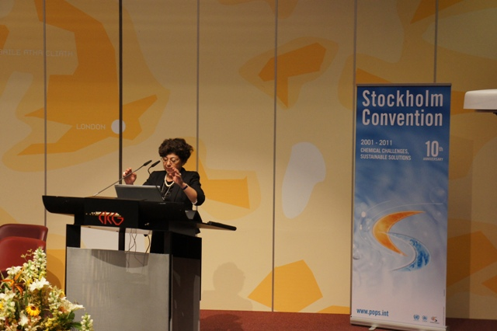
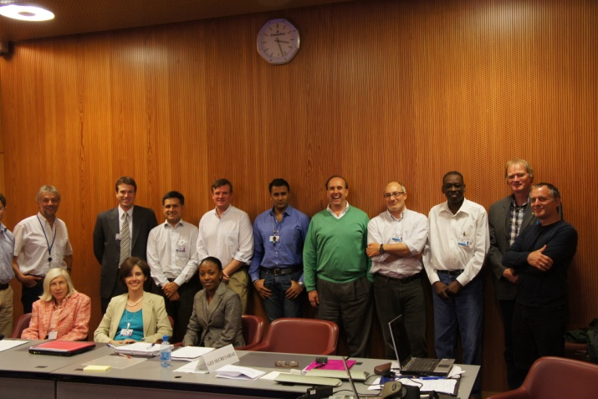
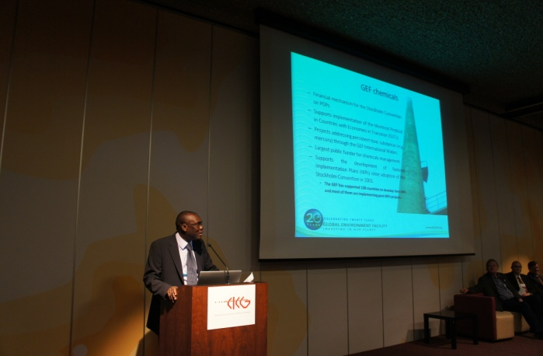
FEM-5 ― Tour d’horizon
88 M USD d’investissements et 489 M USD de ressources additionnelles pour la gestion des substances chimiques
Approbation de 2 projets pilotes sur la réduction du mercure : orpaillage et secteur de la santé
Approbation de mises à jour des Plans nationaux de mise en œuvre présentées directement ou par le biais d’Entités d’exécution. Nous encourageons toutes les Parties pouvant y prétendre à continuer de soumettre des demandes d’actualisation
Agrément du projet d’élimination progressive des chlorofluorocarbones (CFC) dans les inhalateurs à doseur en Russie
Notes:
Up to the end of GEF 4 investments in Chemicals is 450M plus 700M in co-financing. GEF 5 has an allocation of 375M for POPs, 15M for Mercury, 25M for ODS and 10M for Sound Management of Chemicals. We have programmed so far 88M plus 489M in Co-financing.
The Mercury Projects approved are: Improve the Health and Environment of Artisanal and Small Scale Gold Mining (ASGM) Communities by Reducing Mercury Emissions and Promoting Sound Chemical Management – A regional project in Africa implemented by UNIDO (Burkina Faso, Mali and Senegal) and A Mercury Inventory and management system within the following project approved for Kazakhstan - NIP Update, Integration of POPs into National Planning and Promoting Sound Healthcare Waste Management in Kazakhstan.
The approved NIPS are Kenya through direct access and Kazakhstan through agency access. The following proposal for NIP Updates under direct access are being reviewed – Uganda, Mali and Senegal. Macedonia has applied through agency access (UNICO)
Metered Dose Inhalers (MDIs) are used for asthma and COPD treatment. The propellant in them was CFC. These need to be replaced with HFC. The projects in this sector helps companies reformulate the product and modify the delivery mechanism of the devices which requires both technology transfer and technical assistance.

Slide 4
Polluants organiques persistants
La plupart des projets du FEM seront axés sur les priorités des plans nationaux de mise en œuvre, y compris la réduction des polychlorobiphényles (PCB), des pesticides contenant des POP, du DDT (dichlorodiphényltrichloroéthane) et des POP produits involontairement
Dans le cadre de FEM-5, les Parties sont invitées à soumettre des demandes de financement (maximum de 250 000 dollars) pour l’examen et la mise à jour de leurs plans nationaux de mise en œuvre
Les Parties peuvent proposer des activités témoins ou pilotes portant sur les nouveaux POP
Notes:
PCB projects are usually in the Electricity generation and transmission sector. Typical projects include doing a detailed inventory of PCBS contained in equipment in use and equipment not in use, developing an environmentally sound management plan for the in use equipment and safe handling, interim storage and final disposal of PCBs in stockpiles and end of life equipment. Projects can also include replacement of equipment. Contaminated equipment and soil is also included in projects. While PCB is included in the list of Unintentionally Produced POPs (U-POPS), we have not had projects that addresses unintentional releases of PCBs. Equipment that contains PCBs include transformers and capacitors used in electricity generation and transmission. It is also found in the ballasts in old fluorescent bulbs, refrigerators, some types of paints etc. They are/were used when there was the need to have an electirc insulator.
Pesticide projects usually involve re-packaging, safe storage and disposal of pesticide stockpiles. Obsolete Stocks of DDT used as pesticide are included in these projects.
DDT projects typically focus on looking at alternatives for DDT in vector control. DDT use is not prohibited under the convention as long as countries have an exemption from the Convention, however they need to over the long term reduce and eliminate the use of DDT by finding suitable, chemical and non-chemical alternatives.
COP 4 added nine new Chemicals to the initial 12,and COP 5 added one more. Under the Convention this triggers an update of National Implementation Plans. There is up to a maximum per country of 250K for this purpose and countries can access either through direct access or agency access. So far 5 countries have applied via direct access (Kenya is already approved) and three others have applied via agency access (Kazakhstan has its NIP update approved with a larger FSP)

Slide 5
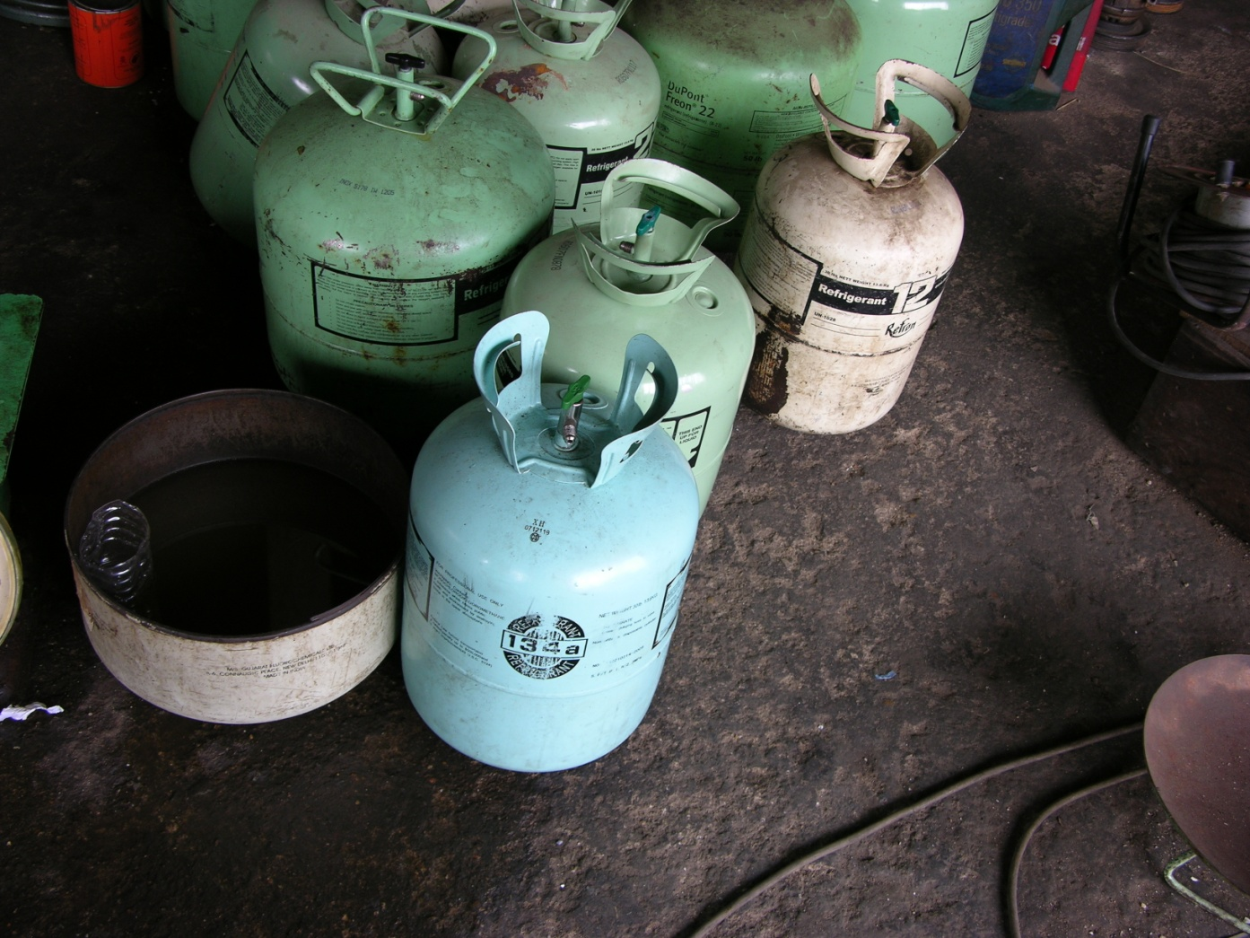
Financement de l’application du Protocole de Montréal
Le FEM appuie l’application du Protocole de Montréal dans les pays en transition. Pendant FEM-5, 25 M USD seront consacrés à l’élimination progressive des substances appauvrissant la couche d’ozone (SAO)
Le FEM a investi 232 M USD pour éliminer progressivement les SAO dans les pays en transition. Les quantités de SAO éliminées dans les pays en transition et en Russie équivalent approximativement à celles éliminées dans l’ensemble des pays en développement.
Le FEM continue d’appuyer les efforts déployés par les pays en transition admissibles pour éliminer les hydrochlorofluorocarbones (HCFC) et le bromure de méthyle.
Notes:
The GEF has funded the phase out of CFC in the CEITS. We are now investing in the phase out of HCFCs in these countries. The main applications of HCFCs are in the heating and cooling sector, refrigeration, industrial solvents, insulation foams, fire-fighting agents.

Slide 6
Financement d’accompagnement des travaux du Comité intergouvernemental de négociation sur le mercure
Pendant FEM 5, 15 M USD seront consacrés à des activités pilotes de réduction du mercure.
Le FEM a contribué à tous les travaux du CIN sur le mercure.
Les projets devraient porter sur l’un ou plusieurs des enjeux suivants :
réduction de l’utilisation du mercure dans la fabrication de produits ;
réduction de l’utilisation du mercure dans les procédés industriels ;
réduction de l’utilisation du mercure et de l’exposition à ce polluant dans l’orpaillage ;
renforcement des capacités d’entreposage du mercure ;
réduction des émissions de mercure dans l’atmosphère ;
amélioration de la collecte des données et de l’information scientifique au niveau national ;
renforcement des capacités de gestion des déchets et sites contaminés.
« Les ressources destinées au travail sur le mercure pendant FEM-5 visent le financement d’évaluations et d’activités pilotes qui permettront de faire avancer l’élaboration d’un instrument mondial de réduction de la pollution par le mercure et de renforcer la capacité des pays à appliquer les dispositions de cet instrument lorsqu’il entrera en vigueur. »
Stratégie de programmation
du FEM pour le mercure

Slide 7
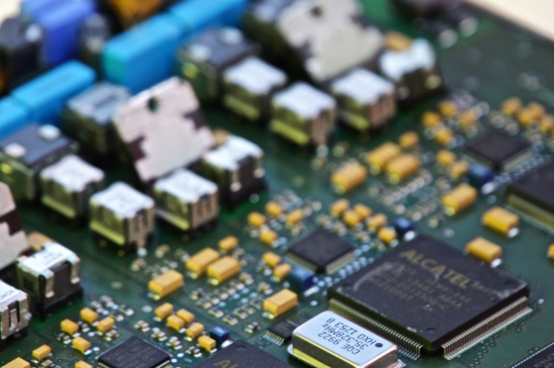
Financement de la gestion des substances chimiques
Pendant FEM-5, 10 M USD seront consacrés à la gestion sans risque des substances chimiques, notamment dans les domaines suivants :
Déchets électroniques – Des projets bien conçus de gestion des déchets électroniques devraient prendre en compte les problèmes causés par le mercure et les POP.
Produits contenant des substances chimiques constituant une menace pour la planète, conformément à l’Approche stratégique de la gestion internationale des produits chimiques (ASGIPC).
Plomb contenu dans la peinture.
Notes:
E-waste covers a range of consumer and other products. It can range from mobile phones, to computer, refrigerators, stoves, microwave ovens etc. Once there is a chip in it is can be considered e-waste. Proper handling of this waste is necessary due to the hazardous chemicals in them included POPs. Mercury and lead, however significant revenues can be generated from proper recycling of these wastes. There are precious metals, recyclable plastics, copper etc that have a high resale value.

Slide 8
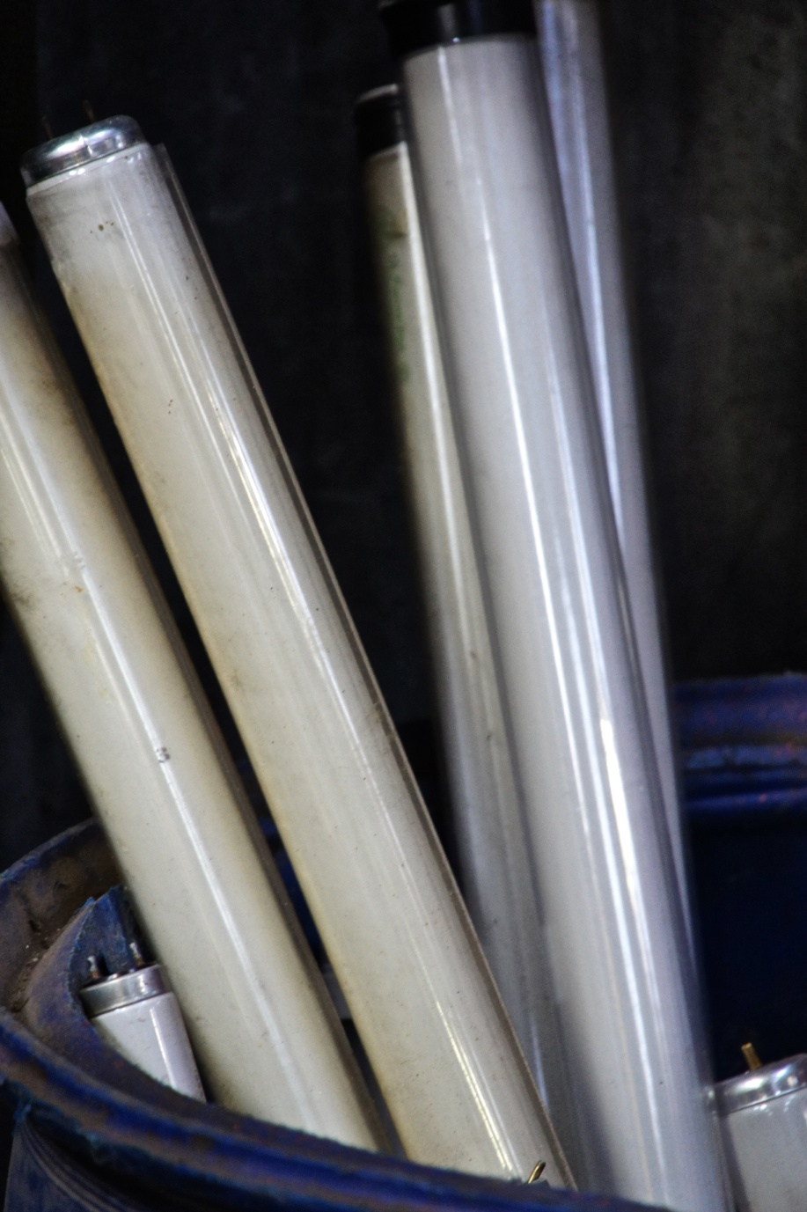
Rechercher des synergies pour les projets de gestion des substances chimiques
Pendant FEM-5, la recherche de synergies sera encouragée dans les projets afin d’en accroître l’impact.
Voici quelques exemples d’activités plurisectorielles ou de projets de gestion de plusieurs substances chimiques auxquels les pays pourraient juger utile de s’intéresser :
Traitement des POP, des déchets électroniques, du mercure et du plomb, et amélioration de la gestion des déchets
Lampes à mercure et autres déchets lors de projets de maîtrise de l’énergie dans les bâtiments et les systèmes d’éclairage
Projets de maîtrise de l’énergie dans les secteurs de la production et de l’utilisation de systèmes de chauffage/refroidissement/climatisation, et projets d’élimination progressive des SAO.
Réduction du mercure et des POP dans les déchets médicaux
Projets incorporant la mise en application des principes des conventions de Bâle, de Rotterdam et de Stockholm.
Destruction simultanée de POP et SAO.
Notes:
Encouraging synergy is an advantage to the recipient country since they can deal with a number of issues through one project or program. Most e-waste for example contains some of the new POPs and burning of the cables and plastic from this waste will produce dioxins and furans so that proper handling of this waste eliminates both the amount of e-waste but also POPs.
When projects are designed to replace lighting or to create green buildings, while replacing energy inefficient equipment it makes sense to deal with the waste which contains POPs, mercury and ODS.
Medical waste contains mercury from medical devices such as thermometers. Safe handling of this waste removes the mercury and reduction and proper incineration reduces the production of U-POPS.

Slide 9
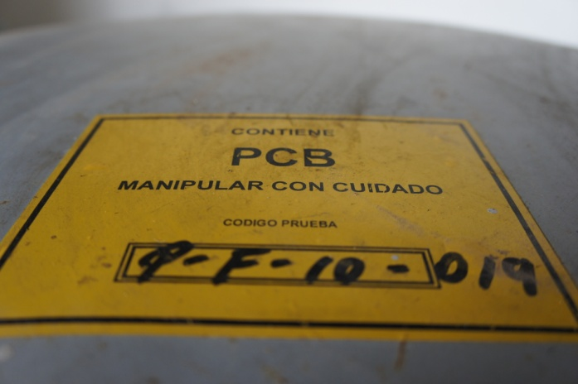
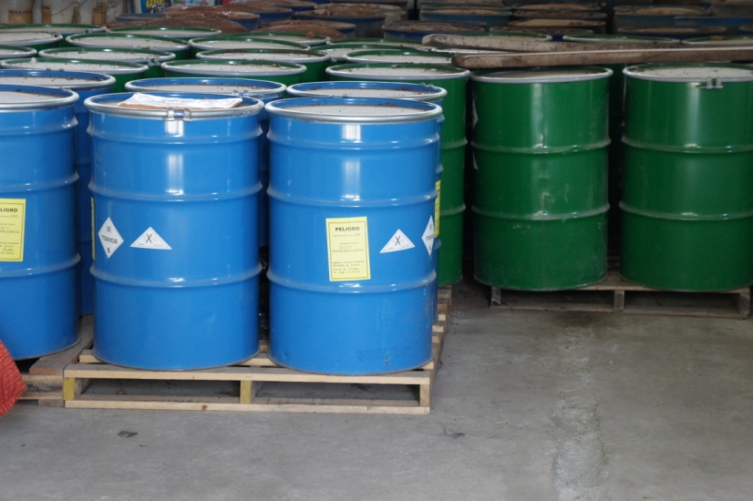
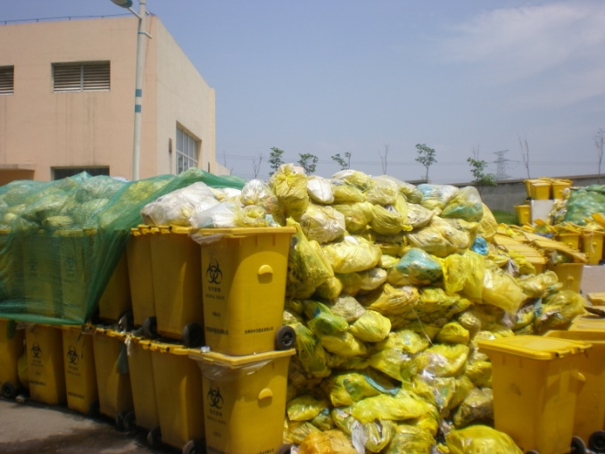
Pour plus d’informations :
Ibrahima Sow Coordonnateur du module « substances chimiques » isow@thegef.org
Anil Sookdeo Spécialiste de l’environnement asookdeo@thegef.org
Evelyn Swain Spécialiste de l’environnement eswain@thegef.org
Jie Pan Junior Professional Associate (JPA) jpan@thegef.org
Marie Boucher Détachée de la U.S. EPA mboucher@thegef.org

Slide 10
Merci !
Des questions?

