Slide 1
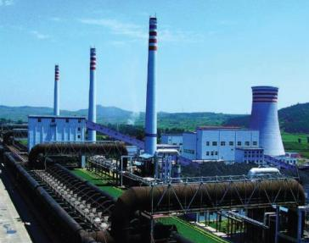
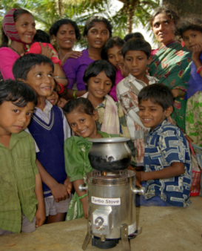
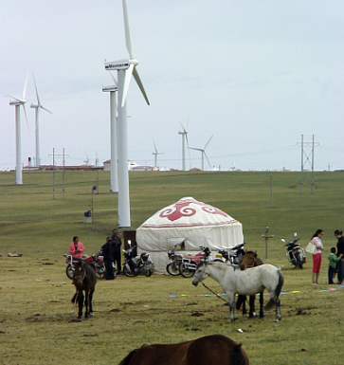
Expanding Engagement with the Private Sector on GEF Projects
Minsk, Belarus
September 23-24, 2015

Slide 2
Expanding Private Sector Engagement in GEF Projects (1)
Private sector engagement is not new; but GEF projects can deliver more by partnering on sustainable business models and attracting more investment for environmental benefits
During GEF-5 → the Council approved five innovative PPPs (three in LAC) with a
total funding commitment of $70 million which has attracted $907 million in co-financing → potential to generate re-flows
The IDB Sustainable Caribbean Basin Private Equity Fund ($15 Million - co-financing $200 million) seeks to foster private investments that promote energy security, environmental sustainability and related economic opportunities in nations across the Caribbean Basin.
    highly innovative investment platforms and business models that expand access to clean and safe energy, achieve the sustainable use of natural capital, and generate opportunities for local businesses and low income populations, including women and indigenous people

Slide 3
Expanding Private Sector Engagement in GEF Projects (2)
The IDB MIF PPP Program ($15 Million – co-financing $266 Million) is making targeted equity investments in funds to promote energy efficiency, renewable energy, and bio-diversity in Latin America.
  investments will contribute to energy savings, new renewable energy supply, reduction of greenhouse gas (GHG) emissions, preservation of natural resources, protection of bio-diversity, and development of sustainable business models.
The IDB Climate-Smart Agriculture Fund For The Americas ($5 Million – co-financing $50.9 Million) is catalyzing greater private sector investments in sustainable agriculture, forestry and rangeland systems in order to maintain and improve the flow of agro-ecosystem services from productive landscapes in the face of climate change and increasing resource scarcity.
    focuses on the synergies between private sector funds and agricultural development funds. It will also be the first fund tailored to incentivize private sector investment in climate-smart agriculture.

Slide 4
Expanding Private Sector Engagement
In GEF-6 we are pursuing:
Mainstreaming - seeking private sector engagement in all projects
2. Integrated Approach Pilots - targeted pilots
3. Non-grant instrument Pilot - special set-aside

Slide 5
(1) Non-grant Instrument Pilot (NGI)
115 Million → $5 million will be reserved for the Sustainable Cities Integrated Approach Pilot
Objective → to support the achievement of the GEF’s objectives through the use of non-grant instruments for targeted investments that promote global environmental benefits
Until now, non-grant instruments have not been used in the GEF’s engagement with public sector entities → we expect this to happen
The use of non-grant instruments under the GEF-6 Pilot will be focused on instruments that have the potential to generate reflows → contribute to the GEF Trust Fund’s financial sustainability

Slide 6
(2) Non-grant Instrument Pilot (NGI)
By demonstrating and validating successful models for the use of non-grant instruments, the GEF can help catalyze large-scale changes through broader adoption and generate experiences which may also be useful for other international environmental funding mechanisms
Selection criteria:
  Demonstrate use of non-grant instruments in areas other than climate change
  Demonstrate innovative application of financial mechanisms and partnerships that may be broadly adopted and can be scaled up;
  Support innovative engagement of the private sector and public sector through innovative business models;
  Deliver high levels of co-financing

Slide 7
(3) Non-grant Instrument Pilot (NGI)
For projects/programs with private sector recipients, the GEF Partner Agency will negotiate an appropriate concessional rate or return on investment, which, consistent with the Agency’s regular practices → no necesita carta de endoso de PFO
For projects/programs with loans to public sector recipients, the Pilot will use differentiated terms:
  LDCS and SIDS: 40 years maturity, 10 years grace period, 0,25% interest
  Non LDCS - SIDS: 20 years maturity, 10 years grace period, 0,75% interest
In case of the use of guarantee instruments for public sector entities, the reflow schedule and fees will be negotiated on a case-by-case basis by the GEF Partner Agency

Slide 8
Typical types of private sector actors for GEF projects
Type
Description/Examples
1
Capital providers
  Pension funds, VCs
2
Financial intermedi-aries and facilitators
  Investment banks, commercial banks, financial advisory services
3a
Industry players – large corporations
  Large retail, manufacturing companies, project developers, etc.
3b
Industry players – SMEs
  Full time staff below 250 or less depending on the country
3c
Industry players – individuals/ entrepreneurs
  Small start-ups with full time staff below 10

Slide 9
Benefits of Private Sector Engagement
The private sector can strengthen partnerships and make contributions to environmental and developmental solutions, such as:
1. Additional funding
2. Expertise/skills/knowledge
3. Innovation
4. Technology transfer
5. Phase out substandard products

Slide 10
Reflections on selected GEF projects in this region
We reviewed a few GEF projects to learn:
>
Was the private sector part of the problem and solution?
>
Is there an essential contribution of private sector stakeholders in the project?
>
What results or lessons learned can provide insights for future private sector engagement?
We used the GEF intervention models to review these projects

Slide 11





The GEF regularly uses five intervention models
1
Transforming policy and regulatory environments
2
Strengthening institutional capacity and decision-making
3
Deploying innovative financial instruments
4
Convening multi-stakeholder alliances
5
Demonstrating innovative Approaches

Slide 12
Transformation of policy and regulatory environments
Introduction of Climate Friendly Measures in Transport in Mexico (GEF ID 1155) World Bank
Focal Area
GEF
Climate Change Mitigation
The GEF supports the development of policies and measures to facilitate the renewal of small, inefficient vehicles to vehicles that are compatible with the climate, more efficient and less polluting.
Objective of the Project
Introduce means of public transportation that allow energy savings.
Private Sector
Best practices and lessons learned
Participates with its technical capacity and capital investment in more efficient and less pollutant buses.
The government developed a suitable regulatory and timely framework to facilitate the investment of the private sector and actively searched the participation of the private sector.

Slide 13
Strenghtening institutional capacity and decisión-making processes
The GEF Earth Fund: Greening the Cocoa Industry (GEF ID 3357/4070) IFC/UNEP
Focal Area
GEF
Biodiversity
GEF funds support the strengthening of capacity building in countries and Cocoa-producing companies in the field of business practices and production that integrate the promotion of biodiversity, a long-term stability of the industry and growth in the revenue of entrepreneurs.
Objective of the Project
Transform 10% of the global supply of cocoa to a sustainable cocoa production system to enhance biodiversity conservation.
Best practices and lessons learned
Private Sector
The project created a public-private partnership between two leading manufacturers of chocolate. Mars Inc., Kraft Foods and commercial cocoa companies to mobilize and support the growing involvement of the private sector towards the use of sustainable practices.
GEF investments were catalytic, gathered partners, supported the development and adoption of common standards, and demonstrated the feasibility of the PPP scheme to encourage the use of sustainable practices within the private sector.

Slide 14
Establishment of multi-stakeholder partnerships
The GEF Earth Fund: Public-Private Funding Mechanisms for Watershed Protection
(GEF ID 3357/4260) IFC/BID
Focal Area
Objective of the Project
GEF
Biodiversity
To establish mechanisms for public-private long-term financing to promote private sector participation in the conservation of freshwater ecosystems and biodiversity.
Support the establishment of at least five water funds across the Latin American and Caribbean region with contributions from a variety of public and private funds.
Private Sector
Best practices and lessons learned
The funds will attract capital contributions from water supply companies and local industry, including endowments, which can be invested in a wide range of asset markets and watershed programs or other conservation projects, which may involve other private sector actors
A partnership between stakeholders helped align incentives and contributions to the successful implementation of a project that lives at the intersection of conservation and economics. GEF's contribution helped demonstrate the feasibility of high- scale investments in ecosystem management . The project successfully attracted various actors united by a common purpose.

Slide 15
Piloting Innovative Approaches
Towards a Green Economy in Uruguay: Stimulating Sustainable Production Practices and Low-emission Technologies in Prioritized Sectors (GEF ID 4890) UNIDO
Focal Area
Objective of the Project
GEF
Climate Change Mitigation
Transforming waste generated in agriculture and the agribusiness production chains to various types of energy and other products, with the goal of developing a model of sustainable production and low carbon , supported by the development and transfer of technologies
Support a combined approach of capacity building, technology transfer and regulatory frameworks with regard to waste recovery and waste -to-energy transformation
Private Sector
Best practices and lessons learned
The involvement of large agricultural producers and bioenergy companies . The implementation of a communication campaign aimed at private companies in the agricultural sectors to promote the transformation of waste into energy, sustainable patterns of production , low emission technologies and exchange of experiences in the region
GEF intervention demonstrates the application of a proven technology in a new environment through innovative business models that go beyond " demonstrations " and to realize the potential of this technology on a significant scale

Slide 16
Private sector engagement exercise
>
Would private sector engagement contribute to environmental benefits and my projects?
>
Identify specific actions to engage the private sector and include private sector in project design and implementation.
>
Think about who you would need to involve, through the project design, which agency, why.
>
Examples include 1) forestry: private sector alliances to help design lacking regulatory policies and 2) e-waste: corporate partners.

Slide 17
Documents and Publications

Slide 18
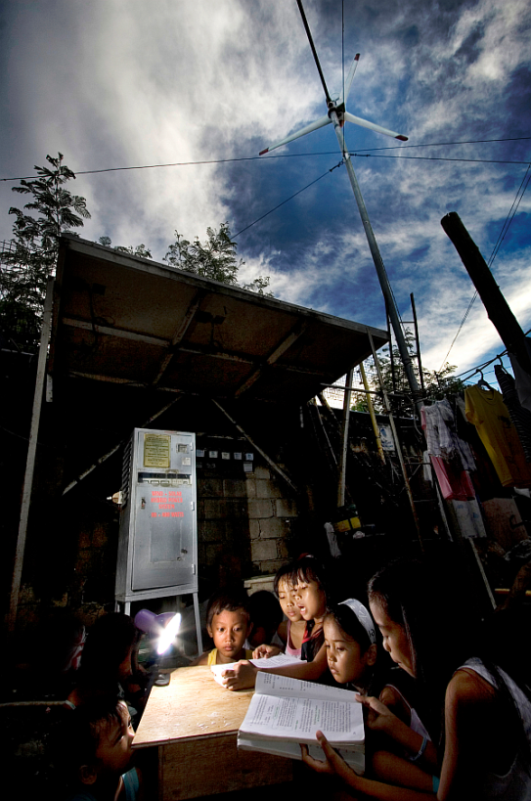
Your Questions or Ideas!
Contact your country support representative.
More information is also available at the following link: www.thegef.org/gef/ppp

