Slide 1
Cross-Cutting Capacity Development (CCCD)in the GEF – A REVIEW GEF Expanded Constituency Workshops 2017

Slide 2
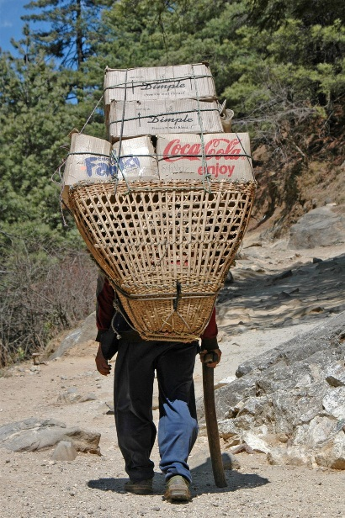
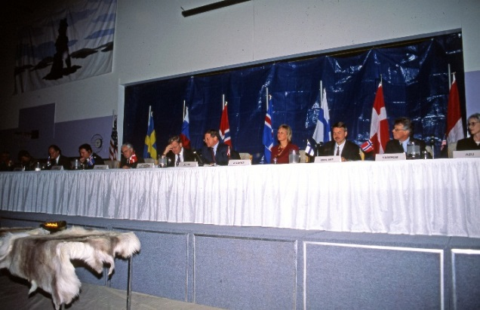
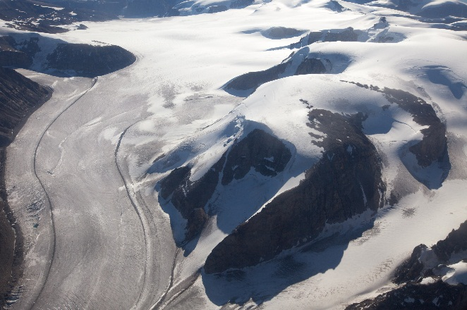
Capacity Development
GEF definition : “The process by which individuals, organizations and societies strengthen their ability to address environmental issues, manage natural resource issues, and mainstream environmental sustainability into development policies, plans and decisions.”
Notes:
CD = Strengthen abilities to address issues.
There are many definitions of what capacity development means. This is just an example of one that we use, which is UNPD’s definition.
For those of you who might not know, Capacity Development is a key issue in development politics since the end of World War II, when there was a clear need to strengthen the abilities of those who would be in charge of reconstructing the devastated world and promoting development across the globe.
With the Declaration on Millennium Development Goals in September 2000, the importance of Capacity Development came again to the fore.
In that context, the GEF Council in its 22nd meeting in 2003 approved the document on Strategic Approach to Enhance Capacity Building and requested the GEF Secretariat to take appropriate measures to operationalize it.
In response to the Council, the GEF Secretariat adopted its approach on Cross-Cutting Capacity Development (CCCD), aimed at addressing national environmental issues in recipient countries in a systemic manner (which is transversal, crosscutting or across environmental focal areas), but also paying attention to projects in a regular individual manner (per each focal area separately).
Of the many definitions of capacity development, at the GEF, we like to use this definition on screen, which is clearly focused on the environment.

Slide 3
Evolution of Capacity Development at the GEF
UNDP, UNEP And WB jointly assessed projects and found at least one component of Capacity Development (CD). Council Approved - Capacity Development Initiative (CDI)
2003- GEF council approved NCSAs as well as a Global Support Program managed by UNEP and UNDP
23 Projects in GEF 4 (CB2), 37 projects in GEF 5 and 12 projects approved in GEF 6
Notes:
The CDI -Capacity Development Initiative – in GEF 2 – assessed CD activities in UNEP, UNDP and WB and found that their activities have at least one CD component
The 2003 GEF Council document (GEF-3) on Strategic Approach to Enhancing Capacity Building identified 4 pathways to promote capacity development:
Almost all countries did an NCSA, they should have these documents, all of which are also available on our website.
The Agencies UNEP and UNDP put together a publication.
GEF publication with contributions form UNDP and UNEP
NCSAs
The NCSA itself consists in a self-assessment effort conducted by each country at the national level through UNDP in order to determine its own collective abilities to meet requirements from the Environmental Conventions.
The idea of conducting NCSAs came in 2003 (still during GEF-3), when the GEF Council, interested to help determining if countries had national capacity to address their priority environmental issues, made available USD 200 thousand for each country to conduct their own NCSAs.
In general, the NCSAs assess if countries have 4 types of capacity :
1) To manage functions to mobilize information and knowledge;
2) to build consultative partnerships among stakeholders in different sectors of the economy;
3) to formulate policies, legislation, and programs to implement convention requirements; and
4) to monitor, evaluate, and learn from all these activities.
As a result of most NCSAs, the outputs identified were basically immense needs for capacity building at the individual, institutional, regulatory, and systemic levels.
The results and lessons learned from these NCSAs were compiled in a publication by UNDP and UNEP which is available on our website (cover is on screen).
Also, you can all access the NCSA of your respective countries on the GEF website’s home page, at the bottom’s quick link to NCSAs.
Also FYI, the Current Status of NCSAs is:
Out of the 183 GEF member countries;
166 are eligible to receive GEF funding to conduct an NCSA
153 have already received these funds
133 have already completed their NCSAs
4 are still drafting the final report
8 are still in the process of implementing the NCSA
7 had their NCSAs cancelled.
From Evaluation Report - As of June 30, 2011, 133 NCSAs (87%) are completed, 13 are still under implementation or at the final stage, and 6 were cancelled. When considering the 146 completed and to-be-completed NCSAs, UNDP implemented 111 NCSAs (77%), UNEP 34 (23%) and the World Bank 1 (<1

Slide 4
National Capacity Self Assessment (NCSA)
193 countries received funding for National Capacity Self Assessments (NCSAs)
146 completed and prepared Action Plans
All countries in this constituency carried out NCSAs
Two countries prepared follow up projects – Seychelles and Kenya. (GEF 4 – Now closed)
South Sudan, Sudan, Madagascar, Comoros, Djibouti, Uganda approved In GEF 6

Slide 5
CCCD Projects Alignment with MEA Obligation

Slide 6
Follow up Projects - Focus
Improving environmental information, monitoring and reporting – in Croatia – reporting system for MEAs, in Albania – EMIS,
Capacity Development for Improved National And International Environmental Management in Seychelles,
Notes:
The Overall CCCD Goal in GEF-6 is to help countries meet and sustain global environmental outcomes by strengthening key capacities that address challenges and remove barriers common to the MEAs that the GEF serves and to mainstream the global environment into decision making.
CCCD-1: To integrate global environmental needs into management information systems and monitoring.
CCCD-2: To strengthen consultative and management structures and mechanisms.
CCCD-3: To integrate MEAs’ provisions within national policy, legislative, and regulatory frameworks.
CCCD-4: To pilot innovative economic and financial tools for Convention implementation.
CCCD-5: Updating of NCSAs.
Recommendations for GEF 6
Value added of GEF CCCD - capacity across focal areas and catalyze synergies
Integration of environmental sustainability across key development sectors – Planning and Finance and various actors.
Innovation – engage private sector and CSOs in decision making
Strong knowledge management and awareness raising
Align with GEF 2020.

Slide 7
Follow up Projects
Using Enhanced regulatory and information systems for integrated implementation of MEAs Kenya,
Strengthening Coordination, consultation and management approached to implementation of MEA obligations e.g strengthening capacity to integrate MEA obligations in national regional and local levels in Romania
Notes:
The Overall CCCD Goal in GEF-6 is to help countries meet and sustain global environmental outcomes by strengthening key capacities that address challenges and remove barriers common to the MEAs that the GEF serves and to mainstream the global environment into decision making.
CCCD-1: To integrate global environmental needs into management information systems and monitoring.
CCCD-2: To strengthen consultative and management structures and mechanisms.
CCCD-3: To integrate MEAs’ provisions within national policy, legislative, and regulatory frameworks.
CCCD-4: To pilot innovative economic and financial tools for Convention implementation.
CCCD-5: Updating of NCSAs.
Recommendations for GEF 6
Value added of GEF CCCD - capacity across focal areas and catalyze synergies
Integration of environmental sustainability across key development sectors – Planning and Finance and various actors.
Innovation – engage private sector and CSOs in decision making
Strong knowledge management and awareness raising
Align with GEF 2020.

Slide 8
Follow up Projects
Pilot innovative Economic and Financial tools e.g strengthening environmental fiscal reform in Moldova, piloting natural resources valuation within environment impact assessments in Jamaica
Notes:
The Overall CCCD Goal in GEF-6 is to help countries meet and sustain global environmental outcomes by strengthening key capacities that address challenges and remove barriers common to the MEAs that the GEF serves and to mainstream the global environment into decision making.
CCCD-1: To integrate global environmental needs into management information systems and monitoring.
CCCD-2: To strengthen consultative and management structures and mechanisms.
CCCD-3: To integrate MEAs’ provisions within national policy, legislative, and regulatory frameworks.
CCCD-4: To pilot innovative economic and financial tools for Convention implementation.
CCCD-5: Updating of NCSAs.
Recommendations for GEF 6
Value added of GEF CCCD - capacity across focal areas and catalyze synergies
Integration of environmental sustainability across key development sectors – Planning and Finance and various actors.
Innovation – engage private sector and CSOs in decision making
Strong knowledge management and awareness raising
Align with GEF 2020.

Slide 9
Follow up Projects
73 Projects implemented in 64 countries, and 2 Regional projects and 1 global project
24 projects (33%) are now closed, 32 projects under implementation (44%) and 17 projects either just started, being developed or at signature stage.
Notes:
As a follow-on to NCSAs, having identified limitations, CB2s were so called (considering NCSAs as CB1)
They derived directly from NCSAs and they were meant address the gaps identified in NCSAs.
CB2 Portfolio
Based on the results of the NCSAs, the GEF has funded during GEF-4 implementation of CB2 projects (as are called the MSPs on CCCD) and has proven to be very relevant to address capacity gaps in GEF recipient countries.
GEF-4 MSPs to address gaps that were identified in NCSAs.
As a result of the CB2 portfolio implementation, projects have managed to:
1) Strengthen multi-sectoral implementation processes, through increased institutional coordination and cooperation;
2) Promote policy and legislation harmonization;
4) Mainstream global environmental issues into national strategies and programs, thereby also meeting obligations before International Environmental Conventions.
The CB2 projects have managed to address these gaps by promoting a holistic approach, clearly cross-cutting across focal areas, to develop the required capacities, helping to clarify existing bottlenecks and lack of skills.
GEF 5 Objectives
CD 1: Enhance capacities of stakeholders for engagement through consultative process (NDI, CSP, SGP and focal area projects)
CD 2: Generate, access and use of information and knowledge
CD 3: Strengthened capacities for policy and legislation development for achieving global benefits
CD 4: Strengthened capacities for management and implementation of convention guidelines
CD 5: Capacities enhanced to monitor and evaluate environmental impacts and trends

Slide 10
Projects classified under
Improving environmental information, monitoring and reporting (40%)
Improving Policy and Legislation (22%)
Mainstreaming Implementation of MEAs in National Development (27%)
Strengthening Coordination, Consultation and management approaches to Implement MEA obligation (38%)
Pilot Innovative Economic and Financial Tools (8%)
Notes:
Some institutional arrangements that have been supported under the CCCD
Informal and/or formal committees to coordinate between national focal points, different ministries and agencies, and other stakeholders.
National GEF committees as mechanisms for national focal points to foster the coherent implementation of the MEAs and SDGs.
National strategy for the implementation across MEAs and SDGs.
Regional initiatives including learning and peer-to-peer exchange, regional centers of excellence in data monitoring and reporting, implementation of large-scale, cross-cutting impact programs.
The Overall CCCD Goal in GEF-6 is to help countries meet and sustain global environmental outcomes by strengthening key capacities that address challenges and remove barriers common to the MEAs that the GEF serves and to mainstream the global environment into decision making.
CCCD-1: To integrate global environmental needs into management information systems and monitoring.
CCCD-2: To strengthen consultative and management structures and mechanisms.
CCCD-3: To integrate MEAs’ provisions within national policy, legislative, and regulatory frameworks.
CCCD-4: To pilot innovative economic and financial tools for Convention implementation.
CCCD-5: Updating of NCSAs.
Recommendations for GEF 6
Value added of GEF CCCD - capacity across focal areas and catalyze synergies
Integration of environmental sustainability across key development sectors – Planning and Finance and various actors.
Innovation – engage private sector and CSOs in decision making
Strong knowledge management and awareness raising
Align with GEF 2020.

Slide 11
Table Discussions
What other areas do you think your countries need to focus on in regards to MEAs, SDGs? Synergies? And How would you propose that GEF support you?

Slide 12
Thank you for your attention
Any questions?

