Slide 1
GEF-6 Strategic Programing and Case Studies
GEF Expanded Constituency Workshop
Windhoek, Namibia
February 17-18, 2015

Slide 2
GEF-6 Programming
Blending Integrated Thinking with Focal / Multifocal Area Strategy Delivery
Selected SD Themes
Food Security
Sustainable Cities
Forests
Integrated Approach Pilots
Partnership for SS-Africa
Commodities
Cities
Biodiversity
Land Degradation
International Waters
Sustainable Forest Management
Climate Change
Chemicals
Focal /
Multi-focal Area Strategy Delivery
Notes:
Taking Deforestation out of the Commodities Supply Chain
Avoiding deforestation in supply chains of critical commodities by supporting action with financial institutions, and producers
A New Development Path for the Amazon Basin
Enhance the development options available for the region, that are more reliant on a strong forest-related sector ,can reduce poverty and stabilize the agriculture frontier

Slide 3
GEF2020 Strategy
A new strategy of the GEF to support transformational change and achieve impacts at scale.
Outline of GEF2020 Strategy
Focus on drivers of environmental degradation
Deliver integrated solutions, given that many global challenges are interlinked
Forge close relationships with a variety of stakeholders
Finance resilience and adaptation
Ensure complementarity and synergies in climate finance

Slide 4
Integrated Thinking
Drivers of environmental degradation are linked in complex ways
Single issue analysis leads to “silo” thinking
Systems analysis leads to integrated thinking
Integrated thinking inspires creative and inclusive solutions
Creative and inclusive solutions deliver environmental benefits aligned with GEF focal area objectives
Examples: Water, Food & Energy Nexus; Urban Environments; Integrated Approach Pilots

Slide 5
Water, Food, Energy Nexus
Availability of Food
Cost of Water
Cost of Power & Fuel
Human Health
Biodiversity impacts
Food prices
Natural Disasters
Availability, distribution, access and sustainability of Water Food, energy and their resilience in the face of climate change.
9. Managing the Human- interface: landscape/seascape approach
4.Water/Food/Energy/Ecosystem Security Nexus
SFM 1: To maintain forest resources
LD 3: Integrated Landscapes
Objective 1: Promote innovation & technology transfer

Slide 6
Urban Environments
Bio-diversity
Waste & Water
Pollution and Climate Change
Buildings
Transport
Industry & Jobs
Land-Use Planning
Urban environments are complex systems that touch our lives and the environment across all focal areas. Use integrated thinking for creative solutions.
10. Integration of biodiversity and ecosystem services in development
6. Prevent the Loss and Degradation of Coastal Habitat
Climate resilient urban systems
5. Mainstreaming SLM in Development
Program 3: Integrated low-carbon urban systems

Slide 7
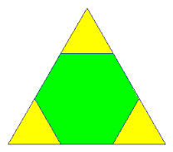
Focal Area Objectives
Using integrated thinking, propose creative and inclusive solutions
Solutions should deliver results that align with GEF-6 focal area objectives
Single FA projects might still be necessary in specific contexts
MFA projects on the rise
FA
MFA
FA
FA

Slide 8
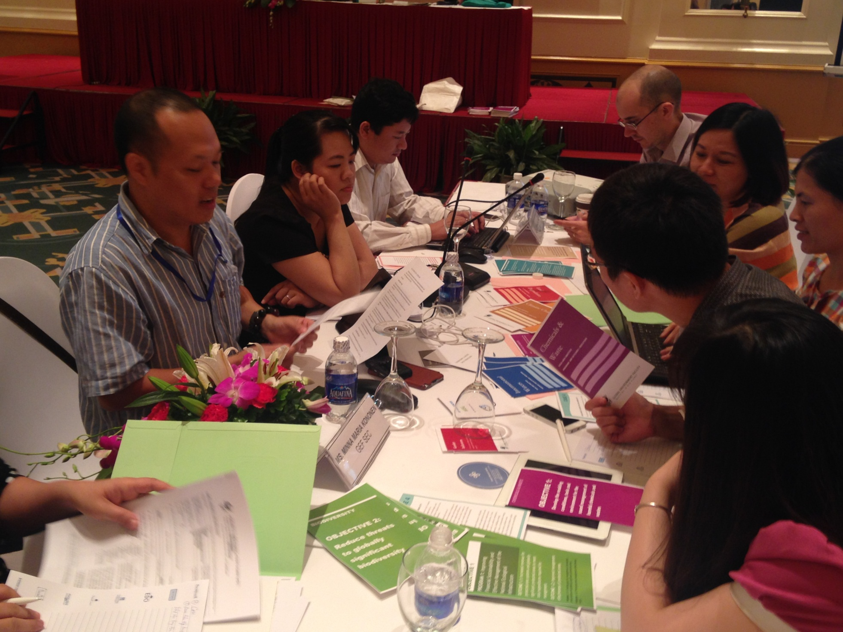
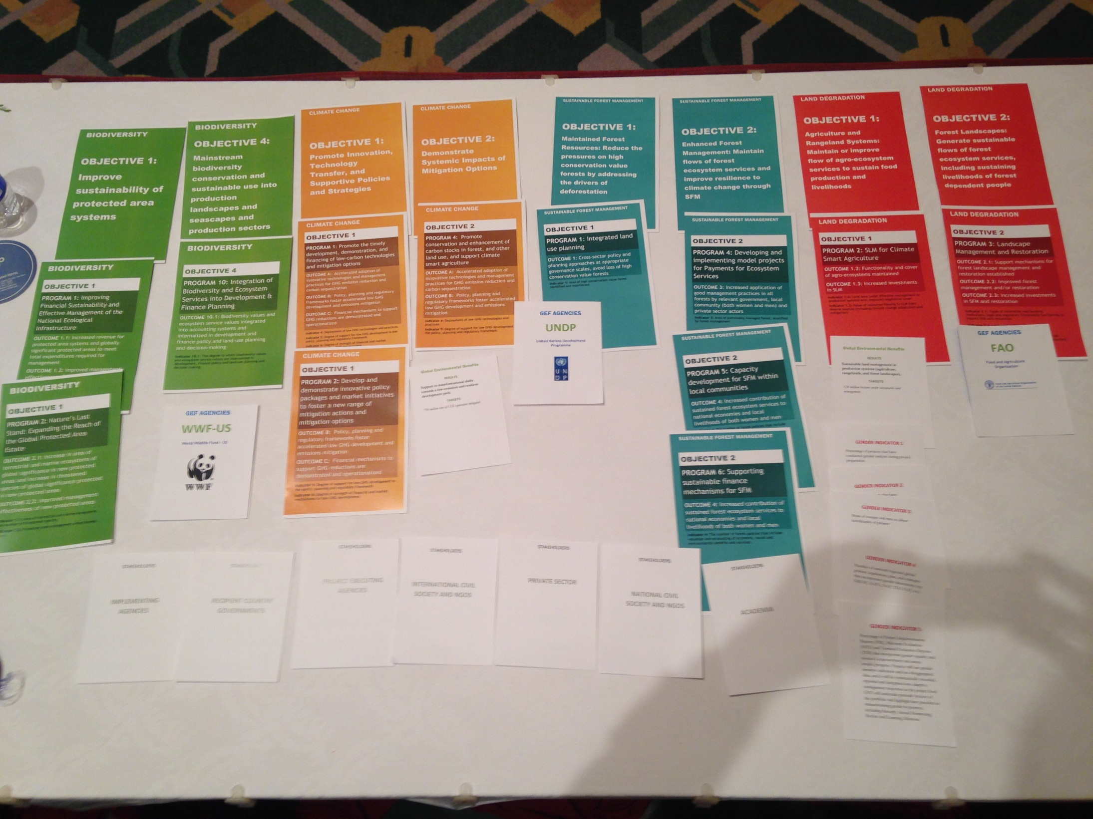
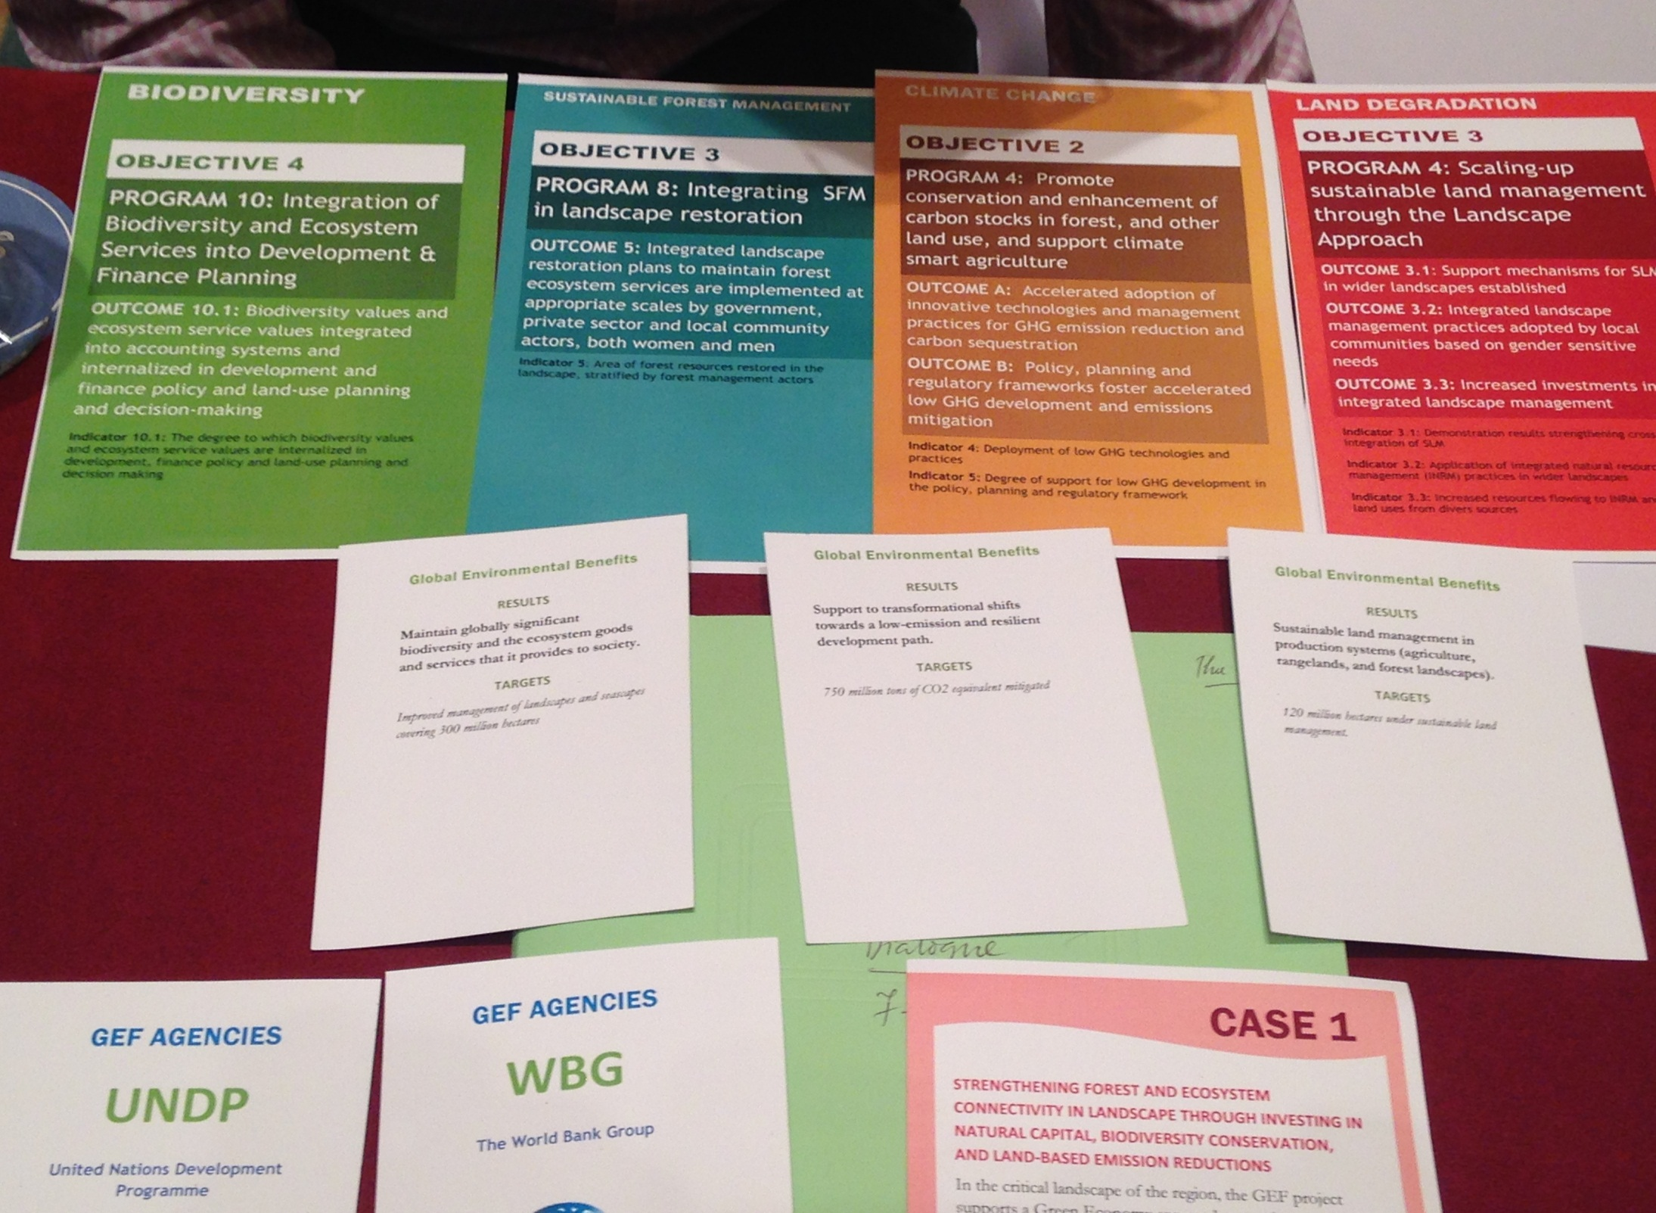

Slide 9
GEF-6 BD Strategy
Goal: To maintain globally significant biodiversity and the ecosystem goods and services that it provides to society
BD1: Improve Sustainability of Protected Area System
BD 2: Reduce threats to Globally Significant Biodiversity
BD 3: Sustainable Use of Biodiversity
BD4: Mainstreaming Biodiversity Conservation and Sustainable Use in Production Landscapes/ Seascapes and Sectors
1. Improving financial sustainability and effective management of national ecological infrastructure
3. Preventing extinction of known threatened species
6. Ridge to Reef: Maintaining integrity and function of globally significant coral reefs
9. Managing the Human- interface: landscape/seascape approach
4. Prevention, control, and mgmt of Invasive Alien Species.
7. Securing Agriculture’s Future: Sustainable use of plants and animals genetic resources.
10. Integration of biodiversity and ecosystem services in development and financial planning
2 . Expanding the reach of the global protected area estate.
5. Implementing the Cartagena Protocol of Biosafety
8. Implementing the Nagoya Protocol on Access and Benefit Sharing.
Notes:
GEF 6 IW Strategy

Slide 10
GEF-6 CCM Strategy
Goal: To support developing countries to make transformational shifts towards low emission, resilient development path
Objective 1: Promote innovation & technology transfer
Objective 2: Demonstrate systemic impacts of mitigation options
Objective 3: Foster enabling conditions to mainstream mitigation concerns into SD strategies
1. Low carbon technologies and mitigation options
3. Integrated low-carbon, urban systems
5. Convention obligations for planning and mitigation contributions
2 . Innovative policy packages and market initiatives
4. Forests and other land use, and climate smart agriculture
Notes:
GEF 6 IW Strategy

Slide 11
GEF-6 LD Strategy
Goal: To arrest or reverse land degradation (desertification and deforestation)
LD 1: Agriculture and Rangeland Systems
LD 2: Forest Landscapes
LD 3: Integrated Landscapes
LD 4: Institutional and Policy Frameworks
1. Agro-ecological Intensification – efficient use of natural capital (land, soil, water, and vegetation) in crop and livestock production systems
3. Landscape Management and Restoration – community and livelihood-based options for increasing forest and tree cover
4. Scaling-up SLM – moving appropriate interventions to scale for crop and rangeland productivity
5. Mainstreaming SLM in Development – influencing institutions, policies, and governance frameworks for SLM
2. SLM in Climate-Smart Agriculture – innovative practices for increasing vegetative cover and soil organic carbon
Notes:
GEF 6 IW Strategy

Slide 12
Sustainable Forest Management GEF-6 Strategy
Goal: To achieve multiple environmental, social and economic benefits from improved management of all types of forests and trees outside of forests.
SFM 1: To maintain forest resources
SFM 2: To enhance forest management
SFM 3: To restore forest ecosystems
SFM 4: To increase regional and global cooperation
Integrated land use planning
Identification and monitoring of HCVF
Identifying and monitoring forest loss
Developing and implementing model projects for PES
Capacity development for SFM within local communities
Supporting sustainable finance mechanisms for SFM
Building of technical and institutional capacities to identify degraded forest landscapes and monitor forest restoration
Integrating plantation management in landscape restoration
Private sector engagement
Global technologies for national progress
Notes:
GEF 6 IW Strategy

Slide 13
GEF-6 IW Strategy
Goal: To promote collective management of transboundary water systems and implementation of the full range of policy, legal and institutional reforms and investments contributing to sustainable use and maintenance of ecosystem services
Objective 1: Catalyze Sustainable Management of Transboundary Waters
Objective 2: Balance Competing Water-uses in the Management of Transboundary Surface and Groundwater
Objective 3: Rebuild Marine Fisheries, Restore and Protect Coastal Habitats, and Reduce Pollution of Coasts and LMEs
1. Foster Cooperation for Sustainable use of Trans- boundary Water Systems & Economic Growth
3. Advance Conjunctive Management of Surface & Groundwater systems
5. Reduce Ocean Hypoxia
6. Prevent the Loss and Degradation of Coastal Habitat
2 .Increase Resilience & Flow of Ecosystems Services in Context of Melting High Altitude Glaciers
4. Water/Food/Energy/
Ecosystem Security Nexus
7. Foster Sustainable Fisheries
Notes:
GEF 6 IW Strategy

Slide 14
GEF-6 C&W Strategy
Goal: to prevent the exposure of human and the environment to harmful C&W of global importance, including POPs, mercury and ODS, through a significant reduction in the production, use, consumption and emissions/releases of those chemicals and waste
Objective 1: Develop the enabling conditions, tools and environment for the sound management of harmful chemicals and wastes
Objective 2: Reduce the prevalence of harmful chemicals and waste and support the implementation of clean alternative technologies/substances
1. Develop and demonstrate new tools and economic approaches for managing harmful chemicals and waste in a sound manner
3. Reduction and elimination of POPs
4. Reduction or elimination of anthropogenic emissions and releases of mercury to the environment
2. Support enabling activities and promote their integration into national budgets and planning processes, national and sector policies and actions and global monitoring
5. Complete the phase out of ODS in CEITs and assist Article 5 countries under the Montreal Protocol to achieve climate mitigation benefits
6. Support regional approaches to eliminate and reduce harmful chemicals and waste in LDCs and SIDs
Notes:
GEF 6 IW Strategy

Slide 15
GEF-6: Adaptation Programming Strategy
Aims to “increase resilience to the adverse impacts of climate change in vulnerable developing countries, through both near- and long-term adaptation measures in affected sectors, areas and communities”
Thematic Priorities for Adaptation
Agriculture and food security
Water resources management
Coastal zone management
Infrastructure
Disaster risk management
Natural resources management
Health
Climate information services
Climate-resilient urban systems
Small Island Developing States
Notes:
GEF 6 IW Strategy

