Slide 1
Facilitating synergies in implementing MEAs towards sustainable development
ECW, Vietnam, Da Nang, 5 April 2017

Slide 2
Synergies at the institutional level
Basel, Rotterdam and Stockholm Conventions look back on over a decade of synergies:
Joint Secretariat
Joint Conferences of the Parties (triple COPs)
Joint sessions at the COPs

Slide 3
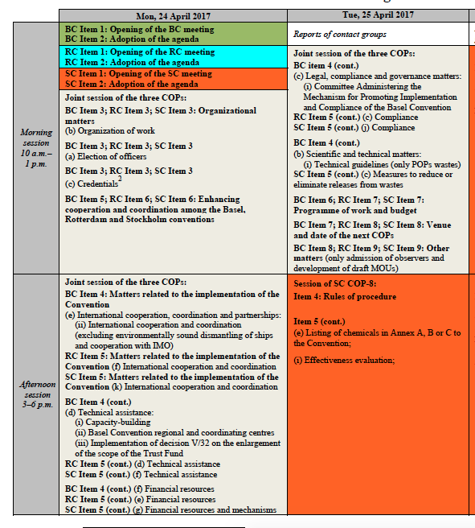
Joint sessions
Financial resources and mechanisms
Technical assistance
Synergy reviews
Compliance
Technical guidelines
Programme and budget
International cooperation

Slide 4
Synergies at the institutional level
Challenges and opportunities:
Coordination and coordination at the national and regional level
Increased complexity
Cross-fertilization of ideas
Enhanced decision-making
National capacity key to synergies
Technical assistance (BRS Secretariat)
Special Programme (UNEP)

Slide 5
Synergies in the implementation of the Conventions
Promoted through existing guidance to the GEF:
Give special consideration to support for those activities identified as priorities in NIPs which promote capacity-building in sound chemicals management, so as to enhance synergies in the implementation of MEAs and further strengthen the links between environment and development objectives.
Decision 3/16 (para 12)

Slide 6
Synergies in the implementation of the Chemical and waste Conventions
Elements of guidance that also address the relevant priorities of the Basel and Rotterdam conventions:
POPs waste (including e-waste)
Waste minimaztion (U-POPs eliminiation)
Development or strengthening of national legal and regulatory frameworks
Decision 7/21 (para 8)
Synergies with the Minamata Convention (technical guidelines, BAT/BEP, possible institutional synergies, regional centres)
Other opportunities: co-incineration, inventory development, reporting

Slide 7
Broader synergies
Programming across focal areas in the environment field (in the GEF context)
Implementing the SDGs: e.g. sustainable consumption and production, food and water security

Slide 8
Thank you

