Slide 1
Enhancing synergies towards climate action and sustainable development on the ground
GEF Expanded Constituency Workshop
Da Nang, Vietnam, 5 April 2017

Slide 2
Overview and aim of the presentation
Highlight key aspects of the “transformation agenda”: Interlinkages and synergies between the Paris Agreement and the 2030 Agenda for Sustainable Development
Present entry-points and opportunities for enhancing synergies at the country level among MEAs and through GEF programming
Provide some practical ways to strengthen interaction and engagement in 2017 and beyond
Questions and joint discussion

Slide 3
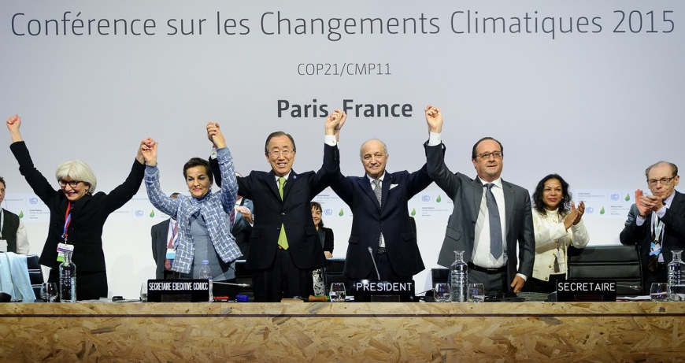
The “transformation agenda”
The 2015 outcomes define one universal agenda for the well-being of all societies ➔ the transformation agenda
The Paris Agreement
The 2030 Agenda on Sustainable Development with its 17 Sustainable Development Goals (SDGs)
Unprecedented universal action involving all actors at all levels in all regions of the world is crucial.

Slide 4
Paris Agreement and the SDGs: a shared and interwoven agenda
The deep synergy between the Paris Agreement and the 2030 Agenda is manifested through the nationally determined contributions (NDCs)
Direct inter-linkages for SDGs that affect global GHG emission trends such as: SDG 7 (Affordable and clean energy), 11 (sustainable cities and communities), 12 (responsible consumption & production), 13 (climate action)
Indirect inter-linkages: adverse impacts of climate change on the achievement of SDGs such as: SDG 1 (no poverty), 2 (zero hunger), 3 (good health and wellbeing), 12, 14 (life below water) as well as 15 (life on land).
Resilience building closely linked to the pursuit of SDG 1, 2, 5 (gender equality), 8 (decent work and economic growth), and 10 (reduced inequalities)

Slide 5
Key aspects of the “transformation agenda”
Urgency of action
Unprecedented rates of de-carbonization are required ➔ Need to shift investments into climate-friendly infrastructure
Cooperative action in support to national contributions
Key to transformation is integration of climate action and SDG implementation across governments and sectors
Governments to act in full understanding of their unique national circumstances and to ensure that all relevant sectoral ministries work hand in hand
Important role of Non-state actors
Important to build on the momentum generated on the lead to Paris and SD Conference ➔ support gathered from progressive cities, regions, states, businesses and investors
Regular stocktaking on progress
Transparency mechanisms and global assessments of progress based on aggregation of reporting and on best science available

Slide 6
Entry-points and opportunities for enhancing synergies at the country level among MEAs and through GEF programming
UNFCCC guidance on GEF Programming
Overall framework: GEF – Convention
Guidance on GEF-7 replenishment (11/CP.22)
Consider lessons learnt from past replenishment periods
Take into account the entry into force of the Paris Agreement in its deliberations on the strategy for the 7th replenishment
Alignment of GEF support with priorities identified in NDCs
Support for the Capacity-building Initiative for Transparency (CBIT)
Assist developing countries in accessing resources in an efficient manner
Streamlining of GEF approval process
GEF to take into account climate risks in its activities
One of the two operating entities of the Financial Mechanism; shall serve the Paris Agreement
Functions under the guidance of and is accountable to the COP
COP provides regular guidance to the GEF on policies, programme priorities and eligibility criteria for funding
GEF reports annually to the COP

Slide 7
Entry-points and opportunities for enhancing synergies at the country level among MEAs and through GEF programming
Implementation of NDCs
Capacity-building of relevant actors at the country level
Multi-focal area projects providing sustainable development co-benefits and leveraging additional (private) funding
Facilitating access to funds
Transparency framework under the UNFCCC

Slide 8
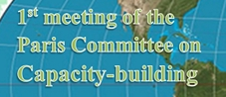
Practical examples for strengthening interaction and engagement in 2017 and beyond
Sharing country experiences and engaging in UNFCCC policy discussions, e.g.:
In-session workshop on long-term finance (Bonn, May 2017):
Articulating and translating needs identified in country-driven processes into projects and programmes;
Roles of policies and enabling environments for mitigation and adaptation finance;
Facilitating enhanced access to climate finance
2017 Forum of the Standing Committee on Finance (date: tbd)
Theme: Mobilizing finance for climate resilient infrastructure
Launch of the work of the Paris Committee on Capacity-building (Bonn, May 2017):
“Capacity-building activities for the implementation of NDCs”
Technical Expert Meeting (TEM) on mitigation and adaptation

Slide 9
Practical examples for strengthening interaction and engagement in 2017 and beyond
Actively engage with the UNFCCC Regional Collaboration Centre
Five regional centers in partnership with UNFCCC and regional institutions
Mission: to catalyze climate action on the ground
Key benefits
Direct support, partnerships and outreach
Technical expertise and experience in the regional, national and sub-national context
Active network of non-party stakeholder partners
Close partnerships with financial institutions to match actions with sources of funding

Slide 10
For more information…
Please visit the following webpages:
The Paris Agreement: http://unfccc.int/9485
The Standing Committee on Finance: http://unfccc.int/6877.php
Long-term climate finance: http://unfccc.int/6814.php
Capacity-building: http://unfccc.int/1033.php

Slide 11
Thank you!

