Slide 1
Strengthening climate information and early warning systems in Africa for climate resilient development and adaptation to climate change – Country: Sierra Leone
Gabriel Mannah Kpaka
Deputy Director General/Head of Operations

Slide 2
OUTLINE
Country Scenario
Network of Weather stations
Project Overview
Proposed Project Operational structure
Project outputs
1 and 2

Slide 3
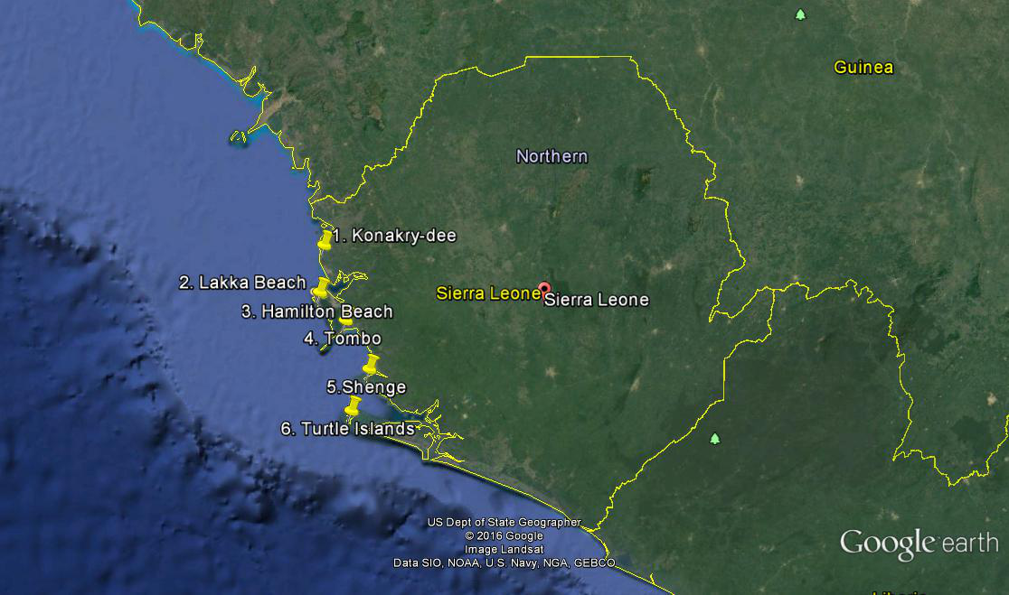
Country Senario
Sierra Leone is particularly vulnerable to:
the increasing frequency and severity of droughts, floods and severe storms
Their impacts on sectors such as agriculture, fisheries, as well as infrastructure and hydro-electric power production had been severe.
Such climate related hazards are having increasingly adverse effects on the country and future climate change is likely to further exacerbate the situation.

Slide 4
Weather Station: Past and Present
Station Type | Past (Before the War) | Before the Project | Currently
Manned | 12 | 2 | 3
Synoptic | 16 | 5” | 9+5”
Agromet | 32 | 0 | 8 (IFAD)
Rainfall station | 110 | 0 | 5 (WMO)
Upper Air Station | 2 | 0 | 0
Radar | 1 | 0 | 0

Slide 5
Project overview
enhance the capacity of hydro-meteorological services and networks to predict climatic events and associated risks
develop a more effective and targeted delivery of climate information including early warnings ( Issuing warning and dissemination)
Support improved and timely responses to forecast climate-related risks.
Capacity development to effectively predict future climate events;
Enhance a national framework and environmental databases to assess and integrate climate change risks into sectoral and development policies;

Slide 6
Proposed Project Operational structure

Slide 7
PROJECT OUTPUTS ( 1&2)
OUTCOME 1. Enhanced capacity of national hydro-meteorological (NHMS) institutions to monitor extreme weather and produce sector tailored weather forecasting
OUTCOME 2.Efficient and effective use of hydro-meteorological information for generating early warnings and support long-term development plans

Slide 8
OUTPUT 1 Components
Output 1.1: 12 river gauges, 2 water level (limnimetric scale), 6 groundwater data logger, 2 signal counter rotations for hydrological monitoring are installed in partnership with SLMD to complement watershed management networks of Guma Valley, Bumbuna Watershed and The Ministry of Water Resources (MWR). (The Ministry of Water Resources (MWR))
Results
13 automatic hydrological monitoring stations
15 groundwater monitoring stations

Slide 9
……Output 1 component…
Output 1.2: 38 rainfall gauges, 8 synoptic, 8 Agrometeorological/climatological automatic weather stations, to support the establishment of an integrated weather monitoring network. (Sierra Leone Meteorological Department-SLMD)
Results
9 Synoptic AWS
1 Manual Station
These stations emits 10 days forecast

Slide 10
……Output 1 component…
Output 1.3: Forecasting meteorological tools, software, infrastructure facilities and specialized training are made available to run SYNERGIE, & AMESD systems to strengthen the capacity of SLMD to produce improved and sector tailored weather forecasts. (Sierra Leone Meteorological Department SLMD)
Results
Partnership between SLMD and the MAFFS (Food and Nutrition Early Warning Platform) for collaboration in AMESD-PUMA MESA e-station.

Slide 11
……Output 1 component…
Output 1.4: A total of 6 Meteorologists, 16 Meteorological Technicians, 4 Forecasting Superintendent Officers 20 Specialist Superintendent Officers are trained to support EWS data handling and forecasting operations. (Sierra Leone Meteorological Department-SLMD and the University of Sierra Leone - Fourah Bay College)
Results
2 Meteorologist trained at MSc level in Reading
7 Meteorological technicians trained in Nigeria
5 hydrologist trained in Niger
In-service training on-going

Slide 12
……Output 1 component…
Output 1.5: A Communications network is established for SLMD and ONS-Disaster Management Department to support EWS warning and dissemination mechanism. (ONS-Disaster Management Department and Sierra Leone Meteorological Department-SLMD)
Results
Communication network between SLMD and the ONS- Disaster Management Department and all DM Committee Members including Directorate of Water Resources established (CIDMEWS);
SLMET website

Slide 13
OUTPUT 2
OUTCOME 2: Efficient and effective use of hydro-meteorological information for generating early warnings and support long-term development plans
Results
10 days forecast generated from the 8 AWS
The installation of the hydrological monitoring stations is ongoing

Slide 14
Gaps
needs for hydro-meteorological monitoring to support warning of floods
Procure and install more weather stations countrywide ( Marine, Agromet, Upper Air station and Synoptic Weather station)
Procure and install Radar
Procure and operationalize a mobile AWS for sensor’s field calibration, integrating recently installed and existing AWS and interfacing to central data collection & storage system;
Centralize data collection & storage systems;
Forecasting meteorological tools, software, infrastructure facilities and specialized training: workstations to support downscale of regional and international forecast products for sector tailored forecasting;

Slide 15
….GAP.....cont…
Procure and install a Television and Radio Weather Broadcast equipment for forecast dissemination;
Efficient and effective use of hydro-meteorological information for generating early warnings and support long-term development plans

Slide 16
WAY FORWARD
PHASE 2= Building on the SCIEW project

Slide 17
THE END
gabrielkpaka@gmail.com

