Slide 1
Highlights of the First Meeting of the Seventh Replenishment of the GEF Trust Fund, Paris, March 28-30, 2017

Slide 2
Structure of the Presentation
Background
The Proposed Shift to Impact Programs Under GEF-7
Proposed Policy Areas to Enhance

Slide 3
Background
The GEF-7 Replenishment Process was launched in October 2016
  First Replenishment meeting was from 28-30 March 2017
  GEF-7 Replenishment Process expected to be concluded in June 2018
  GEF-7 to begin on July 1, 2018

Slide 4
Pressures on the World’s Environmental Systems Continue to Grow
World population expected to reach 8.5 billion by 2030, with 60% in cities.
60-70% more food needed by 2050.
1.1 billion lack electricity, relying instead on wood, coal, charcoal or animal waste for cooking and heating.
Outdoor air pollution responsible for 2.9 million deaths per year.

Slide 5
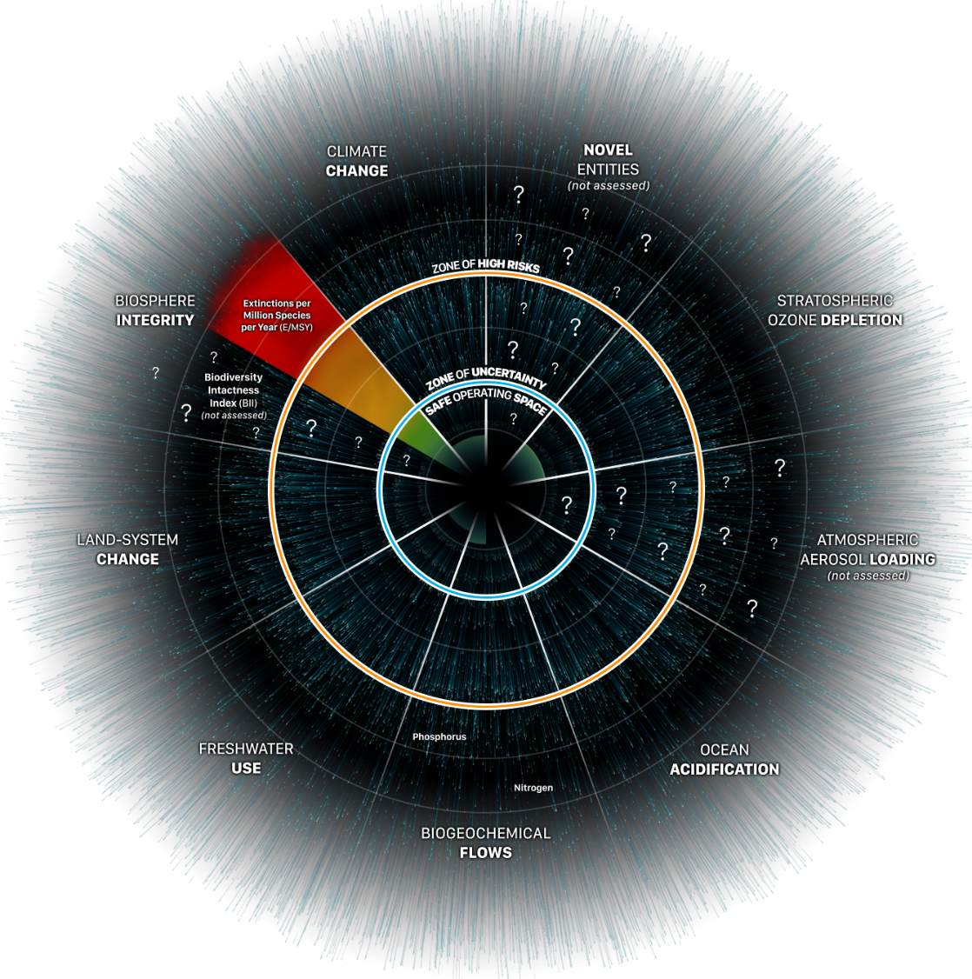
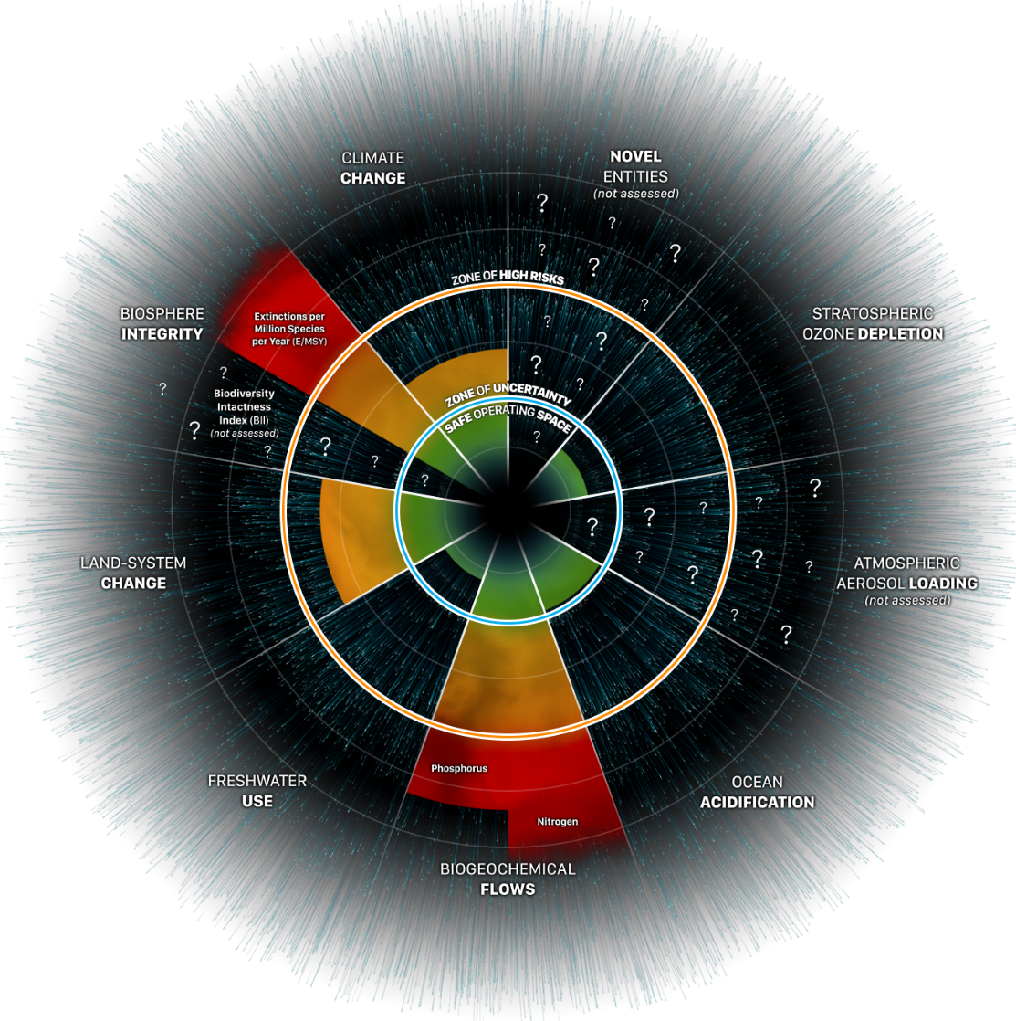

We are running out of time
1950
2015
Notes:
So, we are running out of time. Last 50-60 years have been critical for the planet under the great acceleration, and what we do now will either propel us on a sustainable trajectory or make us fall behind even more. On the other hand, the GEF has accumulated mandates across most all of the planetary boundaries that define environmental dimensions crucial for human well-being. These are in turn interdependent and merit a more systemic approach that builds on existing synergies.

Slide 6
The GEF’s Response
The GEF cannot afford to stand still
  The GEF needs to focus and better program its resources to achieve greater impacts.
  The GEF needs to shift away from programming its resources by focal areas to more Impactful Programs, i.e. Impact Programs

Slide 7

GEF-7 Programming Framework
Focused and Complementary Approach to Deliver GEBs
Impact Programs
Complementary Investments
Global Environmental Benefits for Biodiversity, Climate Change, Land Degradation, International Waters, and Chemicals and Waste
Notes:
The GEF-7 programming strategy is organized along two major axes that are interdependent and complementary to one another. The first consist of a series of impact programs to be designed to achieve scale and help transform key systems; and the second ensures that all aspects of guidance are also prioritized beyond the global environmental benefits to be accrued through the impact programs across multiple MEAs.

Slide 8


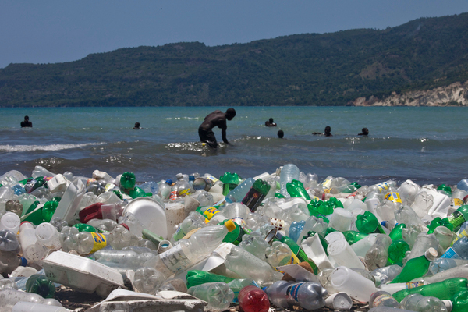

GEF-7 Higher Level Integrative Framework for Impact Programs
Land, Agriculture and Food Systems
1
Accelerating De-carbonation and Economic Footprint
2
Reduced Pollution and Waste
3
Natural Capital-Based Development
4
Notes:
The impact programs can be organized at higher Ievel integrative frameworks that encompass key systems that must be placed on a more sustainable trajectories by changing land, agriculture and food systems, accelerating de-carbonization, reducing pollution and waste, and promote natural-capital based development.

Slide 9
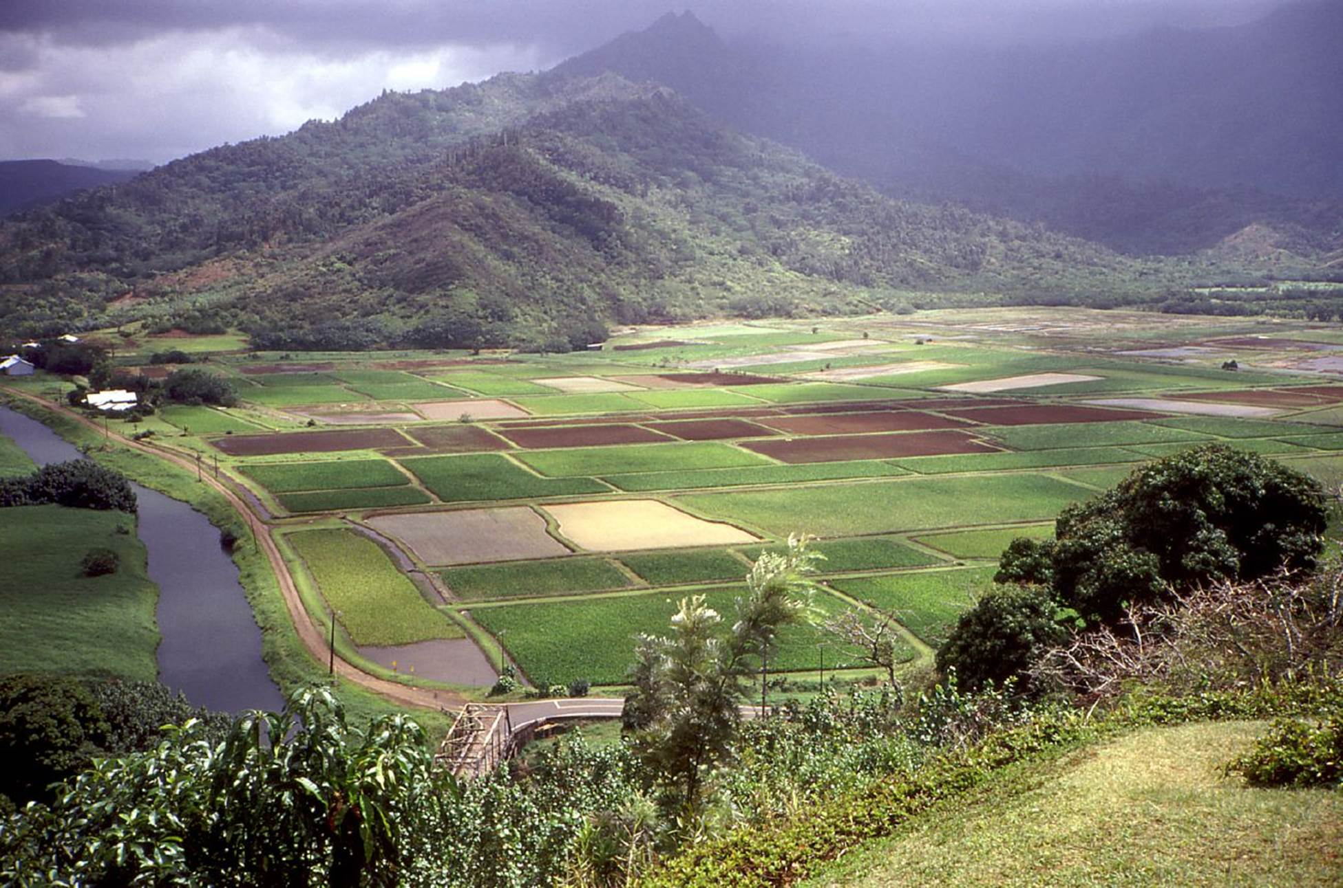
Land, Agriculture and Food Systems
1
Notes:
This first of these impact program areas contains initiatives in land, agriculture and food systems. Priorities can be addressed via impact programs on agricultural commodities responsible for a large fraction of tropical deforestation; also by helping to transform food systems to reduce impact on natural habitat and GHG emissions; by expanding efforts to restore and reclaim degraded lands for multiple uses, thereby reducing pressure over standing habitat; the strategy proposes to continue multi-country efforts to conserve the Amazon and the services it provides to the planet; achieve inclusive Conservation and demonstrate models of indigenous peoples-led conservation in diverse political, social, and ecological contexts; and restore and sustain fisheries by improving the health of ocean and coastal ecosystems on which fisheries and marine aquaculture depend.

Slide 10
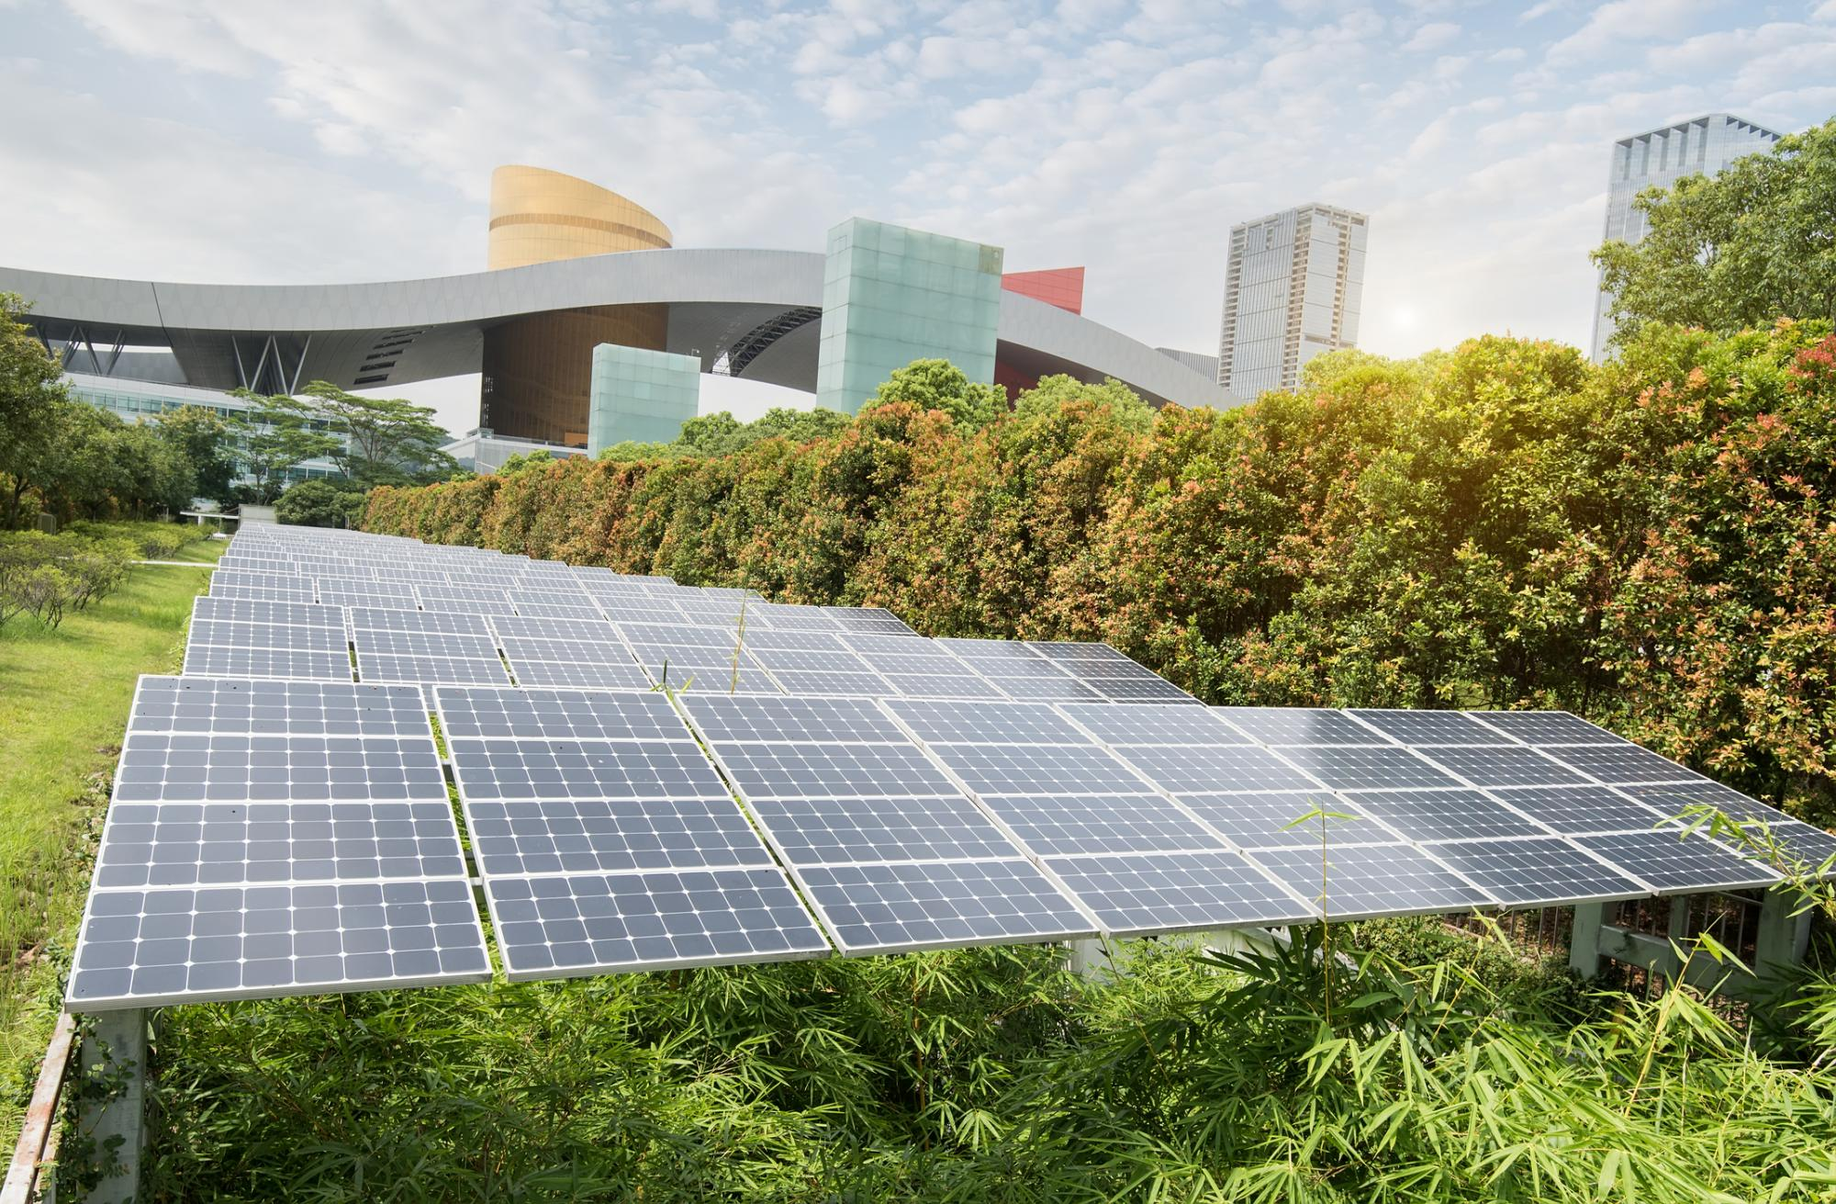

Accelerating De-carbonization and Economic Footprints
Impact Programs
Sustainable Cities
Transforming Energy Systems
Green Infrastructure
2
Notes:
Accelerating de-carbonization and economic footprints will be pursued through impact programs addressing sustainable cities and the urban environment, helping transform energy systems across GEF partner countries, and start working to ensure that the massive investments in infrastructure anticipated to take place in the developing world do not erase the gains being made in our collective efforts towards greater sustainability.
Transforming Energy Systems:
Rational for action: Energy related carbon emissions are the major driver of climate change. Transformation of energy systems is vital to achieving the Paris Agreement and the SDGs. Goal: Adress key barriers limiting the use of energy efficiency and renewable energy in the most energy intensive countries. Focus: The GEF has identified interventions that will: take advantage of technology advancements (e.g., smart grid, energy storage); blend policy and regulatory reform with linked investments; promote private sector engagement; demonstrate models that can be replicated and scaled-up; and strengthen the ability of energy intensive countries to
meet their NDCs. In addition, the GEF will support LDCs and SIDS to enhance energy access while still delivering global environmental benefits. Geography: Please ask David if geographies have been specified. The IP will build on GEF-6 energy related investments and work with i.e. SE4ALL, IEA, IIASA,
private sector, WEF, WBCSD.
Circular Economy:
Rational for action: Approximately 60 billion tons of raw materials are extracted per year (22kg/person/day). While most materials are disposed of within one year, only 7% being recycled or reused, creating serious environmental consequences, including GHG emissions, hazardous chemical emissions and marine debris affecting biodiversity.
Goal: To be an enabler towards flipping global supply chains and country/regional manufacturing/economic development strategies from take-use-dispose to redesign-reduce-reuse-repair-recycle approaches.
Focus: To further the Circular Economy concept by bringing governments and private sector together particularly in developing economies The Circular Economy IP will focus primarily on plastics because of its relevance and feasibility to further Global Environmental Benefits, specifically to reduce GHGs, hazardous chemicals, and marine debris.
Geography: Last I heard the main focus was Asia hotspots, please confirm with Leah.
Green Infrastructure:
Rational for action: The world is expected to invest around $90 trillion in infrastructure over the next 15 years, more than our entire current inventory today. This will require a significant increase in investment globally, from the estimated $3.4 trillion per year currently to about $6 trillion per year. Under business as usual, infrastructure planning will not include low-carbon or sustainability design principles, resulting in increased emissions, lock-in of "grey" infrastructure, and further disruption to integrated landscape planning and contiguous ecosystems protection.
Goal: The GEF is uniquely positioned to work with National governments, the multi-lateral development banks, the private sector and other stakeholders to create an enabling environment conducive to increased domestic and international investments for green and sustainable infrastructure, and to foster techniques, criteria, and tools that go beyond safeguards for green infrastructure investments.
Focus: The major focus of the impact program will be to convene and support coalitions willing to foster innovative and integral solutions for green infrastructure investment; support country efforts to build capacity and enabling environments; and work with private sector and other investors to make sustainability practices the new normal.
Geography: Priority regions will include areas expected to see significant infrastructure development in the next decade and where globally significant land and biodiversity may be adversely impacted.

Slide 11

Reducing Pollution and Waste
Investment programs
Circular Economy
Industrial chemicals
Agricultural chemicals
3
Notes:
1. GEF efforts with reducing pollution and waste will be enhanced by initiating work on circular economy, meaning changing production practices from take-use-dispose to redesign-reduce-reuse-repair-recycle approaches.
2. The industrial chemicals program is intended to eliminate or significantly reduce chemicals listed under
• The Stockholm Convention on Persistent Pollutants;The Minamata Convention on Mercury; The Strategic Approach to International Chemicals Management; and The Montreal Protocol on Substances that Deplete the Ozone Layer
The program will fund facilitation of enabling environments including the removal of barriers to market access of manufacturing of products containing GEF relevant chemicals
3. The Agriculture Chemicals Program will address the agricultural POPs. Where the chemicals are in use, investments will be made to introduce alternatives with a preference given to non-chemical means. The program will target the reduction of hazardous pesticides that enter the global food supply chain as well as address plastics used in agriculture.

Slide 12

Natural Capital-Based Development
Impact Programs
Wildlife for Sustainable Development
Natural Capital
Green Finance
Environmental Security
4
Notes:
Finally, the GEF will enhance its work on natural capital-based approaches by expanding on the ongoing work combating illegal wildlife trafficking by making it more relevant to local livelihoods and job generation; expand the work with GEF countries to measure and account for natural capital, including biodiversity, demonstrate its value, and integrate this value into decision making and policy instruments; work with the finance and banking sectors to steer financing away from activities that degrade the global environment while exploring new instruments based on nature and its sustainable use; and support fragile states and post-conflict countries to both prevent future potential conflicts driven by the collapse of their natural resource base, as well as rebuild and restore environmental assets as part of post-conflict development investments.
Wildlife for Sustainable Development:
Rational for action: Africa is the only continent on the planet that retains a full spectrum of large animals, with many areas having fifteen or more species. Inside and outside protected areas there is evidence of widespread declines in the numbers and range of many wildlife populations across the continent attributed to a number of factors, including poaching and illegal wildlife trade, human encroachment, and competition with livestock for space.
Goal: To secure the population of wildlife in order to propel one of the most promising economic development engines in Africa: the conservation of wildlife in the vast wilderness areas of Africa to generate benefits to local communities and revenue to support the conservation areas.
Focus: The IP builds on the GEF-6 Wildlife PFD program and has a two pronged approach: First, to continue investing in addressing the illegal wildlife trade in supply, transit and demand countries. Second, to use growing and stable populations of wildlife to generate socio-economic benefits.
Geography: The geographic targets are the following Transfrontier Conservation Areas: Okavango- Zambezi (Angola, Botswana, Namibia, Zambia); the Greater Limpopo (Mozambique, South Africa and Zimbabwe); Malawi-Zambia TFCA; ZAMOZA (Zimbabwe, Mozambique, Zambia); Lower Zambezi-Mana Pools TFCA (Zimbabwe-Zambia) and Niassa-Selous (Tanzania-Mozambique).
Natural Capital:
Rational for action: Although a number of approaches are currently being used to recognize, measure, and account for natural capital and demonstrate its values, these exercises have too rarely influenced decision making and policy instruments in order to mitigate or eliminate harmful incentives leading to the degradation of natural capital and enhance financing for sustainable management of natural capital.
Goal: To build the capacity of countries to measure and account for natural capital, including biodiversity, demonstrate its value, and integrate this value into decision making and policy instruments.
Focus: The IP builds on the capacity of countries to measure and account for natural capital and will operate according to phases: Phase I: Natural Capital Accounting baseline diagnosis; Phase II: Natural Capital Accounting; Phase III: Institutional development and policy process for Natural Capital Accounting
Geography: Countries that demonstrate the following would be considered ready to engage in the Program: 1) Statistical system and basic capacity in place with a system of national accounts; 2) Data for developing ecosystem accounts including science-based biophysical spatial information systems is available nationally or internationally or can be generated relatively easily; 3) Commitment to maintain and use the new accounts developed and institutionalize Natural Capital Accounting; and 4) Countries in which natural resources and biodiversity play an important, albeit often invisible, role in economic development and human welfare, thus incentivizing application of Natural Capital Accounting (NCA). The NCIP aims to work in 25 countries during GEF-7 that meet the criteria above.
Green Finance:
Rational for action: Currently less than 1% of global bonds are categorized as green and less than 1% of holdings by global institutional investors are green assets. Only 5-10% of bank loans are green in those few countries where national definitions of green loans are available. The potential for scaling up green finance hence is significant. Green finance may provide growth opportunities while delivering environmental benefits, including by supporting high-potential green industries, technological innovation and business opportunities for the financial sector.
Goal: Connect financial system reform with environmental agenda (biodiversity, climate, land degradation, international waters, chemicals and waste)
Focus: The GEF’s intervention will build on existing platforms to foster and strengthen national-level support. The GEF will also support complementary activities for global support and innovating conservation finance.
Geography: Principles of green finance are imbedded in all of the impact programs, as we seek to internalize externalities and foster greater private sector investment across the GEF’s full portfolio. Lessons learned from each impact program will also add value to this program, for example, through the transfer of experience in climate change-related green finance toward areas such as land, forests, agriculture, and oceans. The IP will coordinate with existing and emerging initiatives in the area of green and conservation finance such as the Coalition for Private Investment in Conservation (CPIC), the Sustainable Forestry Initiative (SFI), the Sustainable Banking Network (SBN) and the Equator Principles, and the Global Sustainable Investment Alliance (GSIA). It would also build on recent needs assessments such as the State of Private Investment in Conservation by Forest Trends.
Environmental Security:
Rational for action: Climate change and extreme weather events, land degradation and water stress are considered compounding factors for loss of livelihoods, conflicts and displacement of people especially in dry areas. Further, in the World Economic Forum’s annual Risk Reports, for the past five years these new combinations of threats have consistently ranked among the top five global risks in terms of likelihood/impact. Also, large scale involuntary migration have been ranked among highest risk for two years in a row.
Goal: To maintain, enhance, and restore GEBs (biodiversity, land, transboundary waters) in fragile states that are under direct threat linked to conflict and the breakdown of governance.
Focus: To support fragile states and post-conflict countries to both prevent future potential conflicts as well as rebuild and restore environmental assets as part of post-conflict development investments. In particular, the IP will keep in mind that rebuilding institutions and governance is essential to maintain GEBs over time focusing on four kinds of interventions: (1) Identifying and monitoring global environmental fragility (2) Protecting the environmental assets from potential harm (3) Restoring the asset from impacts suffered during conflict and (4) Mainstreaming Resilience Systems Thinking across GEF investments.
Geography: Focus countries will need to be carefully selected and in consultation with partners and countries - an initial target of 4 – 6 countries could be a realistic minimum.
Please talk to Astrid, I am not sure that all interventions will truly overlap transboundary ecosystems, i.e. groundwater systems.

Slide 13
Landscape Restoration
Generate multiple environmental benefits by restoring and maintaining global network
of resilient landscapes
Target restoration of 15–25 selected landscapes spanning 60–100 million ha
Entry points: Bonn Challenge and other platforms such as TRI, GPFLR, GRC
Build on GEF Sustainable Forest Management investments
Notes:
Given that time is precious and you have the documentation on proposed programming before you, I will only illustrate a few of the impact programs and their rationale, starting with landscape restoration.
Rationale for action: Global estimates suggest that nearly 2 billion ha (22.5%) of agricultural land, pasture, forest and woodland are degraded. Continued degradation impacts negatively on ecosystem services, posing serious obstacles to the achievement of the SDGs, the Paris Agreement, the Aichi Targets, and the land neutrality targets. The IP builds on a baseline of GEF Sustainable Forest Management investments focusing on restoration and maintenance of a global network of resilient landscapes, either transboundary or subnational in scope, and targeting restoration of 15 – 25 selected landscapes, spanning up to 100 million ha. Many powerful platforms will enable the scale up of this work, including the Bonn Challenge, the Latin American 20x20 initiative, the TRI, GPFLR and others.

Slide 14
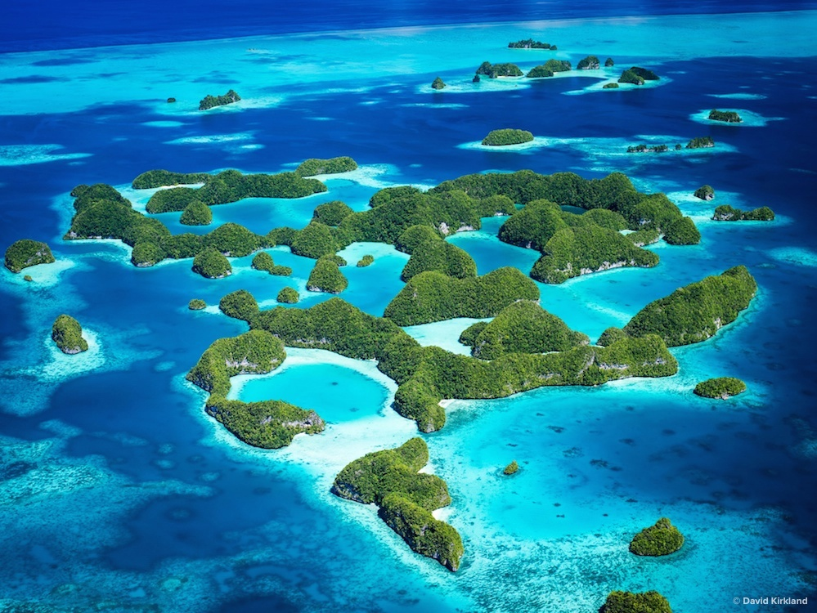
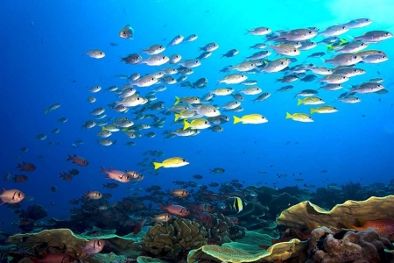
Healthy Oceans for Sustainable Fisheries
Improved governance mechanisms to facilitate:
Pollution reduction and restoration and conservation of habitats
Sustainable capture fisheries to end IUU and overfishing and investment in sustainable aquaculture to improve ecosystem health
Notes:
The goal of the healthy oceans for sustainable fisheries IP is to restore and sustain fisheries by improving the health of ocean and coastal ecosystems on which fisheries and marine aquaculture depend. Within framework of existing commitments as part of regionally agreed SAPs, the IP will focus on (1) - sustainable governance of marine capture fisheries to end illegal, unregulated and unreported fisheries, along with stimulating investments in sustainable marine aquaculture to improve ecosystem health and (2) focus on improved governance mechanisms to facilitate pollution reduction and restoration and conservation of habitats.
Geography: The IP will operate within the framework of country commitments as part of regionally agreed SAPs

Slide 15
Sustainable Cities
Transformation of cities towards greater sustainability and global benefits
Strengthen global support and coordination by building on GEF-6 Sustainable Cities IAP
Notes:
The Sustainable Cities IP will build on the SC-IAP to push the envelope further by enhancing policy and financing environments to improve the design and financing of urban infrastructure and by incorporating innovations that are increasingly within reach to revamp how cities operate at all levels and for all stakeholders. The Global Platform on Sustainable Cities has been created in GEF-6, supporting 11 countries, and has engaged a major International network of city platforms and technology providers, including C40, ICLEI, UCLG (united cities and local governments), Compact of Mayors, 100 Resilient Cities, WRI, and others. The broad-based coalition will attract additional partners, including private sector entities to help increase opportunities for cities and local governments aspiring for sustainability. The network partners will increasingly connect people who are tackling challenges and enable them to learn from others’ experiences and adapt solutions to their own unique situations.
The GPSC aims to provide a global convening space for dialogue and a ‘clearing house mechanism’ on issues, resources and expert needs that will help position cities as major hubs for global environmental and development benefits, including opportunities for financial leverage to advance the sustainability and resilience agendas for cities

Slide 16
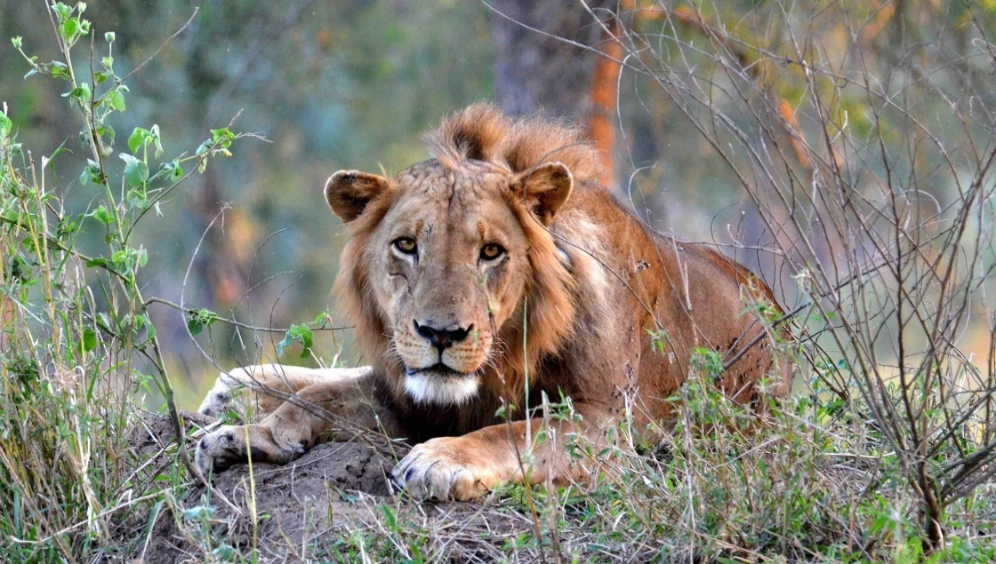
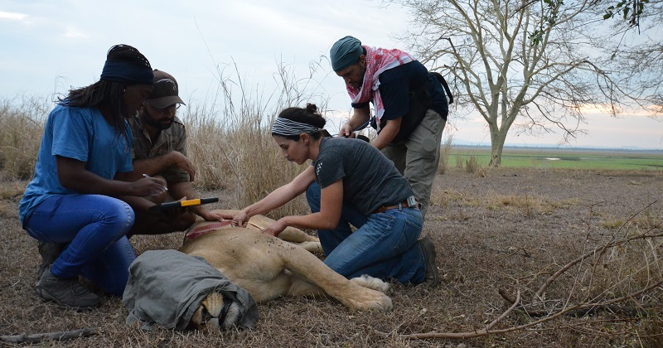
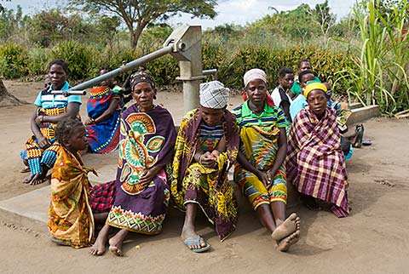
Wildlife for Sustainable Development
Conserve wildlife in the vast wilderness areas of Africa to generate benefits to local communities and revenue to support conservation areas:
Build on GEF-6 Global Wildlife Program
Invest in addressing illegal wildlife trade in supply,
transit and demand countries
Use growing and stable populations of wildlife
to generate socio-economic benefits
Notes:
Securing the health of wildlife populations is one of the most promising economic development engines in Africa. The proposed wildlife for sustainable development IP builds on the GEF-6 Wildlife PFD program and has a two pronged approach: First, to continue investing in addressing the illegal wildlife trade in supply, transit and demand countries. Second, ensuring the sustainability of these efforts by making use of the growing and more stable populations of wildlife to generate socio-economic benefits for local communities and economic development.
Geography: The geographic targets are the following Transfrontier Conservation Areas: Okavango- Zambezi (Angola, Botswana, Namibia, Zambia); the Greater Limpopo (Mozambique, South Africa and Zimbabwe); Malawi-Zambia TFCA; ZAMOZA (Zimbabwe, Mozambique, Zambia); Lower Zambezi-Mana Pools TFCA (Zimbabwe-Zambia) and Niassa-Selous (Tanzania-Mozambique).

Slide 17
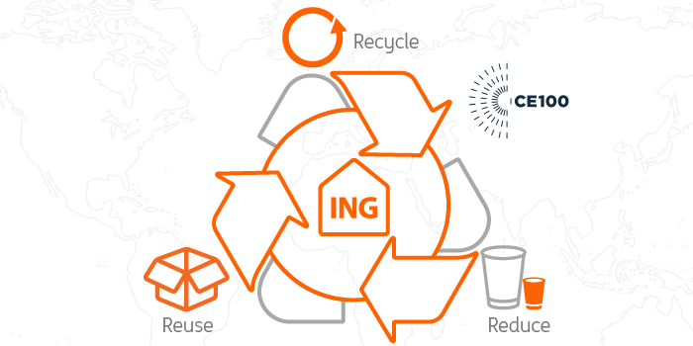
Circular Economy
“…an industrial system that is restorative or regenerative by
intention and design, replacing the end-of-life concept with restoration,
shifts towards the use of renewable energy, eliminates the use of toxic
chemicals, which impair reuse and return to the biosphere, and aims for
the elimination of waste through the superior design of materials,
products, systems and business models.” (WEF)
Flip global supply chains and country/regional manufacturing/economic development strategies from take-use-dispose to redesign-reduce-reuse-repair-recycle approaches
Initiate work on plastics because of its relevance and feasibility to further global environmental benefits, specifically to reduce GHGs, hazardous chemicals,
and marine debris
Expand to other production sectors
Notes:
The IP for circular economy addresses a very important global environmental stressor represented by approximately 60 billion tons of raw materials that are extracted per year (22kg/person/day). While most materials are disposed of within one year, only 7% being recycled or reused, creating serious environmental consequences, including GHG emissions, hazardous chemical emissions and marine debris affecting biodiversity. Goal: To be an enabler towards flipping global supply chains and country/regional manufacturing/economic development strategies from take-use-dispose to redesign-reduce-reuse-repair-recycle approaches.
To further the Circular Economy concept, GEF proposes to bring governments and private sector together particularly in developing economies The Circular Economy IP will ramping up early work on plastics because of its relevance and feasibility to further Global Environmental Benefits, specifically to reduce GHGs, hazardous chemicals, and marine debris, but expand ot other sectors following the different contexts and priorities coming from GEF countries.

Slide 18
How Were the Impact Programs Determined

Slide 19
Country Priorities and Commitments to MEAs
Thematic Priorities | AFR | ASIA | ECA | LAC | SIDS | Total
Landscape Restoration | 47 (98%) | 17 (100%) | 23 (96%) | 20 (100%) | 33 (97%) | 140 (98%)
Transforming Energy Systems | 47 (98%) | 17 (100%) | 21 (88%) | 18 (90%) | 33 (97%) | 136 (95%)
Food Systems | 47 (98%) | 17 (100%) | 20 (83%) | 20 (100%) | 31 (91%) | 135 (94%)
Sustainable Cities | 46 (96%) | 16 (94%) | 20 (83%) | 16 (80%) | 32 (94%) | 130 (91%)
Environmental Security | 45 (94%) | 17 (100%) | 14 (58%) | 19 (95%) | 31 (91%) | 125 (88%)
Healthy Oceans for Sustainable Fisheries | 40 (83%) | 14 (82%) | 19 (79%) | 19 (95%) | 30 (88%) | 122 (85%)
Natural Capital | 35 (73%) | 13 (76%) | 12 (50%) | 17 (85%) | 24 (71%) | 101 (71%)
Green Finance | 29 (60%) | 11 (65%) | 12 (50%) | 16 (80%) | 19 (56%) | 87 (61%)
Green Infrastructure | 19 (40%) | 9 (53%) | 6 (25%) | 12 (60%) | 10 (29%) | 56 (39%)
Agriculture Commodities Supply Chains | 3 (6 %) | 3 (18 %) | 0 (0 %) | 10 (50 %) | 1 (3 %) | 17 (12 %)
Amazon Landscapes | 0 (0 %) | 0 (0 %) | 0 (0 %) | 8 (89 %) | 0 (0 %) | 8
Wildlife for Sustainable Development
Inclusive Conservation: Engaging Indigenous People
Circular Economy
Integrated National Planning for MEAs/SDGs
Grand Total Distinct Countries | 47 (98%) | 17 (100%) | 24 (100%) | 20 (100%) | 34 (100%) | )
Notes:
The first step in identifying prospective impact programs was an analysis of thematic priorities contained in 138 NDCs, 140 NBSAPs and 105 LDN plans, supplemented with secondary sources, including the World Bank, IADB and UNDP¹
Overall database data base consists of more than 275 country primary source documents supplemented with these secondary sources.
Strategic themes examined and categorize into impact areas, Identified alignment across MEAs
Analysis revealed a high degree of consistency across countries

Slide 20
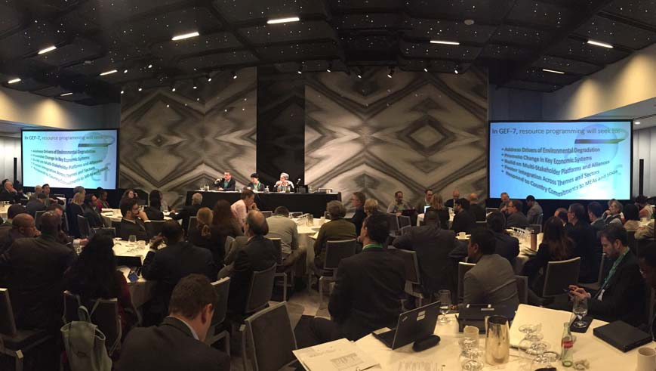
GEF-7 Technical Advisory Groups (TAGs)
Notes:
An initial configuration of impact programs and complementary investments was examined by technical advisory groups that met in DC for 3 days, involving close to 200 people, from independent experts, agencies, NGOs, STAP, the IEO, and representatives of convention secretariats. This is now being brought to your scrutiny, comments, and contributions.

Slide 21
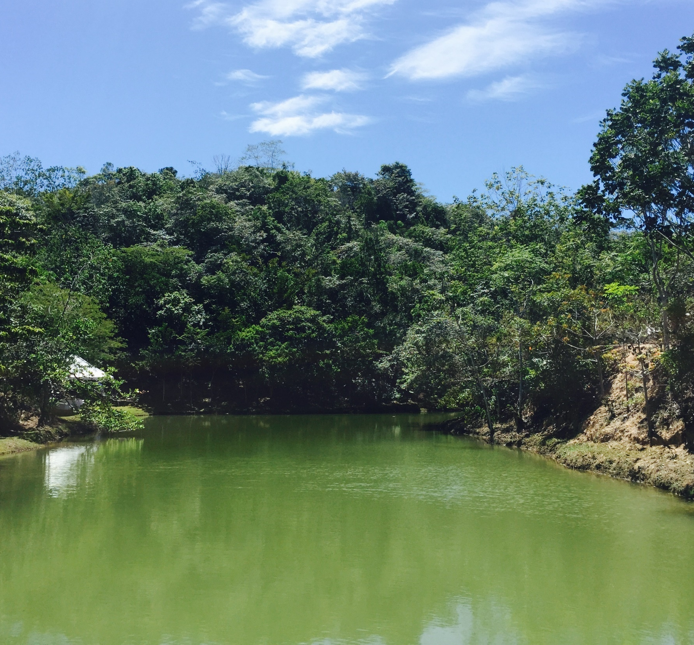

GEF-7
Complementary Investment Frameworks
Notes:
Through the process I have described, we were able to identify a series of high impact programs that can deliver multiple and scaled benefits for two or more conventions. But for certain priorities contained in convention guidance, a more specific set of actions, funded through complementary investment frameworks, are proposed to complement those anticipated being accrued via the impact programs.

Slide 22
Biodiversity Investment Framework
Wildlife Economy
Landscape Restoration
Agricultural Commodities
Inclusive Conservation
Natural Capital
Food Systems
Healthy Oceans
Complementary Investments
Protected Areas
Threatened Species
Invasive Alien Species
Crop Wild Relatives
Access & Benefit Sharing
Biosafety
Convention reporting
Non-Grant Instruments
Resilience
Notes:
In biodiversity, there are at least 7 impact programs that can deliver direct results to convention objectives, but these would be complemented by investments in ….

Slide 23

Climate Change Mitigation Investment Framework
Food Systems
Landscape Restoration
Agricultural Commodities
Sustainable Cities
Transforming Energy Systems
Circular Economy
Inclusive Conservation
Amazon Landscapes
Green Infrastructure
Complementary Investments
Capacity-building Initiative for Transparency (CBIT)
NDC preparation and enhancement
Enabling Activities
  Support National Communications and BURs
Non-Grant Instruments
Resilience
Notes:
9 IPs will provide benefits to CCM…. And complemented by….

Slide 24

Land Degradation Investment Framework
Food Systems
Landscape Restoration
Agricultural Commodities
Environmental Security
Natural Capital
Complementary Investments
LDN implementation support through:
  Diversification of production systems
  Integrated Landscape Management
  Creating Enabling Environment
Enabling Activities
Impact Programs
Non-Grant Instruments
Resilience

Slide 25
International Waters Investment Framework
Amazon Landscapes
Green Infrastructure
Environmental Security
Healthy Oceans
Circular Economy
Complementary Investments
IW implementation support through:
  Catalyzing capacity for multi-state cooperation
  Enhancing multi-state cooperation on transboundary waters
  Enhancing multi-state cooperation in PMEs to rebuild fisheries
Impact Programs
Non-Grant Instruments
Resilience

Slide 26


Chemicals and Waste Investment Framework
Circular Economy
Amazon Landscapes
Sustainable Cities
Transforming
Energy Systems
Green Infrastructure
Complementary Investments
Focus will be on:
1. De-toxifying development that enables the sound management of chemicals and waste of global importance
2. Supporting implementation of the Minamata and the Stockholm Convention, the Montreal Protocol , and the Strategic Approach for International Chemicals Management.
Impact Programs
Non-Grant Instruments
Resilience

Slide 28

How will GEF-7 resources be allocated?

Slide 29
Resource Allocation
STAR would continue to form the basis of the GEF’s approach to resource allocation.
Recipient countries would benefit from full flexibility across focal areas.

Slide 30
GEF-7 Results Framework
GEB Categories | Biodiversity (Land and Water) |  | Sustainable Land and Water Management | De-Carbonization/Reduced Emissions |  | Reduced Pollution/Waste
Results Area | Species with improved status (#), Protected Areas created in Landscapes / Seascapes (HA) | Proportion of Fisheries Managed Sustainably, Basins with Enhanced Water-Food-energy Ecosystem Security (#/HA) | Area of Sustainably Managed Landscapes (hectares); Freshwater Resources Managed Sustainably (%) | Areas with Deforestation Reduced (Hectares), Forest Stocks Conserved (Tons) | Emissions avoided or reduced (Tons of CO₂e) | Quantity of Pollutants, Waste Reduced or Eliminated (Tons)
Impact Programs
Landscape Restoration
Transforming Energy Systems
Food Systems
Sustainable Cities
Environmental Security
Healthy Oceans for Sustainable Fisheries
Natural Capital
Green Finance
Green Infrastructure
Agriculture Commodities Supply Chains
Amazon Landscapes
Wildlife for Sustainable Development
Inclusive Conservation: Engaging Indigenous People
Circular Economy
Integrated Planning for MEAs/SDGs
Focal Area Complementary Investments
Biodiversity
Climate Change
Land Degradation
International Waters
Chemicals and Waste
Primary |  | Impact Program contributes directly to the GEBs
Secondary |  | Impact Program contributes indirectly to the GEBs
Notes:
In summary, we expect to increase the impact and reach of GEF investments by adopting the proposed GEF-7 strategy. Our still preliminary results framework is aimed at delivering integrated global environmental benefits across multiple conventions, and concrete indicators already exist that can be the subject of further deliberation regarding cost-effectiveness and regularity in monitoring.

Slide 31
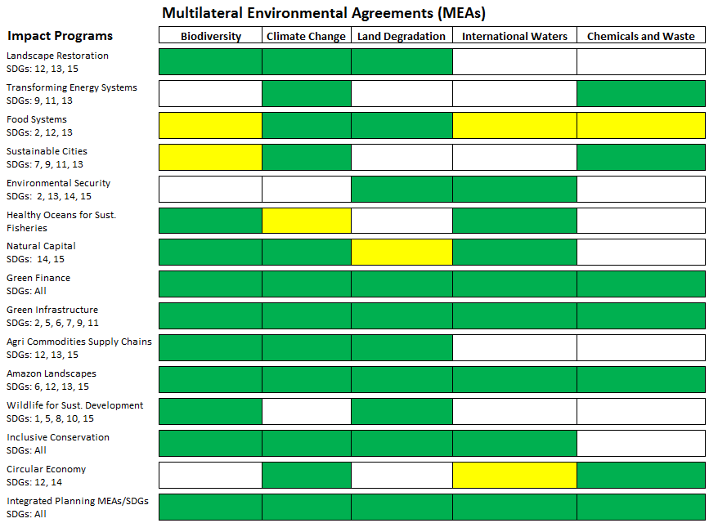

Notes:
In every case, the proposed impact programs are expected to provide benefits to more than one convention or theme within the broad mandate of the GEF, as shown in this table with primary benefits (green bars) and secondary benefits (yellow bars) deriving from the more focused and integrated investments, as well as being relevant to the SDGs.

Slide 32
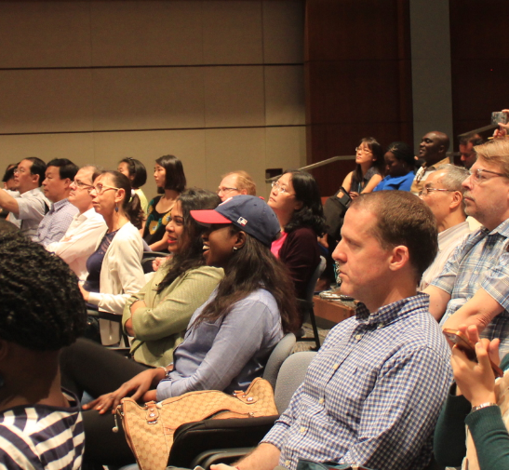
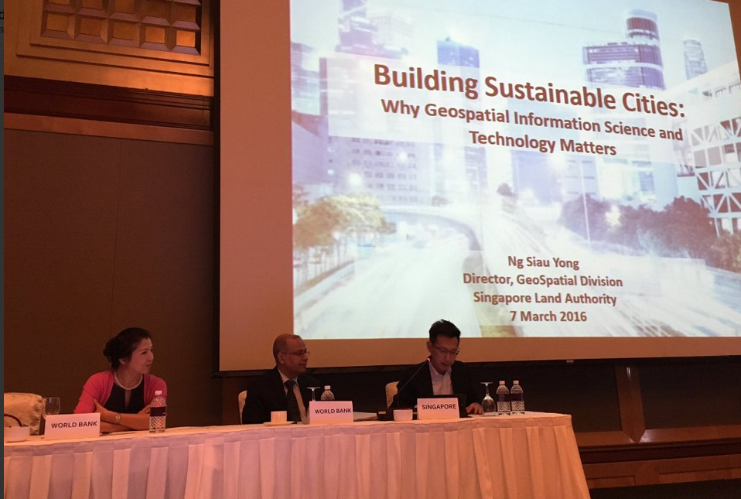
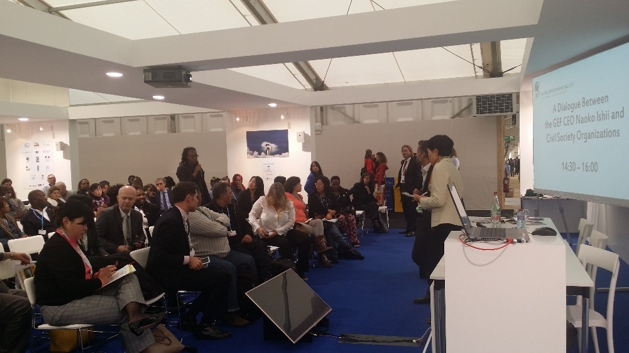
What’s Next?
Develop detailed Impact Programs for October 2017 meeting
Engagement with recipient countries to determine anticipated demand and desired impact
Build upon IAP engagement model with GEF partners, countries Convention Secretariats, etc.
Notes:
We propose to continue and expand the engagement process initiated for the preparation of the draft GEF-7 programming directions document, using the experience accumulated in the preparation of GEF-6 IAPs and other programmatic approaches, which included a diversity of stakeholders, including the GEF IEO, STAP and others. In particular, we will be bringing the recipient countries to reflect on anticipated demand and desired impact, along with existing global and regional platforms and relevant actors from the private sector. The commitment from the GEF secretariat is to bring you in October a revised and further detailed document for deliberation.

Slide 33
Outline of The Policy Agenda
Adapting the GEF’s delivery model
Enhancing efficiency and effectiveness
Allocation
Partnership
Results
Operational efficiency
Gender
Knowledge management
Access to information
Climate risk
Concessional loans

Slide 34
Thank You

