Slide 1
Independent Evaluation in the GEF
GEF Independent Evaluation Office
Neeraj Negi
Senior Evaluation Officer
February 16-17, 2016

Slide 2
Outline
Independent Evaluation in the GEF
Monitoring and Evaluation Primer
Monitoring and Evaluation Design and Implementation
Terminal Evaluations
Pulling it all Together

Slide 3
PART 1 Independent Evaluation in the GEF

Slide 4
GEF Independent Evaluation Office
Mission
To enhance global environmental benefits through excellence, independence, and partnership in monitoring and evaluation
Functions
Independent Evaluation Office
Normative function
Oversight function
Knowledge sharing and dissemination

Slide 5
GEF IEO and the Broader GEF Partnership
GEF Council
Policy-making
Oversight
Enabling environment for
M & E
Independent GEF Evaluation
Oversight of M & E
Setting minimum requirements for evaluation
GEF IEO
GEF Secretariat
GEF Results Based Management (monitoring & reporting)
Review of GEF M & E requirements in project proposals
Project and/or corporate Agency evaluations
Mainstreaming GEF into relevant Agency evaluations
Agency Evaluation Units
Agency GEF Operational Units
Monitoring of the Agency GEF portfolio
Ensure M & E at the project level
STAP
Advice on scientific / technical matters in M & E
Support to scientific and technical indicators
Participation in monitoring activities and mechanisms
Provide views and perceptions to evaluations
Stakeholders
GEF Projects &
Programs
Collaboration on M & E at portfolio and project levels
Participating Countries

Slide 6
IEO FOCUS
Real World
Generate evidence on GEF performance - what works, where, under what conditions, and why
Apply appropriate methodologies and tools to measure the results and impacts of the GEF portfolio
Focus on Behavioral Changes and Broader Adoption using a broader contextual approach
Assess co-benefits or socio-economic benefits of projects in addition to environmental outcomes
Recommend improvements in program/ policy design and implementation to the Governing Council
Problem Driven
To assess
Impacts
Causes
Trends
GIS Model
Satellite data
Data from field visits
Data from e-devices
Socio-economic conditions
Infrastructure
Physical environment
Location and boundaries

Slide 7
IEO Stakeholders
Clients with a governance role:
GEF Council
GEF Assembly
the Replenishment group
Clients that carry out decisions of the governing bodies:
GEF Secretariat
GEF Agencies
Executing agencies at the country/regional level
Country clients
Clients involved in monitoring and evaluation
GEF Beneficiaries
Wider audience: environmental entities, academia, research institutions, civil society, general public

Slide 8
IEO Work Program for GEF-6
KM, Gender, Resilience and Private Sector Mainstreaming

Slide 9
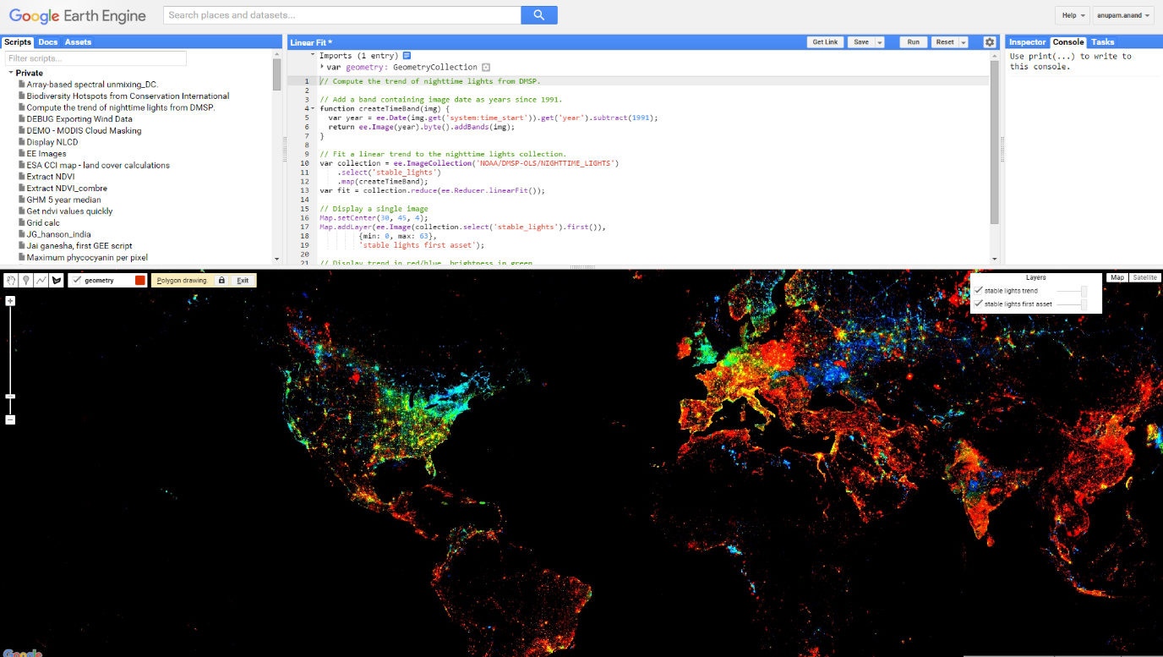
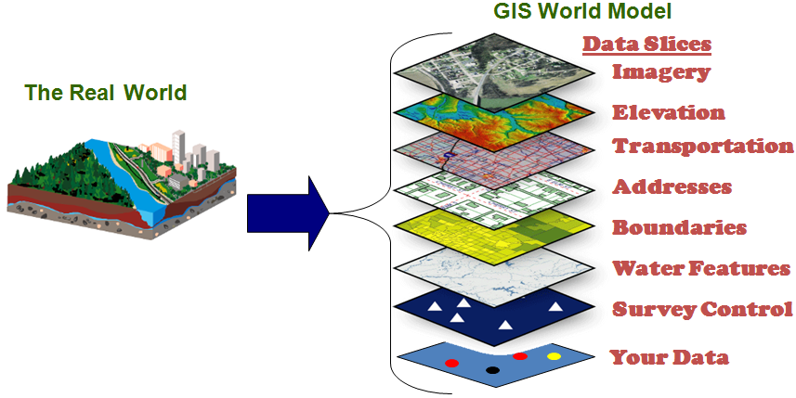
Leading on Methodologies in Environmental Evaluation
Quantitative & Qualitative Approaches
Remote Sensing
GIS
Big Data Analytics
Mainstreaming Gender, Stakeholder Engagement,
Resilience, Private Sector

Slide 10
Annual Performance Reports
Feedback for ongoing improvements in the portfolio
Performance Ratings
Management Action Record
Quality of project M&E across the portfolio
Terminal Evaluations
APR 2015 will provide the following:
Overview of the performance of GEF activities and processes
Key factors affecting performance
M&E within the GEF partnership
In-depth assessment on GEF tracking tools

Slide 11
Impact Evaluations
Determine the long-term effects of GEF support
How these were achieved and what can be done to strengthen them
Lessons Learned
Joint Impact Evaluation of GEF Support to Protected Areas and Surrounding Landscapes
Assesses the impact of GEF investments in non-marine protected areas and protected area systems on biodiversity conservation and sustainable use

Slide 12
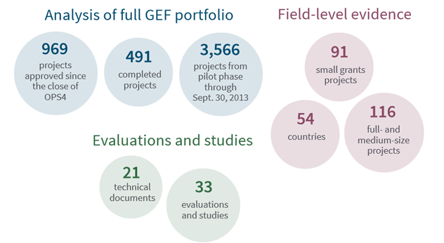
Overall Performance Studies (now known as CEG - Comprehensive Evaluation of the GEF)
A comprehensive evaluation that assesses performance, institutional effectiveness, and impact of the GEF
Informs the next GEF replenishment cycle and identifies potential areas for improvements

Slide 13
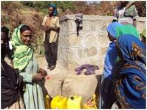
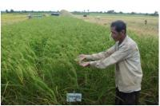
Least Developed Countries Fund (LDCF) / Special Climate Change Fund (SCCF)
IEO provides support to two adaptation funds managed by the GEF
Annual Evaluation Reports:
Evaluative work submitted annually to the LDCF/SCCF Council since 2014
FYs 2016-19 will assess completed projects using information from TEs

Slide 14
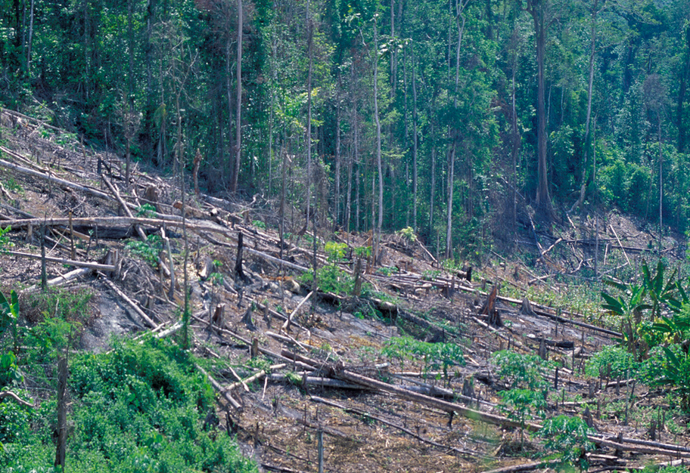
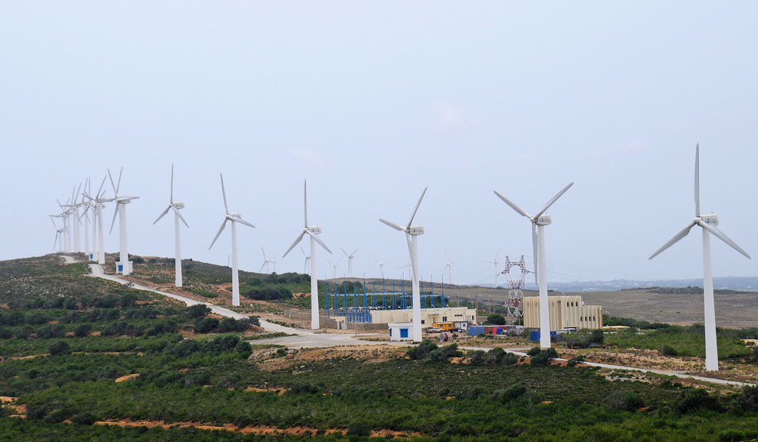
Strategic Country Cluster Evaluations
Assesses the multiple benefits of GEF support and whether GEF projects and portfolios in countries have addressed and are addressing driving forces of global environmental change
Focus on countries and topics that involve a critical mass of projects in GEF-6 to provide lessons for GEF programming, including the new Integrated Approach Pilots

Slide 15
GEF IEO Dissemination and Knowledge Management
Before
Work Program
Approach Paper
During
Data Collection
Analysis
After
Final Report
Preliminary Findings
Sharing and receiving feedback regarding evaluation
circulating approach paper
interagency meetings
management response
online consultations
consultations
webinars
consultations
signposts
social media
social media
online consultations
newsletters
webinars
social media
video
events
webinars
workshops
stakeholders

Slide 16
Notes:
Jeopardy Game!
Open another file with Jeopardy Game.

Slide 17
M&E Primer

Slide 18
M &E in the GEF—Purpose
Monitoring and Evaluation (M&E) promote accountability and learning
to improve performance and as a basis for decision-making
Notes:
Monitoring and evaluation play a very important role in the GEF. The feedback from M&E allows the GEF to track progress in fulfilling its mission of delivering global environmental benefits. Jointly they promote accountability and learning to improve performance and as a basis for decision-making.

Slide 19
Monitoring
Is our activity on track?
Monitoring uses systematic collection of data to keep activities on track.
Forms of monitoring:
Monitoring of environmental status
Monitoring of environmental stress
Monitoring of progress toward project outcomes
Performance monitoring

Slide 20
Evaluation
Are we doing the right thing?
Are we doing things right and efficiently?
Are there better ways of doing it?
Evaluation is a systematic assessment of an activity (program, strategy etc) that assesses relevance, effectiveness, efficiency and sustainability.
Project/Program Evaluations:
Mid-term
Terminal
Other forms of evaluation: impact, process, portfolio, performance, thematic, process

Slide 21
Monitoring and Evaluation
Monitoring:
Clarifies program objectives
Links activities and their resources to objectives
Translates objectives into indicators and sets targets and baselines
Routinely collects data, compares actual results with targets
Reports progress to managers and alerts them to problems
Evaluation:
Analyzes why intended results were or were not achieved
Assesses specific causal contributions of activities to results
Examines implementation process
Explores unintended results
Provides lessons, highlights significant accomplishment or program potential, and offers recommendations for improvement
Source: IPDET (2009)
Notes:
Monitoring and evaluation have complementary roles in the GEF.
Monitoring tracks changes in indicators toward achievement of specific targets
Evaluation provides a broader view, including why the intended results are being or not being achieved, and explores unintended results
Both are needed to better manage projects, programs, and policies

Slide 22
It starts with a …Theory of Change
assumptions
Inputs
Impacts
Activities
Outputs
Outcomes
context
assumptions

Slide 23
Measurement: Indicators
A variable that tracks the changes connected to an intervention
Inputs
Activities
Outputs
Outcomes
Impacts
indicators for Implementation
indicators for results
Good
Specific
Measureable
Achievable and Attributable
Relevant and Realistic
Time-Bound, Timely, Trackable, And Targeted
Good Baselines are a MUST!!
Notes:
Indicator: Quantitative or qualitative factor or variable that provides a simple and reliable means to measure achievement, to reflect the changes connected to an intervention, or to help assess the performance of a development actor. (OECD DAC Glossary, 2010).

Slide 24
Project M&E Plan
(Design and Implementation)

Slide 25
Lets take 10 minutes to think in groups….
What are the elements of a good project Monitoring and Evaluation Plan?
Be ready to explain the reasons, why, certain elements should or should not be included in a project M&E Plan

Slide 26
M&E Policy : Design & Implementation
Project/program monitoring and supervision will include execution of the M & E plan:
Use of SMART indicators for process, implementation and results
Baseline for the project is fully established and data are compiled to review progress
Organizational set up for M & E is operational and its budget is spent as planned
Concrete and fully budgeted M&E plan by CEO endorsement for FSP and CEO approval for MSP
Project logical frameworks should align with GEF focal area results frameworks
M&E Plan should include:
SMART indicators
Baseline data for M&E by CEO endorsement
Mid Term Reviews (where required or foreseen) and
Terminal Evaluations included in plan
Organizational set up and budget for M&E

Slide 27
Good Practices Finding: Strong link between good M&E and project outcomes
M&E Plans sufficiently detailed
Clearly defined responsibilities for monitoring activities and evaluation plans
Dedicated budget for each M&E component
Choice of appropriate methods for evaluation
Provision for active participation of stakeholders in M&E implementation: increased buy-in from beneficiaries and gains in efficiency
M&E system designed to provide timely and relevant information
Substantive provisions of time and resources for training stakeholders in the project M&E system (including those who are supposed to use the findings)
Share M&E findings with broad groups of M&E stakeholders
Source: GEF Annual Performance Report 2013

Slide 28
Terminal Evaluations
Notes:
Terminal Evaluations

Slide 29
Importance and Utility
Source of information on project
Results: Outputs, outcomes and progress to impact
Implementation, execution, and project cycle related information
Project finances including co-financing
Recommendations and Lessons for the future
Reporting at the project portfolio level (APR, AMR)
Input to other evaluations
STAR’s performance index
About 1000 terminal evaluations completed so far.
Terminal evaluation may be accessed at:
GEF website: http://www.thegef.org/gef/gef_projects_funding
Through PMIS

Slide 30
M & E Policy on Terminal Evaluations
All full sized projects and programs will be evaluated at the end of implementation
Evaluations should:
Be independent of project management or reviewed by GEF Agency evaluation unit
Apply evaluation norms and standards of the GEF Agency
Assess, as a minimum, outputs and outcomes, likelihood of sustainability, compliance with design and implementation
Contain basic project data and lessons on the evaluation itself (including TORs)
Should be sent to GEF IEO within 12 months of completion of project/program
Guidelines for Terminal Evaluations

Slide 31
Evaluation Criteria
Efficiency
Relevance
Results
Sustainability
Effectiveness

Slide 32
A Good Terminal Evaluation
Evaluator is independent from design team (unbiased)
Discussion of outcomes and results
Consistency and completeness in information provided
Discussion of issues related to project sustainability
Information on project finance and co-financing
Information on M&E plan and the use of monitoring information
Lessons and recommendations based on the project experience
Other qualities
Balanced judgement
Timeliness
Transparency of the process

Slide 33
Pulling it all together A CASE STUDY
Notes:
In a plenary discussion ask participants to identify main takeaways from the training. Encourage to answer any questions. Write down on the flipchart. Provide answers to any questions.

Slide 34
Group Work: Case Study (30 minutes) Plenary Report out: 15 minutes
M&E Before-During-After
Develop an M&E Plan for the Project
How would you address M&E through implementation?
Now the project is going to be completed. How would you design, manage and report on the terminal evaluation?

Slide 35
Sixth Comprehensive Evaluation (OPS6)
Notes:
Terminal Evaluations

Slide 36
Objectives
To assess the extent to which the GEF is achieving its objectives:
As laid down in the GEF Instrument and reviews by the Assembly
As developed and adopted by the GEF Council in operational policies and programs for GEF financed activities
To identify potential improvements
Two Reports
DRAFT report: at start of replenishment (summer 2017)
A meta-evaluation approach, drawing on existing GEF evaluations
Final report: end of 2017 or early 2018
Final report will update meta-evaluation and include findings of additional studies

Slide 37
Key Issues in the Study
Trends in global landscape for environmental finance and the relevance and added value of the GEF, also in view of other funding channels
Funding
An in-depth look at impact of the GEF focal area strategies, including multi-focal area support and programmatic approaches
Reform processes (RBM, KM)
Governance of the GEF and donor performance
Trends in country ownership and relevance of GEF’s support to country needs, including obligations to conventions
Trends in the involvement of stakeholders, the private sector and civil society
Cross-cutting policies: gender, participation, results based management, knowledge sharing
Role of STAP
Health of the GEF Partnership

Slide 38
Audience for the 6th Comprehensive
OPS6 audience includes
Replenishment participants
GEF Council
Assembly
Through the Assembly the members of GEF
Findings will be shared with other GEF partners
GEF Secretariat
STAP
GEF Agencies
NGO Network
Project proponents and others

Slide 39
We Would like your perspectives..
Discuss series of questions in small groups
Guidance of the conventions
Trends in ownership and country driven-ness
Trends in performance issues
Involvement of civil society and private sector
Record comments on provided forms
Discuss emerging key issues in plenary session

Slide 40
Questions
Do you feel that the GEF support in your country matches the guidance of the conventions, as relevant to your country and supportive of national priorities? Would you like to raise any issues in this regard?
Has the GEF support contributed to your countries’ sustainable development agenda and environmental priorities? Would you like to raise any issues?

Slide 41
Performance
Has co-funding for projects materialized as planned? Why or why not?
What has been the role, division of labor and comparative advantage of the GEF Agencies in your country?
Have GEF lessons been shared with your country or organization, and to what extent have lessons learned in your country or organization been shared with the GEF community? Do you have any issues you would like to raise in this regard?
Do you feel the GEF project cycle is efficient (with respect to time, effort and money that it takes to develop and implement a GEF project) and how would it compare to other donors’ cycles in your country?
How effective has the GEF been in handling complaints, disputes and conflicts?
Are there any other issues you would like to raise regarding performance ?

Slide 42
Civil Society and Private Sector
Are you satisfied with the involvement of civil society organizations and the private sector in GEF activities in your country? Please give examples.
What are the barriers to the involvement of civil society organizations and the private sector in GEF activities in your country?
In what ways could civil society organizations and the private sector be more involved with GEF activities and projects?
Are there any other issues you would like to raise regarding the involvement of civil society organizations and the private sector in GEF activities?

Slide 43
Overall
Have you received adequate support from the GEF Secretariat and agencies?
What do you think is working well in the GEF partnership?
What do you think should be improved in the GEF partnership?

Slide 44
We are open to receive more information, concerns, opinions, and suggestions at:
OPS6@thegef.org
Thank you
www.gefeo.org

