Slide 1
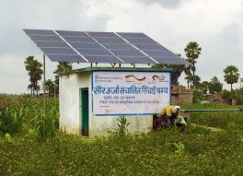
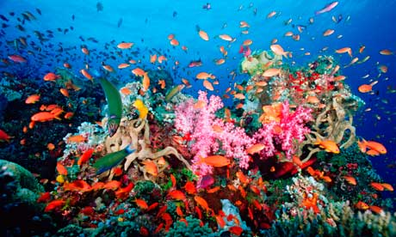
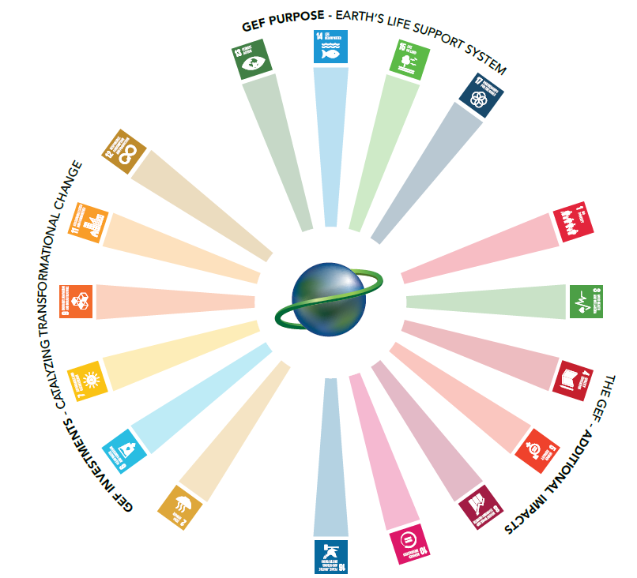
GEF and the Sustainable Development Goals

Slide 2
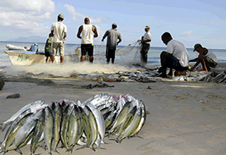
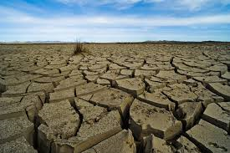
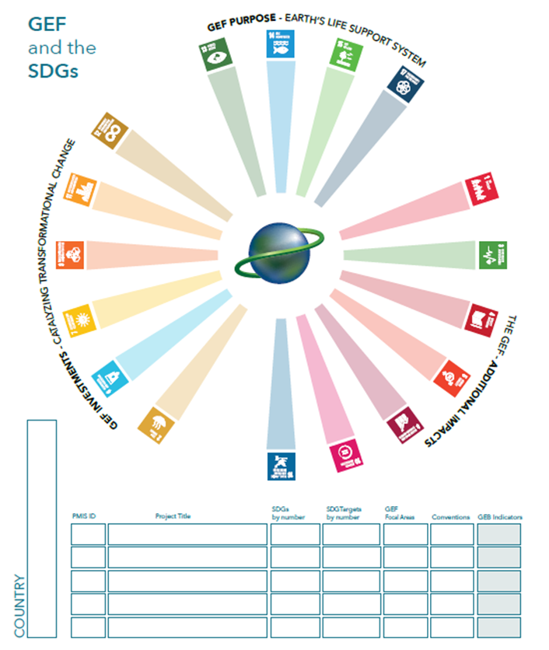
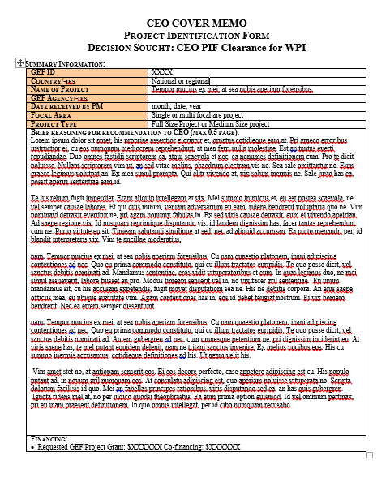
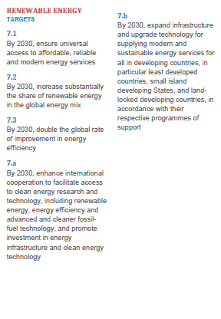
Explore the linkages between GEF investments and the SDGs
What do you have in front of you:
One poster outlining the SDGs and for you to provide further details on
One package of the 17 SDGs, including their targets (please see back of cards)
Two sheets of stickers that illustrates the SDGs
Five project descriptions of GEF projects in your country

Slide 3
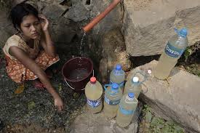
What to do:
Please review the 17 SDG cards
Read the five short project descriptions
identify which of the SDGs that each of the GEF investments will deliver against
stickers are placed next to the associated SDGs on the board
Please note down the associated GEF Project ID, Project Title, SDG, Target and Focal Area / Convention addressed in the table at the lower part of the Poster
Together we will then review and discuss the results.

