Slide 1
Knowledge & Learning for the GEF Partnership
Yasemin Biro Kirtman, PhD
GEF Knowledge and Learning Coordinator
GEF Introduction Seminar
January 2019
Washington, DC

Slide 2
Videos
GEF e-course intro video on YouTube https://www.youtube.com/watch?v=GXOtk6XlqvM
GEF Knowledge Day video
https://www.youtube.com/watch?v=qDPQxxTCQ1c&spfreload=10
GEF Trinidad Video
https://www.youtube.com/watch?v=jfLQqwAuqow
GEF Kaleo
https://www.youtube.com/watch?v=DdhVLcqyv9o

Slide 3
GEF’s Knowledge & Learning Goals:
Improve impact of GEF funded projects and programs
&
Inform global, regional and national policy dialogues to reverse
global environmental degradation

Slide 4
KM Strategic Framework
OPS-5 Study on
KM in the GEF
GEF-6 Policy Recommendations
KM Approach Paper
Internal Capacity Development – KM Work Stream, KM Advisory Group
Pilot KM Exercises
Internal KM Survey, Country KM Surveys,
KM Audit, Knowledge Assets Analysis
Create KM Team
Prepare a Detailed KM Implementation Plan
Embed KM Tools into IT Upgrading and Embrace Open Access Approach
Incorporate KM platforms into IAPs
KM Requirements for PIFs and CEO Endorsement
Knowledge Management
Timeline & Progress
KM Roadmap
KM Products
IT-based Knowledge and Learning System
2011
2015
2016
2017-2018
2019-2020
GEF-5 Policy Recommendations
Art of Knowledge Exchange
GEF Portal
GEF Academy & E-Curriculum
KM Guidelines for GEF 7
GEF Communities of Practice
GEF-7 Policy Recommendations
Objective: Boost GEF’s efforts to
Improve impact of its projects and programs
Inform global, regional and national policy dialogues to reverse global environmental degradation
Learn from Projects & Programs
Share Data, Info and Knowledge with Stakeholders
KM Roadmap:
improve (1) information management and sharing, and (2) collaboration and learning across the Partnership.
strengthen/expand communities of practice for uptake of lessons and best practices
more systematically integrate knowledge capture, dissemination and learning into GEF project design, implementation and reporting
Extraction of Lessons Learned from the MFA Portfolio
GEF Knowledge Days
GEF Kaleo On-line Knowledgebase and Ask-the Expert Tool
IAP Knowledge Platforms (GPSC)
Improve Uptake of Lessons Learned through a Learning Platform
Develop Comprehensive Work Plan for Building a Knowledge Management (KM) System

Slide 5
GEF KM Approach and Roadmap

Slide 6
Knowledge and Learning in the GEF Partnership – ongoing process
GEF Communications Public Relations Website, Publications, Videos, Social Media, Events Presentations
Targeted Knowledge and Learning Projects
Financed by the GEF
GEF Projects and Programs
Incorporating KM & learning from past experience (PIF and CEO Endorsement Review Criteria)
Country Support Program
Expanded Constituency Workshops
GEF Knowledge Days
GEF Communities of Practice
IW: Learn
Green Finance
GEFNet?
GEF Agency Knowledge and Learning Initiatives
Websites, Databases, Publications, Events
GEF KM Advisory Group
STAP
Scientific Knowledge Capture, Analysis and Sharing
IEO
Evaluation of Results, Impact and Lessons from the GEF Portfolio
GEF KALEO
“Ask the Expert”
Online Tool and Knowledgebase
Art of Knowledge Exchange Guidebook and Workshops
Member Country (Recipient & Donor) Knowledge and Learning Initiatives
GEF Council
Policy and Information Papers and Presentations
GEF Academy
E-Curriculum
Partnerships for Knowledge Exchange (GWP)
Technical Forums and Platforms (GPSC)
Internal GEFSEC Knowledge and Learning Initiatives
IAP KM Platforms

Slide 7
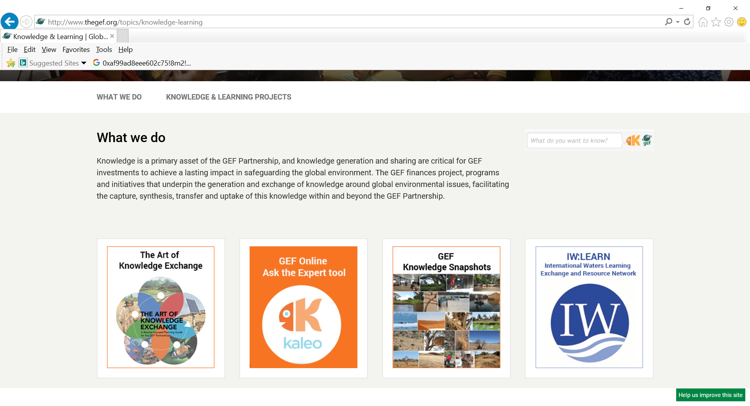
GEF Website & Knowledge and Learning Page
http://www.thegef.org

Slide 8
The Art of Knowledge Exchange - A Results- focused Planning Guide and Toolkit
Practical blue-print on how to design, implement, and monitor knowledge exchange and learning in projects.
Tools and instruments to facilitate knowledge exchange and learning when designing and implementing GEF investments.
Case studies of successful knowledge exchange in GEF projects with examples from WBG, UNDP, FAO, IDB, IFAD, UNIDO and SGP.
Mobile access through Blippar, a free augmented reality mobile app that enables access to the guide from smart phones.
Presented to GEF country counterparts at the Art of Knowledge Exchange Training Sessions held during regional Expanded Constituency Workshops (ECW) throughout 2017.

Slide 9
GEF Framework for Knowledge and Learning in Operations Improving Performance and Impact by Learning from Experience
GEF M&E Policy
KM Approach Paper
GEF 7 Programming and Policy Agenda
STAP Report on KM
Guidelines on Project and Program Cycle Policy

Slide 10
GEF-7 KM Requirements Throughout the GEF Project Cycle Capturing and Sharing Knowledge for FSP and IP Child Projects
Guidelines under preparation for information to Council in June 2019 – in conjunction with the revised M&E policy.
PIF
CEO Endorsement
KM Approach Elaborated/Detailed
PIR
MTR
TE and TER
Progress on K L Deliverables Implementation
Knowledge Products/Events
Lessons Learned
Progress on KM Approach Implementation
Knowledge Products/Events
Lessons Learned
Adaptive Management
Evaluation of KM Results and Impacts
Lessons Learned
Best Practice
Dissemination and Sharing to inform new Design
(As information becomes available.)
Link to overall project impact
KM Approach Outlined
Link to overall project impact
Portfolio and Policy Implications
KM Budget and Time-line
Specific K&L Outputs/Deliverables
Proposed K&L Outputs/Deliverables
Design Stage
Implementation Stage
Evaluation Stage

Slide 11
GEF-7 KM Requirements at PIF and CEO Endorsement Stages (Incorporated into templates in the GEF portal)
PIF | CEO Endorsement
8. Knowledge Management. Outline the “Knowledge Management Approach” for the project and how it will contribute to the project’s overall impact, including plans to learn from relevant projects, initiatives and evaluations. | 8. Knowledge Management. Elaborate on the “Knowledge Management Approach” for the project including a budget, key deliverables and timeline, and explain how it will contribute to the project's overall impact.
Tool tips: This approach will include processes to capture, assess and document, in a user-friendly manner, information, lessons, best practices, and expertise generated during implementation; strategic communications; and knowledge outputs to be produced and shared with stakeholders. | Tool tips: This approach will include processes to capture, assess and document, in a user-friendly manner, information, lessons, best practices, and expertise generated during implementation; strategic communications; and knowledge outputs to be produced and shared with stakeholders.

Slide 12
Seven Criteria Used to Screen PIF Submissions for KM:
Does the KM section of a PIF contain the ingredients of a Knowledge Management Approach, including:
an overview of existing lessons and best practice that inform the project concept?
plans to learn from relevant projects, programs, initiatives & evaluations?
proposed processes to capture, assess and document info, lessons, best practice & expertise generated during implementation?
proposed tools and methods for knowledge exchange, learning & collaboration (at both program and project levels if a PFD)?
proposed knowledge outputs to be produced and shared with stakeholders (at both program and project levels if a PFD)?
a discussion on how knowledge and learning will contribute to overall project/program impact and sustainability
plans for strategic communications?

Slide 13
Thank you!
GEF Knowledge & Learning Coordinator
Yasemin Biro Kirtman
ybiro@thegef.org

