Slide 1
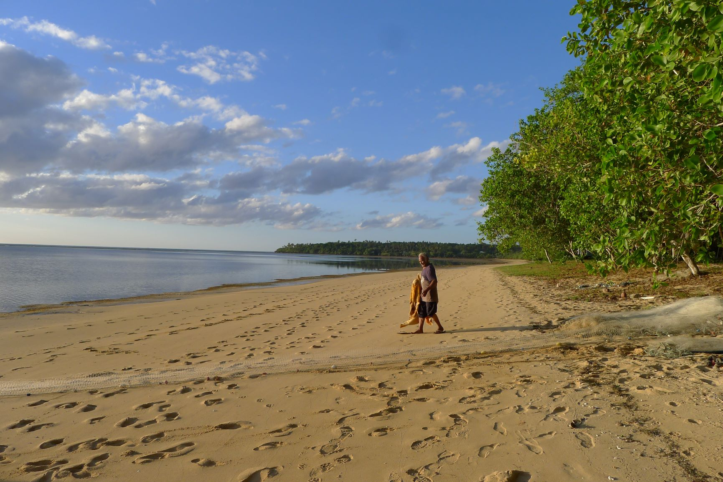
GEF Small Grants Programme
Overview & Strategy
Ana MARIA CURREA, Programme SPECIALIST, UNDP

Slide 2
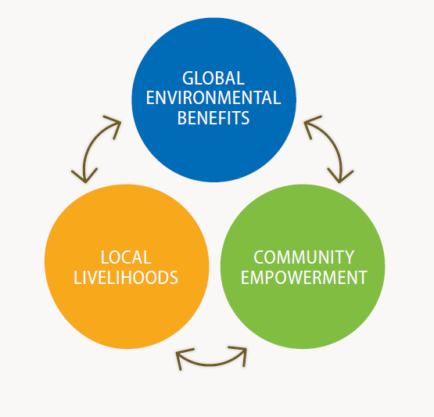
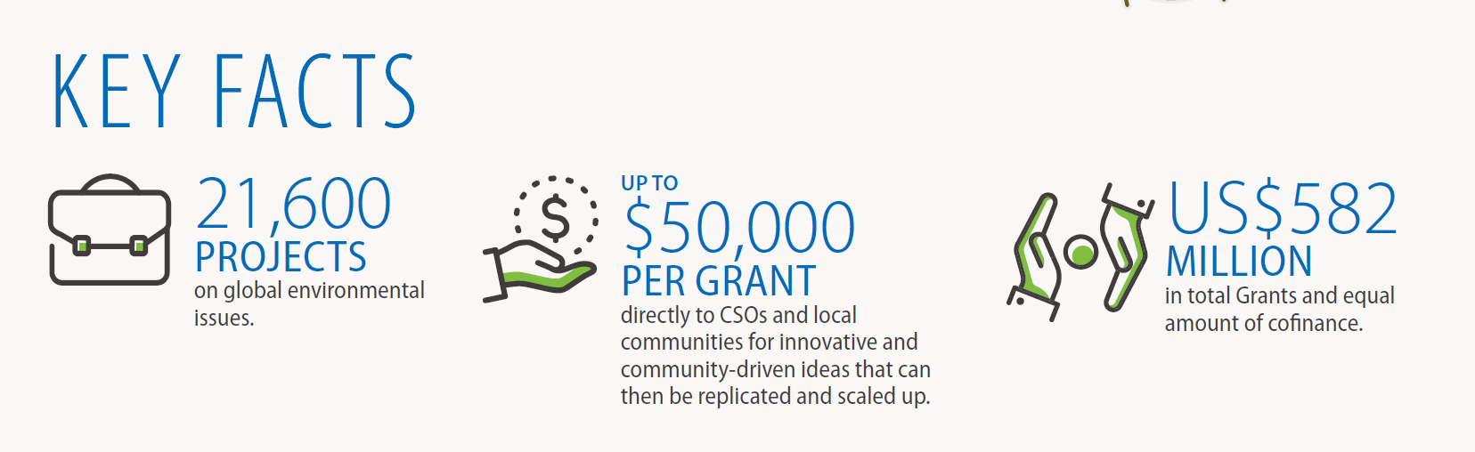
Overview
Local solutions to global environmental problems
Supports community-based initiatives and actions
Since 1992, GEF Corporate Program, implemented by UNDP

Slide 3
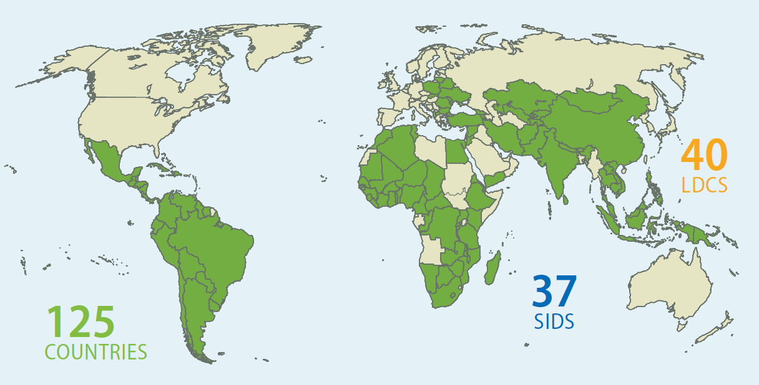
Where we work

Slide 4
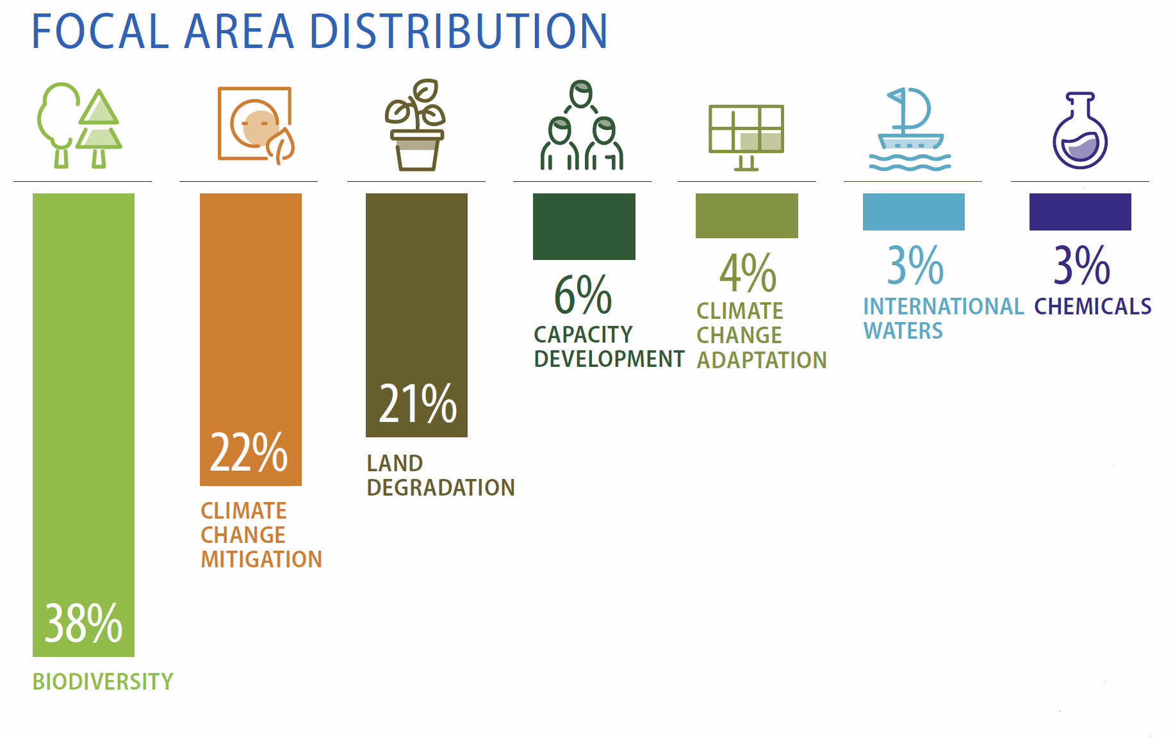
What we do

Slide 5
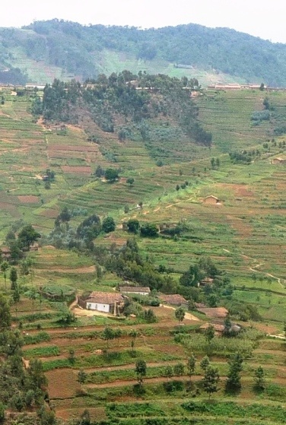
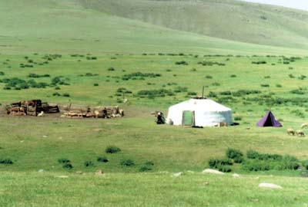
SGP Value Proposition
Strategic partnership/platform for community-based actions for synergy, scaling up, and sustainability;
Incubator of Innovative solutions and risk taker to safeguard the global environment;
Focus on critical landscapes and seascapes for larger impacts, upscaling, and knowledge sharing.
Focus on social inclusion in maximizing global environmental benefits
Notes:
ICCAs
CBD
IPSI
IPBES

Slide 6
GEF-7: Strategic Initiatives
Landscape and Seascape as Overarching Approach:
Sustainable Agriculture and Fisheries - Food Security
Low-Carbon Energy Access Co-benefits
Community-based Threatened Ecosystems and Species Conservation: Land and Water
Local to Global Coalitions in Chemicals and Waste Management
Catalyzing Sustainable Urban Solutions

Slide 7
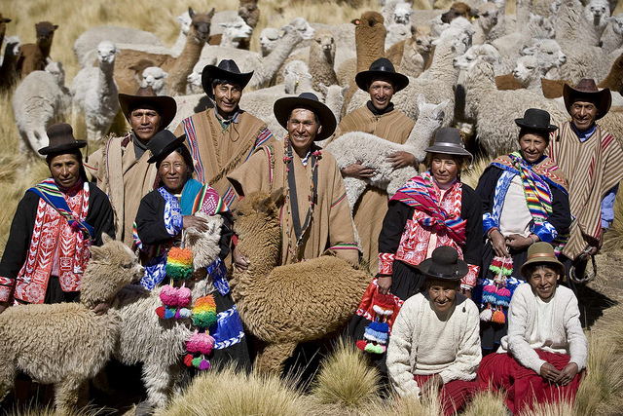
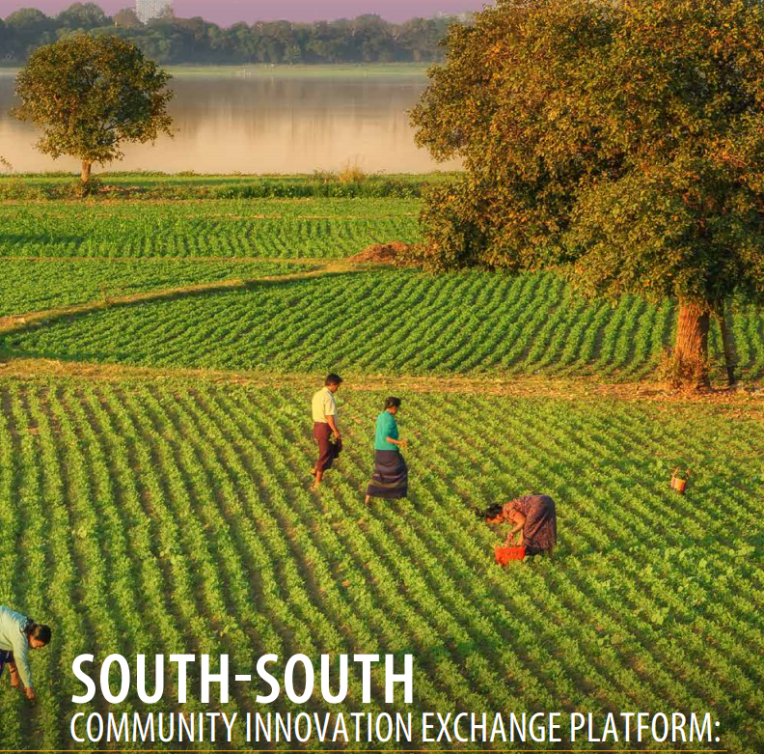
Grant maker Plus
CSO-Government-Private Sector Dialogues
Social Inclusion – Leaving No One Behind
Citizen Based Global Knowledge Platforms

Slide 8


SGP Grants
Planning Grants: up to $5000
Regular Grants: up to $50,000
Strategic Grants: up to $150,000
Global/Regional Grants: $250k to 500k
Innovation Programme

Slide 9
How we work?
Country Programme Strategy
National Steering Committee
Project 1
Project 2
Project 3
Country Programme Team
National Policies and Plan
SGP Global Strategy
Conventions’ Guidance

Slide 10
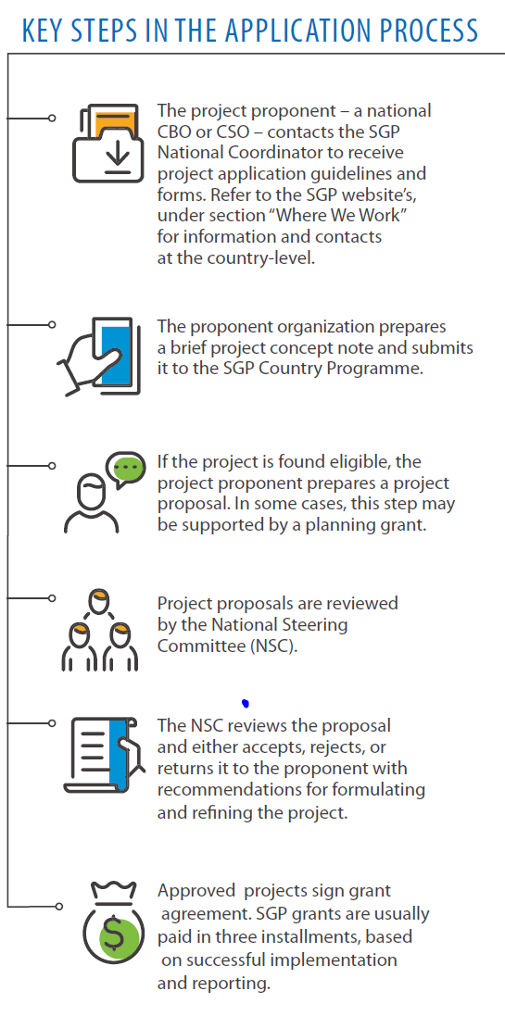

Slide 11

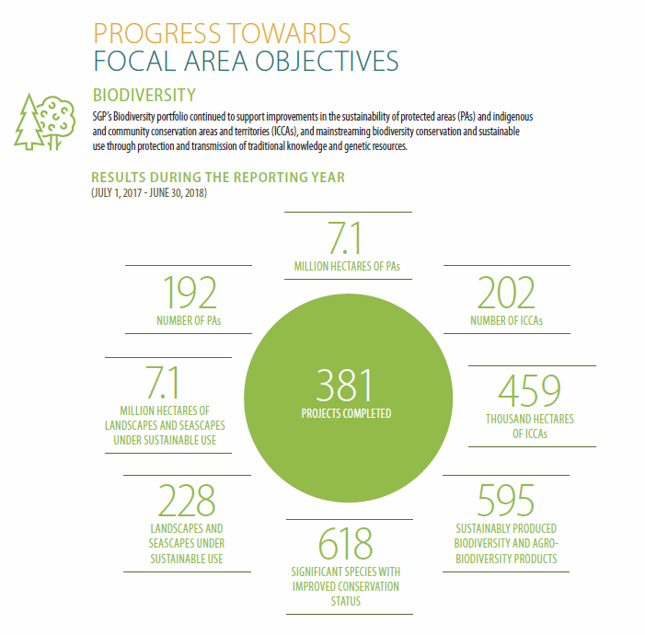
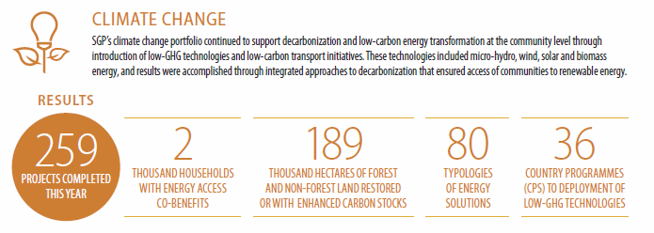
SGP Results 2017-2018:

Slide 12
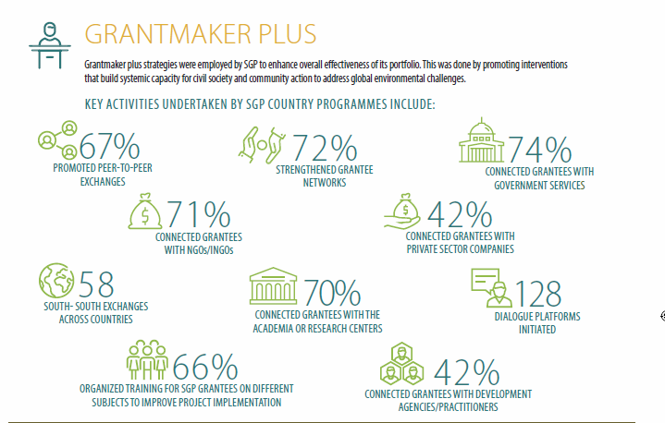
2018 SGP Results:
Grantmaker Plus

Slide 13
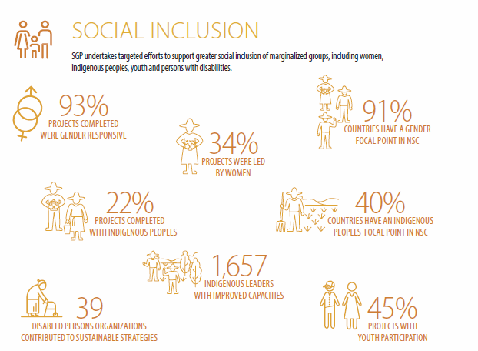
2018 SGP Results:
Social Inclusion

Slide 14



Partnership

Slide 15
THANK YOU

