Slide 1


Operationalizing the GEF-7 Programming Directions
Sierra Leone National Dialogue
January 16 & 17, 2019
Notes:
My name is …… I am program manager ……
It is a pleasure to be with you today to present the general overview of the GEF-7 Programming Directions. As you will see, this is an ambitious and highly impactful program that will deliver global environmental benefits for the world.

Slide 2
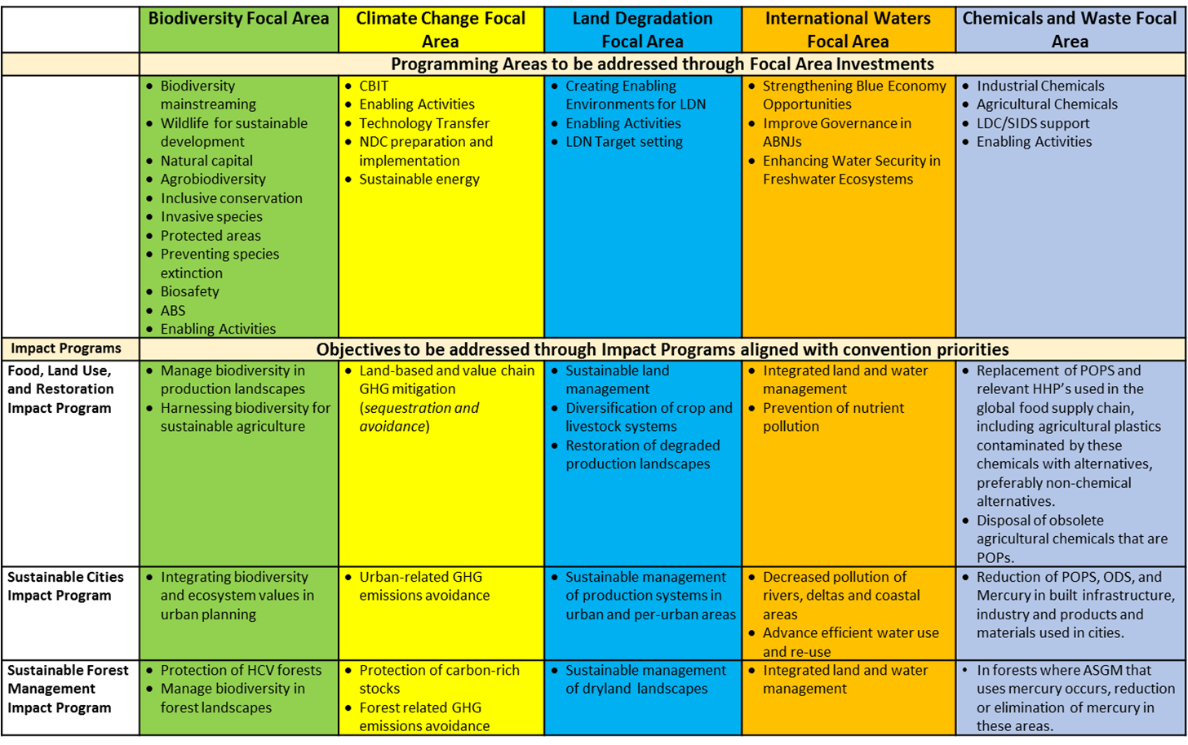


GEF-7 Programming Framework
GEBs
Notes:
The GEF-6 experience will be harnessed in GEF-7, where a set of carefully identified Impact Programs (IPs) and Focal Area Investments will contribute to transforming key economic systems while better promoting the delivery of MEA goals beyond a single convention. As such, the Impact Programs become integral components of Focal Area Strategies and reflect significant demand coming from countries as noted in their NDCs, NBSAPs and NAPs. The proposed investments closely reflect key objectives and guidance received from the relevant COPs, and investments in activities that can best be delivered as stand-alone Focal Area objectives. This “matrix” framework for GEF-7’s programming architecture will be complemented with innovative Frontier Investments that can help prepare the GEF countries for emerging challenges and respective responses in the near future.

Slide 3
Focal Areas
Biodiversity
Climate Change Mitigation
Land Degradation
International Waters
Chemicals and Waste

Slide 4

Biodiversity Focal Area
I. Mainstream biodiversity across sectors as well as within production landscapes and seascapes (Biodiversity Mainstreaming in Priority Sectors; Global Wildlife Program; (IWT and Wildlife and Tourism); Natural Capital Assessment and Accounting; Sustainable Use of Plant and Animal Genetic Resources; and Inclusive Conservation)
II. Address direct drivers to protect habitats and species (Prevention, Control and Management of Invasive Alien Species; Improving Financial Sustainability, Effective Management, and Ecosystem Coverage of the Global Protected Area Estate)
III. Further develop biodiversity policy and institutional framework framework (Biosafety, Access and Benefit Sharing of Genetic Resources, and Enabling Activities)
Notes:
The goal of the GEF-7 Biodiversity Focal Area strategy is to maintain globally significant biodiversity in landscapes and seascapes. To achieve this goal, GEF investments will contribute to the following three objectives identified in the CBD COP 13 Guidance to the GEF:
• Mainstream biodiversity across sectors as well as landscapes and seascapes;
• Address direct drivers to protect habitats and species; and
• Further develop biodiversity policy and institutional frameworks.
In its entirety, the set of programming options included in the strategy also responds directly to the Strategic Plan for Biodiversity, 2011-2020, particularly with regards to the increasingly important biodiversity mainstreaming agenda.
In their totality, the Biodiversity Focal Area investments, the Food Systems, Land Use, and Restoration Impact Program, the Sustainable Cities Impact Program, the Sustainable Forest Management Impact Program, and the International Waters Focal Area investments will collectively contribute to achieving the goal and the three objectives of the biodiversity focal area strategy.

Slide 5
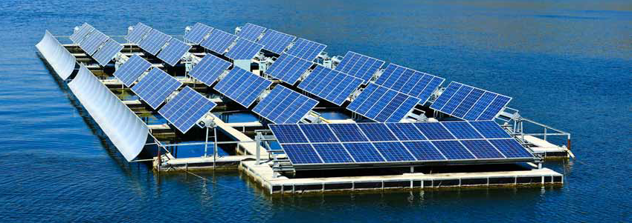
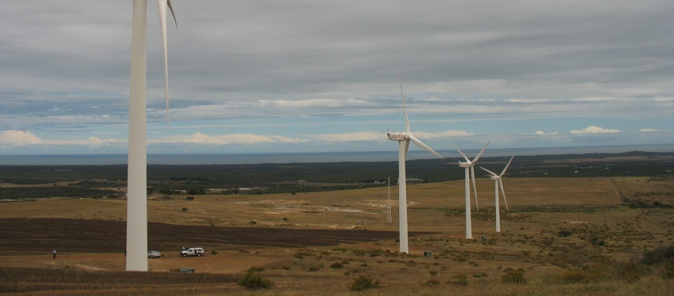
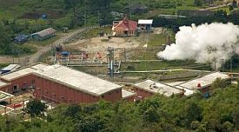
Climate Change
Mitigation Focal Area
I. Promote innovation, technology transfer for sustainable energy breakthroughs (de-centralized renewables with storage; electric mobility; accelerating energy efficiency; and cleantech innovation)
II. Demonstrate mitigation options with systemic impacts (through impact programs)
III. Foster enabling conditions for mainstreaming mitigation concerns into sustainable development strategies, including CBIT, NDCs, Enabling Activities
Notes:
The goal of the Climate Change Focal Area Strategy is to produce significant mitigation results as measured by GHG emissions reductions or avoided. We will accomplish this with a combination of focal area investments in new and innovative technologies, by investing in Impact Programs, and through enabling conditions. More specifically, this strategy will
Promote innovation, technology transfer, and supportive policies and strategies such as:
De-centralized power with energy storage
Electric drive technologies and electric mobility
Accelerating energy efficiency adoption
Cleantech Innovation
We will also dmonstrate mitigation options with systemic impacts though the impact programs.
And Finally, we will foster enabling conditions for mainstreaming mitigation concerns into sustainable development strategies.
Capacity-building Initiative for Transparency
NDC preparation and implementation
National Communications and Biennial Update Reports

Slide 6
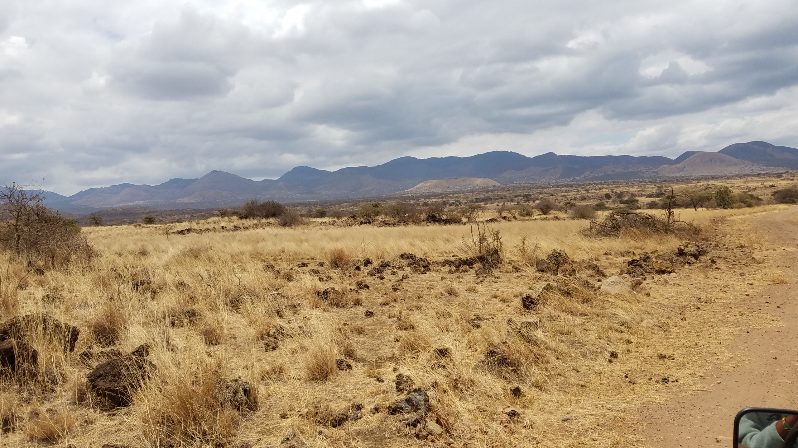
Land Degradation Focal Area
I. Support on the ground implementation of Land Degradation Neutrality (LDN)
II. Creating an enabling environment to support LDN implementation globally, including UNCCD EAs
Notes:
LDFA investment will be consistent with and complement the work of the Impact programs, in particular the FOLUR IP and the Drylands IP under the SFM IP program.
More specifically, we will support on the ground implementation of Land Degradation Neutrality (LDN)
The support of LDN implementation is a broad objective that will include several specific objectives that are all contribute to land degradation neutrality, such as
Sustainable land management (SLM),
Sustainable forest management (SFM),
Forest and landscape restoration (FLR), and
Integrated natural resource management (INRM) for resilient agro-ecosystems
We will also create an enabling environment to support LDN implementation globally, as well as support the UNCCD enabling activities
It is noteworthy that the GEF-7 allocation for the LD FA has significantly increased by 10% as compared to GEF-6. This also indicates the importance that the GEF places on this focal area and its potential to create multiple environmental benefits while also securing livelihoods for smallholders and local communities.

Slide 7
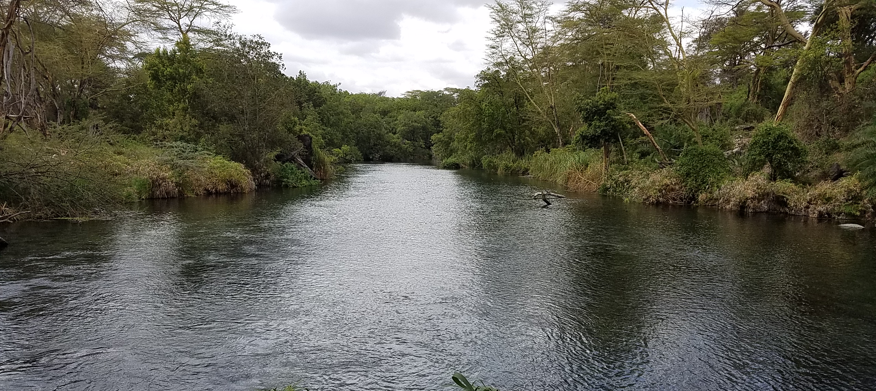
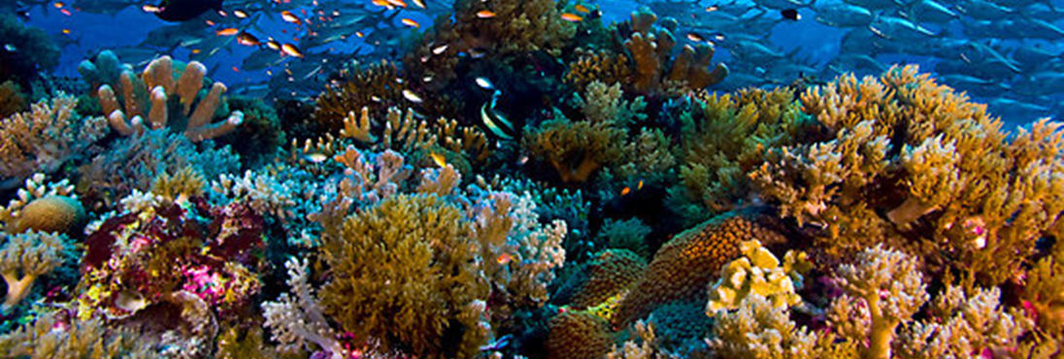
International Waters Focal Area
I. Strengthening Blue Economy opportunities
II. Improve governance in the Areas Beyond National Jurisdiction (ABNJ)
III. Enhance water security in
freshwater ecosystems
Notes:
The International Waters Focal Area has three main objectives: First, strengthening Blue Economy opportunities in key coastal habitats, including marine protected areas, deltas and large marine ecosystems, developing sustainable fisheries, and reducing pollution.
Second, Improve governance in the Areas Beyond National Jurisdiction (ABNJ).. .This will include catalyzing governance reforms to end IUU and overfishing and sustainably manage marine capture fisheries, support policy work to reduce harmful fishing subsidies, and foster collaboration among LMEs, Regional Seas conventions and RFMOs on area-based management in national waters and ABNJs.
Lastly, we will enhance water security in freshwater ecosystems by advancing information exchange and enhancing regional and national governance and cooperation on shared freshwater surface and groundwater basins.

Slide 8
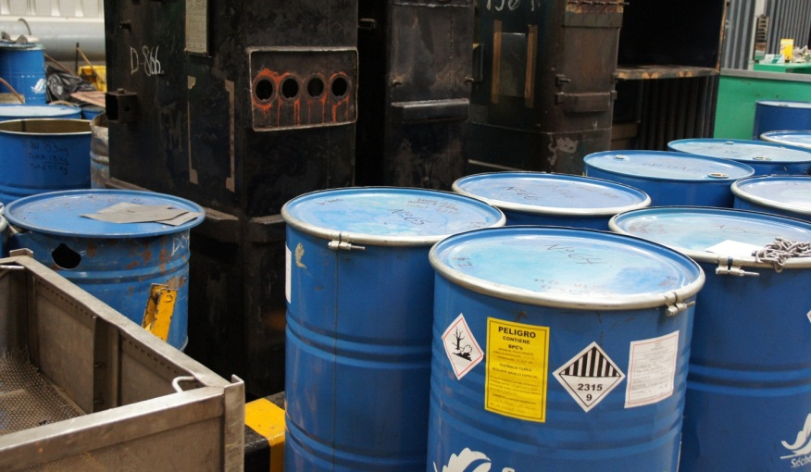
Chemicals and Waste Focal Area
I. Industrial Chemicals
II. Agricultural Chemicals
III. SIDS/LDCs program - Least Developed Countries and Small Island Developing States
IV. Enabling Activities
Notes:
The Chemicals and Waste Focal Area contains 4 eligible programs or entry points for countries to access resources and deliver on the proposed results in this area.
In the Industrial Chemicals Program, we will seek to eliminate and avoid POPS, Mercury and Ozone Depleting Substances by focusing on major industrial sectors that use or produce chemicals covered by the MEAs including gold, textiles, consumer products etc
Secondly, in the Agricultural Chemicals Program, we will seek primarily to eliminate harmful chemicals in agriculture such as obsolete POPs and mercury based agricultural chemicals and introduce low or non-chemical alternatives and practices. This program will also focus on the management and safe disposal of agricultural plastics contaminated by POPs and mercury based agricultural chemicals
We also have a program specifically focusing on Least Developed Countries and Small Island Developing States. Here we will foster regional approaches, incubate technologies that are developed in these countries and seek to create economies of scale for achieving the sound management of chemicals and waste.
And finally ,we will also fund Enabling Activities related to the different conventions and the countries’ obligations. This includes…
Stockholm Convention, including National Implementation Plans (NIPs) and NIP Updates
Minamata Convention, including Minamata Initial Assessments (MIAs) and artisanal and small-scale gold mining National Action Plans (ASGM NAPs)
Global Monitoring of chemicals, related to effectiveness evaluation under the Chemical Conventions

Slide 9
Impact Programs
Food Systems, Land Use and Restoration (FOLUR)
Sustainable Cities
Sustainable Forest Management

Slide 10

Impact Programs: Key Principles
Address drivers and promote systemic change
Deliver impact and results across Focal Areas
Open access but proactive engagement with key countries
Notes:
The GEF7 strategy includes a selected number of “move-the-needle” Impact Programs. Through these, the GEF will be better positioned to help countries pursue holistic and integrated approaches for greater transformational change in key economic systems, and in line with their national development priorities. The focused set of country-driven priorities hold the potential to enhance synergies, integration, and impact of GEF investments, and to promote a more effective use of resources and crowd-in private sector funding.
The impact programs collectively address major drivers of environmental degradation and/or deliver multiple benefits across the many thematic dimensions the GEF is mandated to deliver. Many of the priorities are also making use of increasingly more relevant global or regional platforms that are attracting a multitude of stakeholders and resources in response to political commitments.

Slide 11
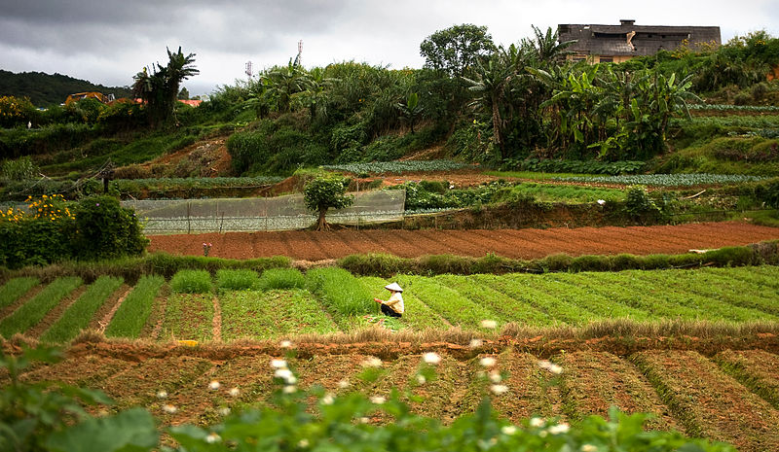
Food Systems, Land Use and Restoration (FOLUR) : Overview
Achieving Transformational Shift – “Sustainability”
Efficient and effective food value chains for multiple benefits
Removing deforestation from supply chains
Expand restoration of degraded lands
Notes:
Globally, countries vary considerably in their approach to food systems and land use challenges. For example, production of agricultural commodities for the global food supply chains is a major driver of land use change and environmental degradation in the tropical forests and peatlands of Southeast Asia, Africa and Latin America. The growing demand for these agricultural commodities (especially palm oil, beef, soy bean, coffee, and cocoa) as sources of raw material for the global food system will increase deforestation risks in many countries in these regions. Similarly, irrigated rice production in Southeast Asia is a major source of negative externalities such as methane emissions, eutrophication from excessive use of nutrients, and overexploitation of both ground and surface freshwater. In sub-Saharan Africa, livestock in the savannah regions are a major source of methane emissions, while low productivity of smallholder agriculture is an important driver of land degradation and loss of vegetative cover. Because of these differences across regions, a one size fits all approach will not achieve the required transformational shift in the global systems. Solutions must target appropriate entry points for recipient countries in order to justify GEF incremental financing, and maximize potential for transformational change in the food system and land use.
Building on GEF experience and comparative advantage on three key entry points as options for maximizing global environmental benefits: 1) promoting sustainable food systems to reduce impacts on natural habitat and GHG emissions; 2) tackling supply chains of major agricultural commodity responsible for a large fraction of tropical deforestation; and 3) expanding efforts to restore and reclaim degraded lands for multiple uses, thereby reducing pressure over standing habitat.

Slide 12
FOLUR: Two key priorities for GEF financing
Spatially explicit geographies defined on basis of their global importance for commodities, food production, and restoration of ecosystem services
Established supply or value chains
Notes:
Public, private, and civil society sectors have begun to take needed steps to improve land management and food production, including making commitments critical to delivering solutions, however, these have not yet been shown as sufficient to generate tangible results on the ground. If global goals to protect our planet’s biodiversity, absorb greenhouse gas emissions, and provide nutritious and affordable food for the growing number of people worldwide are to be met, integration of strategies and stakeholders through a system-wide approach that brings together both horizontal (interventions with actors within spatially explicit landscapes, policy reform, governance strengthening, etc.) and vertical (food value and supply chain commitments and financing) dimensions is necessary.

Slide 13
FOLUR: Spatially explicit geographies
- Evidence of environmental threats (commodity driven deforestation, unsustainable agricultural systems, etc.)
- Evidence of commitment to promote sustainability in the supply or value chain
- Potential for applying a comprehensive land use approach – linking production, conservation, and restoration at scale
Focus on Comprehensive Land Use Planning
To balance demands for increased food production with potential for harnessing ecosystem services
Improve targeting of landscapes for delivering integrated solutions at scale
Notes:
GEF funding will be used to support countries in ensuring productive lands are embedded within landscapes that are providing ecosystem services and protecting the natural ecosystems and soil on which they depend. In GEF-7, we will seek to work in spatially explicit geographies where food and ecological systems are integrated within landscapes. Within these landscapes, implementation at scale of a suite of related strategies and interventions must recognize the interconnectedness of these objectives by engaging them simultaneously as part of the specific landscape needs. These geographies must also demonstrate the following characteristics:
evidence of environmental threat (commodity driven deforestation, unsustainable agricultural systems, etc.)
potential to generate GEBs (GHG mitigation, biodiversity conservation, land restoration etc.)
evidence of commitment to promote sustainability in the supply or value chain
potential for applying a comprehensive land use approach linking production, conservation, and restoration at scale

Slide 14
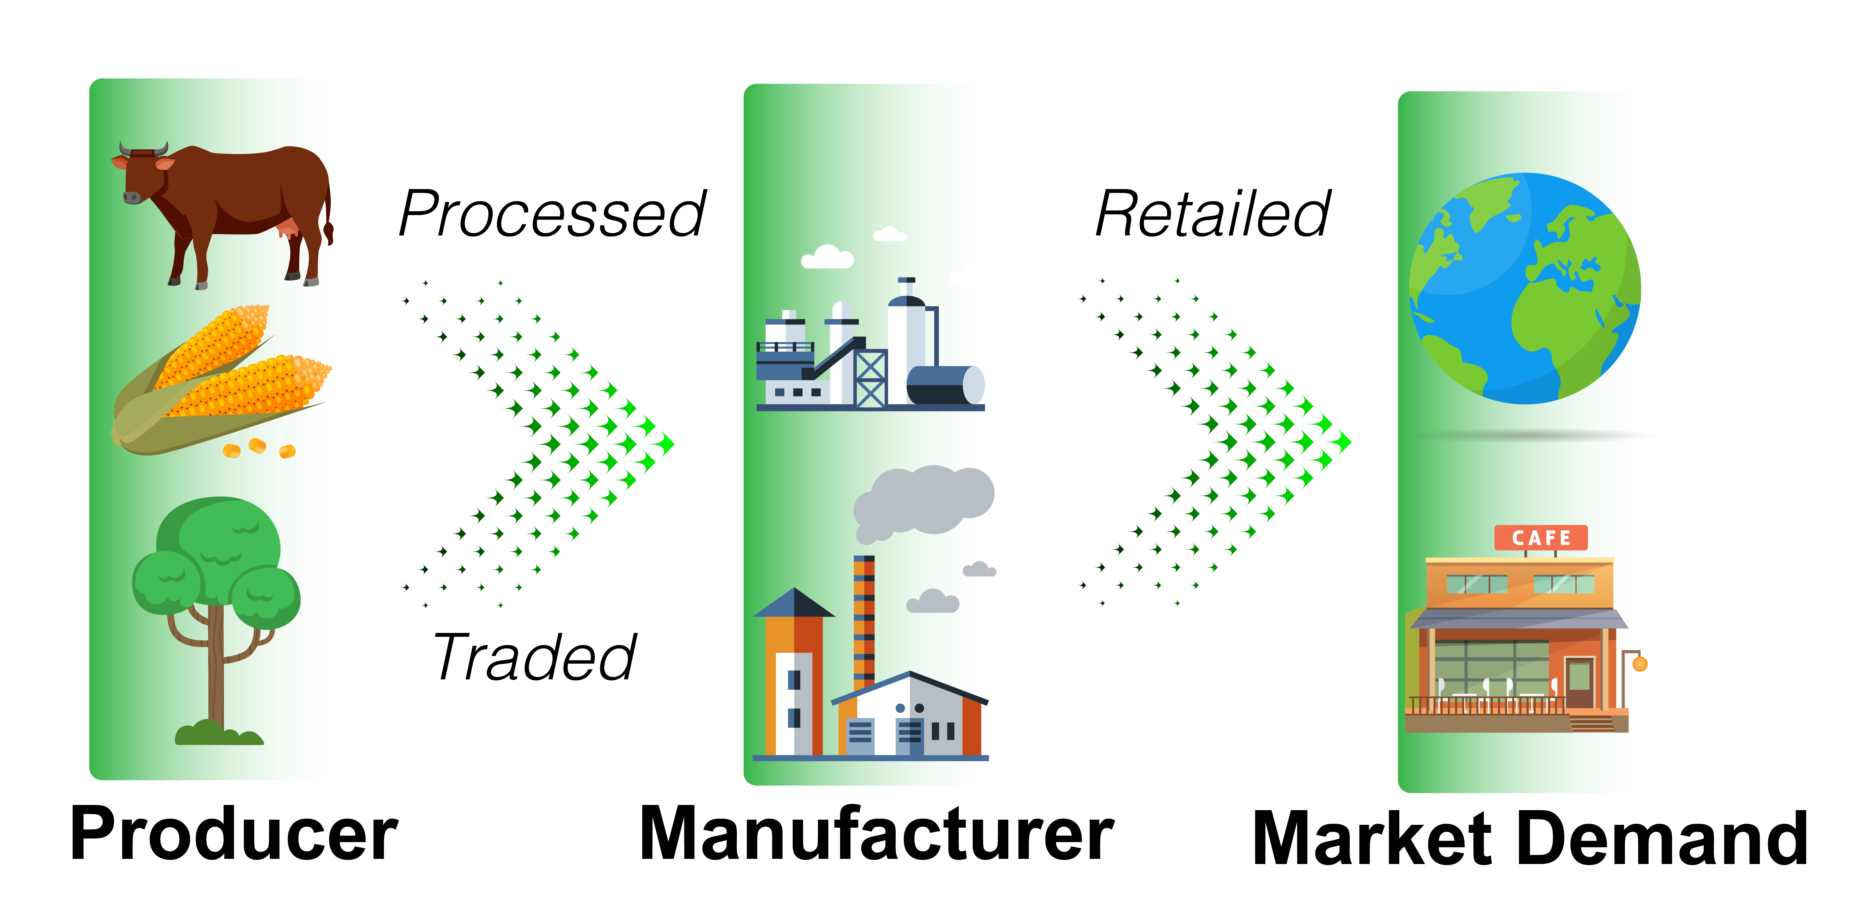
FOLUR: Financial Transactions
Notes:
The supply or value chain approach requires engagement of multiple actors across the full spectrum of the food system, linking actors and actions at the production level at national, subnational and jurisdictional scales to downstream demand sector players, including processors, traders and manufacturers and ultimately the end user. Financing is important to all of the private sector actors and plays a cross-cutting role in the approach. Through this integrated approach, sustainability is sought at all steps of the supply chain, which drives the generation of environmental benefits within landscapes important for both food production and ecosystem values.

Slide 15
Impact Programs
Food Systems, Land Use and Restoration
Sustainable Cities
Sustainable Forest Management

Slide 16

Sustainable Cities Impact Program
Rapid and unplanned urban growth is one of the key drivers of environmental degradation.
  70% of global GHG emissions
  Direct implication on food systems
  Urban sprawl affecting natural infrastructure and biodiversity
Cities offer effective entry points for major investments in global environmental benefits (GEBs).
They offer natural integrated systems, power of innovation and wide stakeholder base to achieve large scale GEBs.
Notes:
- Cities produce 80% of the world’s GDP. They consume over 75% of global energy supply and generate 70% of GHGs. They are increasingly choked by traffic, air pollution and waste production.
Meeting the production and consumption needs of urban populations strains rural and urban ecosystems both locally and globally.
Unplanned physical expansion of urban areas can directly compromise the provision of vital ecosystem services, provided by forests and biodiversity.
If managed well, compact, resilient, inclusive and resource-efficient cities could become drivers of green economy.
Cities have inherent advantages- they provide massive sustainable investment opportunities, are naturally integrated and hotbed of innovation. They also offer strong public private partnership opportunities.
Together, these could result in improving livability and achieving large scale GEBs in terms of protecting global commons, avoid GHGs and protect our biodiversity.

Slide 17

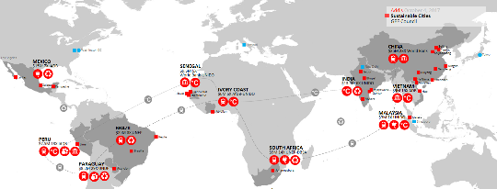











GEF-7 Approach- Sustainable Cities
Adopt an integrated approach for sustainable urban development across sectors and governance levels.
Dual support provided by GEF
  Specific grant support to selected cities for integrated urban development
  Global support on decision tools, knowledge, policy, finance, etc.
GEF 6- City-level Projects (27 cities, 11 countries)
Notes:
- The GEF’s Sustainable Cities Impact Program aims to bring about opportunities for greater integration, efficiency, synergy and increased returns of investment in cities.
It will support an integrated approach for sustainable urban development across sectors and levels of governance – from national to local municipalities.
Building of GEF 6 experience, we will continue to engage with wide set of partners to provide two-fold support.
It will directly support city-level investments to pursue spatially integrated solutions for interdependent urban systems that generate multiple global environmental benefits,
Provide global support through the Global Platform on Sustainable Cities (GPSC) to cities on sustainability decision tools, knowledge, policies and financing.

Slide 18
Expectations from SC IP projects
Program aspects | Country Level | City level
Transformational Impact | Potential to deliver global environmental benefits for the country | Adoption of an integrated planning approach for systemic change. Linkage with the Global Platform on Sustainable Cities (GPSC)
Leveraging resources | - Commitment to leverage financial resources to support the city | Commitment to finance specific sustainability solutions Mechanisms to crowd-in more finance through private sector
Political Will | A clear political will towards sustainable urban growth. Political will to support cities through enabling policy environment. | City level political commitment towards sustainability Proactive engagement with global networks
Notes:
In GEF 7, projects will be selected to achieve the objectives of
Transformational systemic change towards sustainability,
Mobilize and catalyze large scale city level investments for a sustainable future and
Greater policy engagement across different levels especially local.

Slide 19

GEF-7 Categories of Investments and GEBs
Evidence-based Spatial Planning—Cities and surrounding landscapes
Infrastructure Integration at National, Regional, and Local Scales
Building Deep Resilience with smart systems and slum solutions
Financing Solutions for Urban Sustainability.
Notes:
Tentative categories of investments will include the following. (as in the slide).
We expect innovative approaches from countries and cities to adopt integration approaches.
Integrated approach may imply- area based development and rejuvenation, cross sectoral infrastructure integration and potentially focusing on one or two key urban systems e.g. energy, food, transport.
If asked in Q&A on systems:
Food system: Integrated land use planning to prevent agricultural land loss; logistics/transport system for food distribution.
Energy system: Infrastructure integration, improved urban planning and adoption of low carbon technologies can optimize energy demand
Transport: Integrated planning and interconnected infrastructure can reduce pressure on transport infrastructure.

Slide 20
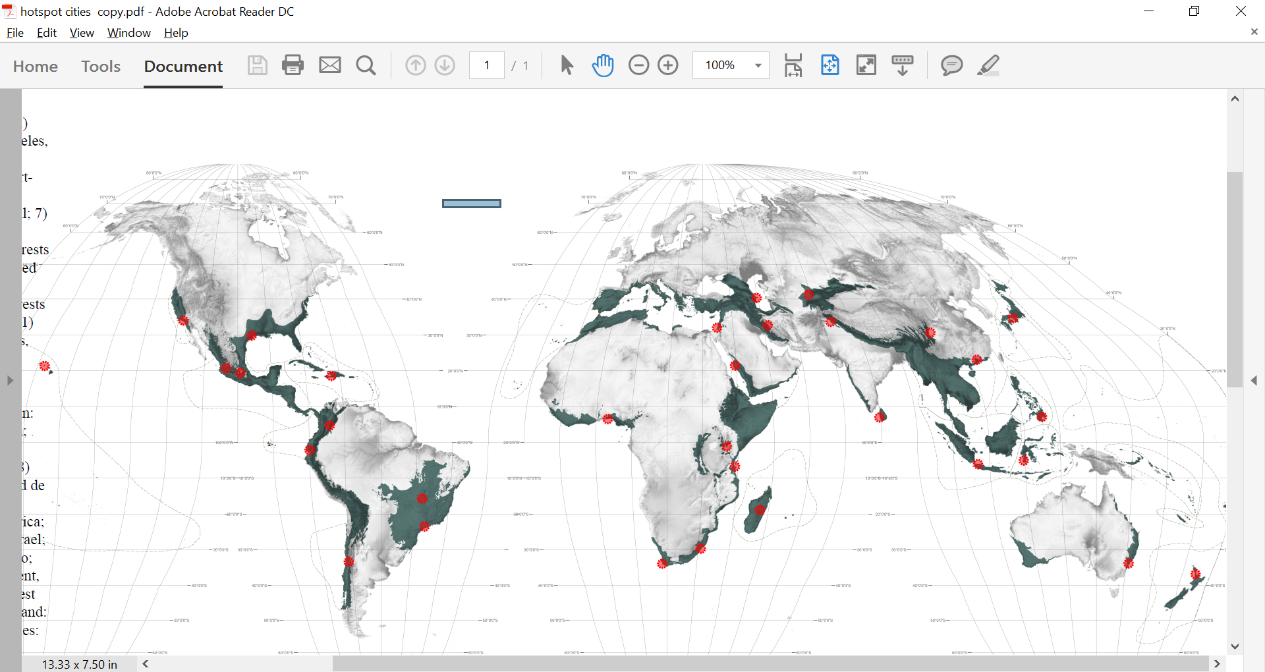
Global Environmental Benefits
Climate Change Mitigation- Decarbonization of cities through low carbon solutions
BD and LD: Integrated land use planning to prevent habitat loss/degradation in peri-urban areas.
Food system: Integrated land use planning to prevent agricultural land loss; logistics/transport system for food distribution.
Marine plastics: employing a circular economy approach that addresses material and design engineering; consumer use; and recovery and recycling.
Resilience: Urban design that is able to absorb potential shocks.
32 cities in the world’s biological hotspots
Notes:
The Sustainable Cities Impact Program is one of the flagship initiatives in GEF 7 to achieve GEF’s GEB targets. The primary focus remains on GHG reduction. We also encourage projects which expands GEBs in the areas of Biodiversity and Land Degradation.
Resilience and adoption of circular economy approach in projects is important and therefore desired in GEF 7 projects.

Slide 21
Impact Programs
Food Systems, Land Use and Restoration
Sustainable Cities
Sustainable Forest Management

Slide 22
Sustainable Forest Management: Overview
Focus on globally important forests
Amazon Forest
Congo Basin Forest
Dryland Forests
Require regional, ecosystem-scale approach to
maintain integrity of the entire Biome
Notes:
The Amazon, the Congo Basin, and some important Dryland landscapes around the world are globally important for biodiversity and carbon storage, provide livelihoods and subsistence to communities that rely on forests and agriculture for their survival and as such qualify as “key ecosystems” where a concerted SFM approach can have value. In these globally important ecosystems, we have the opportunity to change the future development trajectory from natural resource depletion and biodiversity erosion, to one based on natural capital management and productive landscapes. The latest science also indicates that these globally important ecosystems require integrated ecosystem-scale management for maintaining their “ecological integrity and functioning” and delivering Global Environmental Benefits. Fragmented and isolated projects will not be sufficient in these large ecosystems as has been the case for much of the past SFM set of investments. The time is now ripe for the SFM program to evolve into an Impact Program with a clear geographical focus to better harness time-bound opportunities for impact on critical forest biomes and systems. These 3 key forest regions are the major ecosystems and perhaps the last places where an integrated and concerted SFM approach can truly transform the course of development and produce multiple benefits for biodiversity, climate change, and land degradation.

Slide 23

Sustainable Forest Management: Overview
Creating a better enabling environment for forest governance;
Supporting rational land use planning across mixed-use landscapes;
Strengthening of protected areas;
Clarifying land tenure and other relevant policies;
Supporting the management of commercial and subsistence agriculture lands to reduce pressure on adjoining forests; and
Utilizing financial mechanisms and incentives for sustainable forest utilization such as markets, REDD+ and other PES
Notes:
GEF investment will emphasize the following:
Regional transnational coordination of biome level actions
Create a better enabling environment for forest governance;
Support rational land use planning across mixed-use landscapes;
Strengthening of protected areas;
Ensure environmentally-friendly agriculture to reduce pressure on forests; and
Utilizing markets, REDD+, and other PES for sustainable forest utilization

Slide 24
GEF-7 rollout model
Key Issues for Impact Programs
Notes:
As we move closer to the implementation phase of GEF-7, it is important that we understand all of the issues related to the rollout of the Impact programs to ensure a fair and accessible process for all countries.

Slide 25
Role of Countries in Impact Programs
Starting point: countries decide how to deploy their STAR allocation in Focal Area Investments or Impact Programs (one or more)
If country decides to participate in IP(s), country selects agency of their choice to design and implement their child projects
If selected, participating countries will receive 2:1 matching resources
Notes:
As for all GEF investments, the main decision point is with countries, in terms of how they wish to use and prioritize their STAR allocations whether it be in focal area investments or in Impact Programs. As usual as well, countries will select the agency of their choice to design and implement their child project in the case of an Impact Program. If a country is selected to participate in an impact program, they will receive incentive resources at a ratio of 2:1 (STAR;Incentive).

Slide 26
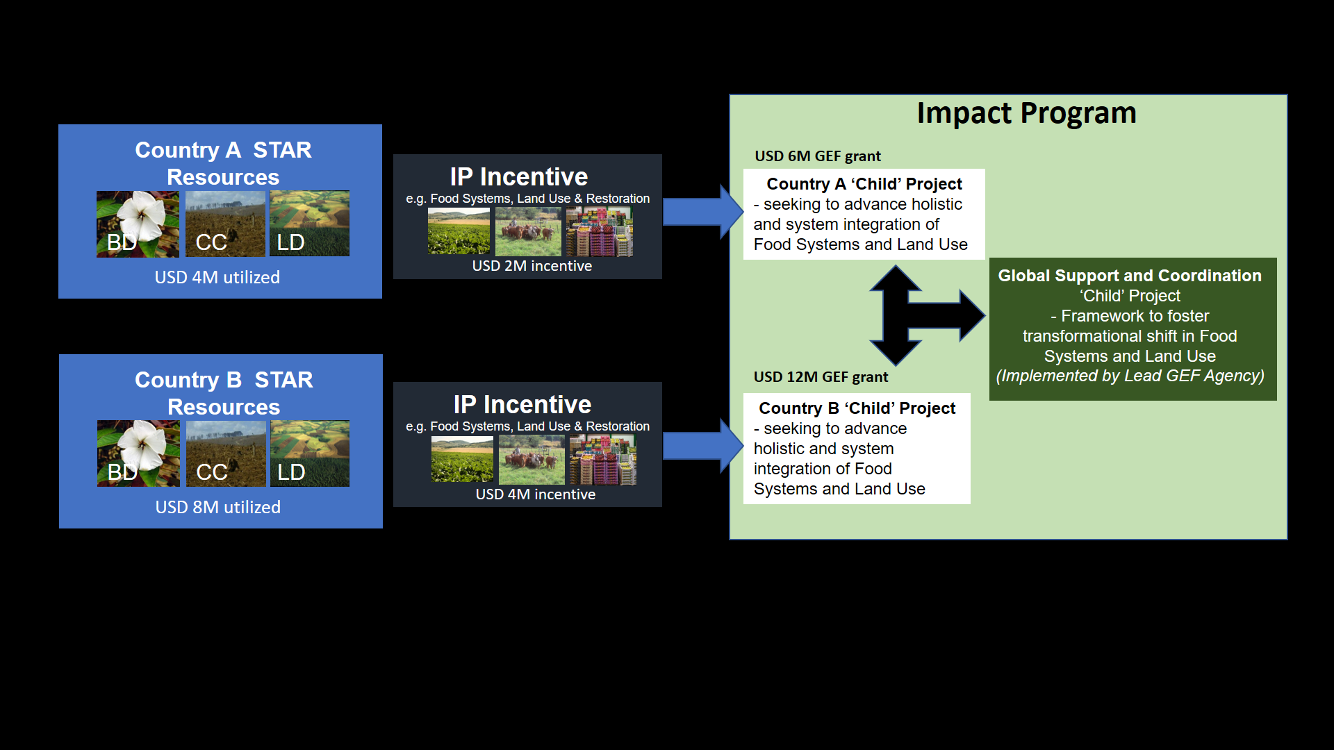
Resource Allocation to Impact Programs
Notes:
As an example of how this can work, we have 2 countries that have decided to participate in an Impact Program but with different levels of STAR. One is allocating $4M the other $8M. Each will receive matching incentives as shown in this slide and also each will benefit from the support (knowledge sharing, lessons learned, etc.) coming from the Global Platform of Support and Coordination that will exist for each Impact Program.

Slide 27
Role of Agencies in Impact Programs
Lead Agency leads the development of a program framework document (PFD) and coordinate with agencies responsible for Child Projects.
Lead Agency develops global or regional coordination and knowledge exchange component designed to provide technical assistance, quality assurance and consistency across Child Projects.
Lead agency and GEF Secretariat facilitate and guide participating agencies to ensure coherence in the proposals coming from countries.
Notes:
Agencies will have important roles as always in programs. In the case of Impact Programs, the lead agency will be responsible for the development of the PFD and to coordinate with other agencies on the Child projects and concepts. The selection of lead agencies for the Impact Programs will be done through a consultative process and interested agencies and this will be facilitated by the GEFSEC. The lead agency will also be responsible for the development of the global and/or regional knowledge exchange component designed to provide technical assistance, quality assurance, and consistency across all Child projects of the Impact Program. Finally, the lead agency and the GEFSEC will facilitate and guide participating agencies to ensure coherence in the proposals coming from countries.

Slide 28
Role of GEFSEC: Ensure a Level Playing Field for Impact Programs
GEFSEC will ensure that all countries have an opportunity to consider and apply for the Impact Programs
GEFSEC will prepare and issue announcements or requests for proposals containing program objectives, selection criteria, consistent with GEF-7 programming directions
GEFSEC will work closely with agencies on program and project design guidelines and frequently asked questions to better guide countries
In case country demand exceeds available matching resources, GEFSEC will facilitate a process of country selection with the Lead Agency
Notes:
The role of the GEFSEC is to ensure a level playing field for participation in each Impact Program. This will be done by making sure that all countries are aware of the process for participation and an opportunity to participate in each Impact Program. The GEFSEC will prepare and issue announcements or requests for proposals containing program objectives, selection criteria, all consistent with GEF-7 programming directions as approved. The GEFSEC will work closely with agencies on program and project design guidelines and frequently asked questions to better guide countries. Finally, if country demand for a particular Impact Program exceeds the available incentive resources, the GEFSEC will facilitate a process of country selection with the lead agency.

Slide 29
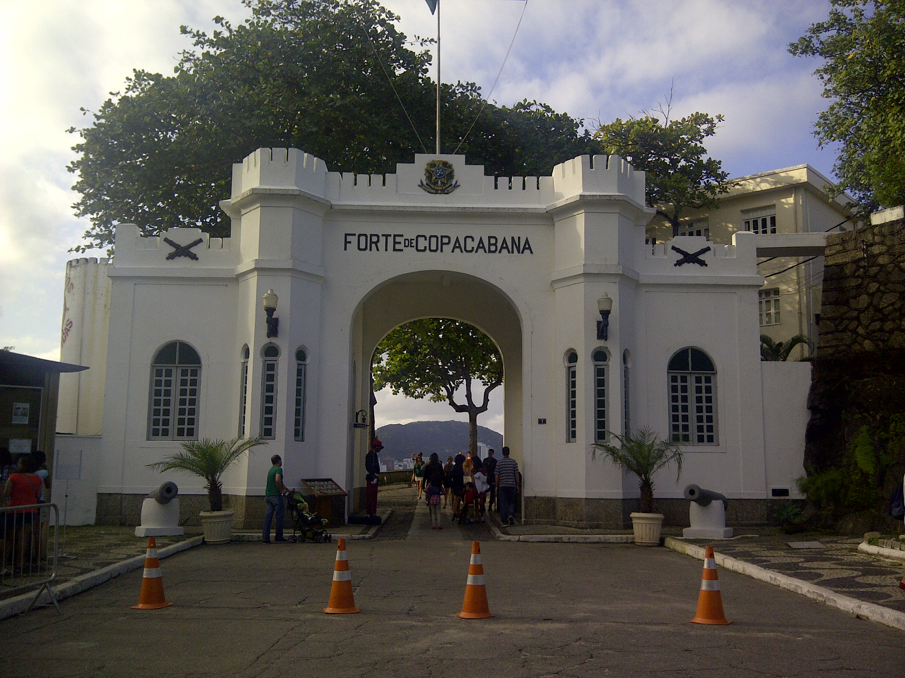
GEF-7
Notes:
That completes the general overview of the GEF-7 programming directions and some rollout considerations. I would be happy to answer any questions you all may have.

