Slide 1
Supporting GEF’s Sustainable Cities Program
Xueman Wang
Coordinator, GPSC
The World Bank
Overview of GPSC and the Urban Sustainability Framework
Xueman Wang
Senior Urban Specialist & GPSC Program Manager
The World Bank

Slide 2
GPSC Program and Participation
GPSC Knowledge Platform
Forum for knowledge sharing and partnership to achieve urban sustainability
Integrated two tracks financed by GEF
City-level projects: $140m
Global platform: $10m
GEF6 (current phase):
GEF7: Now under preparation: expecting more cities to join with larger programs

Slide 3
GPSC Objective To offer a knowledge platform for cities to
Share knowledge—learn from each other.
Collaborate, engage, and build partnerships.
Forge a common vision and approach to urban sustainability.
1
2
3

Slide 4
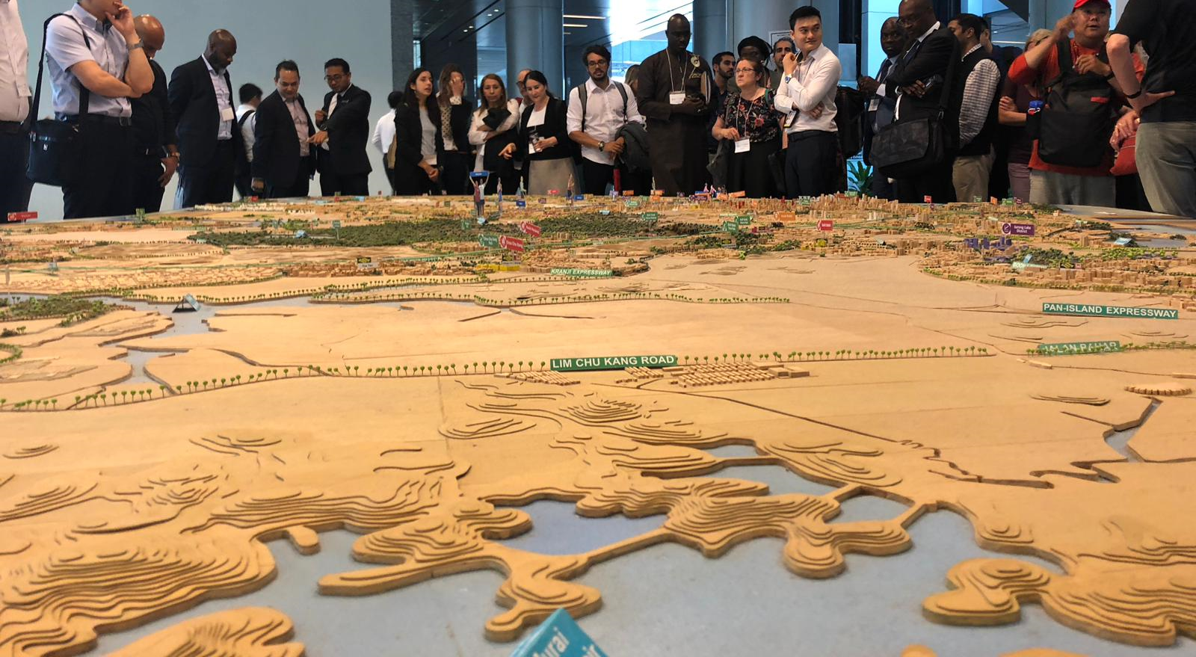
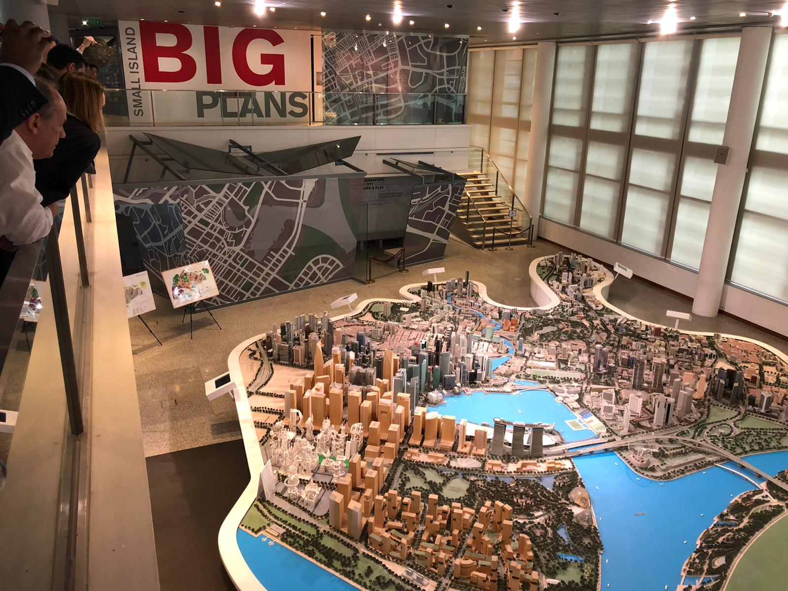
GPSC Cities Academy Singapore
GEF’s Sustainable Cities’ program representatives from Brazil, China, Cote d'Ivoire, Malaysia, Paraguay, Senegal, and South Africa are in Singapore to share and learn about urban development, climate change, transit-oriented development.
November 26 – 28, 2018

Slide 5
A Growing Partnership to Support Cities
National Platforms:
Brazil Platform
India Platform
China Platform
Others
IFIs:
MDBs: AfDB, AIIB, ADB IDB, EBRD, EIB, WB
Regional Banks: CAF, Islamic Development Bank, AIIB, Nordic Investment Bank
National Banks: Development Bank of Southern Africa
IFC: Investment partner
Overall Coordination Led by the World Bank
Resource Team
(WRI/ ICLEI/ C40)
Knowledge Partners:
Aarhus, Denmark
California
China Center for Urban Development
Cities in Japan
UN-Habitat
Implementing Agencies
Partner Organizations:
International: UN-Habitat,
City Alliance, etc.
Regional: Nordic City Initiative
Notes:
Partnerships
Throughout my presentation today, the idea of us all working together to improve cities is a constant theme. Partnerships are integral to GPSC.
Let me particularly highlight our Knowledge Partners. They share knowledge from their experiences in developed countries, such as State California, the City of Aarhus, and Cities in Japan. We were very glad yesterday to have UN-Habitat join GPSC as a Knowledge Partner.
The GPSC also supports national-level platforms which translate global knowledge to their local contexts. This helps GPSC reach out to many more cities. Brazil’s national platform of 260 cities is one such example. With this connection to the national platforms, the GPSC aims to expand to include 500 cities as part of its knowledge network.
This GPSC ecosystem of partnership, together with the cities, is the strength of the Sustainable Cities Impact Program to provide comprehensive and solid support to our cities.

Slide 6
Planning and Financing Must Go Hand in Hand: Partnership with IFIs
IFC becomes GPSC Investment Partner
IFIs form an urban network to support sustainable urban investment:
International Financial Institutions (IFIs)
Exploring partnership with:
- Global Infrastructure Facility (GIF) to help
cities with infrastructure project preparation
Global Facility for Disaster and Risk Reduction (GFDRR) to support urban resilience
Notes:
With the third example, I would like to stress the importance of the intersection of planning and financing. These two must go hand in hand for development projects to be implementable and to optimize their environmental benefits.
The focus here is for cities to: (1) become financially sustainable and develop creditworthiness; (2) improve their revenue streams and smart investments; and (3) to implement market-based financing options, such as Public-private Partnerships.
Yesterday at GPSC’s event, the International Finance Corporation joined the platform as its first Investment Partner. This will offer our member cities a tremendous opportunity to further leverage their GEF funding with private sector financing.
Let me also mention GPSC’s collaboration with the group of International Financial Institutions. Through this range of financing options, cities have a much better opportunity to finance their projects for environmental benefits.

Slide 7
GEF-6 Sustainable Cities: Lessons Learnt
Better alignment of the two tracks to build an integrated program: GPSC and city-level projects
The two tracks should have common activities in order to mutually enrich each other and to deliver as one integrated program
Sufficient budget should be allocated under city-level project activities to participate in the global activities
Support from GPSC is closely aligned with city level project activities to bring cutting edge expertise to cities
More consolidated city level project activities with emphasis on urban sustainability planning and integrated approach to sectoral interventions to maximize global environmental benefits
3. Stronger linkage to investment and private sector participation

Slide 8
GEF-7 Sustainable Cities: Selection Criteria (1)
Criteria for country selection:
Transformational impact
Potential to deliver GEB through city projects
Added value through city projects (i.e. uniqueness of the projects in comparison with “usual” projects under the relevant GEF windows
Leveraging resources
Commitment to leverage resources from public and private financing
3. Political Will
Country’s national policy or vision for sustainable urban development
Existence of governance structure for coordination of national-state-city levels
Commitment at the national level to strengthen sub-national capacity
Commitment of maximizing impact and duplication of the project within the country

Slide 9
GEF-7 Sustainable Cities: Selection Criteria (2)
Criteria for city selection:
Transformational impact
Following integrated approach to developing and strengthening sustainable urban planning
Integration of multiple sectors
Leveraging resources
Significant amount of co-financing secured for investment
Existence of the mechanism to engage private sector
3. Political Will
City’s leadership’s track record toward sustainability (evidenced in city planning and implementation; engagement with global city networks)
Commitment to participate in the Global Platform for Sustainable Cities

Slide 10
Target Area 1: Sustainable Urban Planning (1)
Urban sustainability baseline rapid assessment (jointly conducted by GPSC and the participating city)

Slide 11
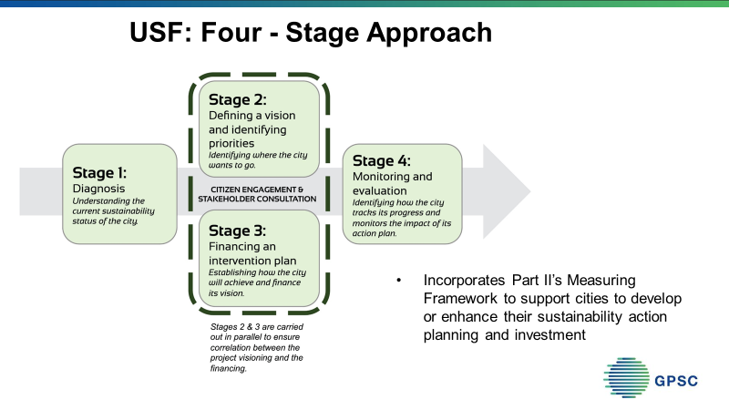
:
Target Area 1: Sustainable Urban Planning (2)
Based on the assessment, cities to develop or strengthen the vision for urban sustainability and planning/implementation framework, including spatial planning (see GPSC’s Urban Sustainability Framework (USF) at www.thegpsc.org)
Activities may also include: Leveraging technology and big data to drive better planning (i.e. data sharing platform to build foundation for integrated urban planning)

Slide 12
Target Area 2: Integrated Approach to Low Carbon and Resilient Infrastructure
Examples:
Bringing land management and urban planning to urban mobility – Transit Oriented Development (TOD)
Promoting value chain transformation to solid waste management
Supporting green urban development through establishing city biodiversity index, city-level natural capital accounting, and urban regeneration
Promoting resilience framework to water management (such as nature based solutions to urban flooding)
Supporting urban upgrading through multiple sector interventions (housing, land use, social inclusiveness and resource efficiency)
Linking energy efficiency to urban form

Slide 13
Target Area 3: Strengthening Municipal Financing
Assessing fiscal sustainability and creditworthiness
Developing revenue improvement strategies
Developing climate smart capital investment plans
identifying market based options to finance infrastructure investment plans

Slide 14
Target Area 4: A Networked Approach to Learning and Sharing
National platforms/networks that links to the Global Platform to reach out to more cities and translates global knowledge to local development
Partnership with cities and sub-nationals from developed countries (City-to-city twinning)
Collaborating with GPSC for joint activities
Participating GPSC Global Meetings (both at the political levels by mayors and practitioners) and regular trainings

Slide 15
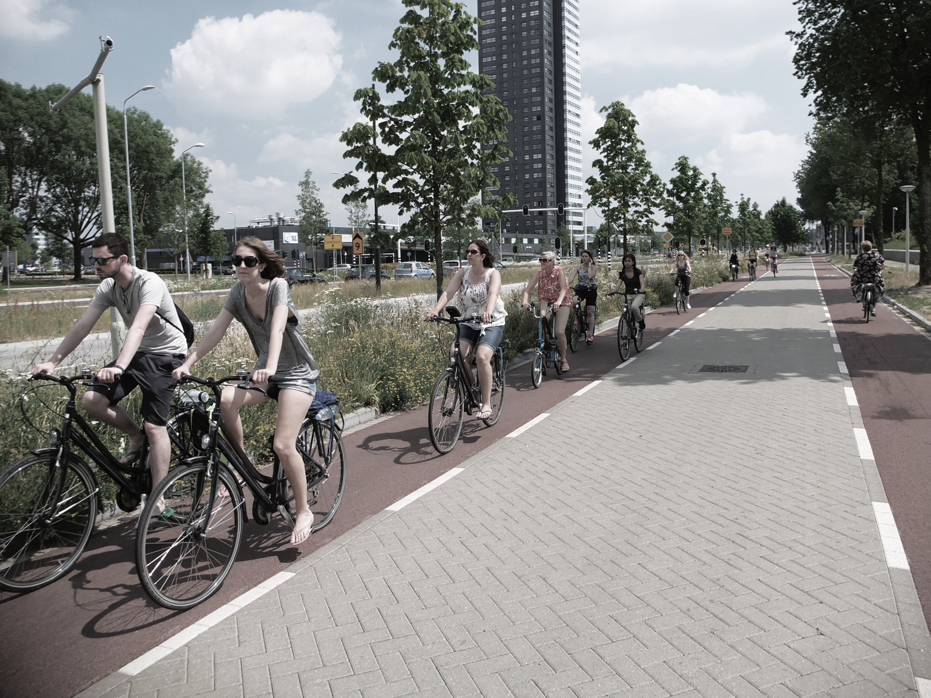
Working with partners, the World Bank Group is committed to scaling up support for the GEF-7 Sustainable Cities Impact Program.
www.thegpsc.org
gpsc@worldbankgroup.org
Frites and Fiets Cycling Trip by George Weeks at the Academy of Urbanism, CC BY-NC-ND 2.0

